Slide 1
Make Your Classroom Musical!
Kristine Quinn, MS, NBCT
Lecturer
California State University, Fullerton

Slide 2
Agenda
We’re gonna get our groove on
We’re gonna bang our drums
We’re gonna hit some Boom Whackers
Okay seriously, we are going to engage in musical activities that will engage learners and bring an element of fun to your classroom.

Slide 3
Why Music & Movement?
Studies suggest that music and movement • Nourish the brain while affecting all areas of development • Strengthen listening, motor skills, language, problem solving, spatial-temporal performance and literacy • Help develop critical listening skills • Create space for emotional well-being • Provide opportunities to practice social skills • Support phonemic awareness • Instill acts of kindness and cooperation • Calm and focus the mind • Encourage interaction in non-threatening ways
So Let’s move! Take a scarf, move to the song.
Happy, Pharrell Williams
https://www.youtube.com/watch?v=y6Sxv-sUYtM

Slide 4
Get creative!

Slide 5
Patriotic Songs
Learning patriotic songs : Kids love to sing!
helps students with their English Language Development,
increases their knowledge about American traditions,
improves their singing skill,
and is enjoyable too!

Slide 6
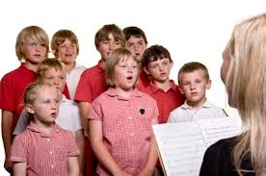
Let’s Sing!
THIS LAND IS YOUR LAND words and music by Woody Guthrie
Performed by Peter, Paul and Mary
Chorus: This land is your land, this land is my land, From California, to the New York island, From the redwood forest, to the gulf stream waters, This land was made for you and me.
I roamed and rambled, and I followed my footsteps, to the sparkling sands of, her diamond deserts, and all around me, a voice was singing, this land is made for you and me.
As I went walking, that ribbon of highway, I saw above me, that endless skyway. I saw below me, those golden valleys. This land was made for you and me.
As the sun was shining, and I was strolling, and the wheat fields waving, and the duck clouds rolling, as the fog was lifting, a voice was saying, “This land was made for you and me.

Slide 7
Why Folk Music?
Folk songs communicated the hopes, sorrows and convictions of ordinary people's everyday lives. Increasingly, music made by other groups of Americans such as Native Americans, Mexican-Americans, and Cajuns came under the umbrella of "folk music." It was sung in churches, on front porches, in the fields and other workplaces, while rocking children to sleep, and at parties. The melodies and words were passed down from parent to child, though songs - and their meanings - often changed to reflect changing times.
PBS-American Roots music

Slide 8
Why else?
Folk music helped to unite the country through difficult times, perhaps we need a new generation of folk singers to unite us once again…..

Slide 9
Music and Literacy
• Children with a strong sense of beat are more likely to read well.
• Music stimulates all the senses, helping children learn to recognize patterns and sequence.
• Early music exposure helps children learn by promoting language, creativity, coordination, social interaction, self-esteem and memory.
• Singing games support children’s need to socialize and play, instead of “pre-academic” skills.
• Music helps “wire” the brain, supporting a higher level of thinking.

Slide 10
Rhythm & Tempo Activities
Steady Beat - Find the beat, march the beat, tap the beat, etc. (stand and march, move your arms to the music)
https://www.youtube.com/watch?v=efRmmFQ8QVA
(KIDZ BOP Kids-Cake By the Ocean)
Clap the rhythm of syllables in names, words, phrases, etc. (introduce yourself)

Slide 11
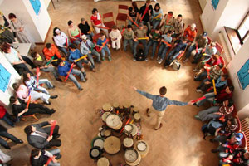
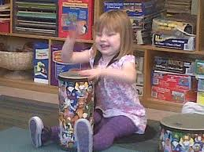
Drum Circle
A drum circle, or rhythm circle, is a group of people creating and sharing a rhythmical and a musical experience. The instruments used are usually percussion instruments including; Drums, metal, wood, shakers and Boomwhackers. The circle format is used to optimize listening and communicating.

Slide 12
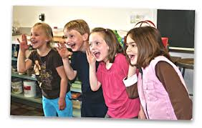
Harmony and Form
Sing Rounds or Canons.
( Row row row your boat)
Create an "Ostinato" - or repeated patterns that continue beneath a melody. (Example: Ding Ding Dong repeated throughout "Are You Sleeping?”
Are you sleeping, are you sleeping
Brother John, brother John
Morning bells are ringing, morning bells are ringing,
Ding ding dong

