Slide 1

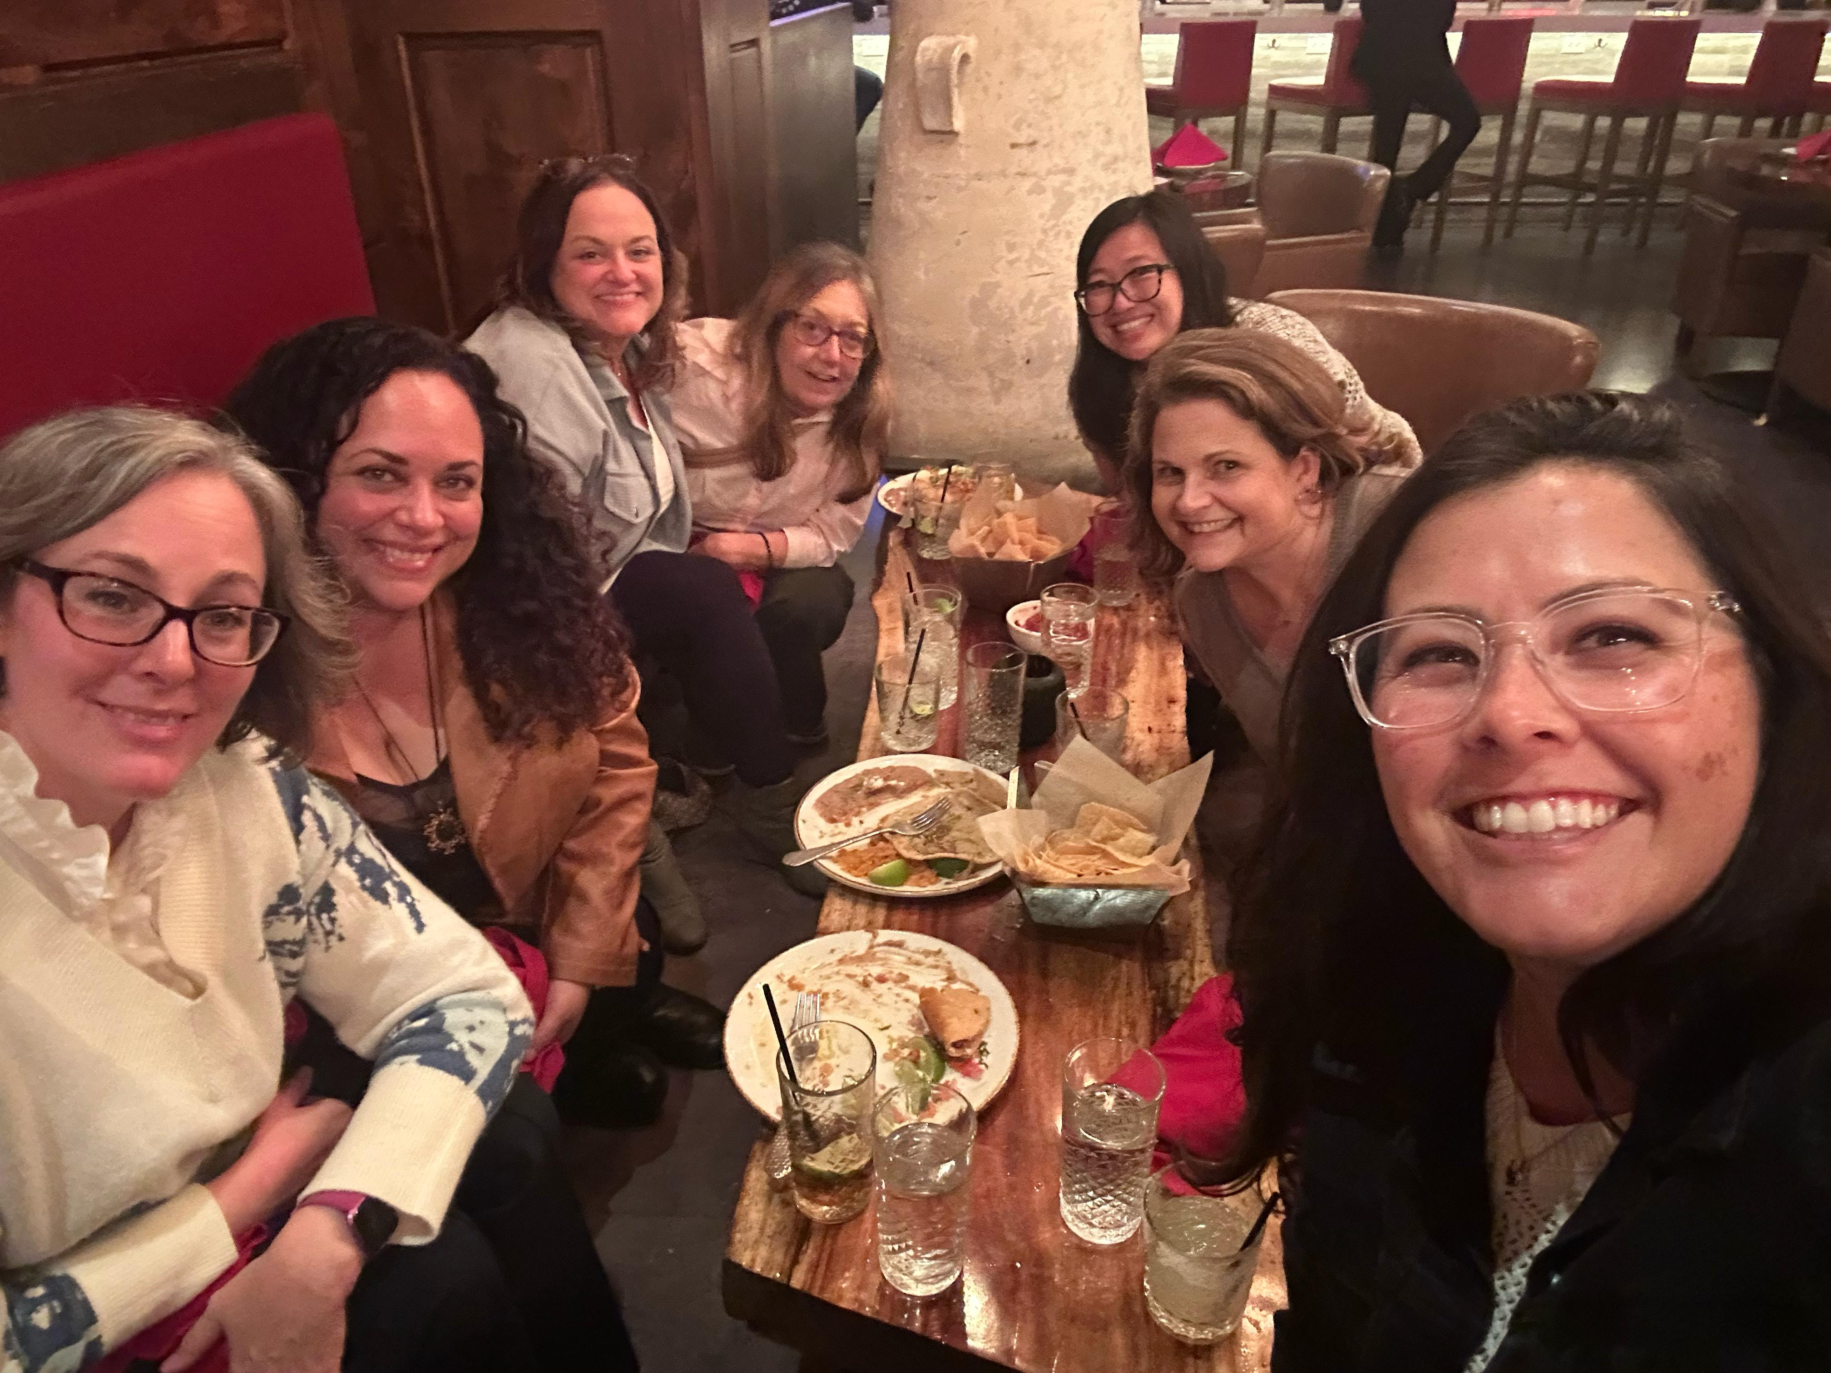
President’s Report November 25, 2025
Fall Plenary
https://asccc.org/events/2025-fall-plenary-session
Presentation Materials
Resolutions Update – Not Available Yet
Spring Plenary
Apr 9 2026, 8am - Apr 11 2026, 5pm
Santa Rosa, CA
Governance Committee Reports
Final Board of Trustees Meeting 2025: December 8
Planning and Organizational Effectiveness (POE): met Wednesday, November 19
District Planning and Process Manual – Approved (Prioritized Requests to Colleges, College Recommendations to POE for approval)
Processes for updating Board Policies and Administrative Regulations Updates

Slide 2
SAC Governance Committees
College Council – Next Meeting December 10
IE&A – Voted to Extend meeting time (1-3pm, 1st Wed of Month), Tent. Planning Meeting Wednesday, February 4th)
Enrollment Management – Membership and faculty involvement with 2 Student Success Metrics workgroups

Slide 3
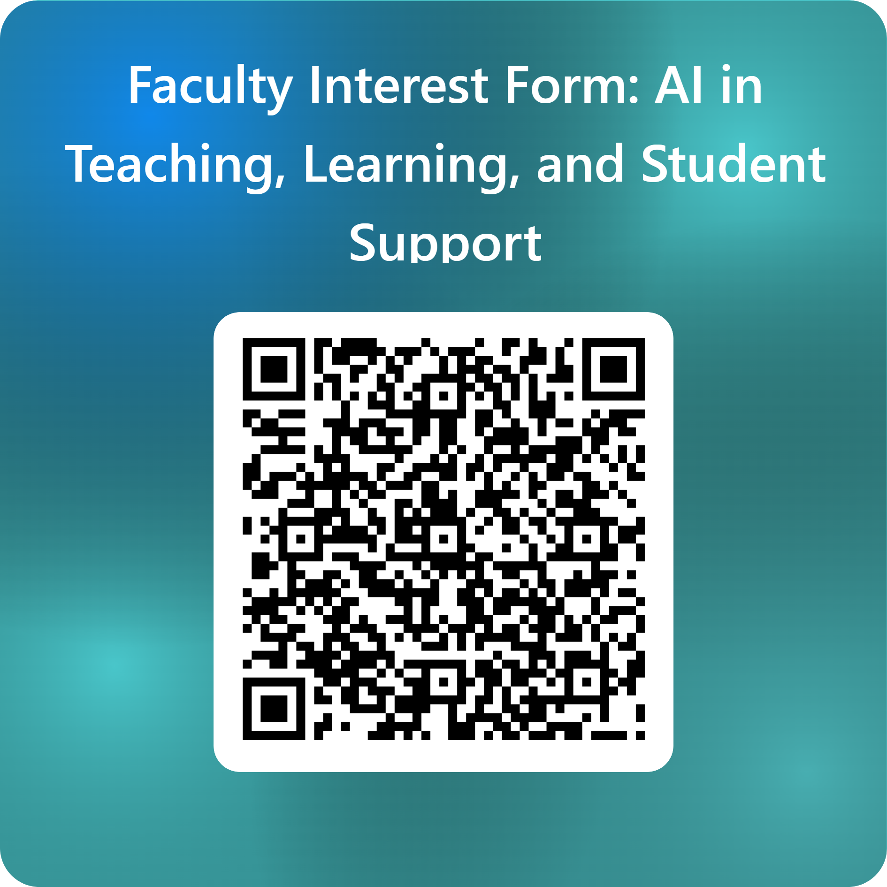
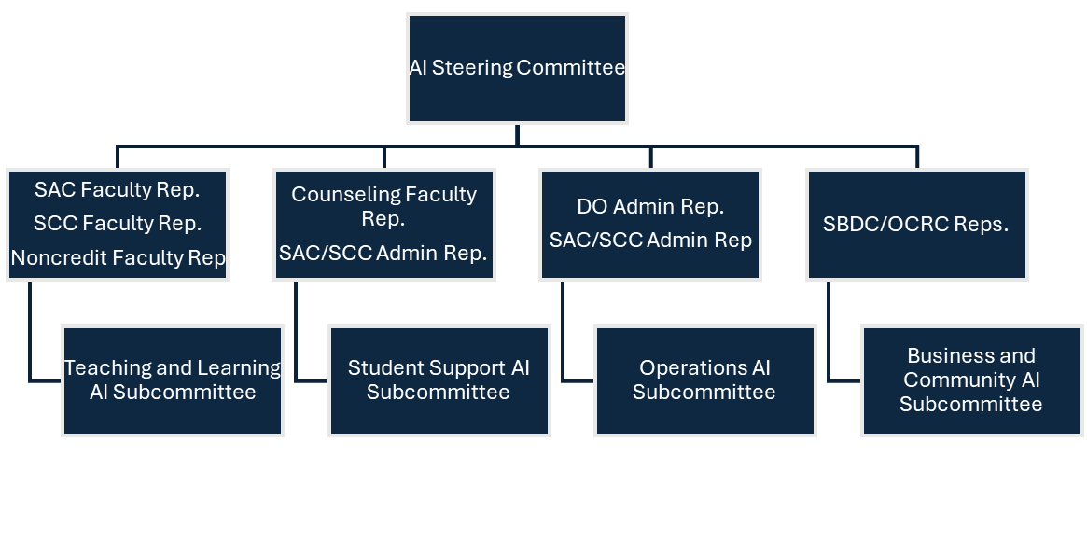
District AI Taskforce – DRAFT
Interest Form: https://forms.office.com/r/KkhSdcFRGA

Slide 4
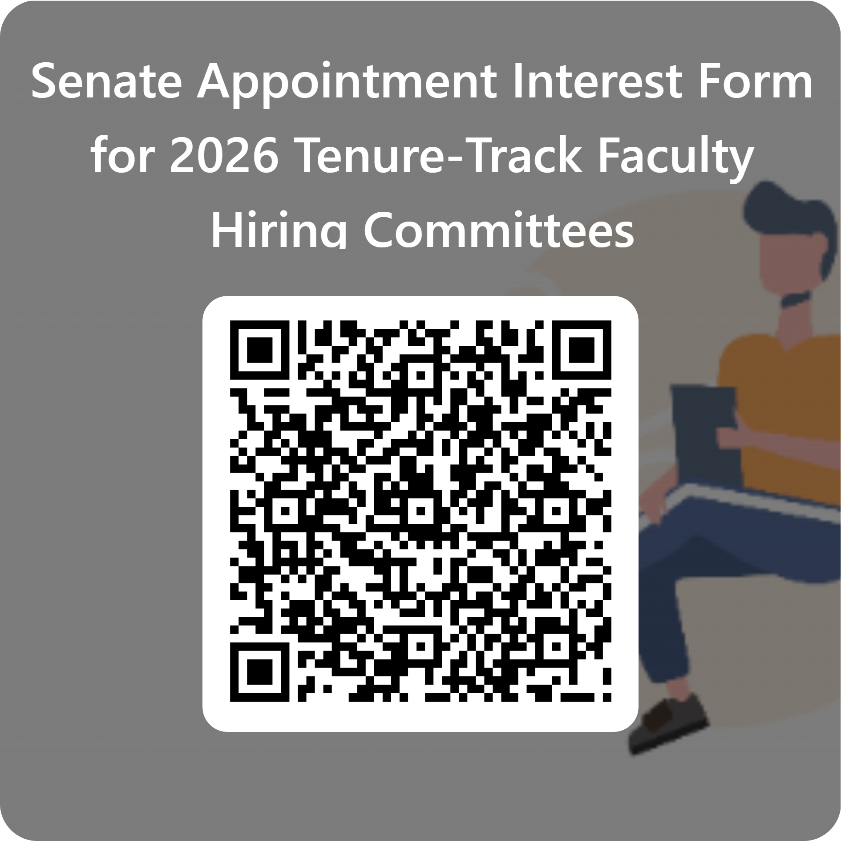
Faculty Hiring
AR 7120.1 Full-Time Faculty Recruitment and Selection.
Faculty share primary responsibility for establishing qualifications, screening applicants, conducting interviews, and recommending finalists.
The faculty co-chair (a tenured faculty member elected by the committee) leads deliberations and ensures fair participation.
All full-time faculty in the discipline must be invited to serve, and if needed, the Academic Senate President appoints additional members.
A faculty member from the sister college must be invited to participate — this is required, not optional — and serves as a full voting member.
Academic Senate President appoints one additional faculty member (can be from outside discipline)
Classified representation is optional and made by CSEA President
Administrative Co-Chair
Supports facilitation of process
Does not direct or overrule faculty deliberations.

Slide 5
Agenda Requests Fall 2025
Per Senate by-laws, The Historian will provide a report at the last semester meeting to the Senate on agenda item activity
15 Agenda Requests
4 – Administrators/Classified Professionals
Thrive Center (2), Student Leadership (announcement), Online Degree Pathway REAL Dashboard
3 – Student Equity & Achievement Plan Writing Group
8 – Faculty (1 Resolution)
All requests addressed with Agenda Item or Recommendation to share as a public comment
MESA Program Spotlight – Presentation request was better suited for Program Review. Senate Exec recommended a public comment with handout as has been done with the Transfer Center.

Slide 6

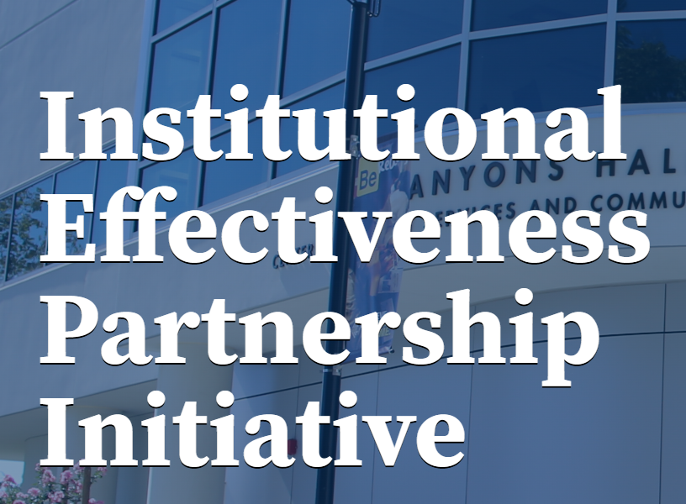
Pleased to inform you that you’ve been selected to serve on a PRT this Spring to support Yosemite Community College District.
Yosemite CCD’s Area of Focus
Strengthening institutional governance and participatory decision-making processes
Conducting a comprehensive review and clarification of governance structures and expectations
Delineating the roles in both districtwide and college-level governance
Targeted professional development focused on participatory governance, effective communication, team building, and conflict resolution

