Slide 1
Online Degree Pathways REAL Student Dashboard

Slide 2
Who Owns Student Retention at SAC?
Academic Affairs
Student Services
Enrollment Management
Faculty

Slide 3

Who Owns Student Retention at SAC? - Answer
Monica MacMillen, Student Services Program Specialist

Slide 4
Who Owns Student Retention at SAC? – Correct Answer
Academic Affairs
Student Services
Enrollment Management
Faculty

Slide 5
When Retention Rates Drop, What is the First Area SAC Examines?
Academic Affairs
Student Success
Enrollment Management
Faculty
Shared Responsibility

Slide 6
Trends informing the R.E.A.L. Dashboard
National Trend: Retention and completion rates are lower in fully online degree programs compared to in-person programs, particularly where admission requirements and support systems are limited (Rahmani et al., 2024; Shaikh et al., 2022).
Statewide Trend: California’s Guided Pathways and Vision 2030 initiatives emphasize completion and equity goals across all community colleges (California Community Colleges Chancellor’s Office [CCCCO], 2023).
Local Need: Within Santa Ana College’s Distance Education Office, one staff member currently provides individualized support for 50 Online Degree Pathway students—a number expected to grow. The R.E.A.L. Dashboard is designed to make this personalized outreach scalable and sustainable (Wang & Houdyshell, 2021; Susnjak, 2022).
Institutional Context: Santa Ana College now offers multiple online course lengths (4-, 8-, 12-, and 16-week formats). Supporting persistence across these varied timelines requires responsive tools for monitoring student engagement and success.

Slide 7
Faculty Course Analytics
Canvas New Analytics
Weekly Online Activity.
Message Students Who Didn’t View.
Assignments
Discussion Forums
Gradebook

Slide 8
Non-Faculty Retention Indicators
Faculty Referrals
Student Contact
Final Grades
???

Slide 9
REAL Student Dashboard: Introduction
The R.E.A.L. (Read, Engage, Achieve, Log-In) Dashboard is a student success and retention tool being developed to support Santa Ana College’s Online Degree Pathways Students by the
Distance Education Office,
Student Information Support, and
Institutional Research
to support Santa Ana College’s Online Degree Pathways.
Moving from concept in Summer 2025 to design in Fall 2025, the dashboard will provide a working model that uses Canvas data to offer a holistic view of student progress.

Slide 10
REAL Student Dashboard: Rendering

Slide 11
REAL Student Dashboard: Purpose
Identify students who may benefit from proactive support and connect them to
tutoring,
counseling,
and other online resources.

Slide 12
REAL Student Dashboard: Indicators
Read – Time on course content
Engage – Participation in assignments and discussions
Achieve – Lowest grade across active courses
Log-In – Most recent Canvas login

Slide 13
REAL Student Dashboard: Indicator Inputs
Indicators reflect the lowest measure across all active courses, highlighting areas where support is most needed.
Input | REAL Dashboard Output | Red | Yellow | Green
Last Page View | Read | 5 days | 3 days | 2 days
Last Participation | Engagement | 5 days | 3 days | 2 days
Grade | Assignment | 69% and below | 70-79% | 80% and up
Last Login | Login | 7 days or more | 4-6 days | 3 days or less

Slide 14
What the R.E.A.L. Dashboard Is and Is Not.
A student-support tool to identify where students may need help across all their active courses.
Not an evaluation tool for faculty or course quality.
No individual course or instructor data is shown
indicators pull only the lowest measure across a student’s schedule.

Slide 15
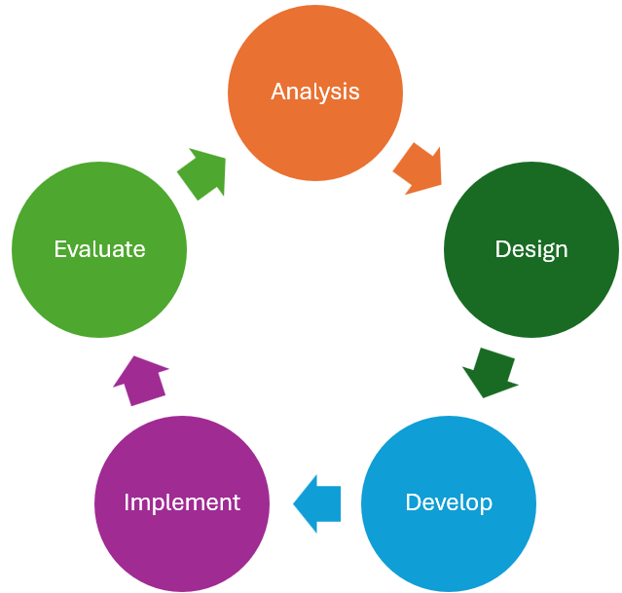
REAL Student Dashboard: Development
Collaborative design with Online Degree Pathway program chairs.
A faculty workgroup to provide input and guidance.
Dashboard rendering will include slicers/filters for actionable student lists.
Referrals and outreach actions will be tracked and eventually integrated with Colleague and/or Starfish for case management.

Slide 16
REAL Student Dashboard: Data Limitations
Data Source Limitations
Canvas Dependent
Student Behavior Measurement
Engagement ≠ Learning
Offline Learning
Timing and Frequency
Early login or submission patterns may not fully predict long-term success
Equity and Representation
Digital access differences: Students with limited devices or internet access may show lower engagement, which could be misinterpreted as lack of effort.
Analysis and Interpretation
Correlation vs. Causation
Instructor Impact: Course Design, assignment frequency, etc.
Data Privacy
FERPA constraints

Slide 17
What does Success Look Like?
Success for the R.E.A.L. Dashboard means students are identified and supported earlier, equity gaps are narrowed, faculty and staff have the tools to work more efficiently, and more of our Online Degree Pathway students persist to completion while increasing enrollment.
Student-Centered Success Outcomes
Students flagged early by the dashboard are connected to tutoring, counseling, or resources within the same week.
Students receiving outreach show higher persistence from term to term compared to peers not flagged.
Increased course success rates in high-impact courses (e.g., transfer-level Math and English).
More students in Online Degree Pathways stay on track to degree/certificate completion.
Equity-Focused Success Outcomes
Disaggregated dashboard data helps identify equity gaps (race/ethnicity, first-gen, Pell, etc.).
Disproportionately impacted (DI) students who receive targeted support show narrowed outcome gaps in persistence and completion.
Equity alignment: The dashboard strengthens SEAP goals and Guided Pathways pillars (“Help students stay on the path” and “Ensure students are learning”).
Faculty & Staff Success Outcomes
Faculty experience a reduced invisible workload by not having to track student engagement manually.
Support staff (e.g., Monica in our office) can scale interventions Dashboard becomes a model for data-informed decision-making across programs.
Integration with Colleague/Starfish enables better tracking of interventions and follow-up.
R.E.A.L. Dashboard is embedded into the college equity plan and Completion Agenda as a key strategy.

Slide 18
Questions and Suggestions
Marvin Gabut
Gabut_Marvin@sac.edu
714-564-6734
Scenarios
RYYR
GGGG
RGRG
Notes:
1. Faculty already own student success: This tool helps the college meet students halfway in online environments where engagement cues are invisible.
2. This is a pilot: We’re seeking faculty input to shape it before scaling.
3. Data belongs to the college, not the dashboard: The tool simply visualizes existing student activity for timely outreach.

Slide 19
Thank you!

Slide 20
References
Rahmani, A. M., Khodabandelou, R., & Kashani-Vahid, L. (2024). Dropout in online higher education: A systematic literature review. International Journal of Educational Technology in Higher Education, 21(1). https://educationaltechnologyjournal.springeropen.com/articles/10.1186/s41239-024-00450-9?utm_
Shaikh, U. U., Jabeen, S., Rasool, S., & Alghamdi, F. (2022). Persistence and dropout in higher online education: Review and categorization of factors. Frontiers in Psychology, 13, 902070. https://www.frontiersin.org/journals/psychology/articles/10.3389/fpsyg.2022.902070/full
California Community Colleges Chancellor’s Office. (n.d.). Guided Pathways. https://www.cccco.edu/College-Professionals/Guided-Pathways
California Community Colleges Chancellor’s Office. (2023). Vision 2030: A Roadmap for California Community Colleges. https://www.cccco.edu/-/media/CCCCO-Website/docs/report/Vision-2030-A-Roadmap-for-California-Community-Colleges.pdf
Susnjak, T. (2022). Learning analytics dashboard: A tool for providing actionable insights and feedback for students. Education and Information Technologies, 27, 16073–16104. https://pmc.ncbi.nlm.nih.gov/articles/PMC8853217/

