Slide 1

DE Advisory Report
Next mtg, 10/30/25 at 11am

Slide 2

CVC numbers 538 total
Please scroll through this excel

Slide 3
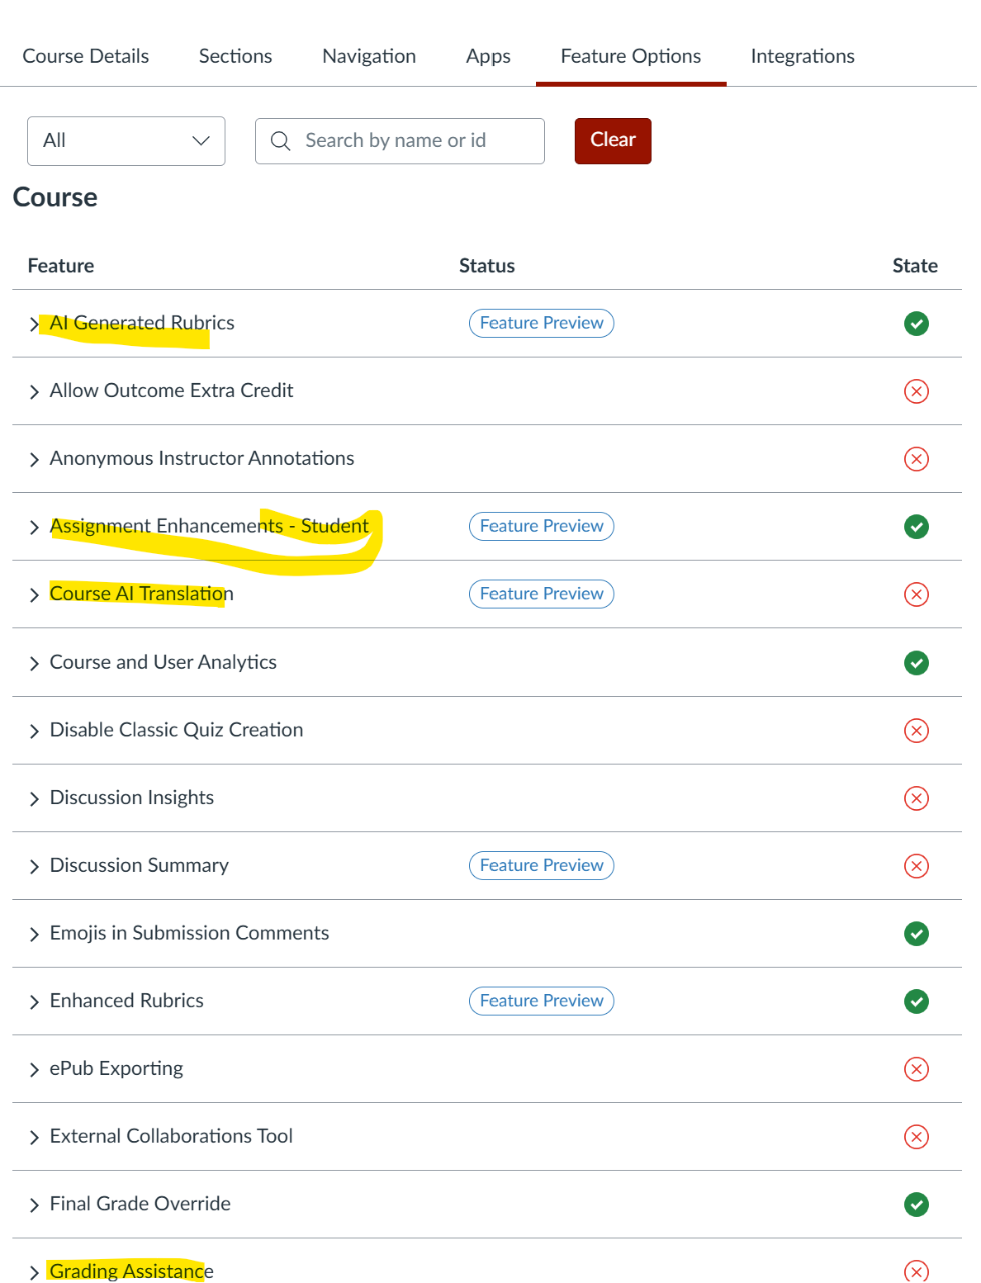
AI tools in Canvas

Slide 4
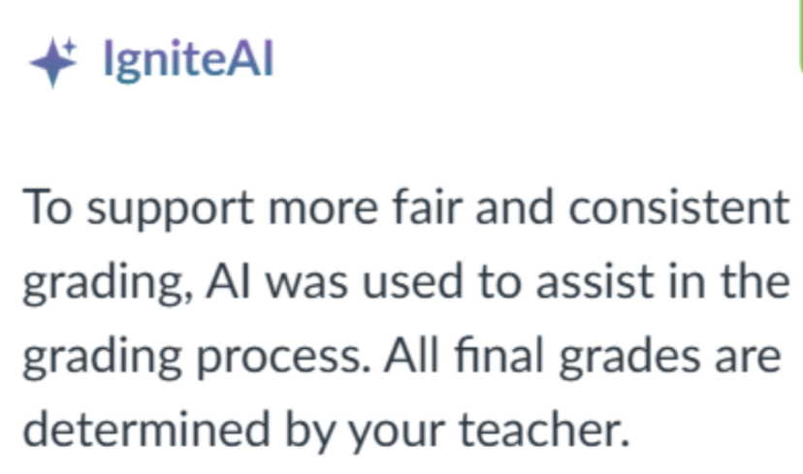
AI tools in Canvas
In particular, the AI Grading Assistant seems especially in need of serious faculty consideration and input. At MiraCosta, we’ve disabled that tool until faculty have an opportunity to weigh in. Using a tool to auto-grade and auto-comment upon significant student work such as essays and other written work) seems a very slippery slope in multiple ways.
Cherry on the top is the note that students would see if the grading assistant is used:

Slide 5
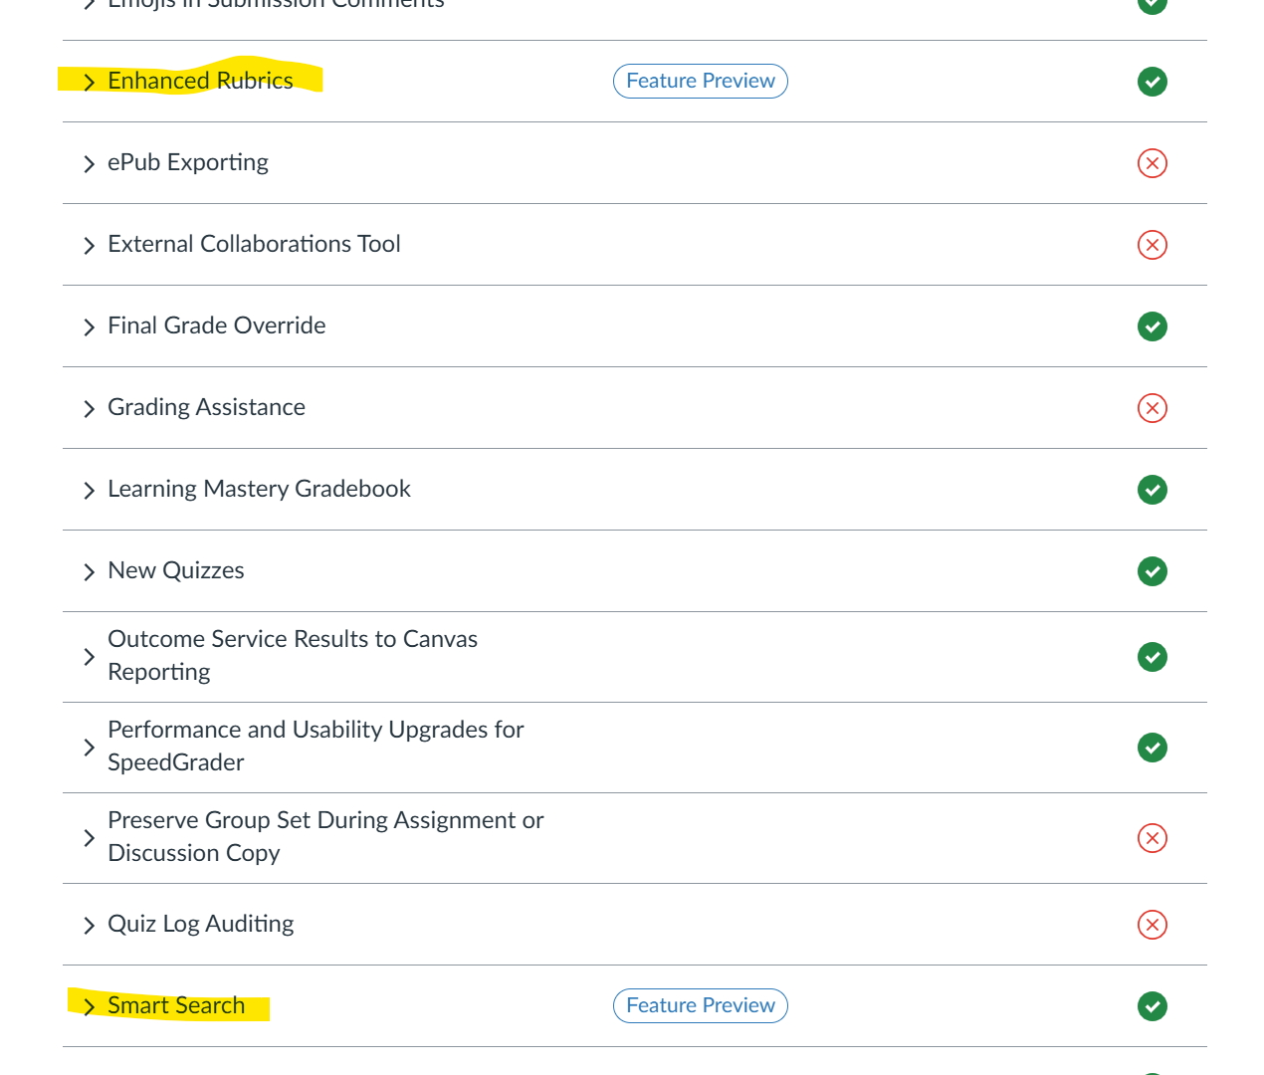
Vetted CAnvas tools

