Slide 1

ROBERT’S RULES OF ORDER
Professor Alejandro Moreno
10/14/2025

Slide 2

Why follow Robert’s Rules of Order?
Allows for democratic speech and action
Preservers order
Rights of the organization supersede the rights of individuals
Facilitates group decisions

Slide 3
Meeting Agendas
Approval of Minutes
Reports (from officers, committees, task forces)
Unfinished Business (replaces term “old business”)
New Business – items brought forward by motion procedure

Slide 4

Motions
A motion is a formal proposal by a member that the group take a certain action or position.
A main motion is required to begin the decision-making process.
A motion occurs prior to discussion

Slide 5

What do I say? When Do I Say It? Why Do I say It?

Slide 6
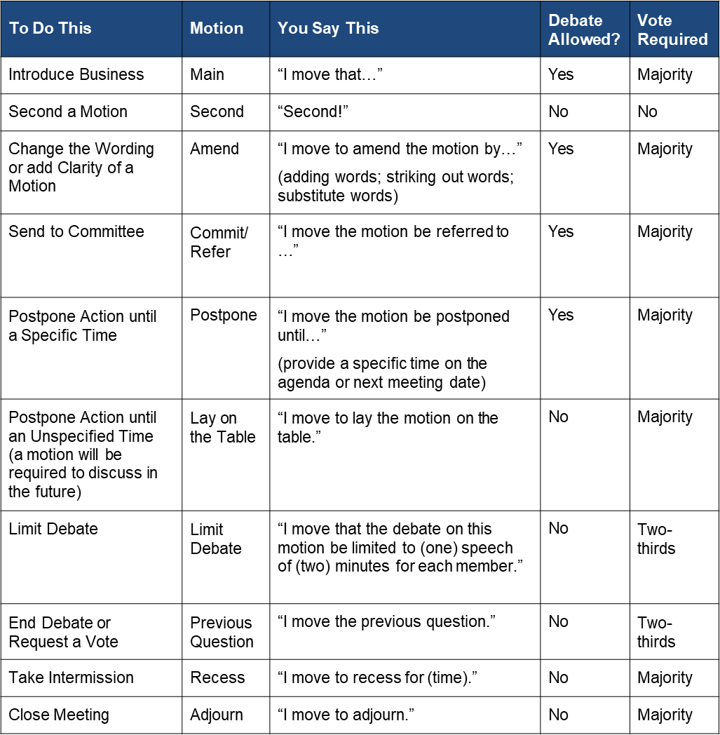

Slide 7

Thank You
Email:
moreno_alejandro@sac.edu

