Slide 1

A look at the law…
September, 1988 AB 1725: California’s community colleges are legally mandated to have participatory governance structures in place
AB 1725 is implemented through Ed Code and Title 5 regulation.
What’s the difference between Ed Code and Title 5 regulation?
Ed Code is the law and Title 5 is the Board of Governors’ interpretation of the law. Education Code supersedes Title 5 regulations.
Notes:
AB1725

Slide 2

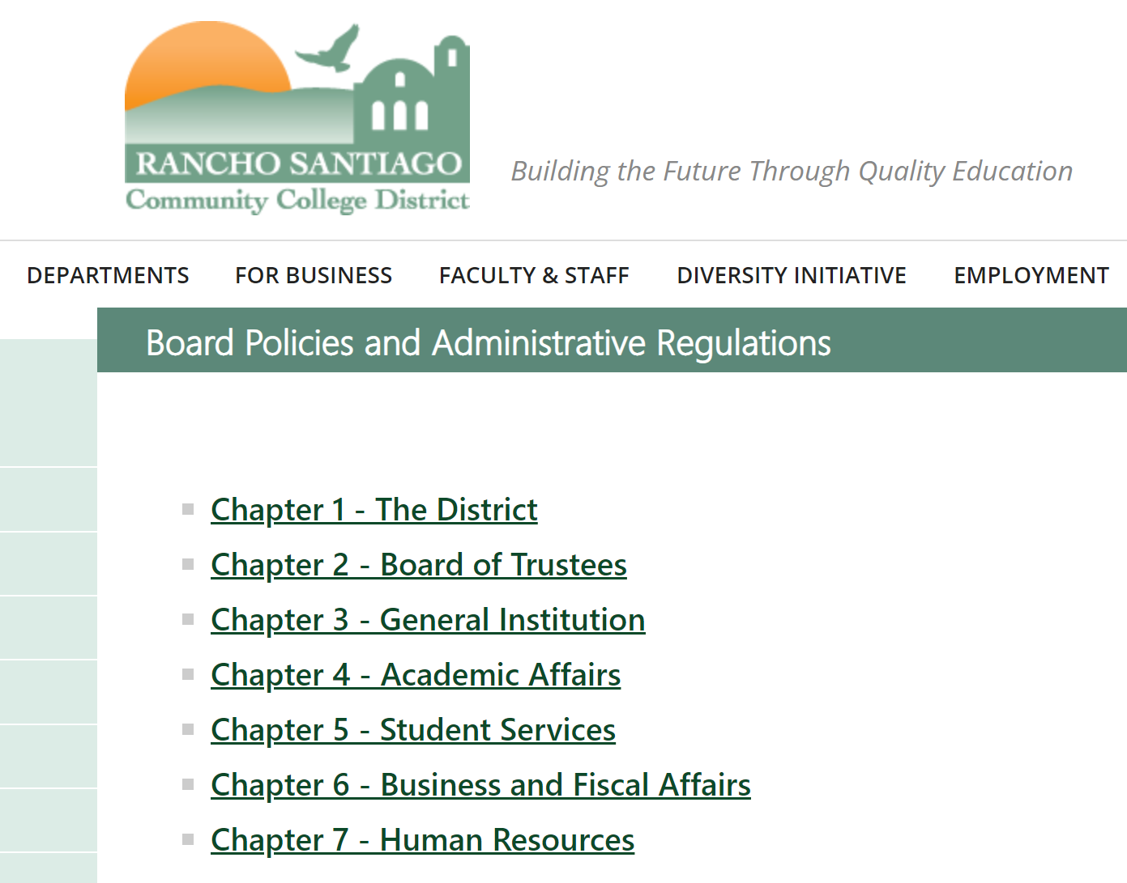
RSCCD Board Policies (BP) to implement laws and regulations and Administrative Regulations (AR) to provide procedural guidance and clarification concerning the implementation of Board Policies
https://rsccd.edu/Trustees/Pages/policies-and-regulations.aspx

Slide 3
What Constitutes a Participatory Governance Committee?
Representation from four groups, what are they?
Faculty- Education Code 70902 (b)(7) & Title 5 § 53200
Classified - Education Code 70902 (b)(7) &TITLE 5 §51023.5 (a)
Students - Education Code 70902 (b)(7) & TITLE 5 §51023.7 (a)
Administration – Not Addressed in Title 5
Faculty, Classified and Students have a legal right to PARTICIPATE EFFECTIVELY in District and College Governance.
Notes:
Administration – not included b/c they are managers, they are supposed to do these things. Management is supposed to allow for participation of faculty, classified and students

Slide 4
The Academic Senate’s “primary function is to make recommendations with respect to academic and professional matters.” TITLE 5 § 53200
Sections 53200 (c), "Academic and professional matters" mean the following policy development and implementation matters…
What constitutes academic and professional matters?
Notes:
First see the language “academic and professional matters” – not language used in Ed Code

Slide 5
1. Curriculum including establishing prerequisites and placing courses within disciplines 2. Degree and certificate requirements 3. Grading policies 4. Educational program development 5. Standards or policies regarding student preparation and success 6. District and college governance structures, as related to faculty roles 7. Faculty roles and involvement in accreditation processes, including self-study and annual reports 8. Policies for faculty professional development activities 9. Processes for program review 10. Processes for institutional planning and budget development 11. Other academic and professional matters as are mutually agreed upon between the governing board and the academic senate.
The 10+1
https://www.asccc.org/10_1
Notes:
Critical that faculty participate in ALL areas!

Slide 6
Title 5 § 53200 (d): Consult Collegially means that the district governing board shall develop policies on academic and professional matters through either or both of the following: (1) Rely primarily upon the advice and judgment of the academic senate, OR (2) The governing board, or its designees, and the academic senate shall reach mutual agreement by written resolution, regulation, or policy of the governing board effectuating such recommendations
Collegial Consultation

Slide 7
Title 5 § 53200 (d): (D) Requires procedures for responding to Academic Senate recommendations that include: 1. When rely primarily, the recommendation of the Academic Senate will normally be accepted, and only in exceptional circumstances and for compelling reasons will they not be accepted
Rely Primarily
RSCCD BP2410: Rely Primarily for..
1) Curriculum, including establishing prerequisites and placing courses within disciplines;
2) Degree and certificate requirements;
3) Grading policies;
5) Standard or policies regarding student preparation and success;
8) Policies for faculty professional development activities;

Slide 8
Title 5 § 53200 (d): (D) Requires procedures for responding to Academic Senate recommendations that include: 2. When mutual agreement and an agreement has not been reached: -Existing policy remains in effect except in cases of legal liability or fiscal hardship -Board may act - after a good faith effort - only for compelling legal, fiscal, or organizational reasons.
Mutual Agreement
RSCCD BP2410: Mutual agreement for..
4) Educational program development;
6) District and college governance structures, as related to faculty roles;
7) Faculty roles and involvement in accreditation processes, including self study and annual reports;
9) Processes for program review;
10) Processes for institutional planning and budget development.
In addition to “10+1,” the Academic Senate has other powers as well.

Slide 9
Education Code Section 87359 (b) Equivalency Section 87360 (b) Hiring Criteria, policies, and procedures Section 87458 (a) Administrative Retreat Rights TITLE 5 § 53203 (E) Academic Senate may assume responsibilities and perform functions as may be delegated by the Governing Board (F) Appointment of faculty members to college committees shall be made by the Academic Senate
Other
Areas
Notes:
Hiring criteria- HR Committee, looking at revising ARs

Slide 10

10+1 and Budget Update
1. Curriculum (BP/AP 4020)
Funding linked to FTES generation underscores the importance of curriculum that attracts and retains students.
Growth was concentrated in SAC’s credit, CDCP, and special admit programs (dual enrollment).
2. Degree & Certificate Requirements
Higher FTES → Pressure to expand high-demand programs to sustain growth funding.
4. Educational Program Development
New or expanded programs can increase apportionment funding.
5. Standards & Policies for Student Preparation/Success
70%+ of supplemental funding tied to SAC’s students (low-income, first-gen, etc.).
Senate role in supporting student equity initiatives is financially critical.
6. District/College Governance Structures
Budget Allocation Model (BAM) shifted $5.5M net to SAC. Senate reps need to monitor how funds flow through committees.

Slide 11
10+1 and Budget Update
7. Faculty Roles in Governance
Growth funding supported new faculty hiring; Senate input on prioritization is key.
8. Faculty Roles in Accreditation
Growth metrics and fiscal stability will be reviewed during accreditation; Senate oversight ensures academic integrity amid fiscal growth.
9. Faculty Professional Development Policies
Growth funding enables potential expansion of professional development, tied to enrollment/retention strategies.
10. Processes for Program Review
FTES growth should be analyzed in program review cycles to inform resource allocation and scheduling.
+1: Other Academic & Professional Matters
Ongoing monitoring of state growth caps and SCFF funding volatility is essential.

Slide 12
What to Do If…
…you’re unsure if an item is a 10+1 matter
→ Ask the Senate President or Exec Team. If it involves curriculum, program review, planning, or budget processes, Senate likely has a role.
…you feel faculty input was bypassed
→ Bring it to Senate (email/public comment). The Senate can request the item return to collegial consultation (Title 5 §53200).
…a committee assignment needs to be filled
→ Refer the request back to the Senate. Faculty appointments to governance committees are made through the Senate.
…there are funding or budget allocation questions
→ Ask how the decision aligns with program review outcomes, CEP/strategic goals, and BAM. Senate has purview under 10+1 #10.
…you’re not sure how to represent Senate’s position
→ Senators represent the Academic Senate, not just departments. Report back, gather feedback, return with Senate’s recommendation.
Never hurts to ask by reaching out to Senate Exec members and Senators.

