Slide 1
Santa Ana College
Midterm Report presentation to the Academic Senate August 28, 2025

Slide 2
Background
New Formative vs Summative Process
ISER– 2014 Standards
Areas of Focus
Visit Fall 2021
Spring 2022-- Reaffirmation

Slide 3

Midterm Report 2026

Slide 4
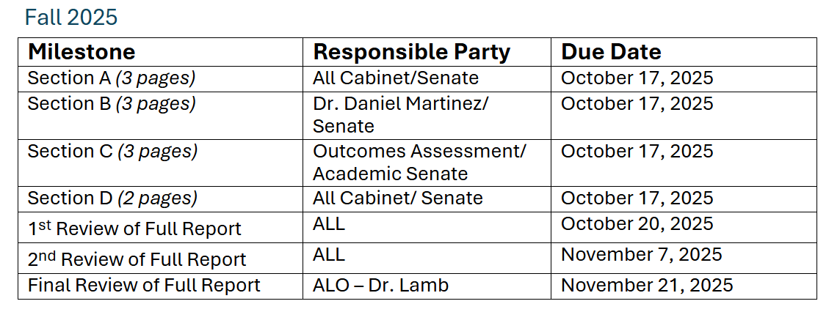
Key Elements
New Midterm Template
No response to Quality Focus Essay required
11 pages total
Finish Narrative Fall 2025
BOT Approval March 2026
Due March 15, 2026

Slide 5
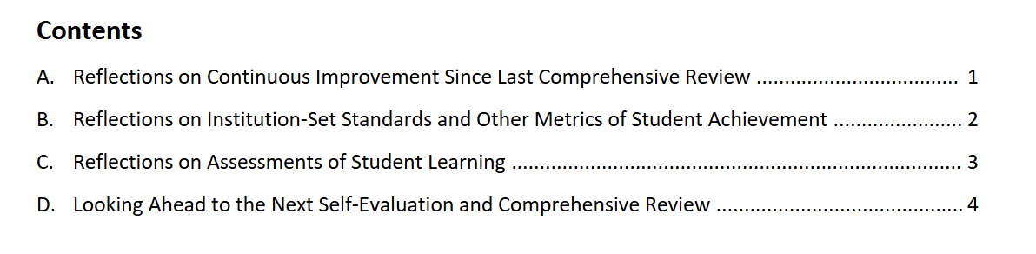
Overview

Slide 6
Sample
C. Reflections on Assessments of Student Learning
Provide a brief response to each question below, referring to Standards 1.3, 2.1, 2.2, and 2.9 for additional context. You may insert graphs, charts, or other similar visuals as needed to support your narrative. Suggested length for Section C (not counting any visuals) is 3 pages.
1. Review the results of learning outcomes assessment. Describe any patterns or trends related to attainment of learning outcomes observable in these data that may be relevant as you implement improvements and innovations in the design and delivery of academic programs?
2. How (i.e., for what subpopulations, modalities, etc.) does your institution disaggregate its assessment results? When you review disaggregated assessment results, what patterns or trends do you see related to equitable attainment of student learning? What patterns or trends excite you? What patterns or trends concern you?
3. What actions has your institution taken/is your institution taking in response to the patterns and trends discussed above? How will you monitor the results of these actions in order to inform future improvements and innovations in support of equitable student learning?

Slide 7
Accreditation Report 2029

Slide 8
Right Around the Corner
Summary Timeline-- DRAFT
Fall 2026: Kickoff, training, project planning
Spring 2027 : Evidence collection, gap analysis, drafting begins
Fall 2027: Full draft, college-wide vetting
Spring 2028: Final edits, board approval
Fall 2028: Submit ISER (Aug)
Spring 2029: Site visit

Slide 9
THANK YOU
Dr. Jeff Lamb
Vice President of Academic Affairs

