Slide 1


Professional Development
Faculty PD Retreat
When: Friday, September 5,
12-2pm
Where: A-130
What: Review Title 5 changes to professional development and come to a collective understanding with the goal to update the Senate Flex document

Slide 2
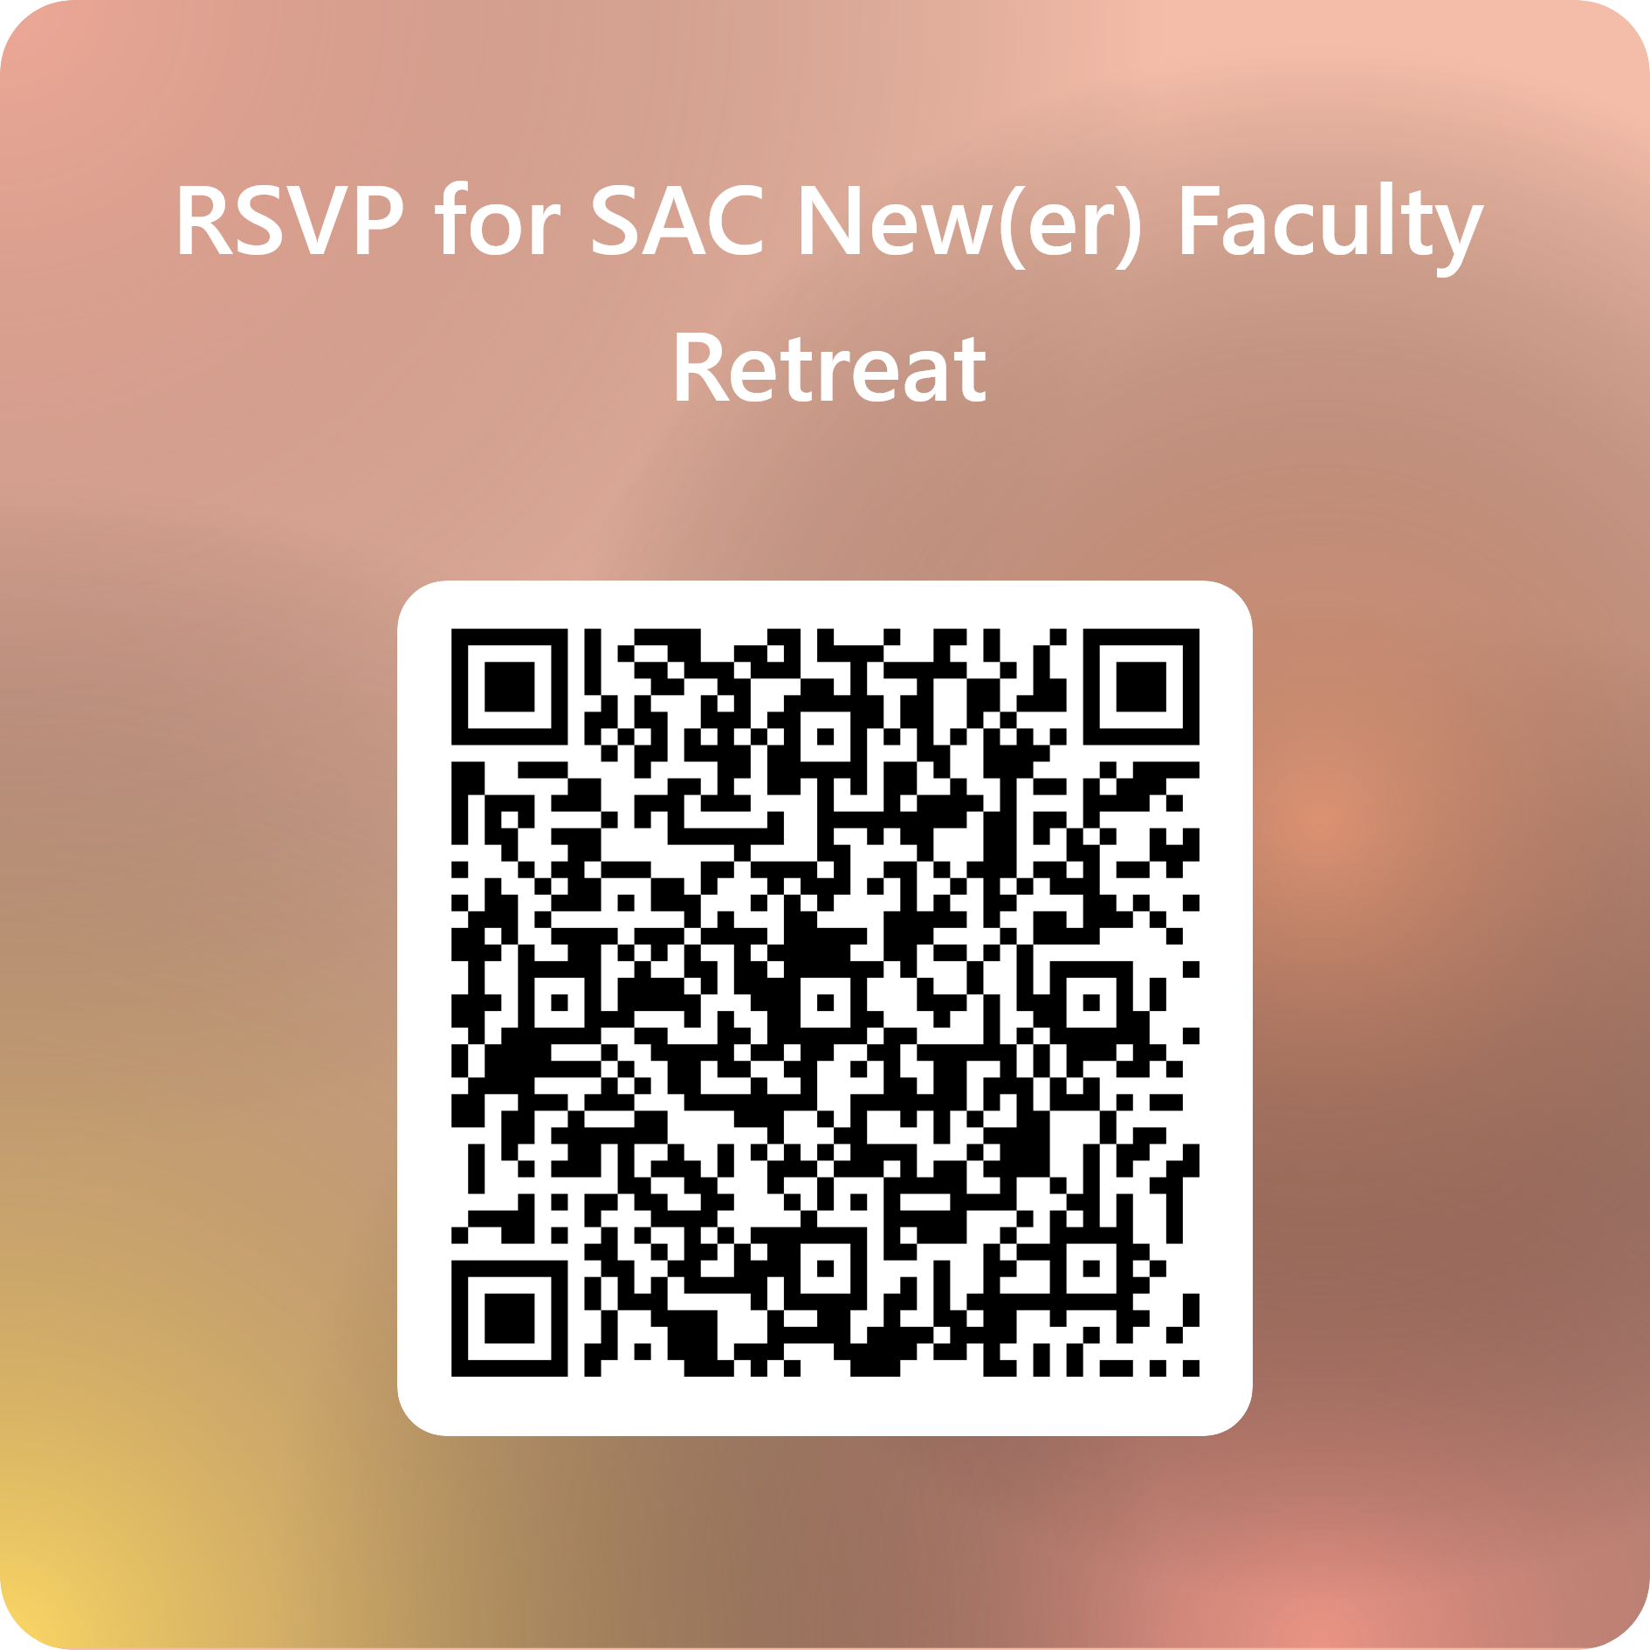
Professional Development
New(er) Faculty Retreat
When: Friday, September 19,
12-2pm
Where: H-124
What: A listening session to hear the needs of newer faculty (since 2021), provide support and an opportunity to come together to build community

Slide 3


Professional Development
Book Study

