Slide 1

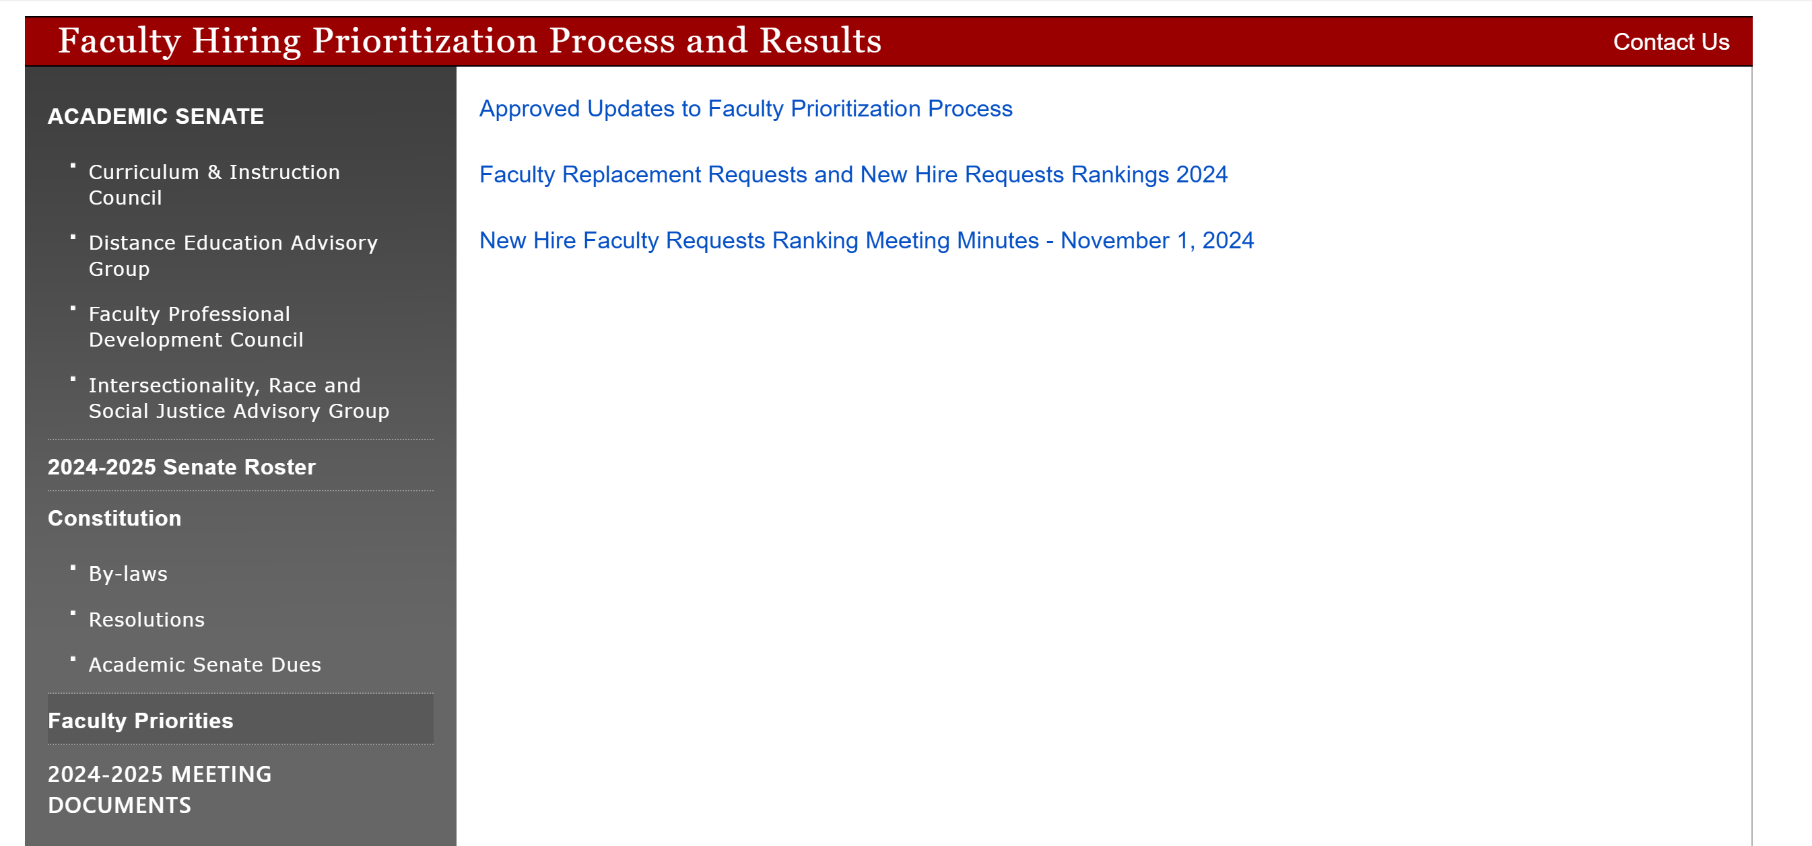
President’s Report
Updates
Fall Plenary 2024 – Approved Resolutions Link Available on AS Website
Faculty Prioritization Process Updates, Rankings and Meeting Minutes – Link on AS Website

Slide 2
President’s Report
Vista Meridian – Intersession Move
Second Floor DMC and 2 Rooms D-Bldg or A-Bldg
Cleanliness Standards
Feedback provided to VP C&E – shared today with Dr. Nery and Dr. Hoffman
Vehicle Updates
Batteries replaced
Brake issues: warped brake rotor, bad calipers, bad wheel bearing, alignment or suspension issue. The vehicle will be down until it can be serviced.
Planning and Organizational Effectiveness
Presentation by ITS with Program Review and their position requests for 2025-2026 (4 positions)
Will be presenting at a SAC College Council meeting next semester

Slide 3

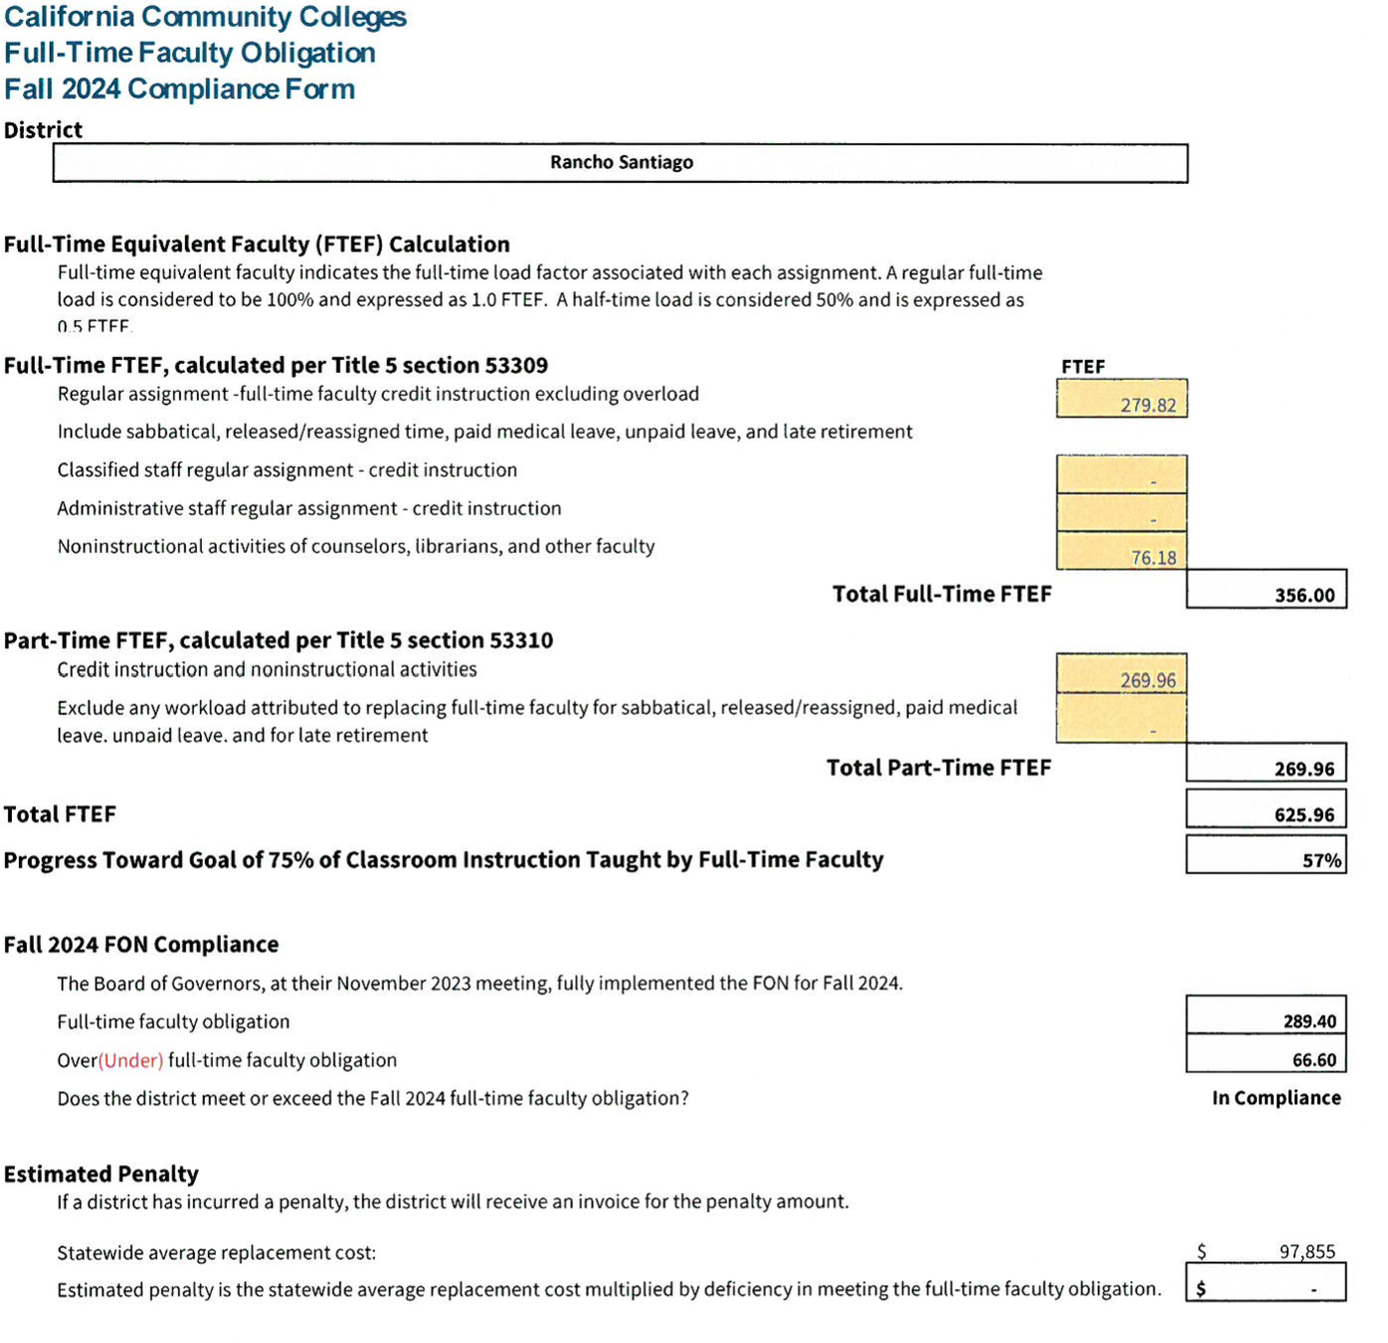
President’s Report
Faculty Priorities Replacement Requests
and Final Ranking Update
66 Above the FON,
57% Full-time Instruction
Awaiting Planning and
Budget Recommendation
5 – 10 positions (very tentative)

Slide 4
