Slide 1
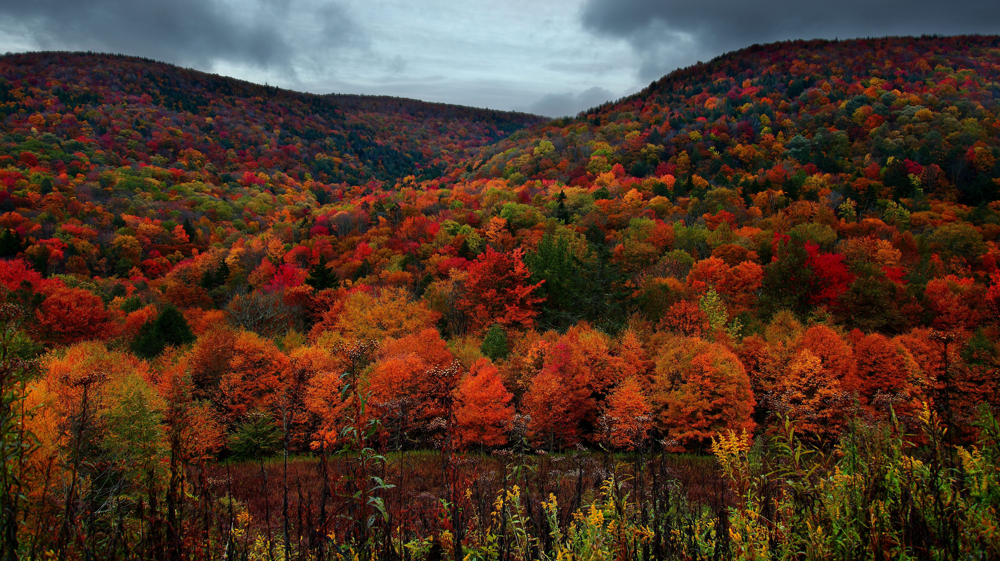
VP of CO
NOVEMBER 12, 2024
ThePhoto by PhotoAuthor is licensed under CCYYSA.

Slide 2
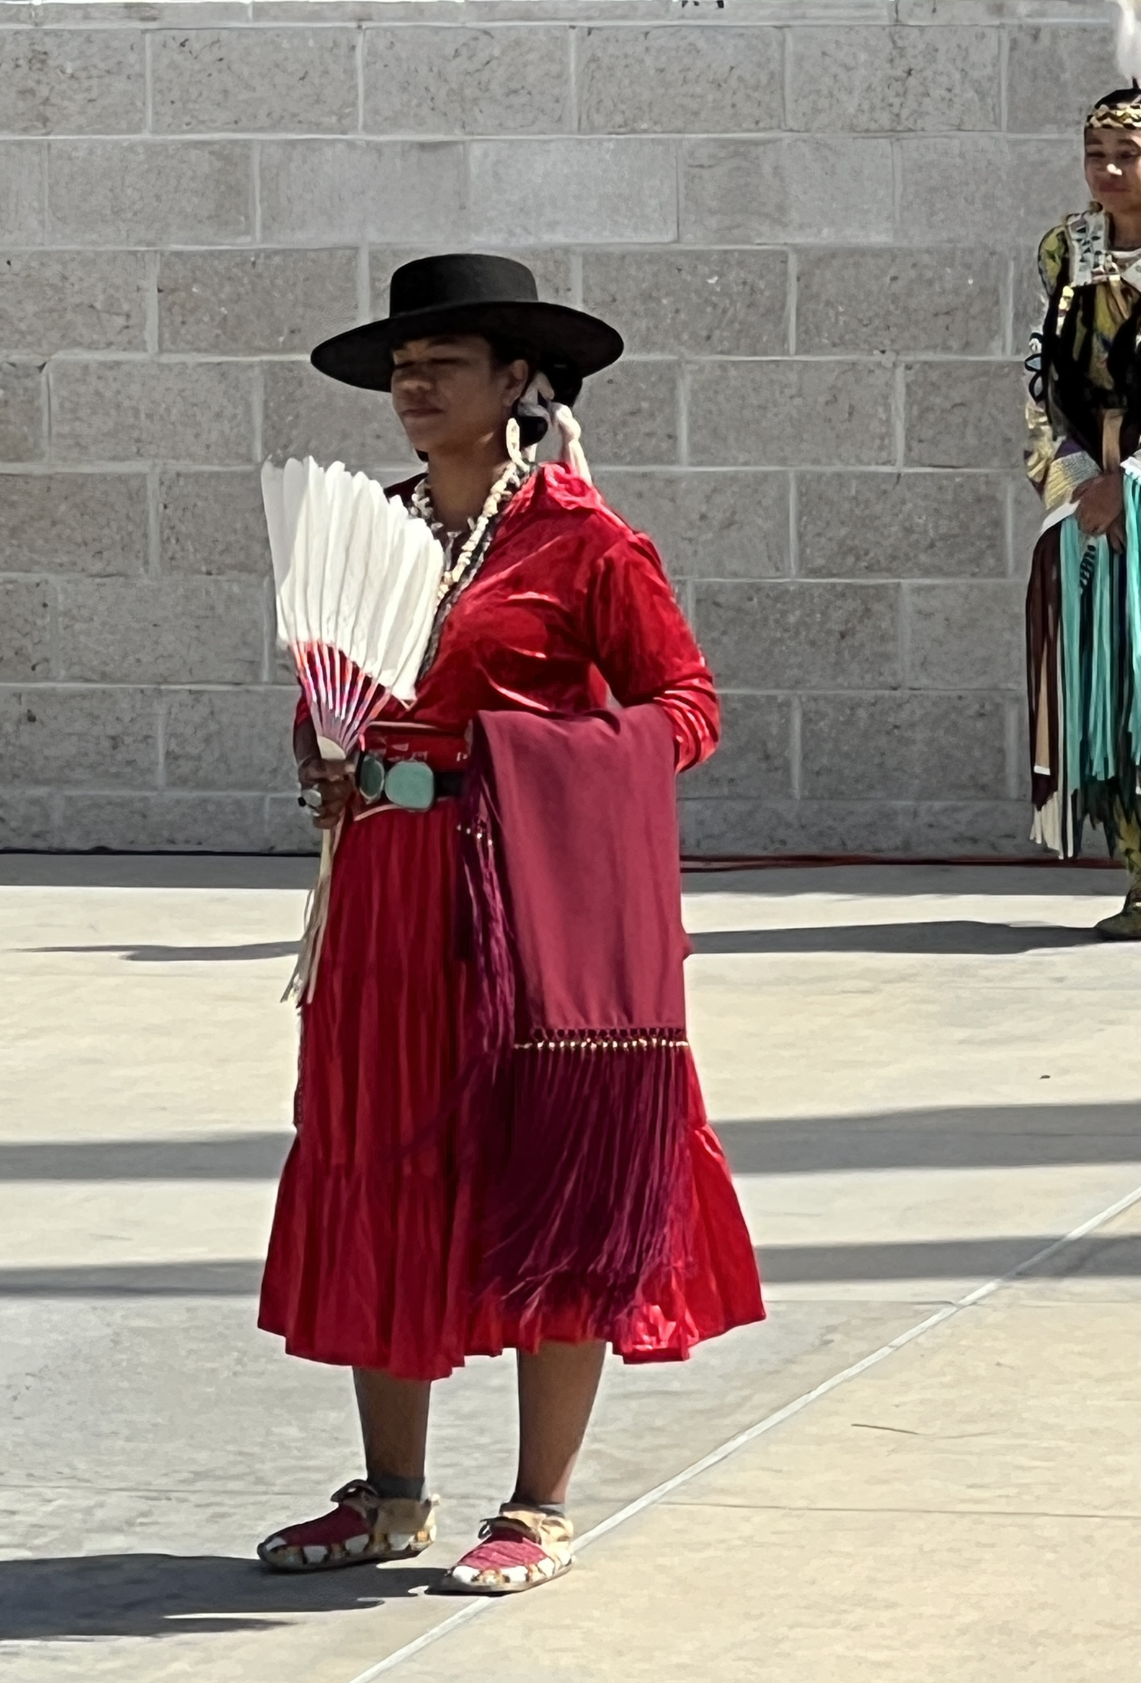
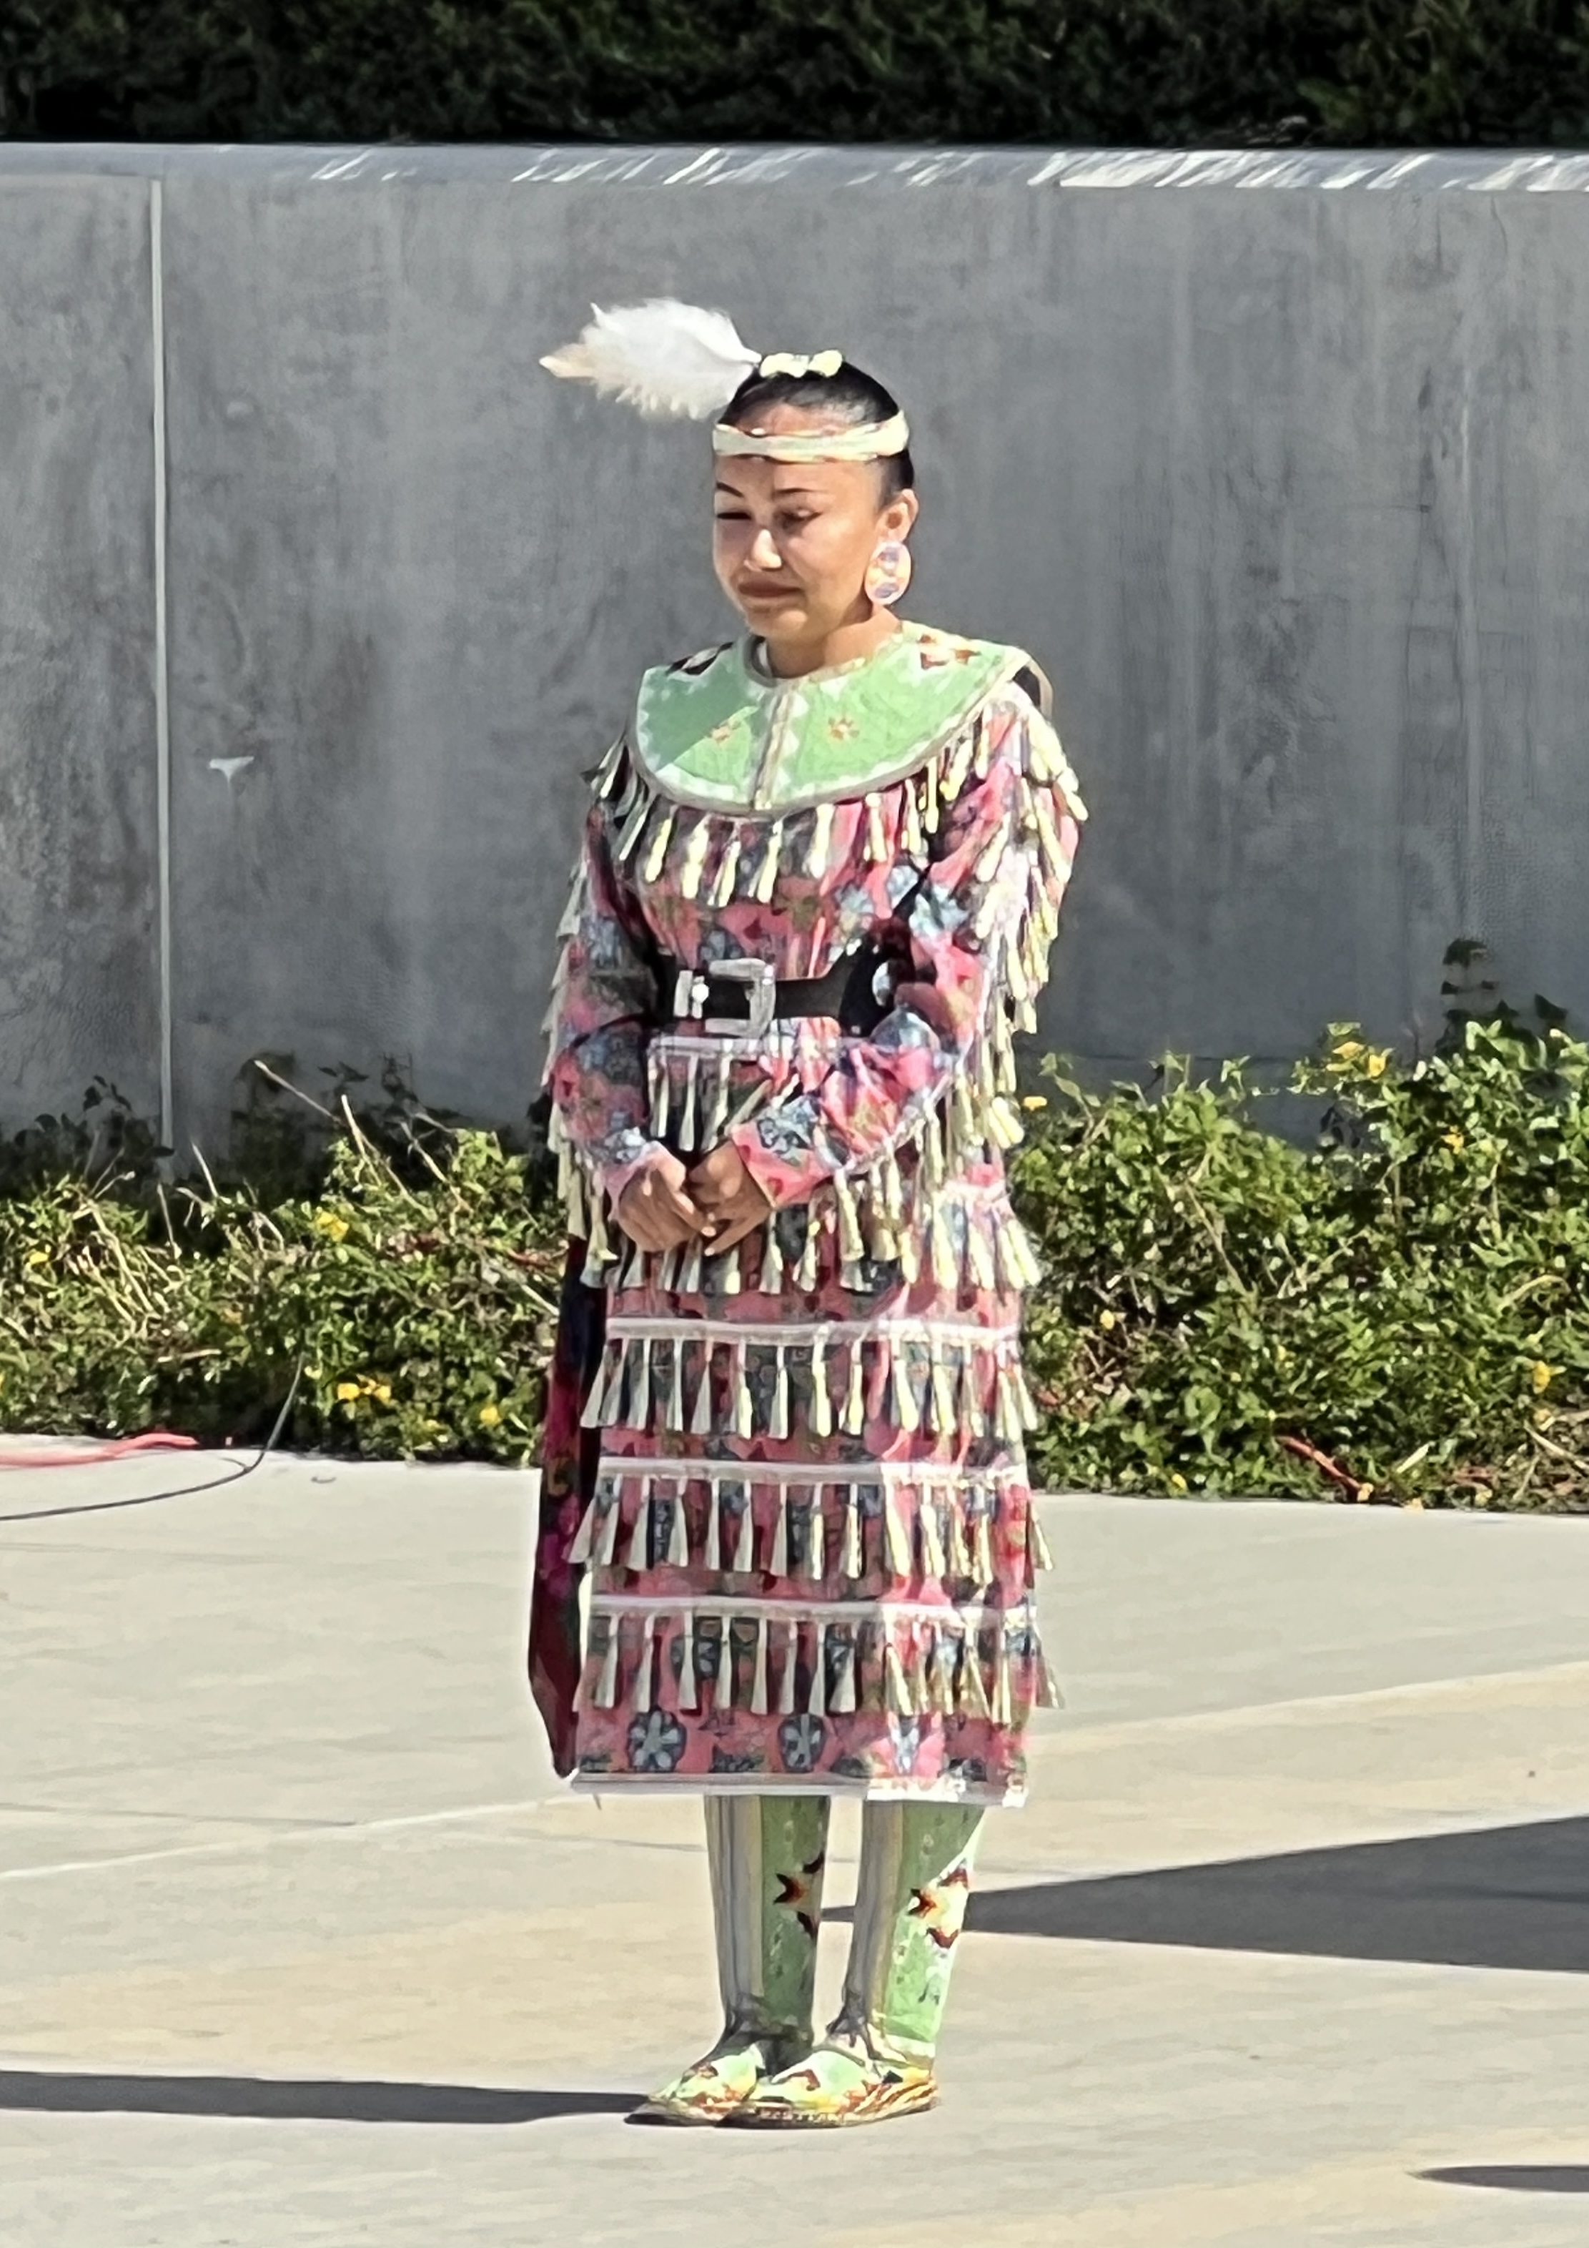
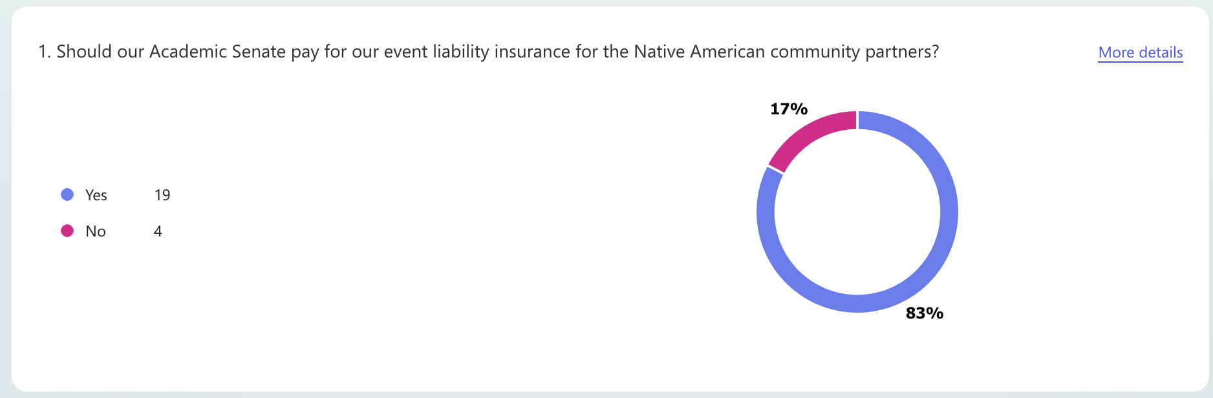
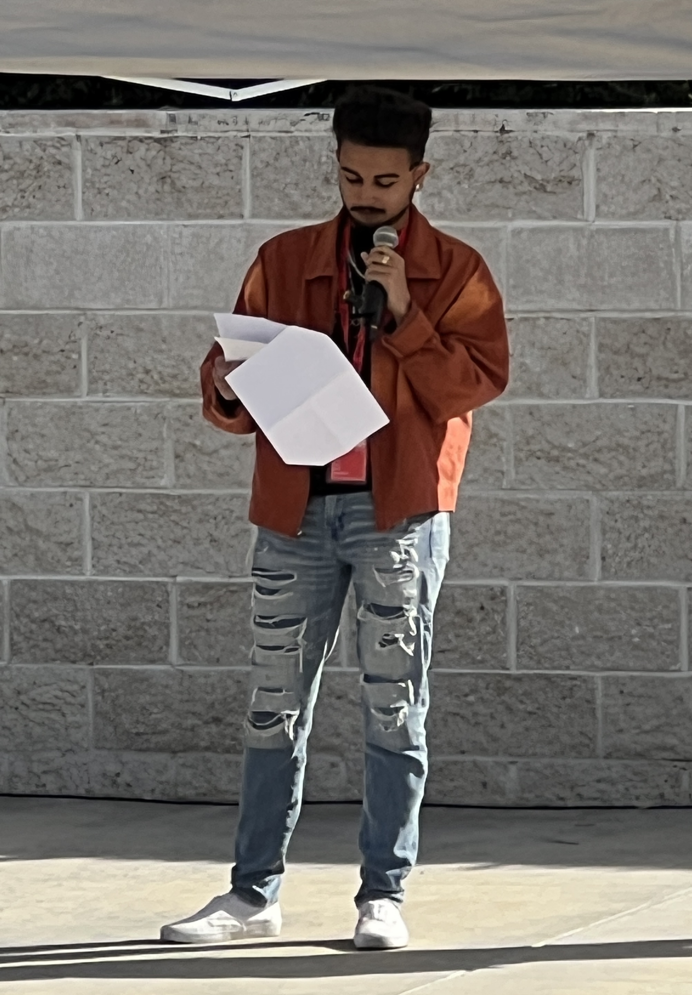
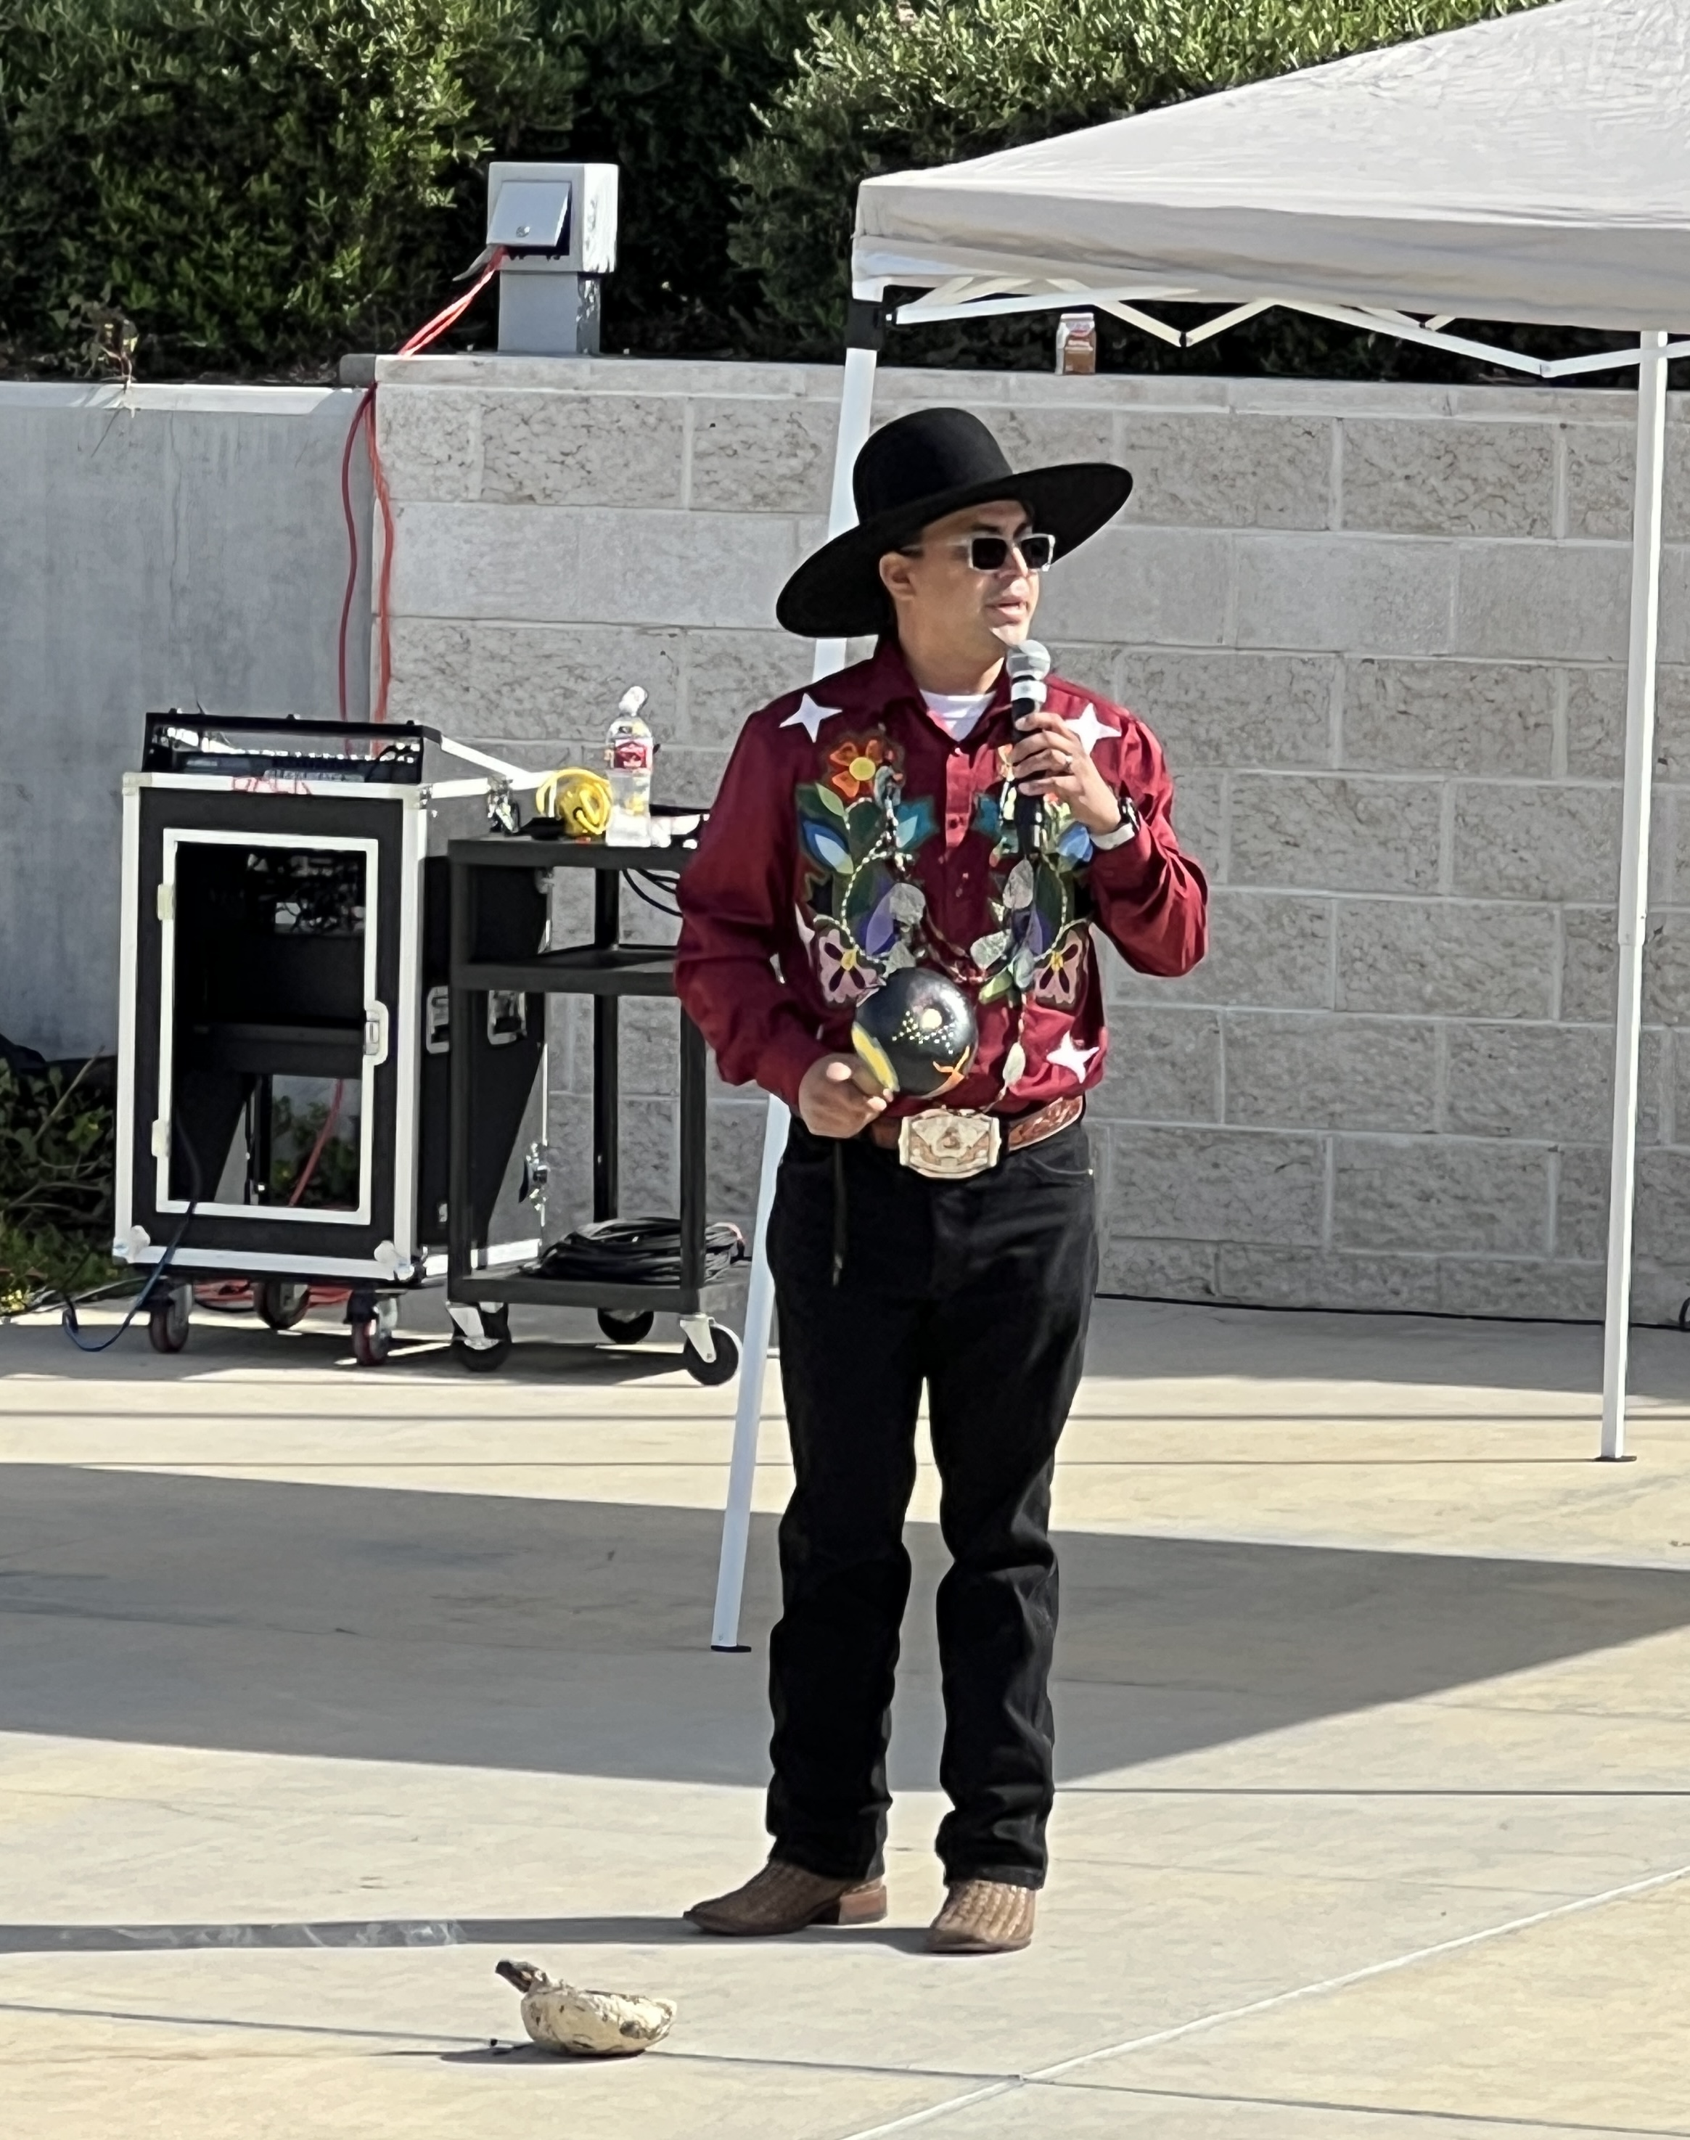
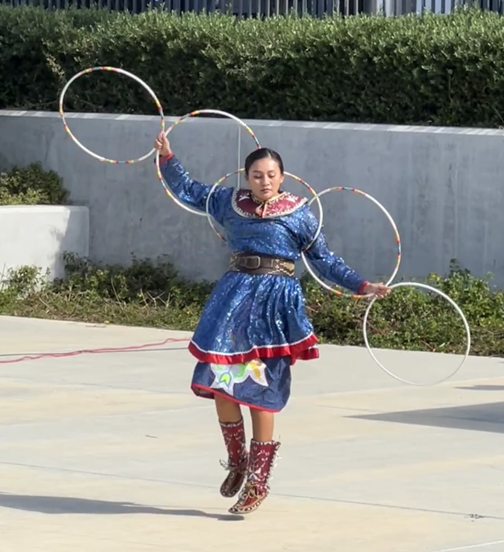
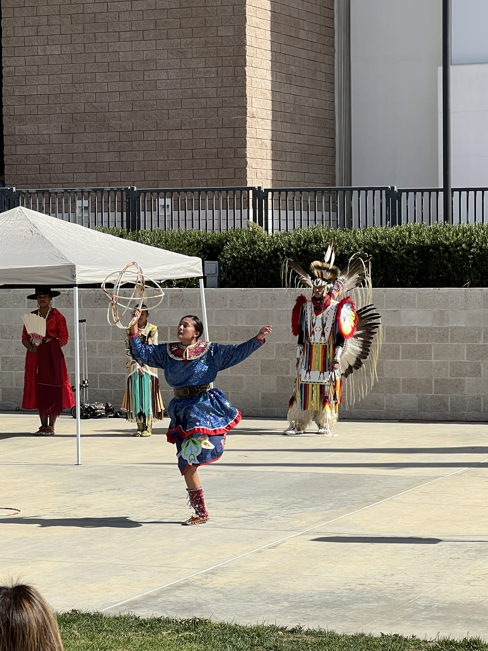
Native American Heritage Event - $138.01

Slide 3

SANTA ANA UNIFIED SCHOOL DISTRICT
STATE OF THE DISTRICT BREAKFAST, NOVEMBER 1, 2024

Slide 4
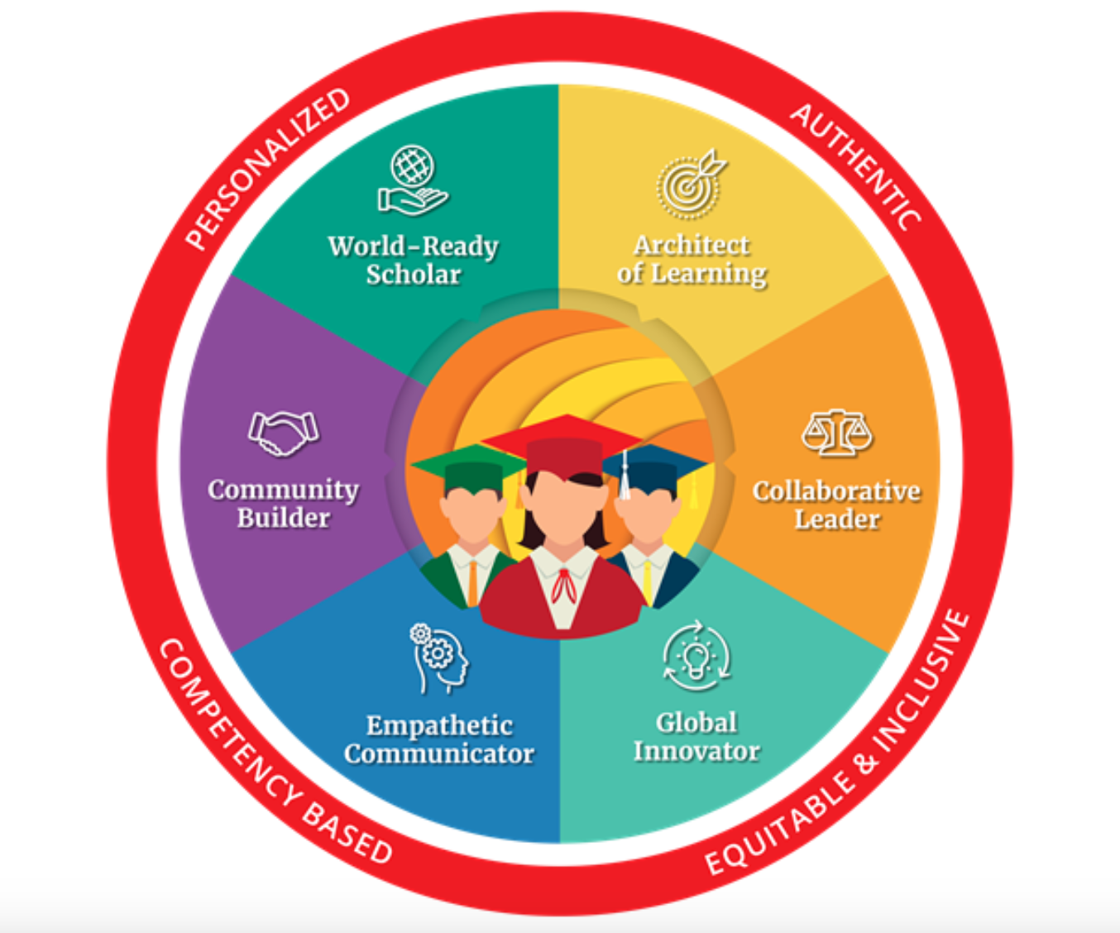

Slide 5
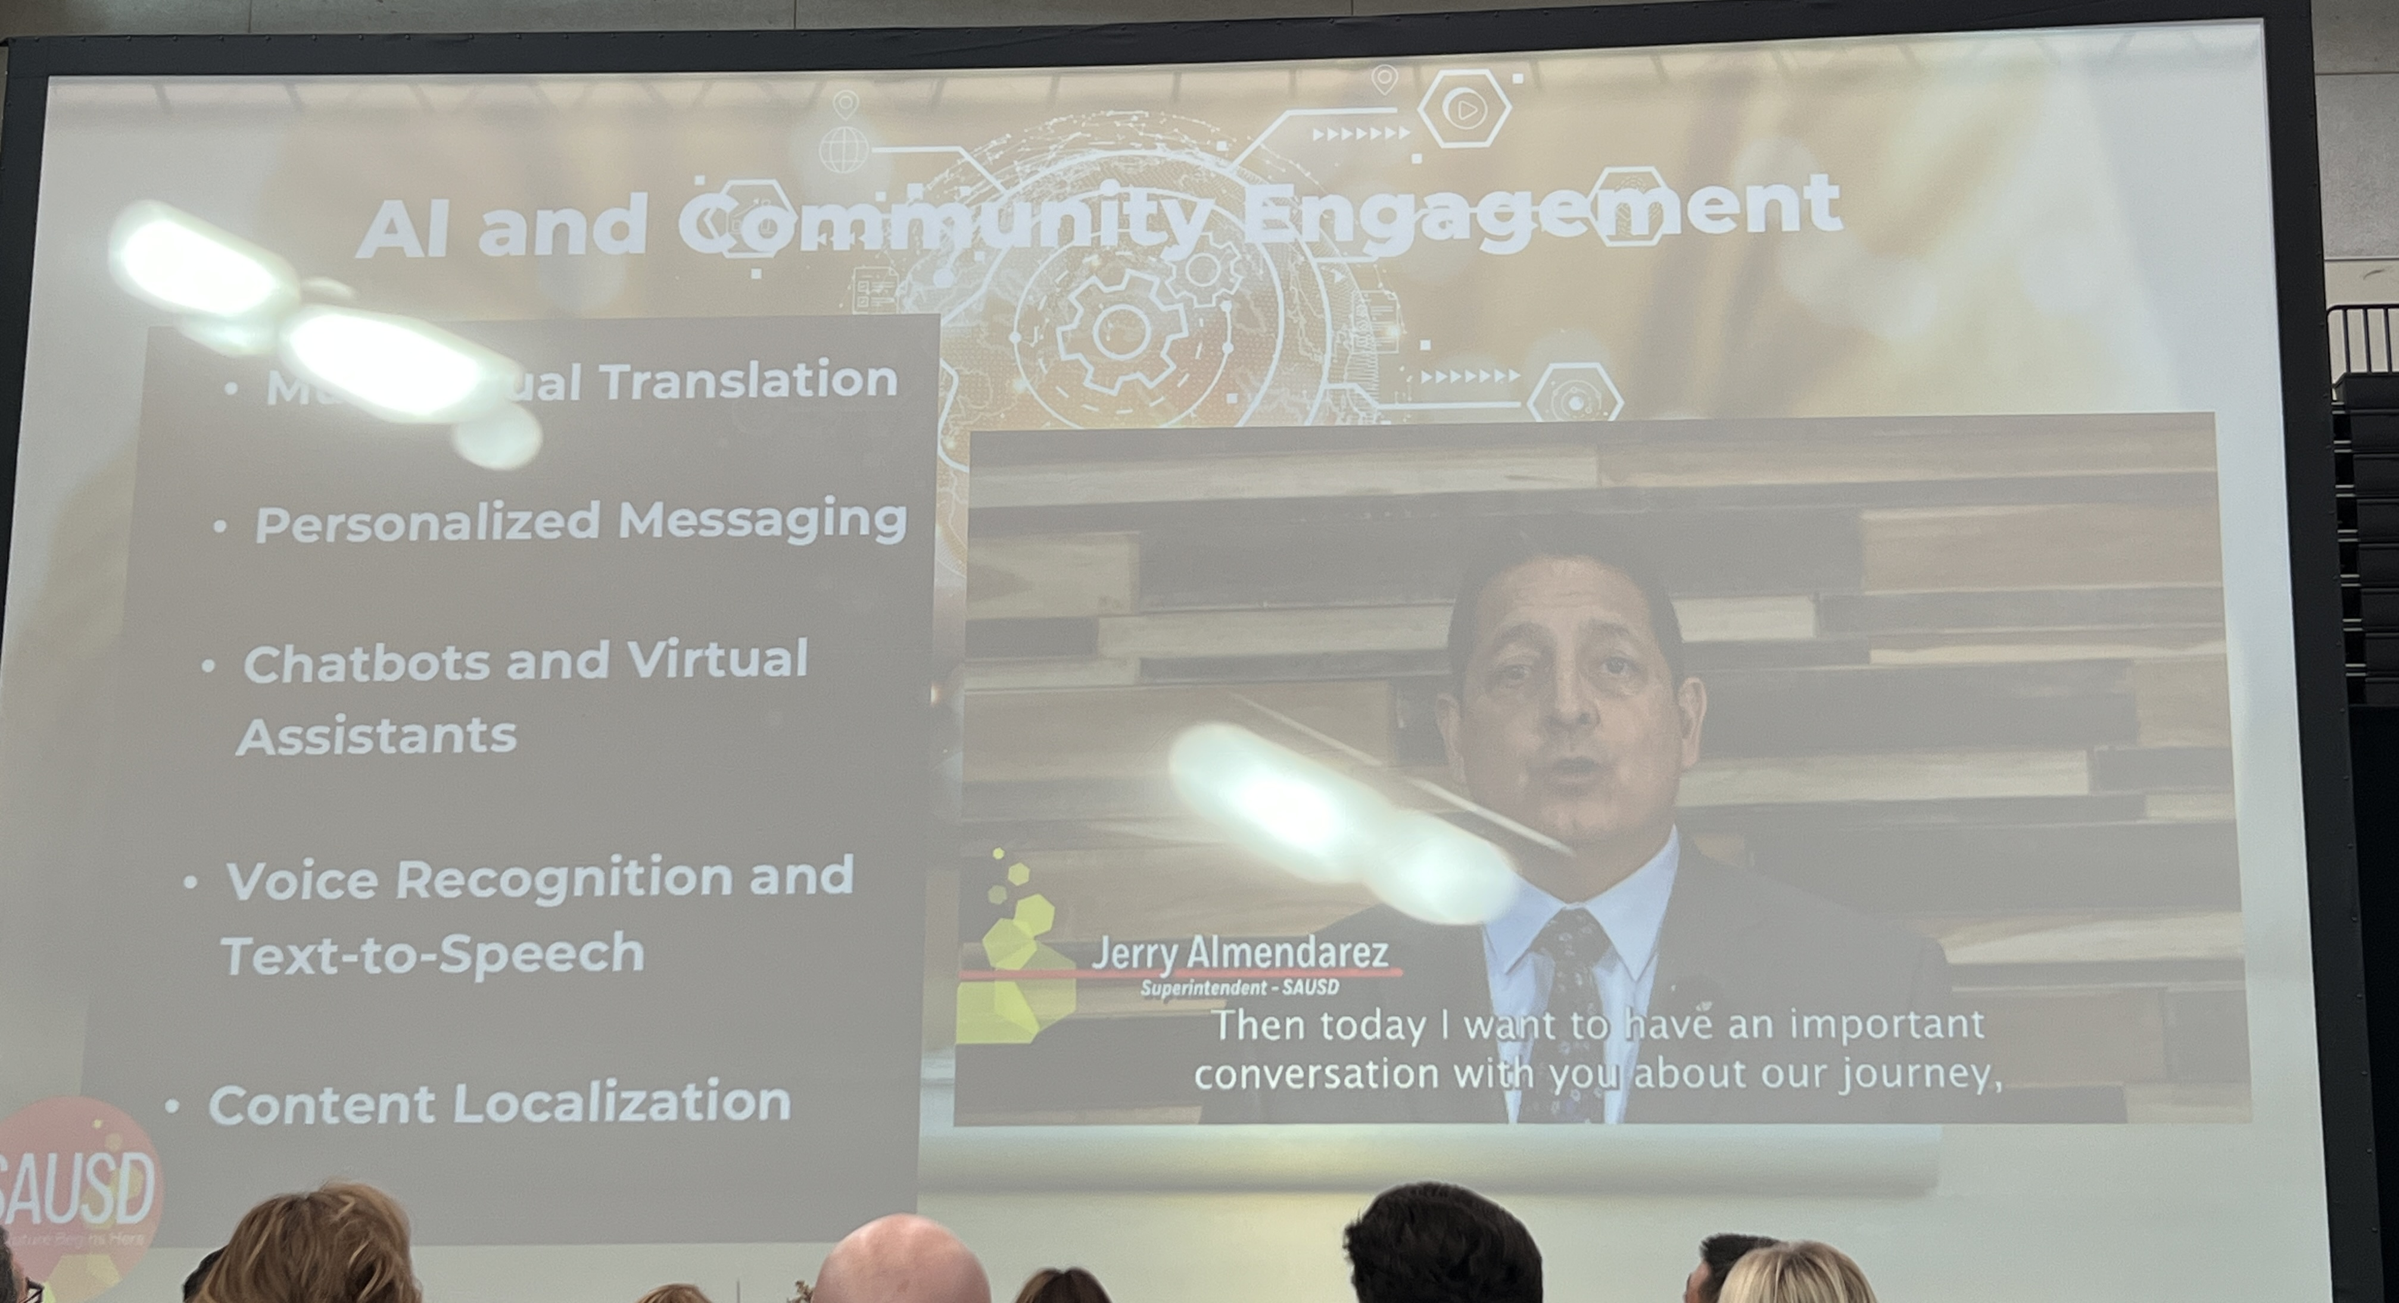
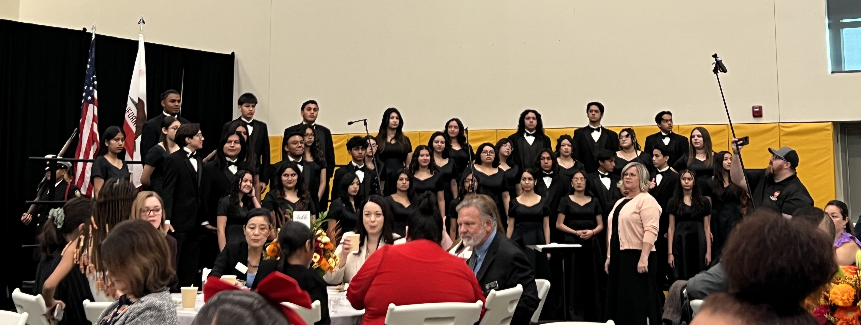

Slide 6



ACUE Self-Study AI Series

Slide 7

FALL 2024 PLENARY
November 7-9, 2024
Adopted Resolutions will be posted in the ASCCC website link (not there yet)

