Slide 1
Affinity Centers/Programs
Simren Arya, Asian Pacific Student Program
Paula Kincaid, Ujima/Umoja (U2) Scholars
Kelvin Leeds, SAC PRIDE!
Rodrigo Ramirez, Undocu-Scholars Program
Dr. Gregory Toya, Dean of Student Affairs

Slide 2
Affinity Centers and Programs
Student Affairs – Outreach to Graduation
  Asian Pacific Student Program
  SAC PRIDE!
  Undocu-Scholars Program
  Umoja/Ujima (U2) Scholar Program
Increase student involvement and sense of belonging
Close achievement gap for disproportionately impacted students
Leading with Equity: SAC Completes
Notes:
Submitted by Christina Wagner

Slide 3


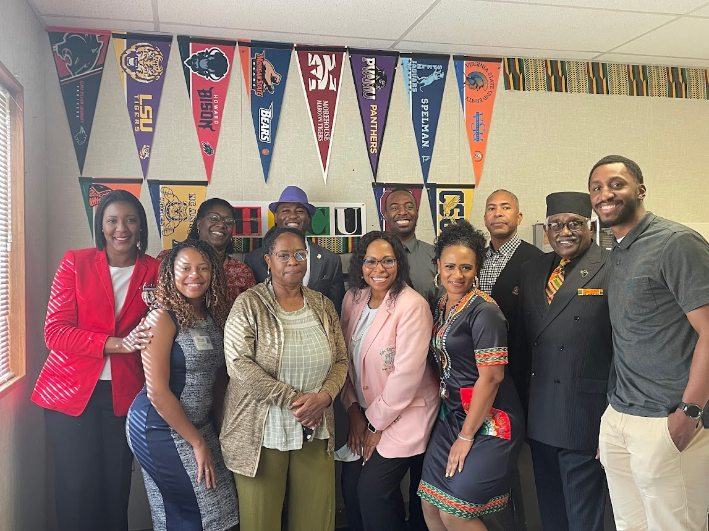
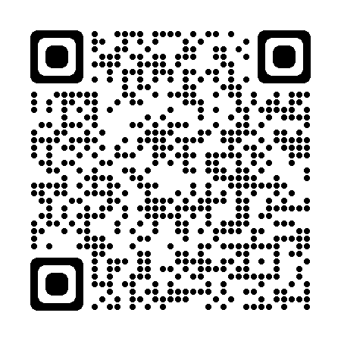
Through a group of educators and community allies, the Santa Ana College U2 Schol​ars Program provides essential educational resources and services, to foster the personal, professional, and academic success of Black/African American students.
Services Provided:
  Academic Counseling
  Personal & professional workshops & seminars
  Cultural events & activities pertinent to the Black experience
  Mentorship & community support
  Financial assistance
2022-2023 U2SCHOLARS Committee Members
Scan to visit sac.edu/u2scholars

Slide 4

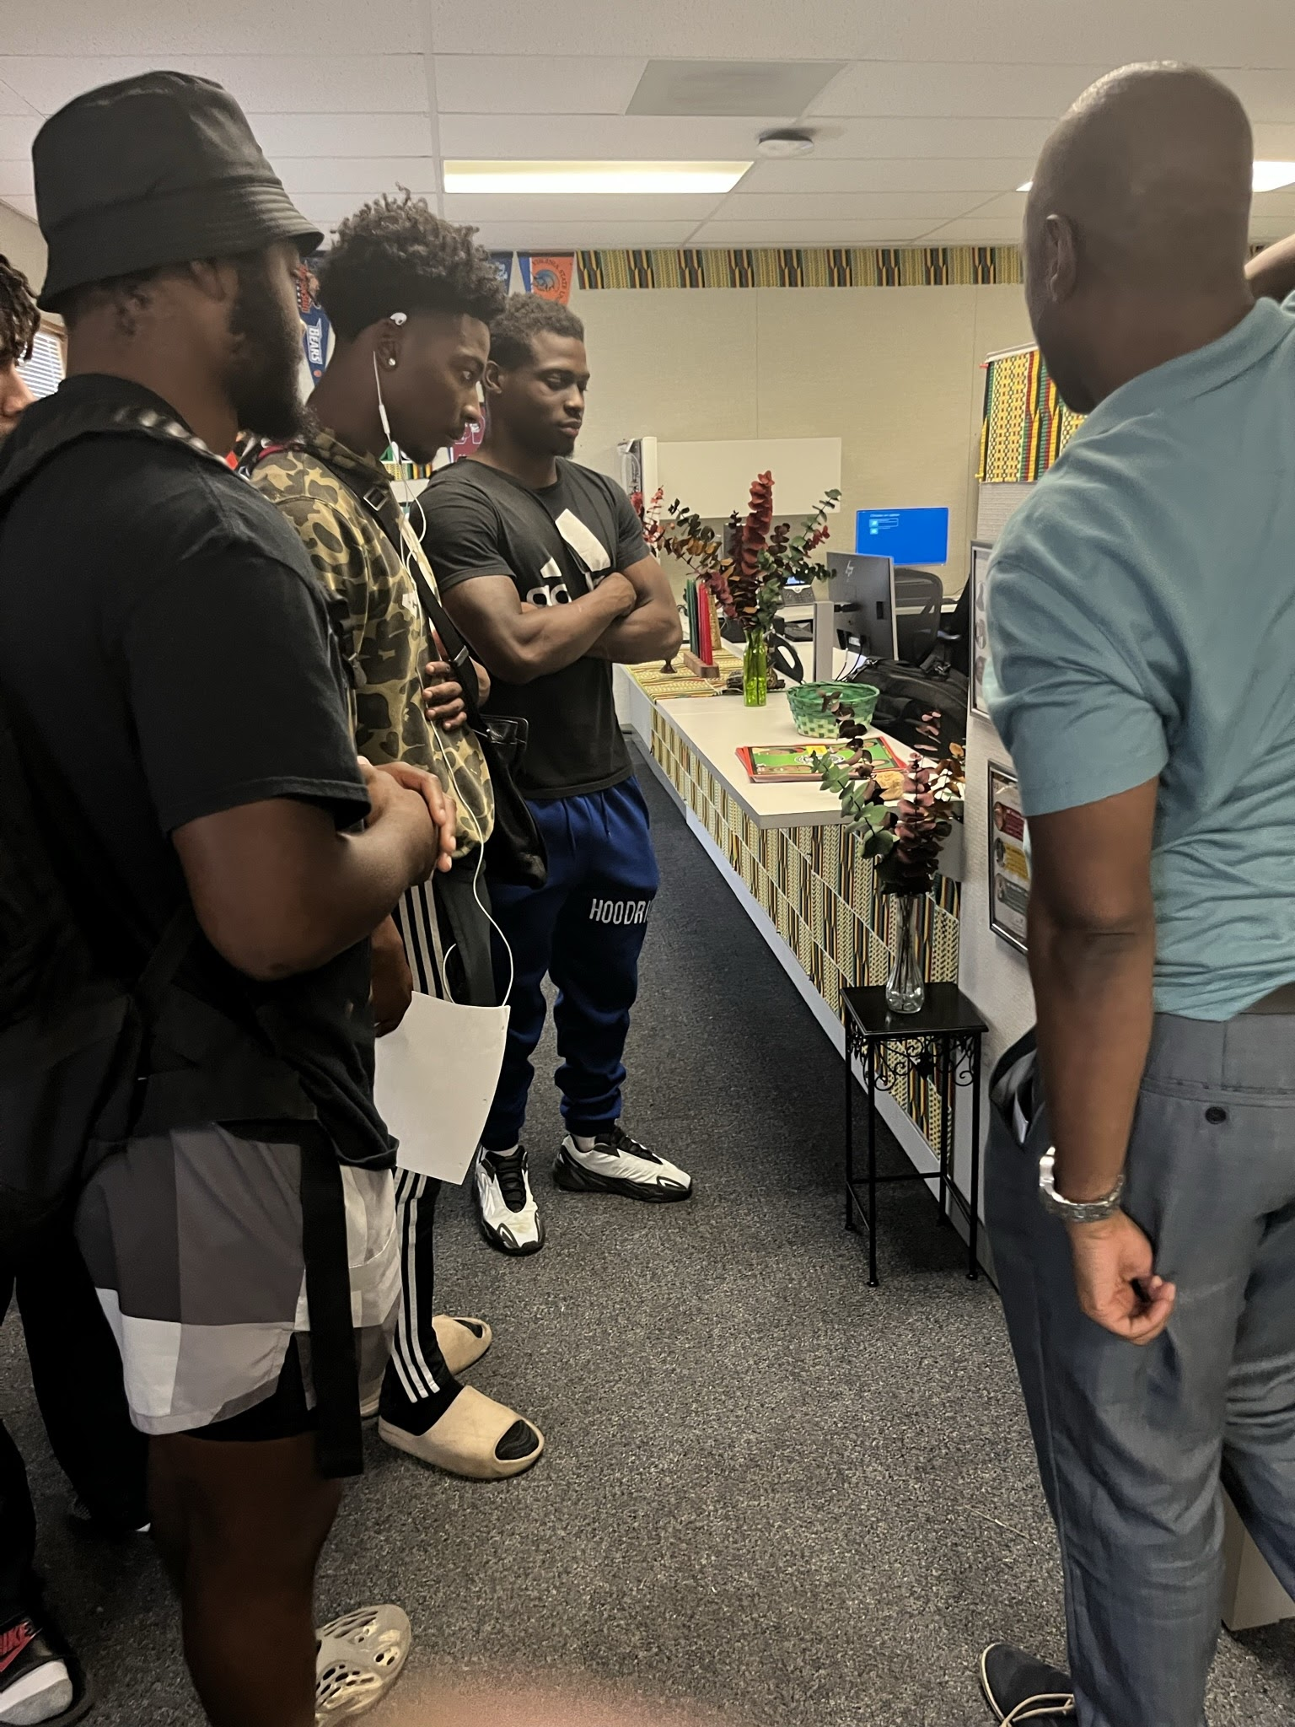
EQUITY GOALS
Increase number of students from SAC noncredit to SAC credit or enter the workforce.
Increase the percentage of students who complete an English or Mathematics transfer-level course within the first year of college.
Increase percentage of students who make an informed decision to declare a major by the third semester or by attaining 15 applicable units towards their AA/AS degree.
Decrease the average amount of time it takes students to complete degrees or certificates.
Increase the percentage of students who become transfer ready, attain transfer degrees or go on to transfer.

Slide 5
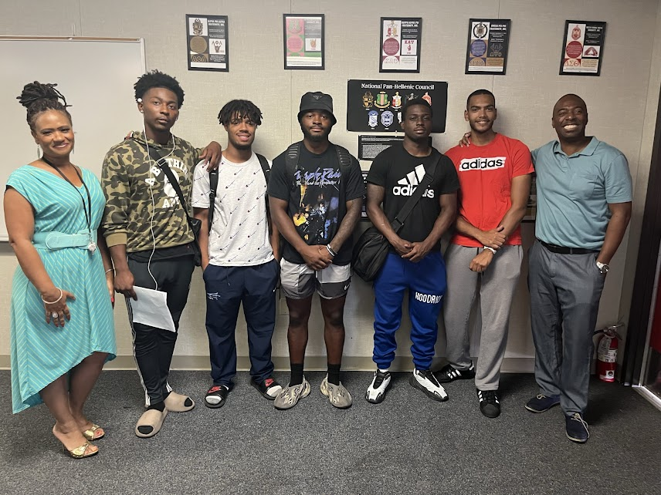
Events
U2 Scholars actively serves and promotes student success through a variety of culturally relevant practices and activities
Black History Month
Forgotten Images
Jazz and BBQ
Keynote speakers
Black Student Success Week
CCC system programs
Umoja
Porch Talks

Slide 6

Program
Promote involvement, community and sense of belonging through requirements
    Orientation, Counseling, Activities, Services
      Use U2 Scholars Center/Umoja Village – 3 x semester
Don Bookstore Voucher

Slide 7



Contact and Hours
Paula Kincaid, Interim Coordinator,
U2 Scholars​
​
Visit VL 108 or email us at u2scholars@sac.edu​
Monday-Thursday, 8:00 a.m. - 5:00 p.m. ​
​
To join the U2SCHOLARS/BHM Committee email u2scholars@sac.edu ​

Slide 8
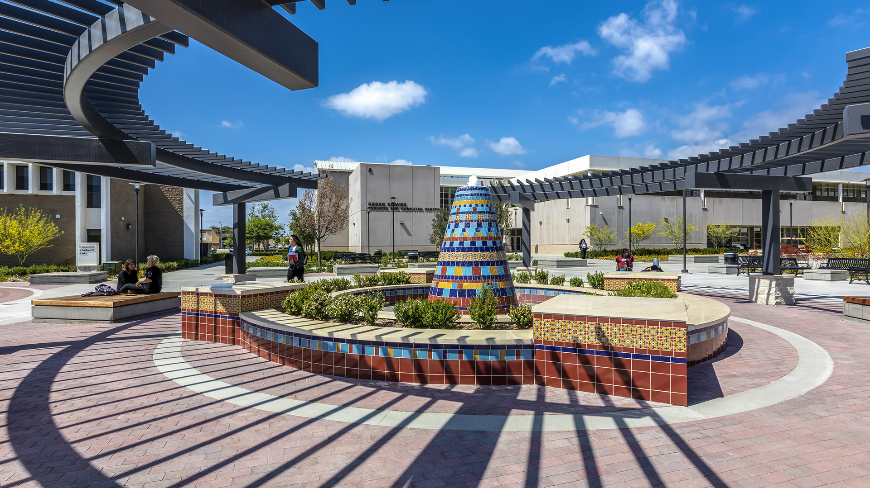


Slide 9
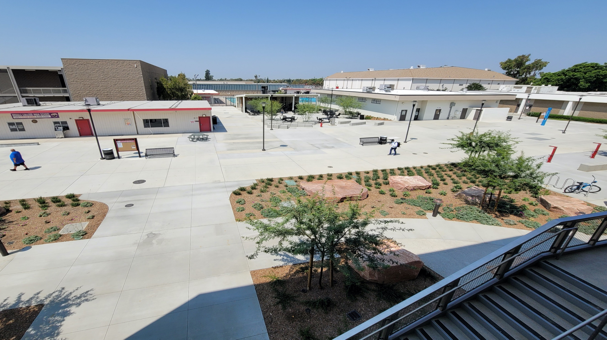

Undocu-Scholars
Undocu-Scholars Center
Undocu-Scholars Program

Slide 10
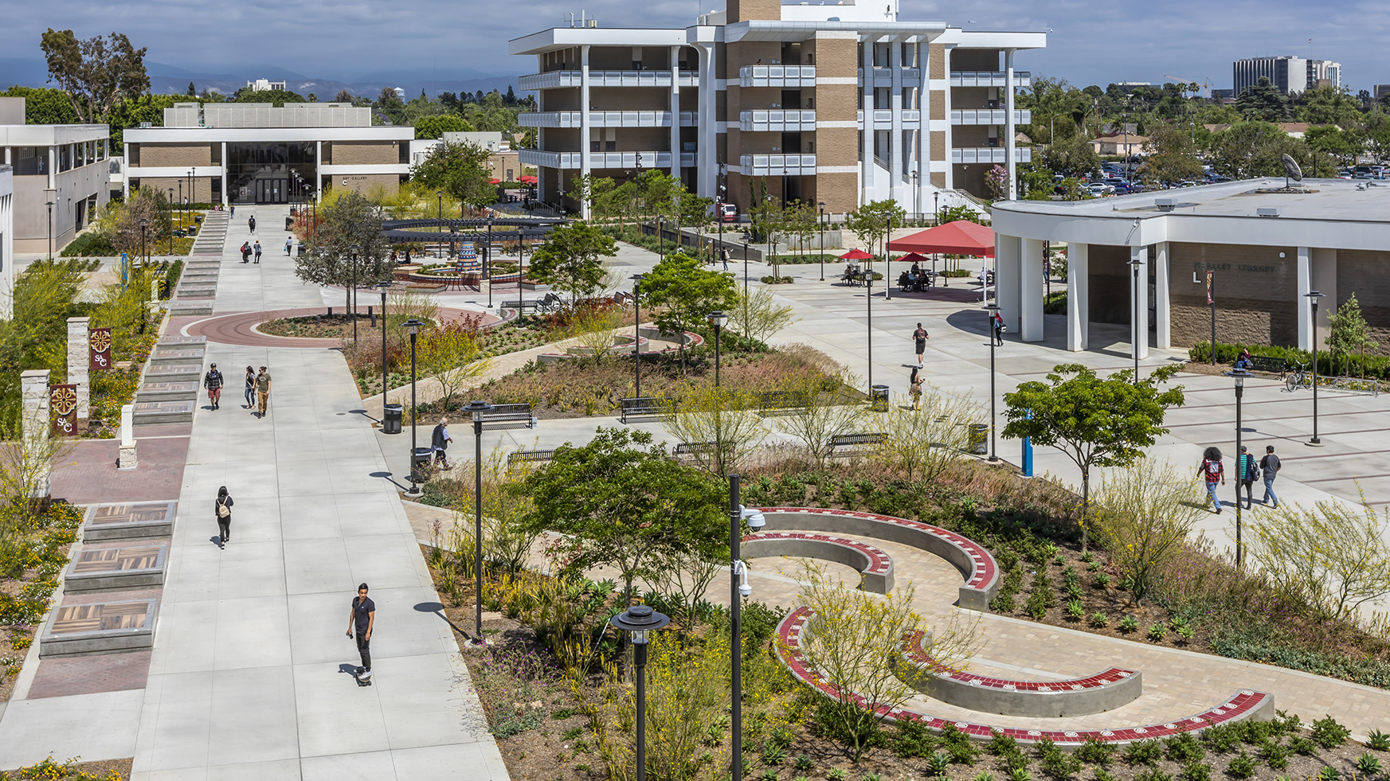
Undocu-Scholars Center
Is a space for Undocumented Students, Mix-Status Students and students undergoing a status change seeking academic, social & emotional support for those impacted by the U.S. Immigration System. Allies are welcomed!
Services & Resources
    Access to Computers
    Study Area
    Light Snacks
    Free Legal Immigration consultations
      Financial legal support:
        DACA, Advance Parole, Naturalization
Notes:
Dedicate A Slide for Parents Instead – Time Self / Pagina en espanol
La Mission del Program
Para mas informacion refer to Flyer

Slide 11
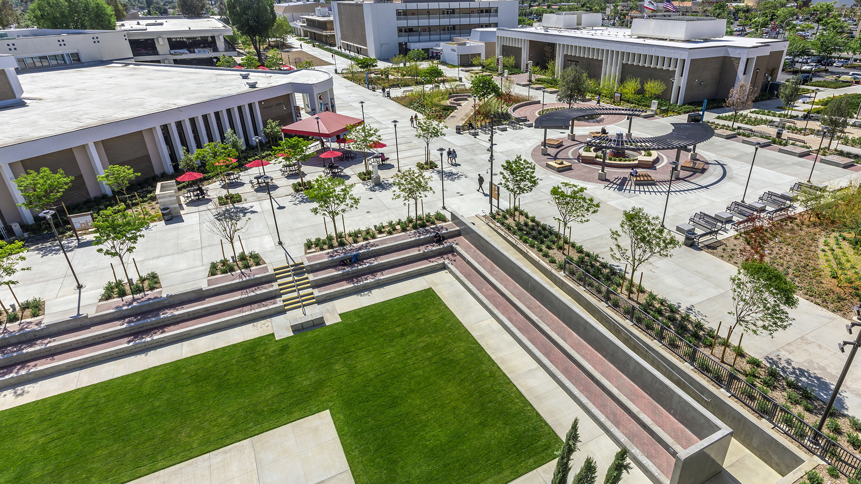
Undocu-Scholars Program
Support students impacted by the US Immigration System to graduate or transfer to a four-year university.
  Assigned to an Undocu-Scholars Counselor​
  Access to Immigration Legal Advisor
  First access to Undocu-workshops
    Financial aid and scholarship application assistance
    Immigration Workshops
  Access to Free Printing
  RSVP Study Area
Undocu-Graduation Ceremony
  Free Graduation Sashes and Cap & Gown

Slide 12
Events
  Undocumented Student Action Week
    October 14-18, 2024
    State Chancellor’s Office​
    Jose Antonio Vargas – October 18
      Filipinx Month (APSP)
  Undocu-workshops
    Financial aid and scholarship application assistance
    Immigration Workshops
Undocu-Graduation Ceremony

Slide 13


Rodrigo Marcos Ramirez
Rodrigo Marcos Ramirez
Undocu-Scholars Center Coordinator
Email: Ramirez_Rodrigo@sac.edu
Phone: (714) 564-6289
Center Hours - Fall 2024:
Monday & Thursday | Tuesday & Wednesday
9:00am – 7:00pm 9:00am – 5:00pm
Friday: 9:00 am – 11:45 am
Santa Ana College | The Village
Room: VL-109

Slide 14
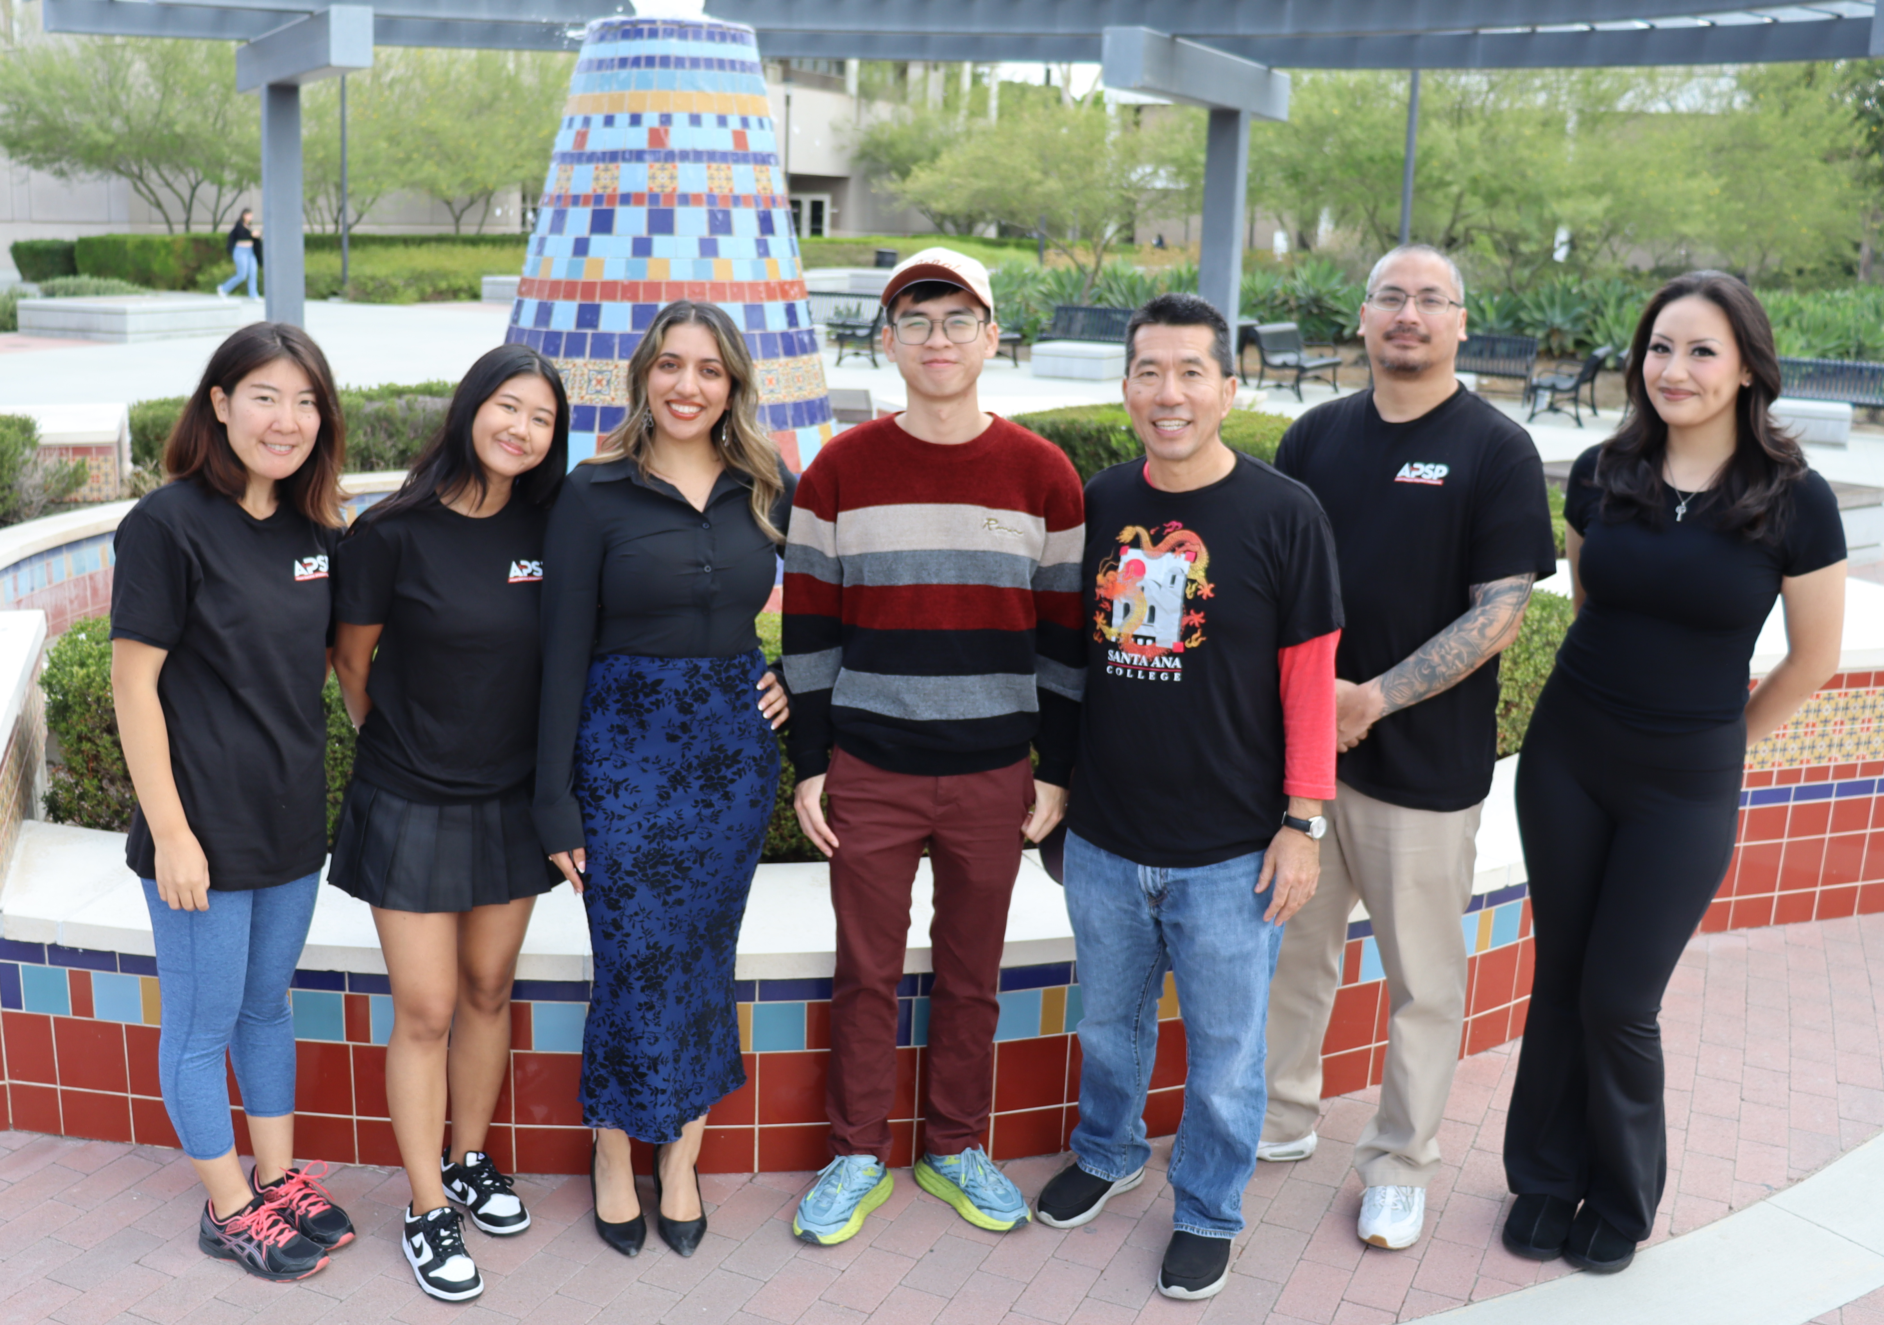

Santa Ana College
Asian Pacific Student Program

Slide 15

APSP Mission Statement
We are dedicated to empowering Asian, Pacific Islander, and Desi American (APIDA) students for success, while cultivating connections to their cultural roots & communities. Through cultural & educational experiences, we strive to equip students with the tools & resources to thrive academically, personally, & as community advocates.

Slide 16
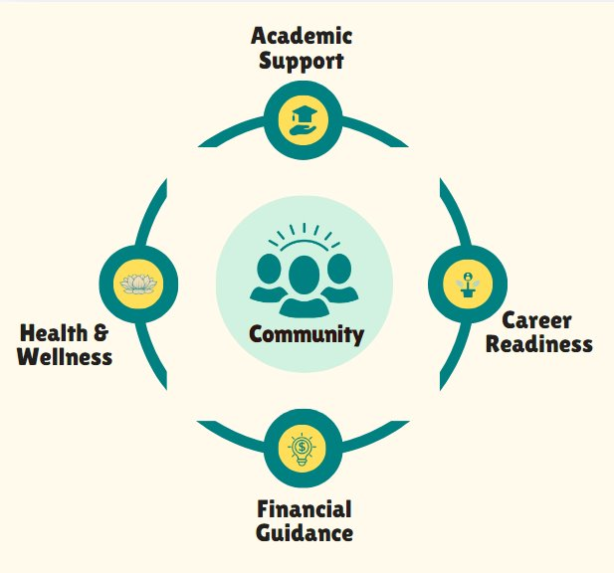
APSP Framework
Together, the APSP Center and Program establish a culturally responsive framework that supports APIDA students in thriving throughout their college journey at Santa Ana College and beyond.

Slide 17




APSP Events and Services
APSP Counselor- Educational Counseling available for personalized academic guidance. Wednesdays, 12pm-5pm. Vietnamese language support offered.
Leadership Opportunities- APSP Club, conferences, field trips, & tours to enhance their leadership and professional growth.
Bookstore Voucher- $350 per Semester
Community Support- Peer Mentor Program
APSP Center and Events

Slide 18
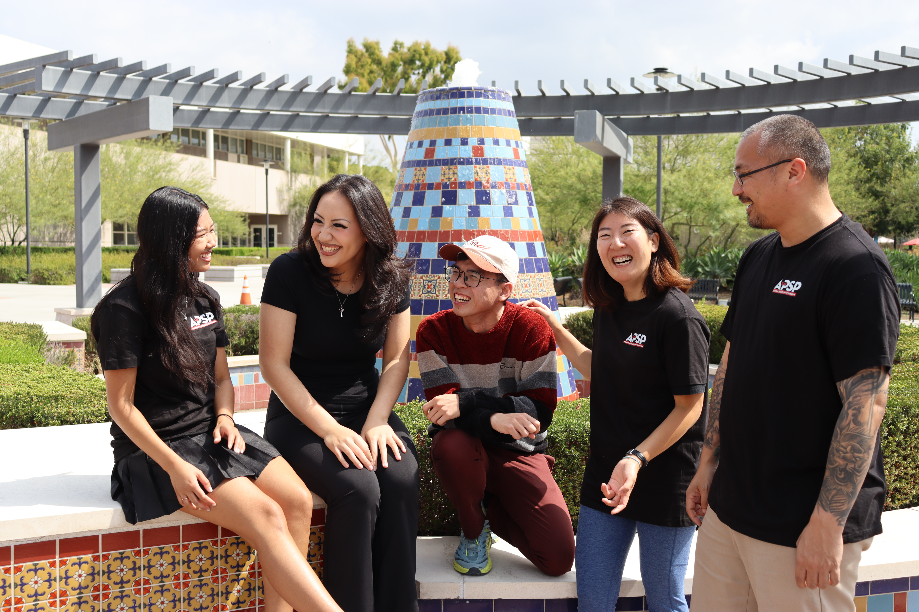
APSP Peer Mentoring Program
Guide and Support: Provide academic and personal guidance to assigned mentees, addressing their unique needs and concerns.
Facilitate Connections: Help mentees connect with campus resources, organizations, and other students to build a strong support network.
Promote Engagement: Encourage mentees to participate in program events and activities to foster a sense of community.
Model Success: Serve as a positive role model, demonstrating effective study habits, time management, and leadership skills.

Slide 19
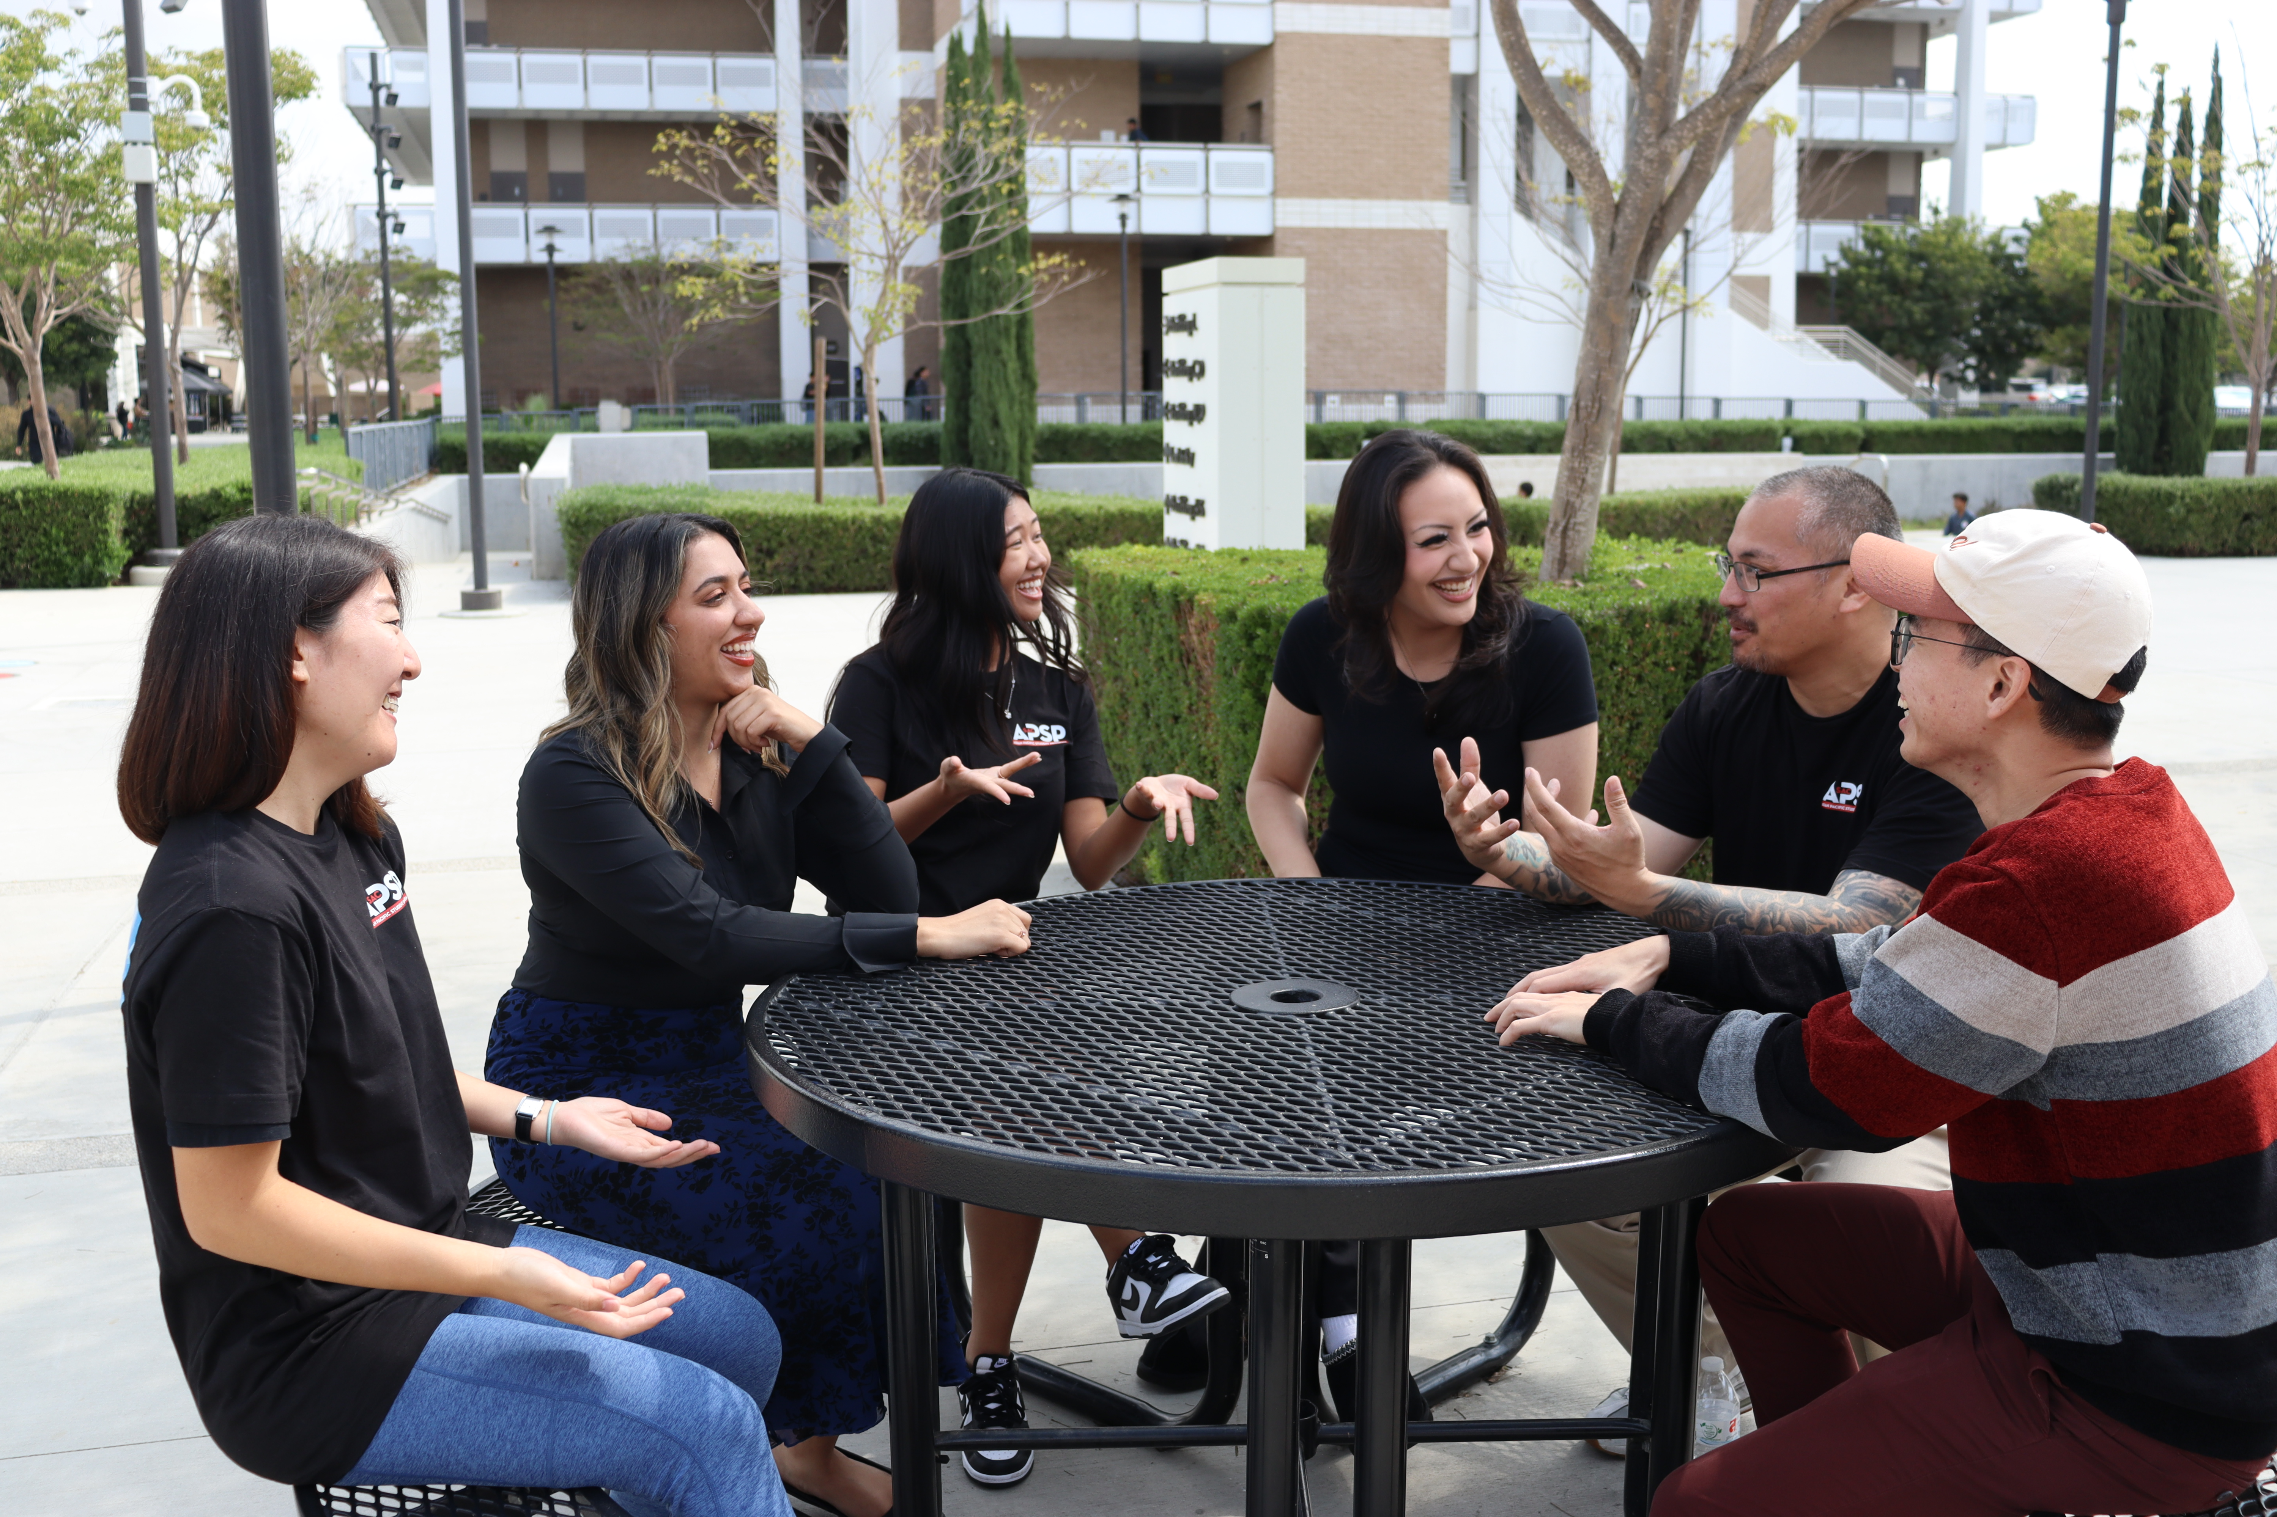
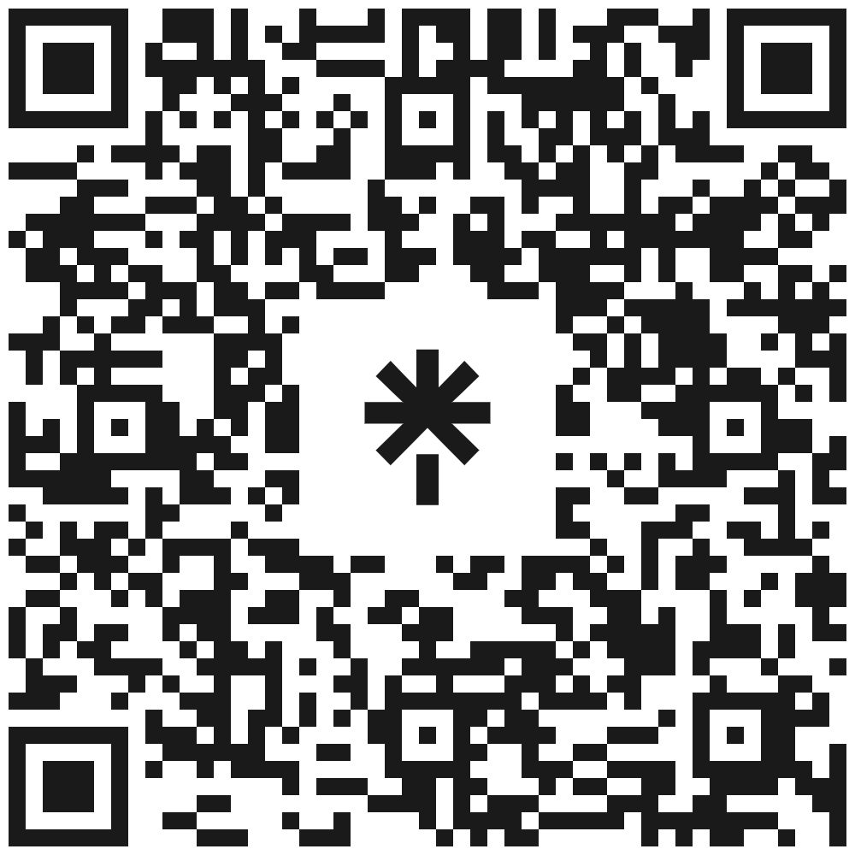
APSP Center Information
Center Hours
Monday – Thursday 9AM – 5PM, Friday 9AM –11:45AM
VL-107 (The Village)
Contact Us
Phone: (714) 564 6369
Email: apsp@sac.edu

Slide 20

SACPRIDE!
The Santa Ana College Pride! Advisory Board advocates for an inclusive and affirming campus environment that supports and empowers the LGBTQ+ community.
SAC PRIDE! Webpage
  Counseling, GSA, Resources
Outober
  Raise the Flag
  Wall of Encouragement
  National Coming Out Day
Lavender Celebration

Slide 21
SACPRIDE!
Coming soon….
  PRIDE Center
  Staffing
Co-Chairs
  Professor Lance Lockwood, LGBTQ+ Liaison
  Dr. Greg Toya, Dean of Student Affairs

Slide 22
Faculty Involvement
Counseling
Advisory Boards
Event Planning Committees
  Black History Month
  Lavender Celebration
Presence in Centers: Office Hours, Tutoring
Referrals: Starfish – Coming soon
Class Announcements and Presentations
  Class Tours
  Events

Slide 23
Affinity Centers/Programs
Alex Pan, Asian Pacific Student Program
Paula Kincaid, Ujima/Umoja (U2) Scholars
Kelvin Leeds, SAC PRIDE!
Rodrigo Ramirez, Undocu-Scholars Program
Dr. Gregory Toya, Dean of Student Affairs

