Slide 2

President’s Report
Board of Trustee's Meeting – Sept 23
Project Labor Agreement Signing with LA/OC Building Trades Council: 10-year agreement
Chancellor’s Report
Founding Partners for Digital Center for Innovation, Transformation and Equity– led by Foothill-DeAnza College, RSCCD – 1 of 5 Founding Partners
From CCCCO (CA Community Colleges Chancellor’s Office)
How is the Digital Center currently structured and funded?
“ Future resourcing will include founding partner districts that will contribute expertise and resources, as well as a mix of additional funding sources including direct funding from state agencies and strategic partner districts, grants, private sector and philanthropic contributions.”
Next Board Meeting – October 14 at SCC
Requested Discussion Item – ASCIP Rebate
Notes:
The Digital Center for Innovation, Transformation and Equity ("Digital Center") represents a strategic approach to supporting Vision 2030 for the California Community Colleges, including leading in innovation, harnessing the power of generative AI, public and private technology partnerships, and transforming our ability to serve students as they move into an AI-powered workforce.

Slide 3

President’s Report
Non-credit and Faculty Obligation Number (FON)
State Chancellor recommending legislation to include non-credit in the FON – when?
Resolution for Plenary encouraging/recommending review of FON to include Non-credit??
Area meeting resolutions due October 18 by 11:59 p.m.
AB2277 – Increasing PT load as up to a range of 80 percent to 85 percent of what is assigned for full-time faculty, rather than 60 percent to 67 percent
Newsom vetoed on September 22 – fiscal impact

Slide 4
President’s Report
SAC Updates
Faculty Coordinator Positions – Discussions with SCC and FARSCCD to create a process for vetting of these positions
Current Vacancies and Potential New Opportunities
Faculty Professional Development (Credit)
Outcomes Assessment
Credit for Prior Learning
Dual Enrollment
Committee Reviews – District and College governance committees reviewing structure/membership to address inequities
Disciplines List Revision Process: 2024-2025 Cycle
Deadline for submission of proposals is September 30, 2024.

Slide 5
President’s Report
Elections for Executive Officer positions in Spring
If thinking, considering, wanting to run for a position – let’s get you to Fall Plenary: November 7 – 9
Email your interest to AcademicSenate@sac.edu
Phase II – CCN
Dept chairs will be contacted for representatives to work on the template

Slide 6
Timeline
Hiring Request Form (Replacement and Growth/Licensing) available September 27 (if not sooner)
Training on Monday, September 30 4:30pm (via Zoom will be recorded)
Full-Time Faculty Hiring Request Form Due: Wednesday, October 16 by 11:59 PM
FPC Review and Rank Requests: October 17 – October 28
Final Ranking Meeting: Friday, November 1 - 9 AM to 4 PM
Affirmation of Final Rankings by the SAC Academic Senate: November 12
or Special Meeting (November 5 via zoom)
Special Meetings
The President may call special meetings if in their judgment such special meetings are warranted. Special meetings shall be called by the President upon a written request submitted to the President by twenty-five (25%) of the faculty or by ten percent (10%) of the members of the Senate. (3.4 members of Senate)

Slide 7
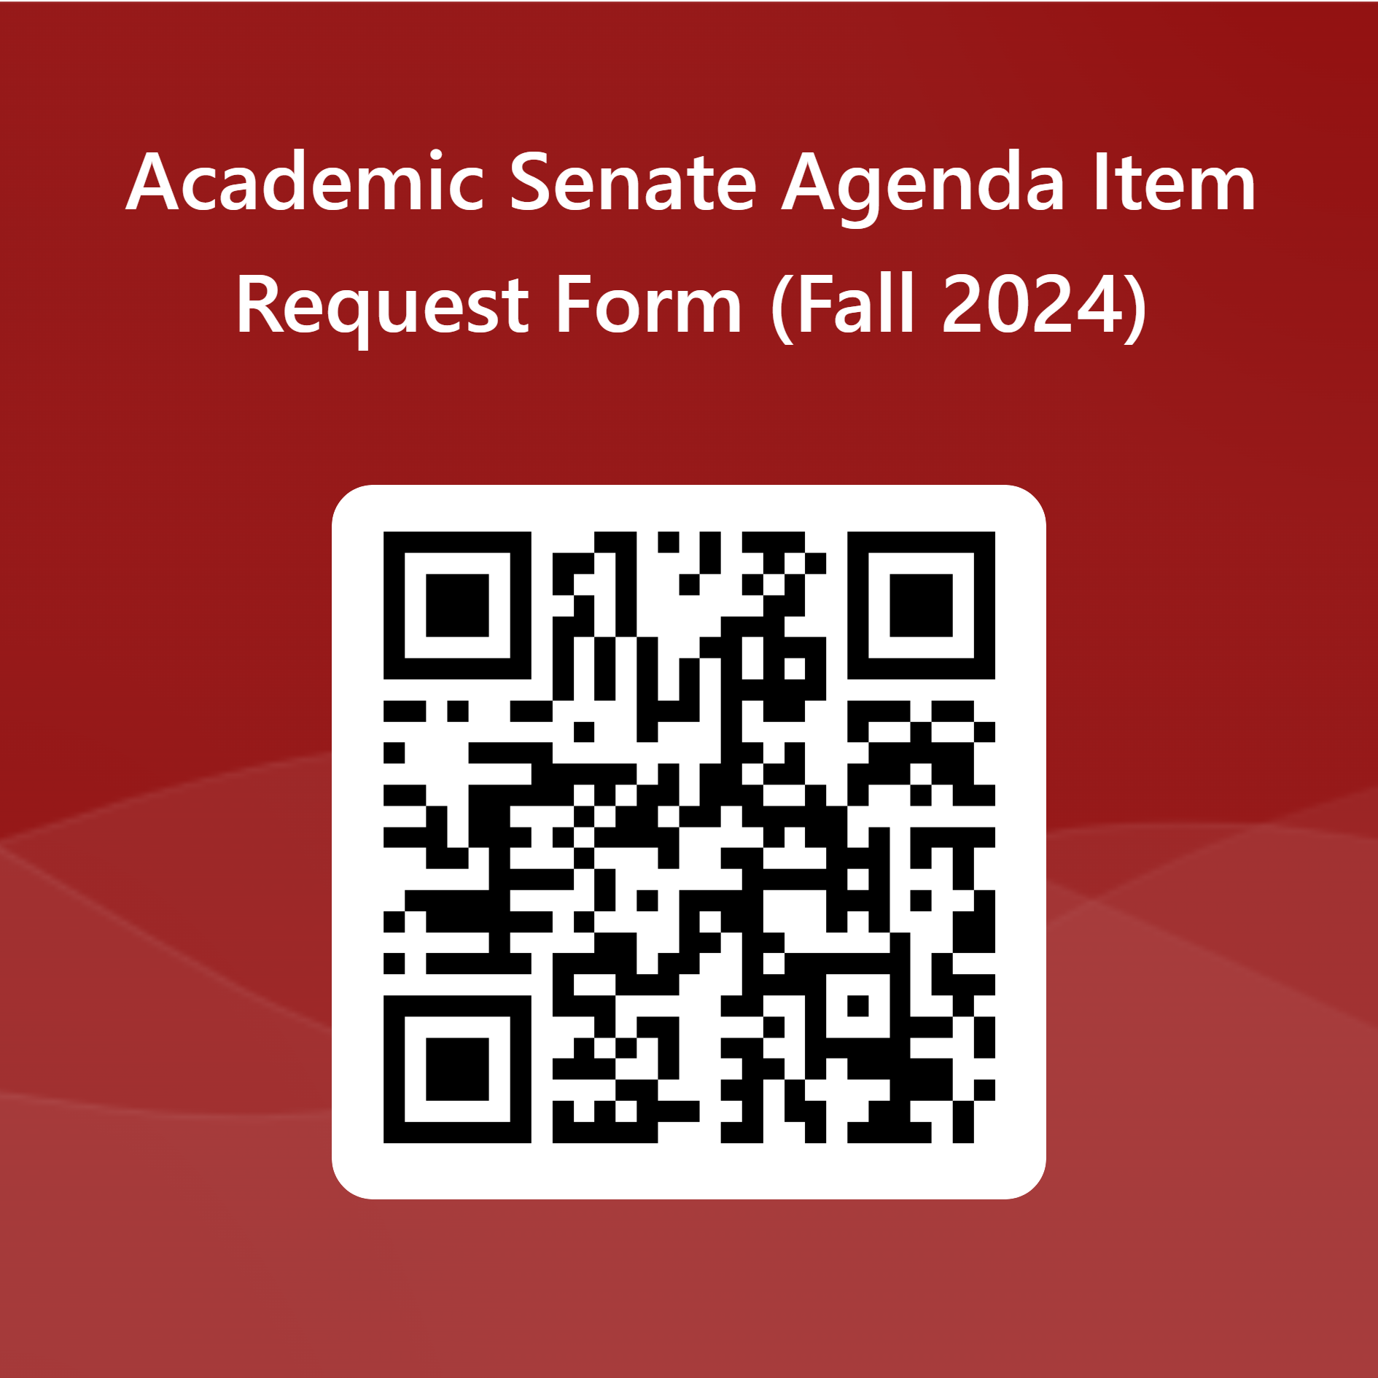

President’s Report
Agenda Item Requests
https://forms.office.com/r/Wtrc4GMcMy
Opportunities to Serve on Hiring Committees https://forms.office.com/r/9WzctRAULE

Slide 8
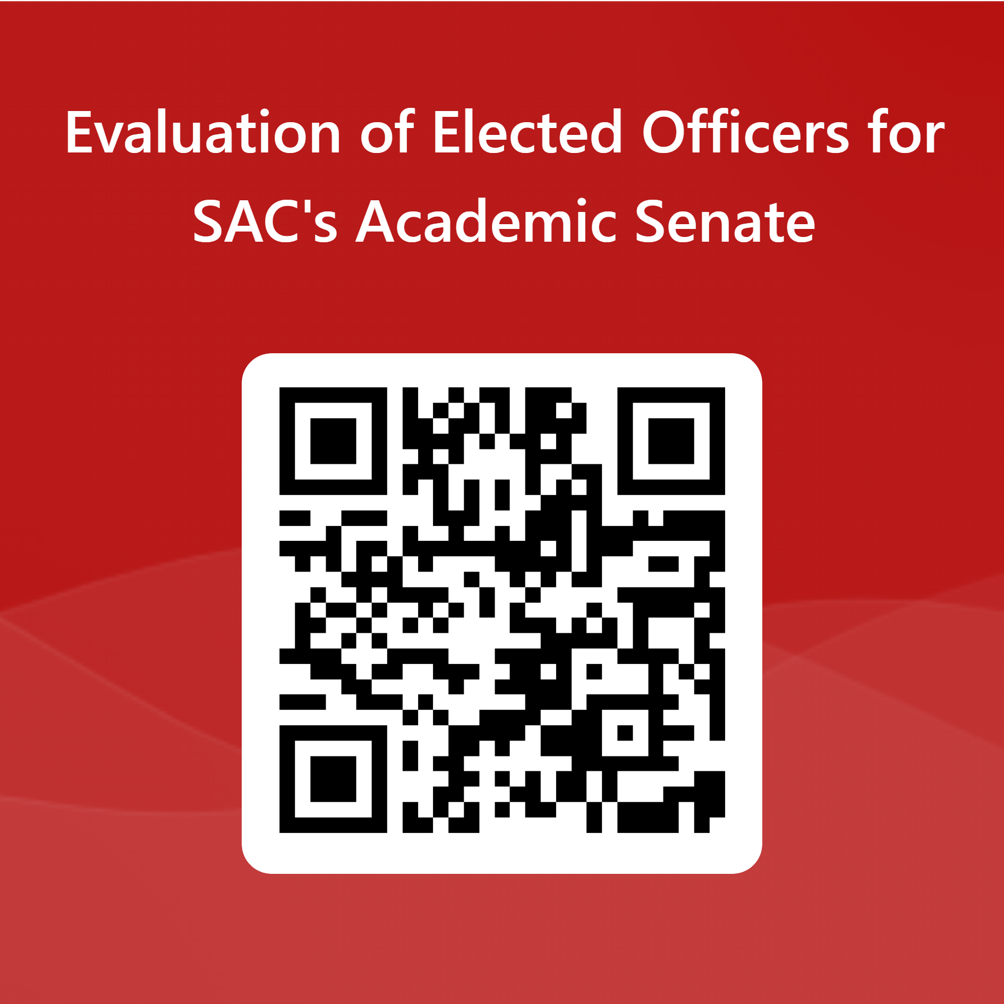
President’s Report
Evaluation of Elected Officers for SAC's Academic Senate
https://forms.office.com/r/5FBGpaHWCC

