Slide 1


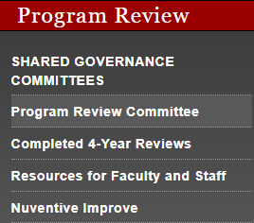
Don't Let Program Review Sneak up on YOU
Nuventive is mandatory for all reports
Annual Reviews are due into Nuventive this November for ALL.
Dept. Chairs and Student Services have been notified about CAPSTONE reviews. A capstone report will be run Nov. 30.
Outcomes->Program Review->RAR
Help can be found: Recorded PDs, Kim's Office Hour on Thursday at 4PM (zoom room is ocsmithlaw) for all questions, and John Steffens (on Nuventive).
https://sac.edu/research/Pages/default.aspx

