Slide 1

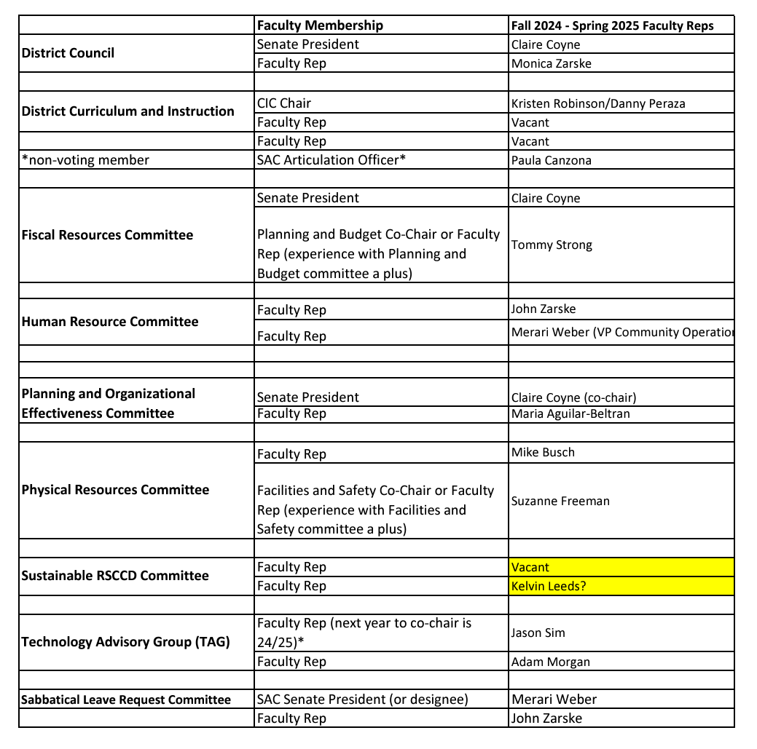
Committee
Appointments
Senate Affirmation
District
Participatory
Governance Committees

Slide 2
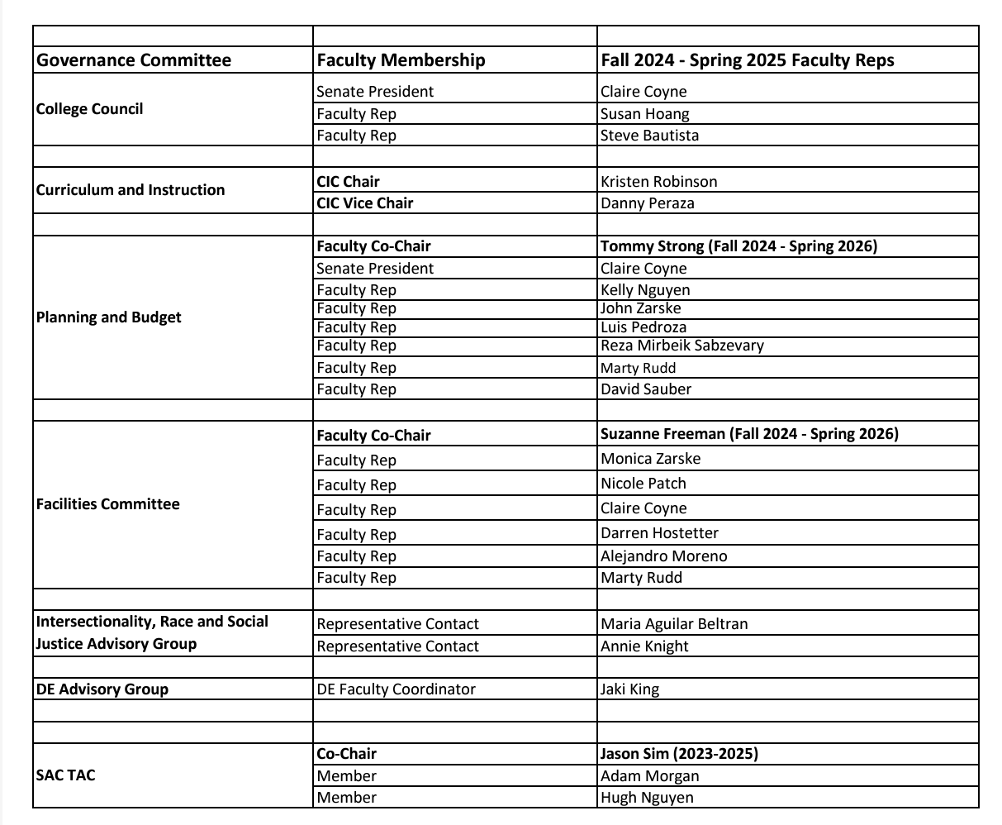
Committee
Appointments
Senate Affirmation
SAC
Participatory
Governance Committees

Slide 3
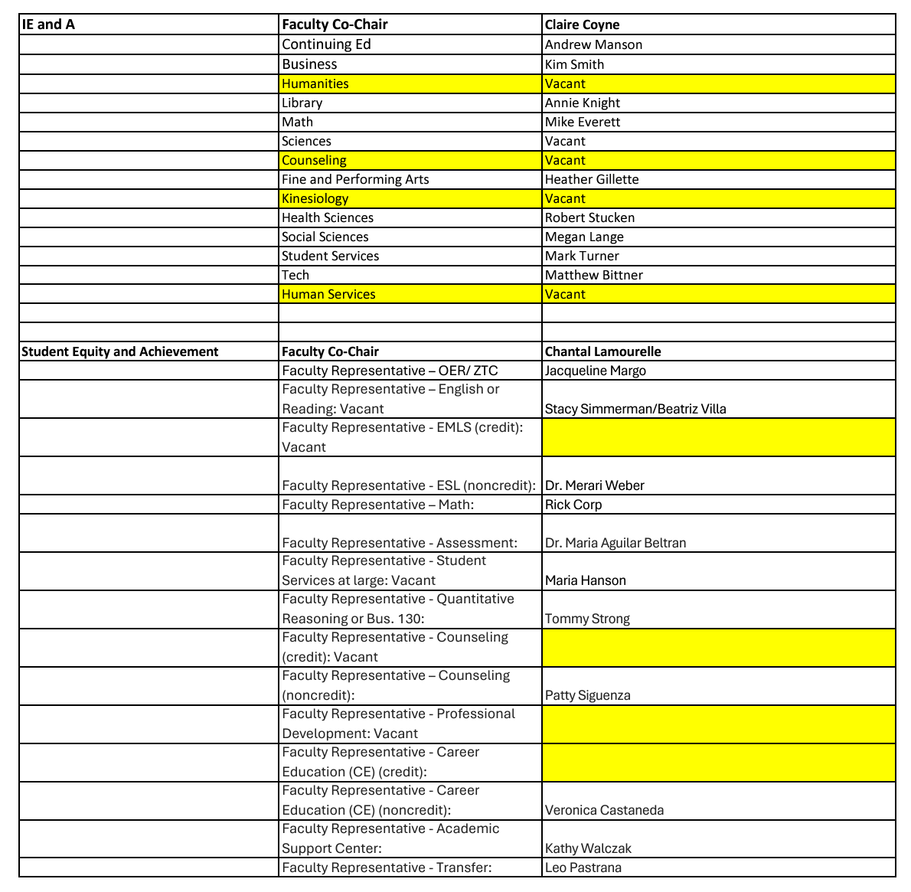
Committee
Appointments
Senate Affirmation
SAC
Participatory
Governance Committees

Slide 4

President’s Report
District Updates
Districtwide Bond and the Senate
Local academic senates are governed by California Education Code §7050-7068. These sections of the Education Code provide specific guidelines regarding the advocacy efforts in which local academic senates can and cannot engage.
  Any discussion of ballot measures or elections among senators should not take place on campus or during academic senate meetings.
  Academic senates may therefore publish information to educate the public regarding the impact of a given ballot measure as long as they do not advocate either for or against the measure. Ed Code section 7054 (b)
Public Hearing for Adopted Budget at September 9th BOT Meeting
The budget will be available for public display the last three workdays of the week prior to the September 9th Board of Trustees meeting at the District Office, 2323 N. Broadway, on the 4th floor reception area between the hours of 8:00 a.m. and 5:00 p.m.

Slide 5
President’s Report
SAC Updates
Repurposing of Campus Spaces and Relocation of Faculty
I-Building: Math - Classes, Faculty Offices and Math Center (possibly MESA)
The Village: el Don, Fashion Design and Merchandising
C-building: Once el Don has relocated, that space will be repurposed for SAC’s Mural Program
Health Sciences Building: Speech – Language Pathology (HS-124)
A-building: Digital Music from DMC
DMC Update – attempt to rent space on 2nd floor to VISTA Meridian
Any questions or unaddressed programs – let me know!

Slide 6
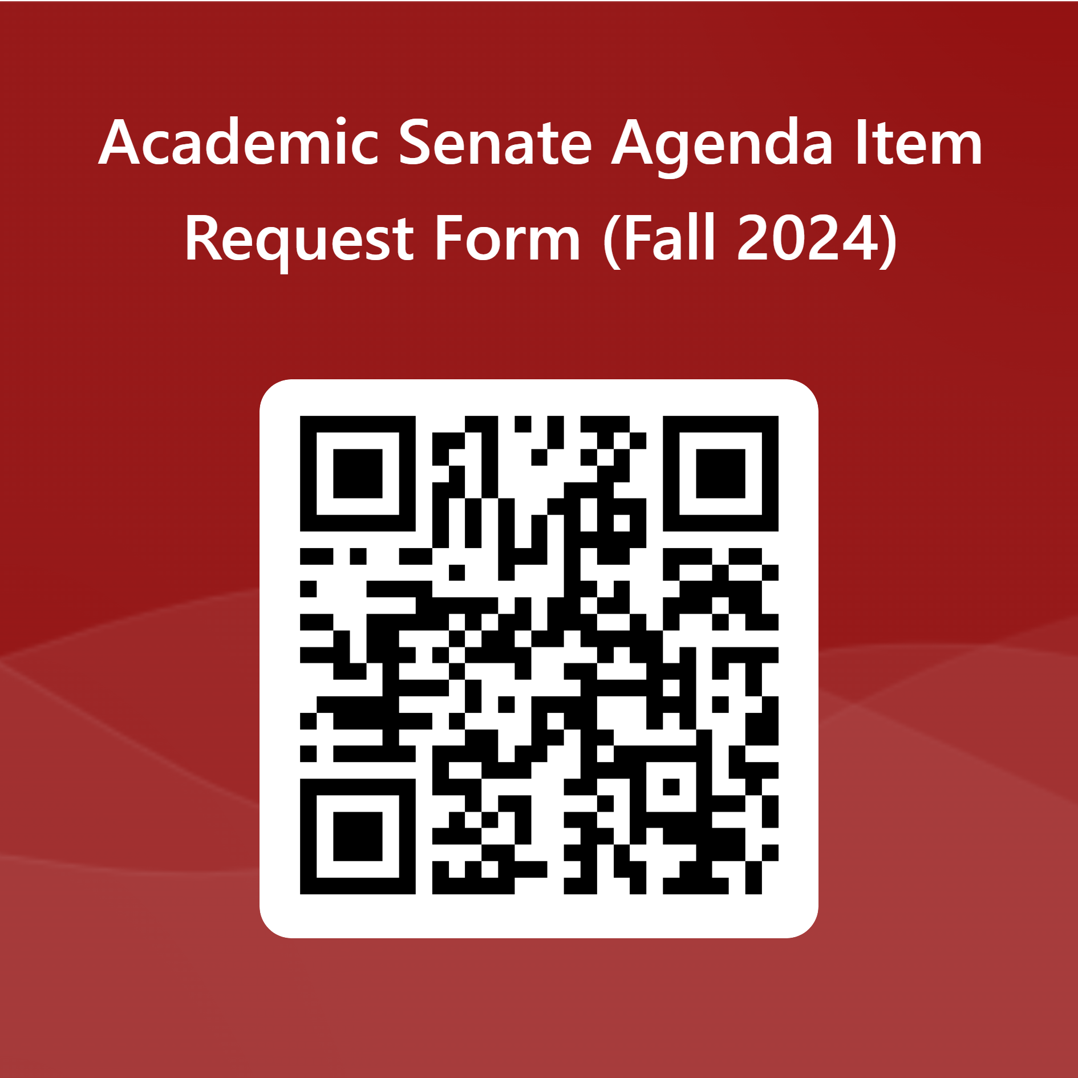

President’s Report
Agenda Item Requests
https://forms.office.com/r/Wtrc4GMcMy
Upcoming Hiring Committees
Director – Human Resources – Closes 9/12
Dean – Academic Affairs – Closes 9/12
Director – Distance Education
Opportunities to Serve: https://forms.office.com/r/9WzctRAULE

Slide 7

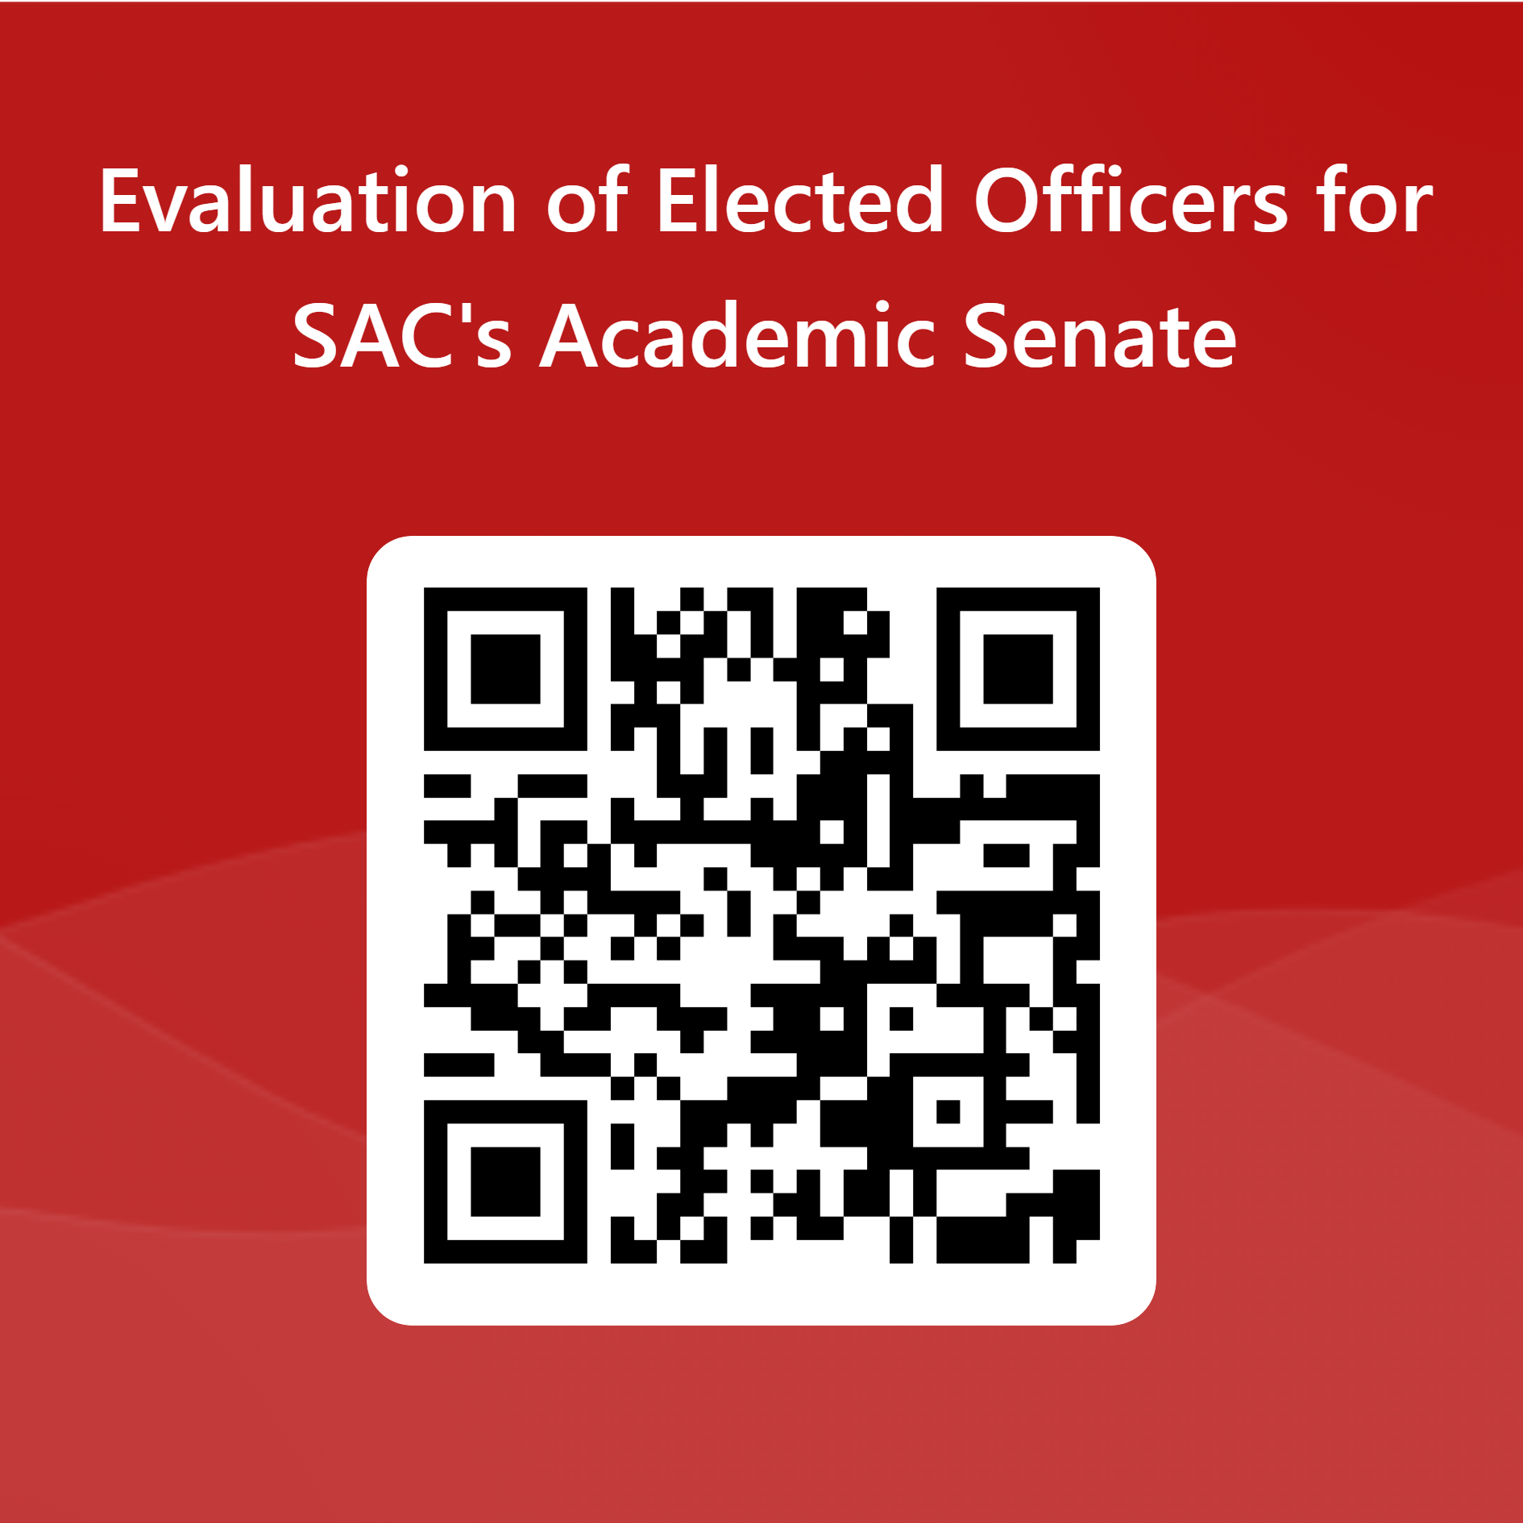
President’s Report
IdeazBoard – Questions, Concerns, Suggestions, Frustrations & Other https://ideaboardz.com/for/Senate%20Retreat%20Fall%202024/5355658
Evaluation of Elected Officers for SAC's Academic Senate
https://forms.office.com/r/5FBGpaHWCC

