Slide 1
Good morning!
Welcome to the
Fall 2024
Senate Retreat
August 14, 2024
IdeazBoard – Questions, Concerns, Suggestions, Frustrations and Anything Else!

Slide 2
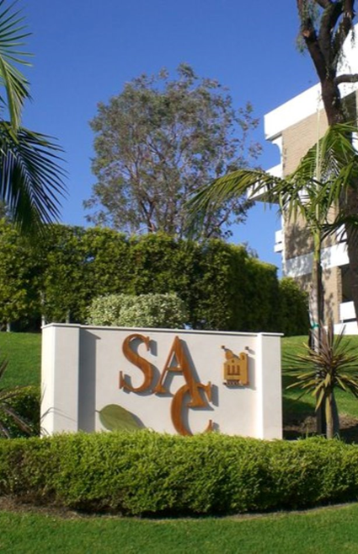
Welcome New Colleagues
Caitlyn Anselmo, Assistant Professor/Counselor, Athletics
Bassam Ayou, Assistant Professor, Chemistry
James Harman, Assistant Professor, Legal Studies
Joanna Kibler-McNerney, Assistant Professor, English as a Second Language (Noncredit)
Caroline Kim, Assistant Professor, English as a Second Language (Noncredit)
Nigel Leos, Assistant Professor/Counselor, CTE
Alya Makarem, Assistant Professor, Pharmacy Technology
Joi Millett, Assistant Professor, Legal Studies
Moises Perez Martinez, Assistant Professor/Counselor, CTE
Gizelle Ponzillo, Assistant Professor, English as a Second Language (Noncredit)
Juliana Saldivar, Assistant Professor, High School Equivalency (HiSET/GED)(Noncredit)
Chris Sanchez, Assistant Professor/Counselor, Transfer
Carolyn Slocum, Assistant Professor/Coordinator Pharmacy Technology
John Conley, Long-Term Substitute Instructor, Geography
13 Full-time Tenure Track (not including Asst Professor, Welding – Final Interviews Today!)
5 Long-Term Substitutes (Counseling, Geography, Ethnic Studies, Physics/Astronomy & CJ Academies)

Slide 3
Today's Agenda
Informational Items and Discussion
  Duties of a Senator
  Continuing Education 101
  Senate and Union Relationship
  Faculty Prioritization Updates
Senate Officer Updates
Senate Committee/Advisory Group Updates
  Curriculum and Instruction
  Distance Education Advisory Group
  Intersectionality, Race, and Social Justice Advisory Group
Breakouts 1 &2 (separate registration)
  Curriculum Updates for Programs
  Equivalency Workshop

Slide 4
Senator Duties
Of The SAC Academic Senate

Slide 5




The primary responsibilities of SENATORS are to:
Regularly attend Academic Senate meetings.
Inform division faculty of Senate business in a regular and timely manner.
Survey results show this is mostly occurring once a month. It is encouraged to do so after each Senate meeting, especially for pressing matters.
Seek out the will of their constituency and to vote and represent that view to the Senate, its officers, the division Deans, other academic Deans and to appropriate councils and committees.
Affirm faculty appointments to college participatory governance committees and other appointed faculty positions.
Hold special meetings/communications/surveys to determine your informed vote.

Slide 6
Obtain knowledge of and uphold 10+1 from Title 5 (RSCCD Board Policy 2410) and other pertinent Board Policy administrative regulations.
  A book and cheatsheet on Robert’s Rules have been provided to aid you in this capacity, as will PD training offered during the academic school year and meetings.
Inform new faculty within their constituent body (Senate Division or Adjunct Faculty) of the dues structure of the Senate.
Senator Duties
Continued…
Represent their division and/or departments during the annual faculty prioritization meeting when serving as Senior Senator.
  This duty may/will change as the Prioritization process has recommended changes to be presented later.
  Hold special meetings/communications with department chair(s) to prepare presentation(s) on their behalf.
Manage their division and/or department Senate elections when serving as Junior Senator.

Slide 7

Serve on either Division Curriculum Committee OR Division Chair's Committee
  In the case where an operational division is comprised of more than one Senate Division, each Senate Division shall have one of the Senators serve on Division Curriculum Committee and one Senator will serve on Division Chair's Committee.
  Senators within each Senate Division may exchange their membership duties between the Department Chair Committee and the Curriculum if the exchange is mutually agreed upon by both Senators.
Senator Duties
Continued…
Any questions???

Slide 8

Requesting IR&SJ Advisory Group to provide a recommended set of Engagement Guidelines to be adopted for all Senate Committees, Advisory Groups and Taskforces.
For today’s retreat, can we agree to the following when engaging in any discussions….
Listen respectfully; Listen to learn
Open and honest communication; Anticipate the impact of your comment
Seek to understand; Expect disagreement & listen harder
Just because you are, doesn’t mean you understand: Just because you’re not, doesn’t mean you don’t understand
Share air-time: Move in, move out
Be fully present
Be open to new perspectives
Explore and take responsibility for impact; acknowledge intent
Expect people to learn and grow; don’t freeze-frame others
Take risks; Lean into discomfort; Be brave; Engage
Respect and maintain confidentiality
Seek first to understand, then to be understood

Slide 9


Senate/Union Relations
Claire Coyne, President SAC Academic Senate
Madeline Grant, President FARSCCD

Slide 10
Session Description
Title 5 Regulations grant Academic Senates the right to be the primary faculty voice in college decision-making regarding academic and professional matters, while unions deal with faculty wages and working conditions.
We will examine the purview of academic senates compared to that of unions, the areas where the work of senates and unions may overlap, and ways to maintain effective senate-union relations.

Slide 11
Authority of Union
Salary and Working Conditions
California Government Code section 3543 (a)
(a) Public school employees shall have the right to form, join, and participate in the activities of employee organizations of their own choosing for the purpose of representation on all matters of employer-employee relations. Public school employees shall have the right to represent themselves individually in their employment relations with the public school employer, except that once the employees in an appropriate unit have selected an exclusive representative and it has been recognized pursuant to Section 3544.1 or certified pursuant to Section 3544.7 , an employee in that unit shall not meet and negotiate with the public school employer.
Notes:
Wendy

Slide 12
Collective Bargaining
School calendar;
Compensation;
Wages;
Hours of employment;
Terms and conditions of employment including health and welfare benefits;
Leave;
Transfer and reassignment policies;
Safety conditions;
Notes:
Wendy

Slide 13
Collective Bargaining
Class size;
Procedures for evaluation of employees;
Organization security;
Procedures for processing grievances;
Layoff procedures;
Alternative compensation or benefits for employees adversely affected by pension limitations;
Additional compensation or salary schedule based on criteria other than years of training and experience.
Notes:
Wendy

Slide 14
Authority of Senate
Ed Code 70901(b)(1)(E)
Minimum standards governing procedures established by governing boards of community college districts to ensure faculty, staff, and students the right to participate effectively in district and college governance, and the opportunity to express their opinions at the campus level and to ensure that these opinions are given every reasonable consideration, and the right of academic senates to assume primary responsibility for making recommendations in the areas of curriculum and academic standards.
Ed Code 70902(b)(7)
Establish procedures that are consistent with minimum standards established by the board of governors to ensure faculty, staff, and students the opportunity to express their opinions at the campus level, to ensure that these opinions are given every reasonable consideration, to ensure the right to participate effectively in district and college governance, and to ensure the right of academic senates to assume primary responsibility for making recommendations in the areas of curriculum and academic standards.
Notes:
Cheryl

Slide 15
Academic and Professional Matters
Title 5 §53200 (c)
“Academic and professional matters” means the following policy development and implementation matters
Curriculum, including establishing prerequisites
Degree & Certificate Requirements
Grading Policies
Educational Program Development
Standards & Policies regarding Student Preparation and Success
Notes:
Cheryl

Slide 16
Academic and Professional Matters
College governance structures, as related to faculty roles
Faculty roles and involvement in accreditation process
Policies for faculty professional development activities
Processes for program review
Processes for institutional planning and budget development
+ 1 Other academic and professional matters as mutually agreed upon.
Notes:
Cheryl

Slide 17
Possible Areas of Overlapping Purview
Academic Calendar
Faculty Evaluations
Tenure Review Process
Faculty Hiring Procedures
Enrollment Management
Program Viability/Discontinuance
Office Assignment
Textbooks
Professional Development
Academic Freedom

Slide 18
Opportunities:
Collegiality and conversation
Familiarity with local board policies and collective bargaining agreement
MOU between the Academic Senate & FARSCCD
Notes:
Wendy

Slide 19
Faculty Prioritization Process Updates
2023 – 2024 Faculty Hiring - Summary
45 Requests (9 Departments/Disciplines with Multiple Requests)
  Art – 2
  Business Applications & Technology – 2
  CEC Adult Basic Ed HSE – 2
  CEC ESL - 2
  CEC Career Ed – 3
  Chemistry – 2
  Child Development – 2
  Comm Studies – 2
  Counseling – 6
  Ethnic Studies – 4
  Library – 2
  Pharm Tech – 2
10 Positions Identified for Recruitment in December 2023
14 New Faculty Hires (Possibly 1 more as of 8/13/2024)
5 Long Term Temporary (LTT) Approved/Hired
(Counseling, Geography, Ethnic Studies, Physics/Astronomy & CJ Academies)

Slide 20
2023 Final Faculty Priorities Ranking
Rank | Discipline/ Department | Ranked (10) Position Identified for Recruitment 12/2023 | Position Filled
1 | Legal Studies | Yes, #1 | Yes (+1)
2 | Business App Sp/Viet Interpretation | No | -
3 | Chemistry (1. Organic Biochemistry) | Yes, #2 | Yes
4 and 29 | Pharm Tech | Yes, #3 | Yes – Both requests
5 | CJ Academies | No | LTT appvd
6 | Medical Assist | No | -
7 | ASL | No | -
7 | Child Develop | No | -
9 | Ethnic Studies | Yes, #4 | Failed search, LTT appvd
10 | Counseling, Transfer | Yes, #6 | Yes
2023 Final Faculty Priorities Ranking
Rank | Discipline/ Department | Position Identified for Recruitment 12/2023 | Position Filled
11* | Counseling, CTE (& Art)* | Yes, #7 | Yes (+1) (Art retracted request)
13 | CEC Adult Basic Ed HSE | Yes, #8 | Yes
14 | Welding | No | FT Position Approved (July 2024) Final Interviews today
15 | CEC ESL | Yes, #9 | Yes (+2)
16 | Math Equity | Yes, #5 | Yes
17 | Comm Studies | No | -
18 | EMSL | No | -
19 | CEC Counseling | No | -
20 | Geol/Earth Sci | No | -
#10 Identified for Recruitment – Counseling, Athletics,
Ranked 41

Slide 21
Take-aways from 2023-2024 Prioritization Process
1. Metrics used are insufficient as other metrics were reviewed when making the final list of positions identified for recruitment
2. Process does not include automatic replacements for retirements, resignations, faculty not earning tenure and/or other untimely losses of faculty (Counseling was afforded LTT for loss of faculty)
3. Process does not address if/when additional hires, that were not requested/prioritized, will occur (3 of the 14 hires)
4. Multiple requests from a Department are not addressed, with the additional requests often ranking very low
5. No process for requesting or ranking Long-term Temporary positions (2 of 5 approved LTT were either not identified for recruitment (Geography) or requested during prioritization process (Physics/Astronomy))
6. Lack of administrator participation
7. Ranking event – too long, inconsistecies on level of engagment prior to event

Slide 22
Recommended Updates
Add the metrics used for final determination of positions approved for recruitment
five years of FTES, section counts, enrollments, faculty load, efficiencies, fill rates, legal mandates, student demand, retirements and/or significant growth in FTES/enrollments/sections.
Meeting w/ Dr. Martinez next week to finalize the data to be included in faculty requests
Automatic replacements for retirements/loss of FT faculty
There are colleges that have this as part of their process
Would reduce the number of requests submitted to only those that are for growth or legal requirement/outside accreditation standards
Recommendation/Consideration: Automatic replacement with considerations/discussions on program viability if FTES, and other metrics show a decline

Slide 23
Recommended Updates
Establish a process for requesting and prioritizing Long-Term Temporary Positions and include how to address additional hires that were not requested and/or prioritized
Incorporate administrators into process
  Faculty Prioritization Committee:
    subcommittee of the Academic Senate
    primary purpose is to evaluate and prioritize requests for full-time faculty positions
    membership of the FPC will consist of the Academic Senate President, Senior Senators for each Senate Division (15) and Deans (4) from Student Services (1), Continuing Education (1), and Academic Affairs (2 – 1 from either Humanities, Fine & Performing Arts or SMHS, and 1 from either Business or Human Services and Technology).

Slide 24
Recommended Updates
Process Revisions
  Request presented at Division/Dept Chairs meeting for feedback
    If multiple positions from 1 Division, requests Ranked prior to Final Ranking event and presented to FPC
  Rubrics created and Requests are evaluated/reviewed by FPC prior to final ranking event (like with hiring committees)
  Final Ranking Event
    In-person
    Dept Chairs invited to present and/or address any questions FPC may have
    Deliberations and Final Ranking by FPC

Slide 25
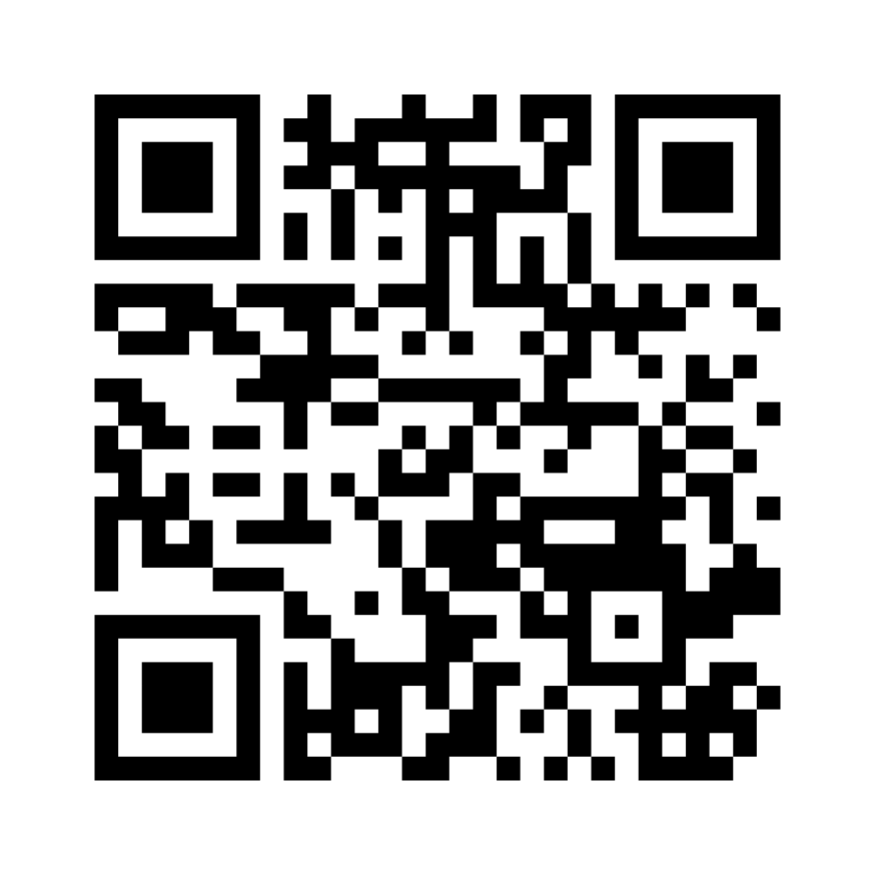
Continuing Education 110
Join menti.com
Use code – 2829 3256
Scan Now!
IdeazBoard – Questions, Concerns, Suggestions, Frustrations and Anything Else!

Slide 26
History of Adult Education
1856 First evening school established by the San Francisco Board of Education
1887 Evening school established in Los Angeles to provide Elementary Basic Skills, Vocational Education and English for Immigrants
1931 First adult education programs in Santa Ana
1960 Donahoe Higher Education Act mandates that junior colleges be independent of unified school districts. Adult education in community colleges changes name to “noncredit”
1990 Noncredit Integrated into the CA CCC Mission. Senate Bill 1874
2006 SB 361 provided enhanced funding for certain noncredit courses considered Career Development and College Preparation (CDCP)

Slide 27
Noncredit is part of the Mission
Education Code section 66010.4 (2) states, “In addition to the primary mission of academic and vocational instruction, the community colleges shall offer instruction and courses to achieve all of the following:
  (A) The provision of remedial instruction for those in need of it and, in conjunction with the school districts, instruction in English as a second language, adult noncredit instruction, and support services which help students succeed at the postsecondary level are reaffirmed and supported as essential and important functions of the community colleges.
  (B) The provision of adult noncredit education curricula in areas defined as being in the state's interest is an essential and important function of the community colleges.

Slide 28
Noncredit Categories
There are 10 noncredit categories:
  English as a Second Language (ESL): Henry Kim and Merari Weber
  Immigrant Education (including citizenship)
  Elementary and Secondary Basic Skills
    Adult Secondary Education: Carrie Patton
    HiSET/GED, ABE: Adrianna Gonzalez
  Health and Safety
  Courses for Adults with Substantial Disabilities
  Parenting
  Home Economics
  Courses for Older Adults: Nicholle
  Short-Term Vocational (including apprenticeship): Osiel Madrigal
  Workforce Preparation

Slide 29
Two Rates of Funding for Noncredit Programs
Career Development College Preparation (CDCP)
$7,346 per FTES* (2023-2024 rates)
*same as Dual Enrollment
Eligible CDCP Areas:
  English as a Second Language
  Elementary and Secondary Basic Skills
  Short-Term Vocational (including apprenticeship)
  Workforce Preparation
  Substantial Disabilities (can be eligible in certain cases)
Noncredit
$4,417 per FTES (2023-2024 rates)
Areas typically not eligible for CDCP and funded at noncredit rate:
  Citizenship
  Supervised Tutoring
  Health and Safety
  Parenting
  Home Economics
  Courses for Older Adults

Slide 30
Differences between Credit and Noncredit
Credit
Degrees and Certificates of Achievement
Generates apportionment; student fees apply
Degree applicable and non-degree applicable
Unit bearing
Not repeatable (exceptions for certain)
Approval: Curriculum Committee and Governing Board, Chancellor’s Office
  Approval to course offering = 1 – 1.5 years
Noncredit
Certificates of completion and competency
Generates two levels of apportionment (noncredit and enhanced noncredit); no student fees
Enhanced noncredit = Career Development and College Preparation (CDCP)
No units
Repeatable
Limited to 10 different categories
Approval: Curriculum Committee, Governing Board, Chancellor’s Office
  Courses offered after BOT approval
Courtesy: http://www.solano.edu/curriculum/1516/Noncredit%20SCC.pdf

Slide 31
Opportunities
Mirrored Classes
Co-requesites and Support Courses
Adult Dual Enrollment (SB544)
Credit courses to meet high school requirement diploma or NC certificate

Slide 32
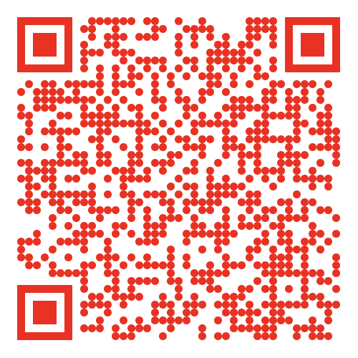
VP of Culture and Engagement
If you missed the photo shoot for a headshot, there are a few slots still available for tomorrow's session.
Use the QR code to sign up.

Slide 33
Adjunct and Chair Surveys ~ Needs & Concerns
Chairs:
Understanding financial aid process to better aid students if they don't get a passing grade.
Marketing or how can a department web page be improved.
Continued training in Nuventive, particularly on entering SLOs and Program Reviews.
Equivalency procedures.
Flex credit sessions for lab preparation in departments during flex week.
Defining the responsibility of a Chair vs. additional duties/requests that may come from the dean, so lines don't get blurred. Team player vs. Boundaries for self-preservation. Training/discussion regarding the black and white (and grey) of chair responsibilities.
Orientation and continued trainings for new Chairs. What is typical annual or less frequent responsibilities. Some responsibilities are so commonplace to existing chairs that reminders or timetables are not frequently sent out or passed on. Should any of this be a Dean's responsibility in orientating expectations and providing due dates?
  Department Chair duties, expectations, challenges, advice, support, and lessons learned needed.

Slide 34
Adjuncts:
Assisting and teaching students with autism spectrum disorder - disability rights, accessibility & inclusion
Micro aggressions and implicit bias & decolonizing
Engagement, Teaching older (40+) students, criteria/objective grading
How to utilize and organize class/lecture time more
Update on adjunct legislation for CCCs
Leadership workshops
A.I. Technology & Information - how to detect the improper use of AI in assignments & incorporate AI and chatGPT into course curriculum as a tool that students find fun and helpful to learn from
Proctoring for hybrid and online courses
OER, ZTC building classes
Canvas tips & tricks
Office 365
Best Practices to help students who are failing (Use starfish, send Academic Concern email, etc.)
Video recording - what gadgets are out there so that we can have high resolution videos for our lectures
Seminars on building syllabi for adjuncts organizing CANVAS pages
Student diversity, retention, engagement, retention & transfer - enrollment or collaboration throughout other departments
Spirituality as a mental health coping alternative

Slide 35
Effective teaching methods to engage students in the classroom & with online lectures; & use of technology to improve teaching online and in the classroom
Accessibility tools for powerpoints and lectures - reaching the i-phone generation
Equity and inclusion in classrooms
Equity and how to be a part of it, specifically for Math adjunct – feeling left in the dark
Local history information and guest speakers on national and foreign history; presentations that shed light on the culture and lives of our students and our surrounding community
Addressing the current student environment and accountability for performance
Aid for our Dreamers
A link where HR and staff can verify CEU's that have been recommended by Distance Ed (Example: Took 10 CEU's that were recommended for Course Hero & want to make it easier for HR to verify these & simplify the process for all parts)
LHE ceiling raised to 12 so adjuncts could teach 2 studio classes; would be beneficial to the students if an Adjunct could commit further and create more continuity within the department
How to become a full-time faculty member, make a living wage as an adjunct faculty member & advocate for complete healthcare coverage
Contract negotiations

Slide 36
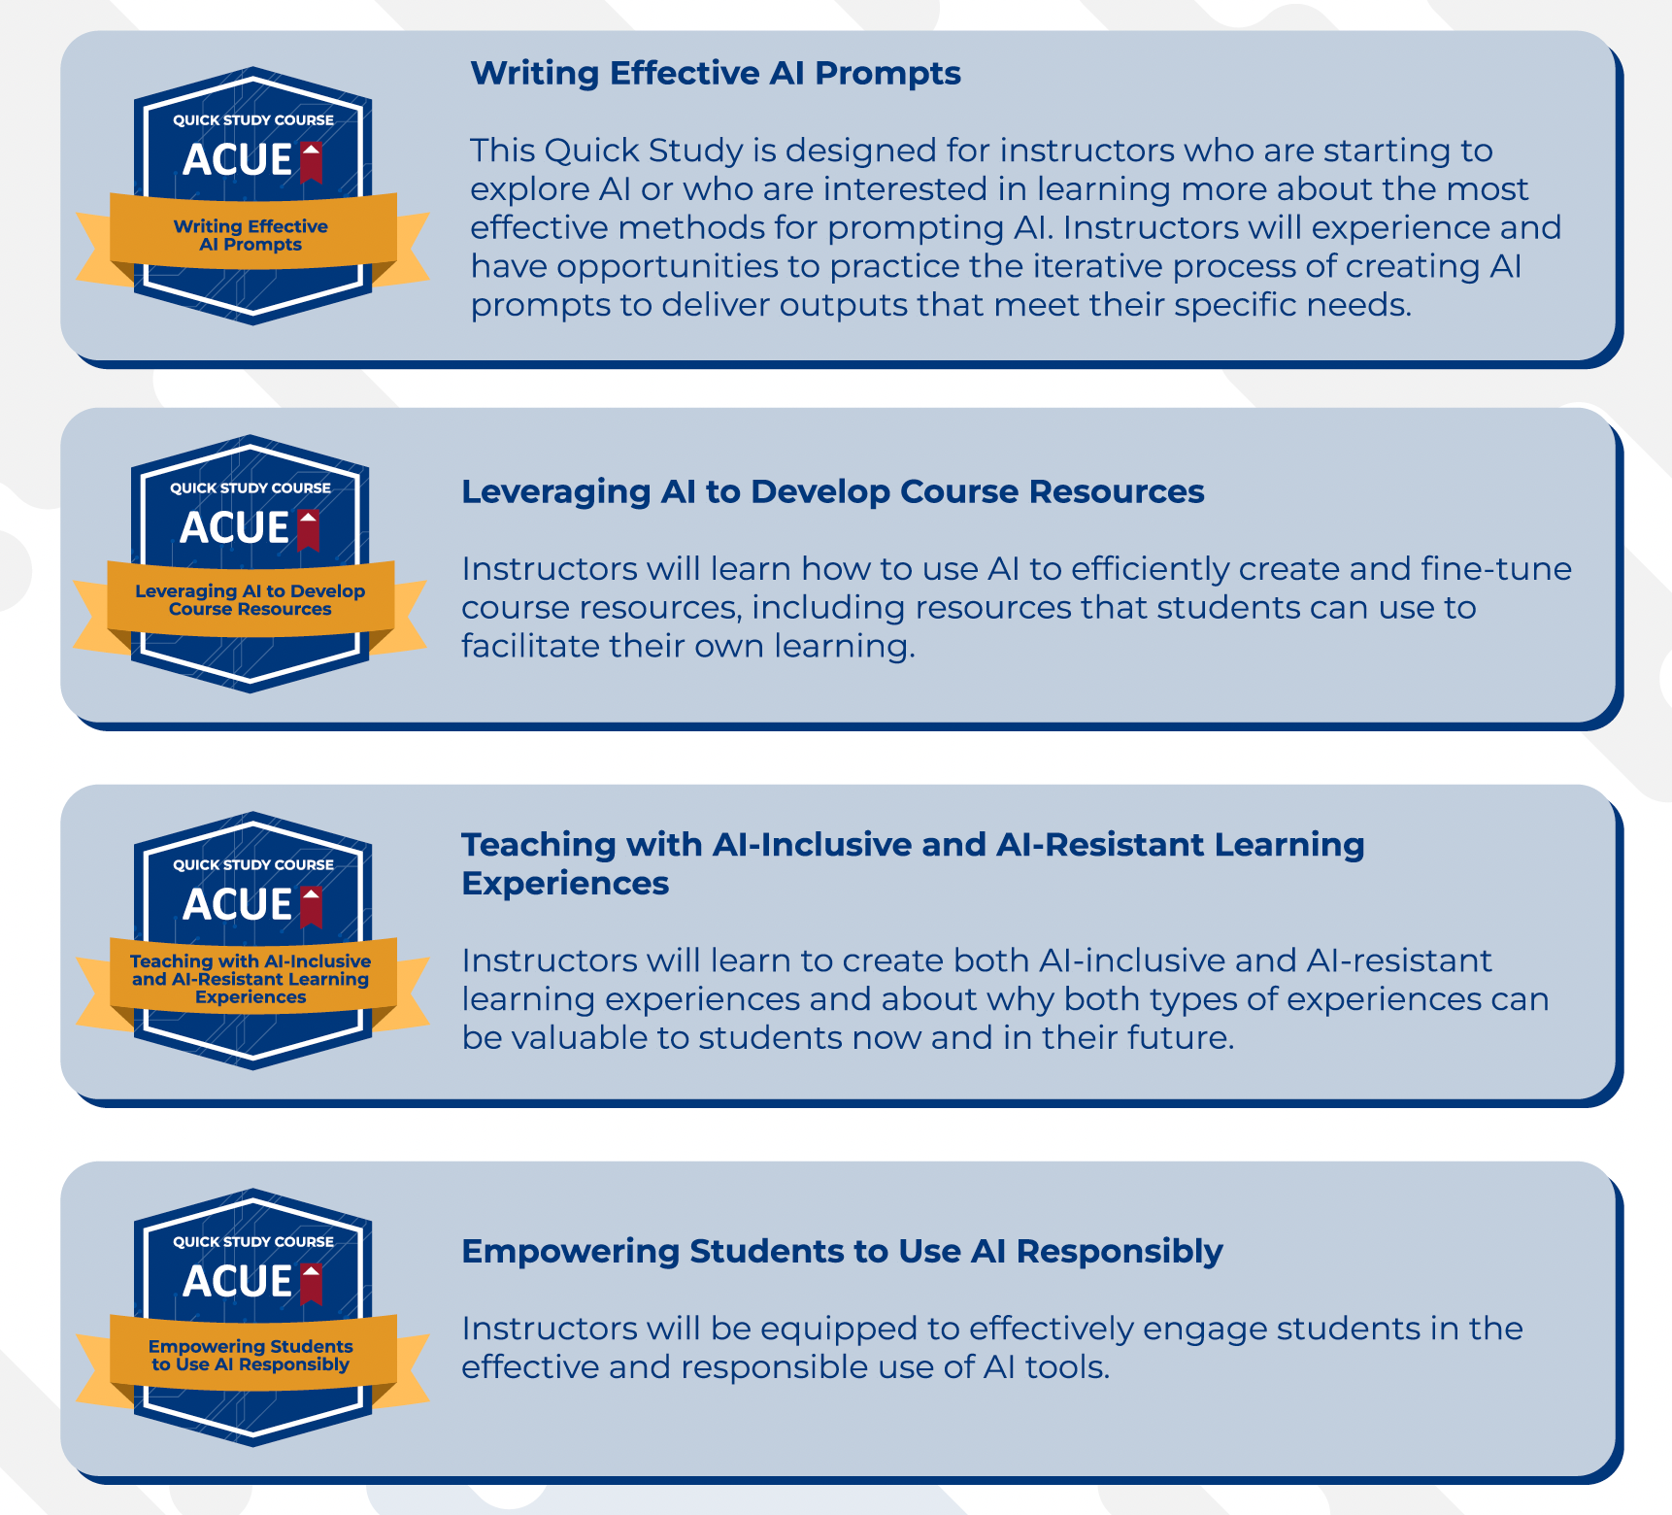


ACUE Self-Study AI Series

Slide 37
New AS Committees:
Awards for Excellence & Bylaws
I will be emailing committee members this month to coordinate our schedules for this year.

Slide 38

Distinguished Faculty & Awards for Excellence 2024-2025
Distinguished Faculty 2024/2025
Awards for Excellence
Website information has been updated for Professor Donato Martinez.
Save the Date: Professor Martinez' Distinguished Faculty Lecture on February 27th 4p-6p, SAC's Phillips Hall.
AfE scheduled for May 15th. More information will be shared in the Fall.
Share thoughts to help us improve these two events.

Slide 39

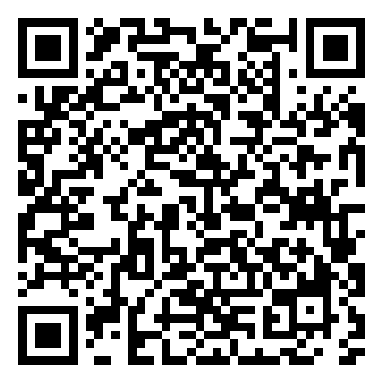
Academic Senate Dues
July 2023
84
August 2024
127
Please visit our Self-Service under the Daily Work Faculty tab labeled "Academic Senate Dues" to sign up.
Please continue sharing to fold in new faculty or faculty that have not signed up yet.

Slide 40
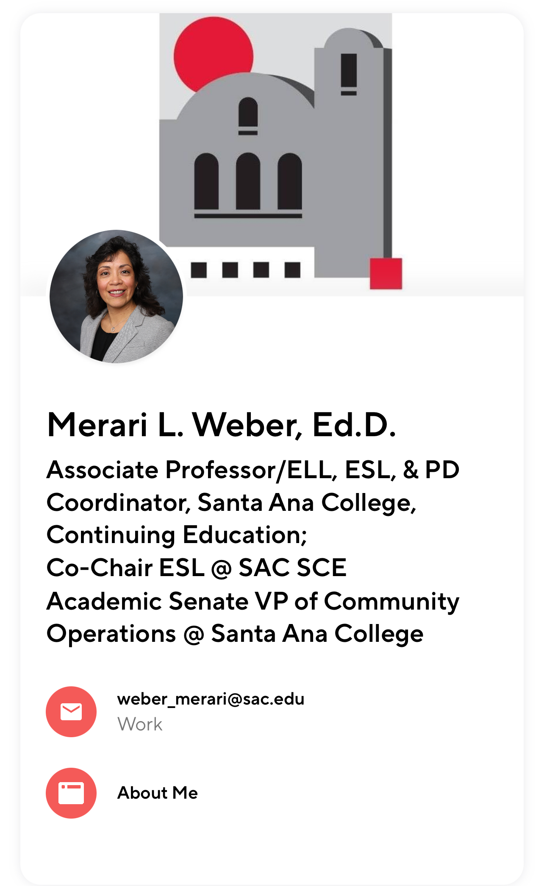
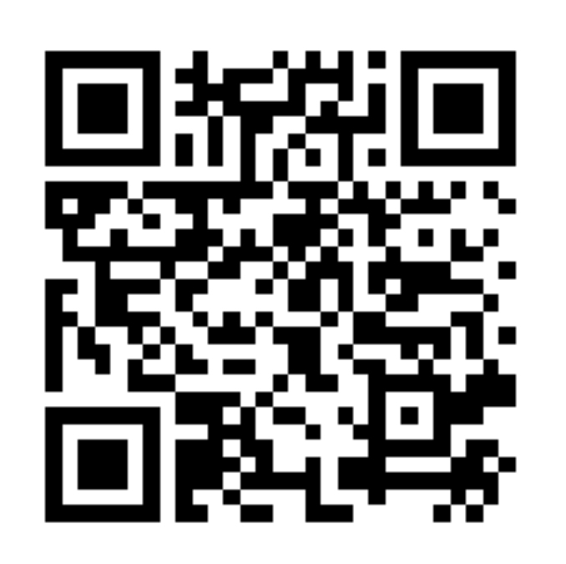
Let's keep in touch:

Slide 41


Participatory Governance & Institutional Service Opportunities
Credit for Prior Learning (CPL) workgroup
Outcomes Assessment Faculty Coordinator
Guided Pathways and Equity
Faculty Professional Development Committee
Joint SAC/SCC AI Workgroup
Hiring Committee Interest Form

Slide 42
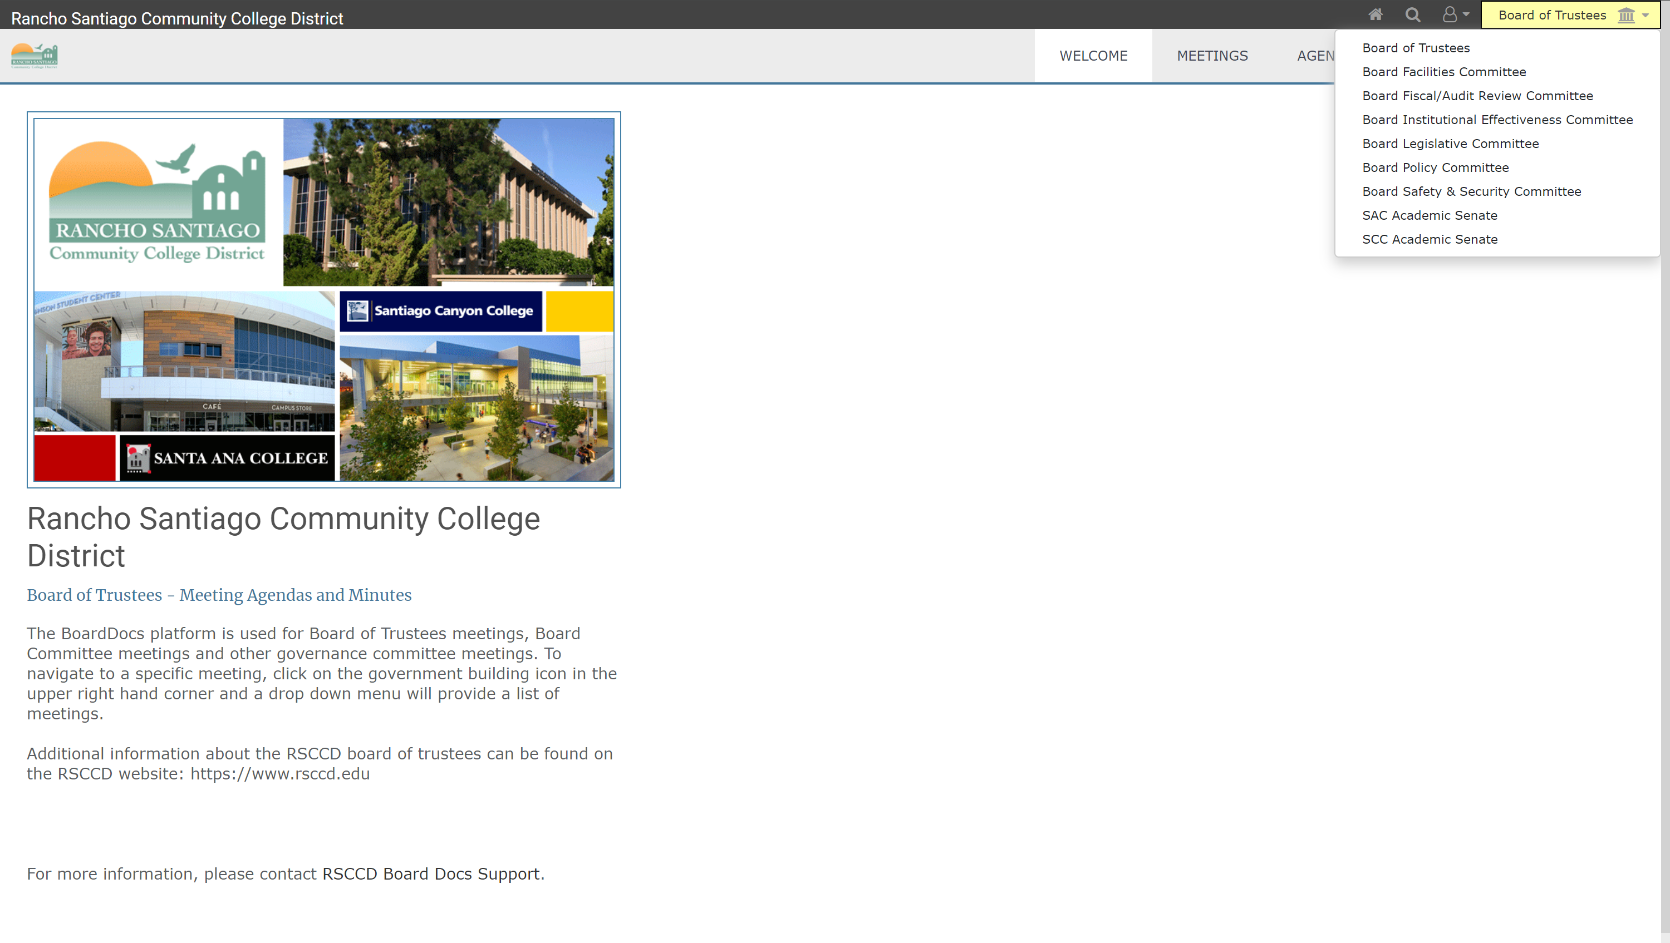
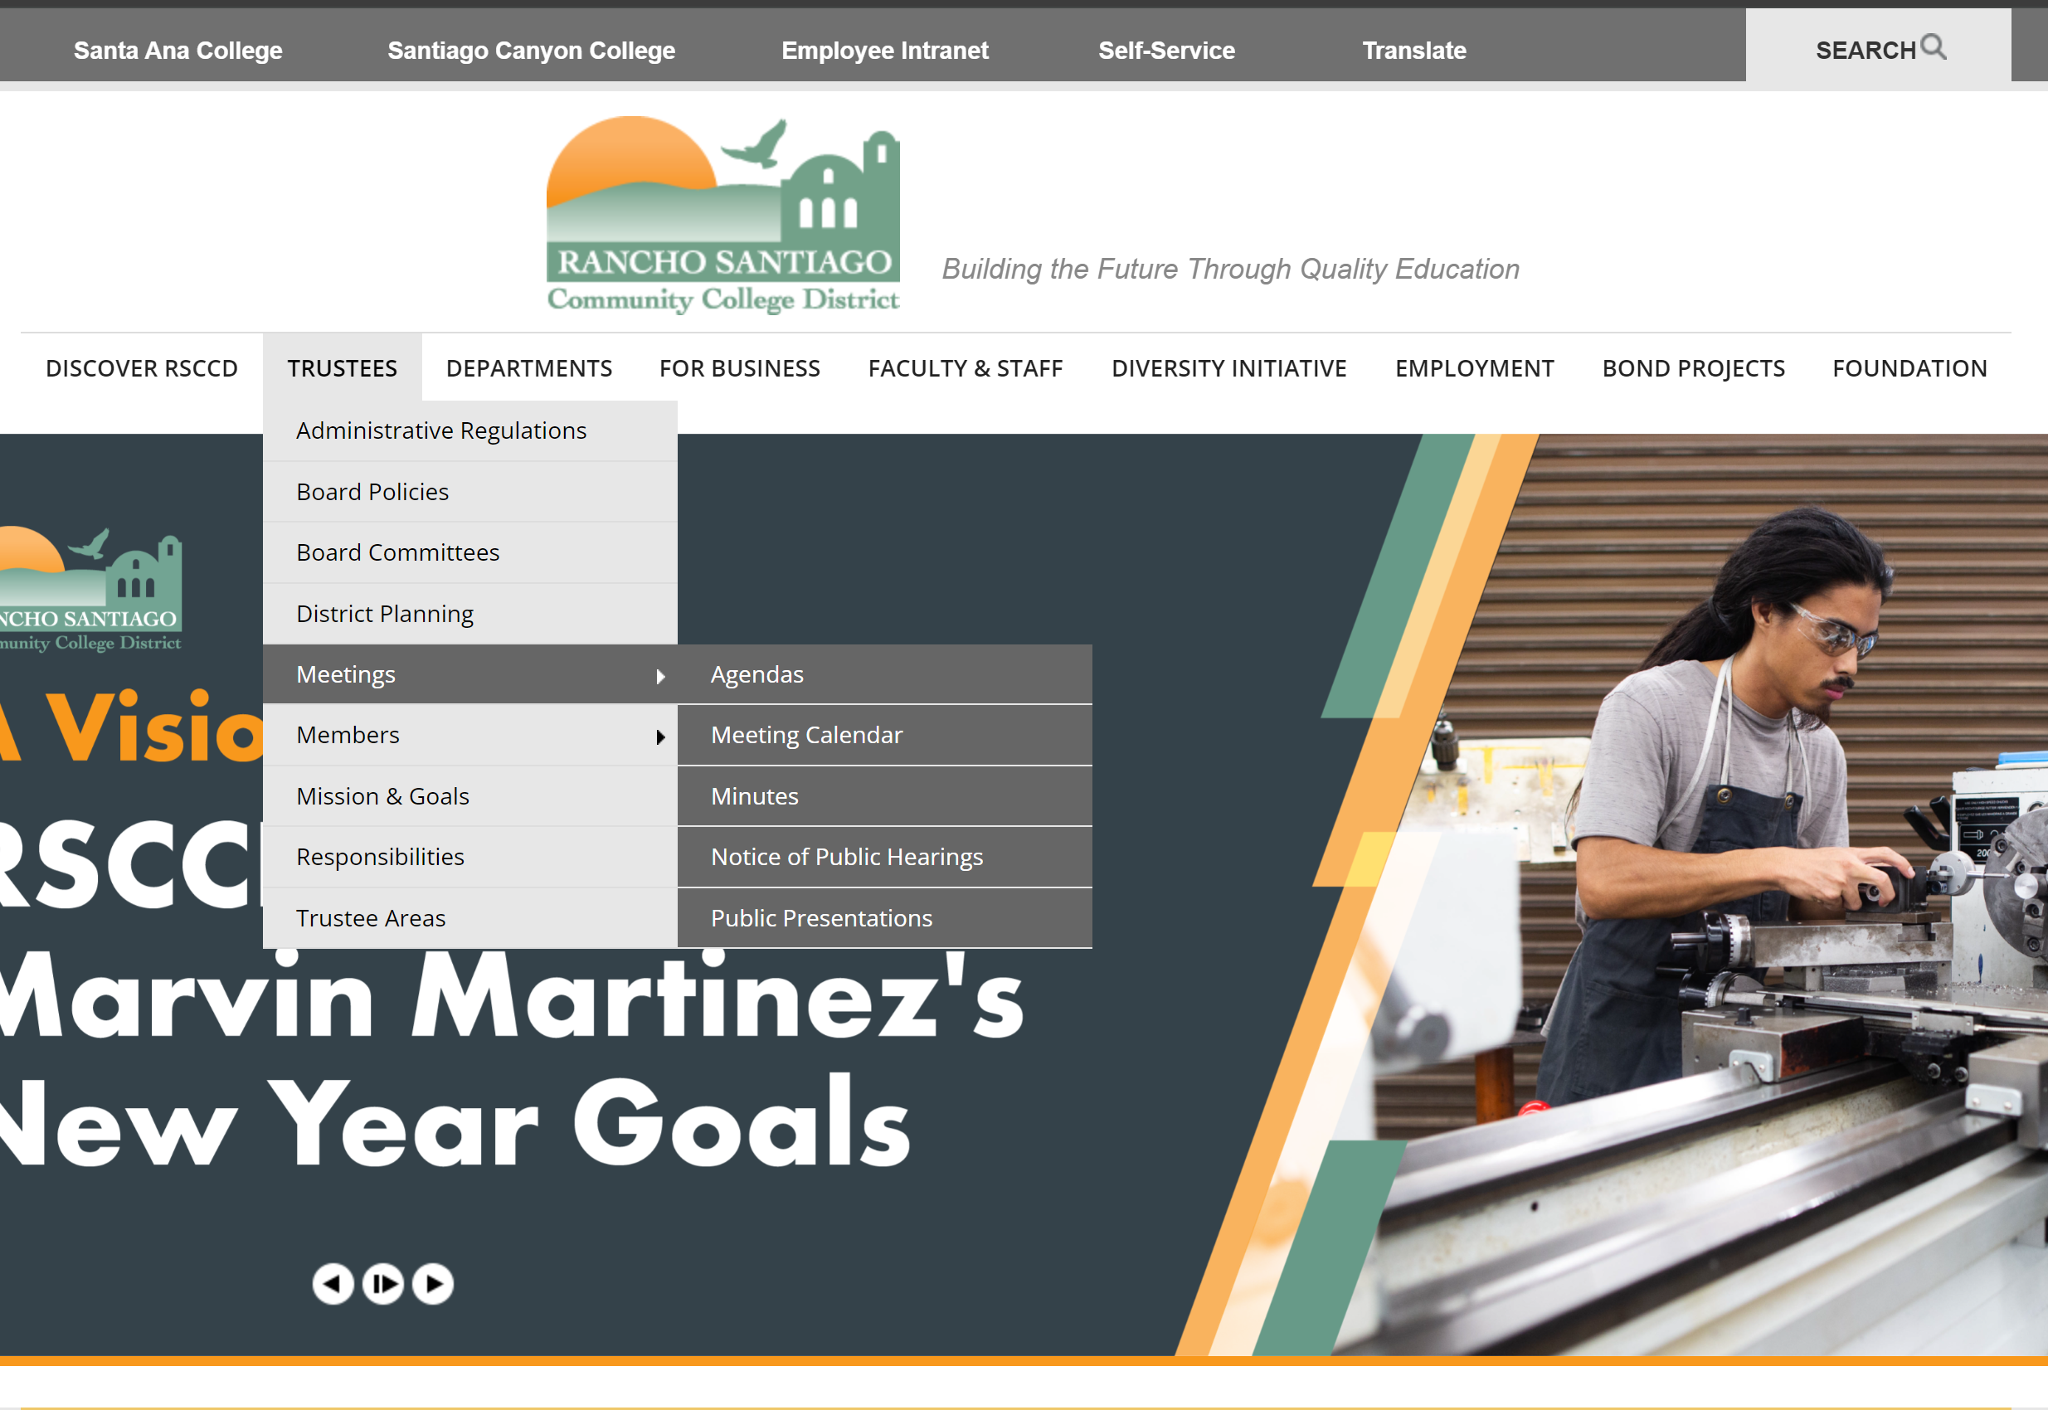
BoardDocs: Access Through District Website
STEP 1: Trustees dropdown menu on district site
STEP 2: BoardDocs dropdown menu to select SAC Academic Senate

Slide 43
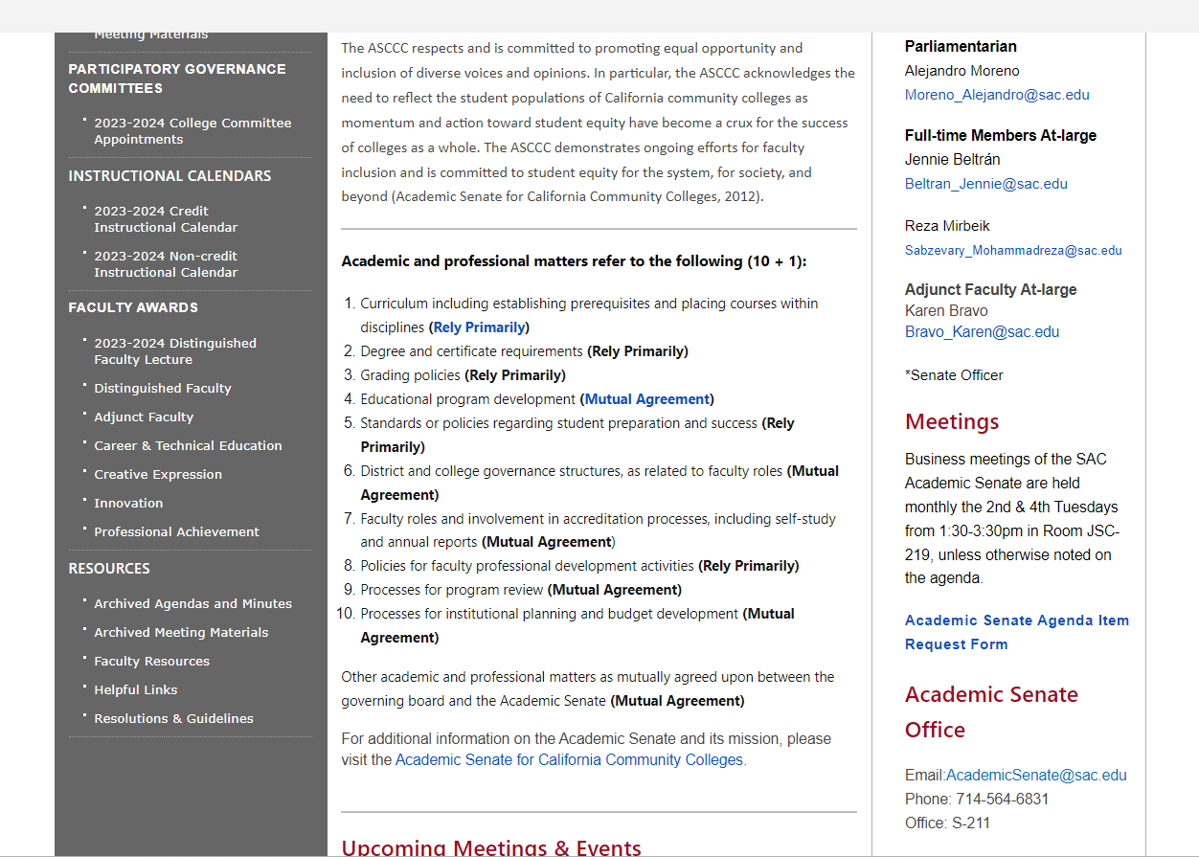
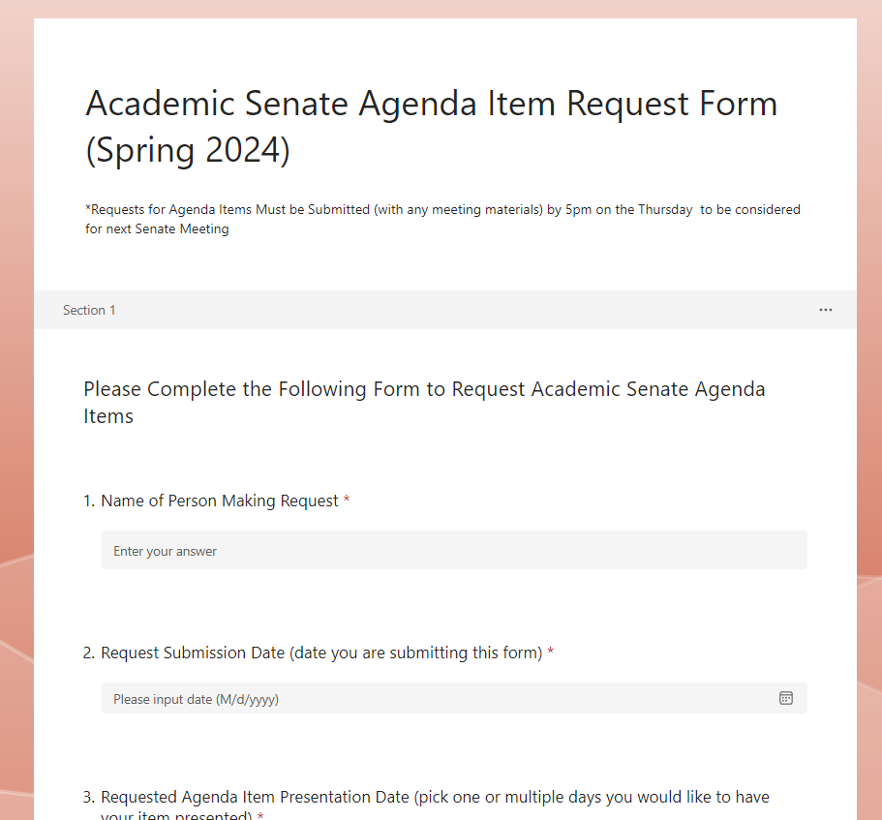
Requesting Agenda Items

Slide 44

August 14th DE updates

Slide 45
Faculty tested Respondus over the Summer
We had two faculty members actively use Respondus Monitor over the Summer.
We will have some workshops occuring regarding this potential "Proctorio" replacement during the upcoming Fall semester.

Slide 46


Student DE Survey: Barriers to Student Success
The internet is incredibly slow. There is no good place to sit and take a zoom class on campus. The library doesn't work and the weather is not always cooperative.
The whole website experience is convoluted. Not intuitive at all in terms of registering for courses, paying for courses, paying for a parking permit...everything is just very clunky and confusing to navigate.
Access to professor not as easy, some were more willing to help, while some did not respond to emails at all.

Slide 47
Student DE Survey: How can we improve your online experience?
Make sure due dates are correct on each module and not left over from a previous session.
Less use of external resources that teach us instead of the teacher themselves teaching us would be helpful
Offer rooms where you can have your drink/coffee with you while taking the online class. The library, computer center does not let you have your drink with you
I wouldn't change anything. It was a positive experience for me!
Have a student or a professor access the online classes from the student point of view to make sure everything is accessible
I really enjoy the recorded lectures that some professors provide. It would be great if more include them in their module/chapter lessons.
I feel you have done an amazing job both with faculty and online . Thank you
Sometimes the internet goes down, but the teachers have been great.
I really don't want anyone teaching an online course if they don't value online education specifically, and the level playing field it brings for disabled people.

Slide 48
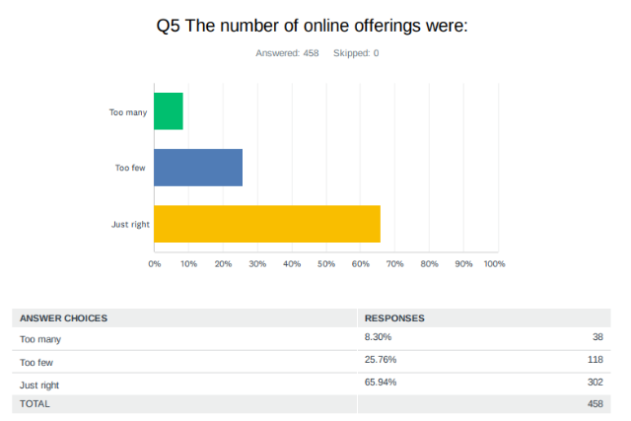

Student DE Survey

Slide 49
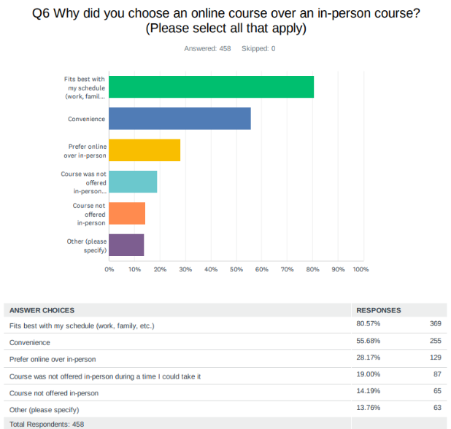

Student DE Survey:

Slide 50

Quality Reviewed Courses
115 (once 2 go through); Saddleback is 1st with 139 (booooo)
  3 non-credit courses so far!
Faculty awarded a "Quality" badge in the 23/24 AY: James Harman, Nayeli Strong, Merari Weber, Rick Castillo, Stephanie Clark, Vivian Luu, Elizabeth Smith, Tim Skaggs, Rosa Bernal, Elena Lourenco, Dori Dumon, Trudy Naman, Ilda Cardenas, Emily Andrus, Patty Sanchez, and Martha Guerrero

Slide 51

Quality Reviewed Courses
23/24 AY Peer Online Course Reviewers: Michelle Kimmel, Justin Tolentino, Lance Lockwood, Elizabeth Smith, Fernando Ortiz, Pete Nguyen, Rick Manzano, TJ Naman, Sergio Perez, Emily Andrus, and Willy Villalpando

Slide 52
Updates Fall 2024 Template
We have streamlined and updated the Fall Canvas templates.
2 big changes are as follows:
  Added "Version 2024" to the title of updated and most recent modules. For example, Student Resources (version 2024) or Course Information (version 2024). This should make it much easier when you are copying in past material.
  Removed the extra modules and pages. Now there is only one module example.

Slide 53
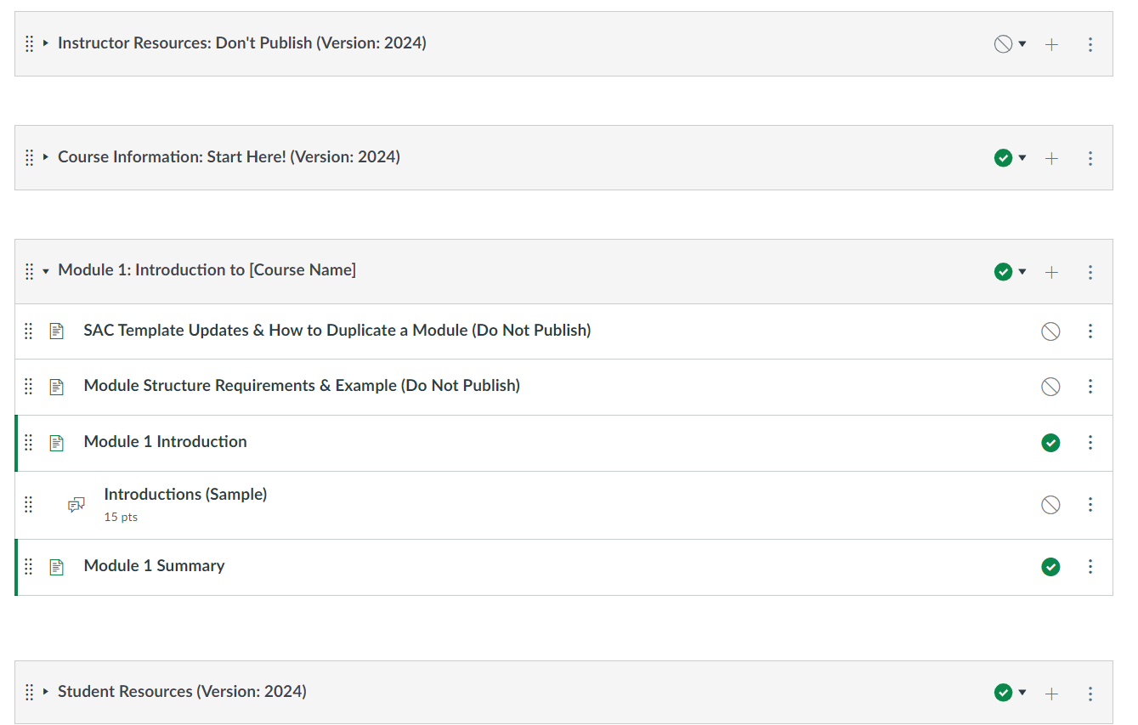
Example of what that looks like:

Slide 54




DE Handbook as a Canvas Course

Slide 55

Updated Faculty Canvas Training Course

Slide 56
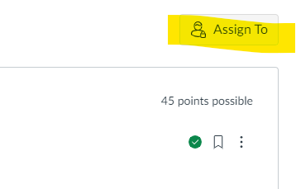
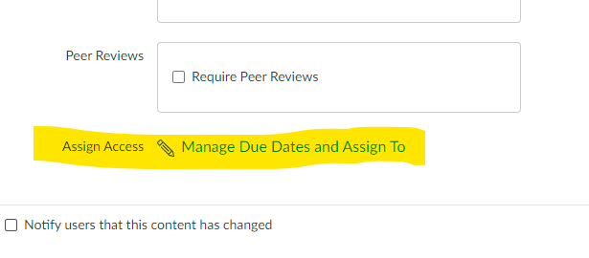

Canvas Updates
Due Dates is now Assign To or Manage Due Dates.

Slide 57

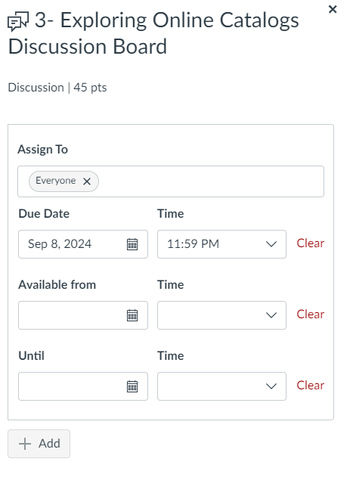
Best practice is not to use the "Available Until" feature on most assignments as it removes content from students, making it invisible.

Slide 58
DE Housekeeping:
DE staff is updating their website to condense, update, and organize all faculty resources.
Be on the lookout for DE's monthly Sway updates as well as some emails from your DE faculty coordinator, Jaki.

Slide 59
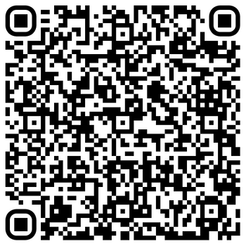

Pit
Academic Senate Intersectionality, Race, & Social Justice (IRSJ) Advisory Group

Slide 60
Intersectionality, Race, and Social Justice (IRSJ) Advisory Group
Purpose
  To provide leadership and recommendations on practices, policies and procedures that support Diversity, Equity, and Inclusion (DEI) and anti-racism initiatives.
  In collaboration with all community stake holders, this advisory group strives to proactively create and support DEI and anti-racism change impacting faculty.
  The IRSJ (formerly the Racially Inclusive Advisory Group) was approved unanimously through Academic Senate Resolution FA2021 11.23.2021

Slide 61
IRSJ Goals
  Discover and learn to operate and lead in ways that promote a campus climate that aligns with our anti-oppression resolution.
    This includes examining not only the individual/collective behaviors but also faculty structures, bylaws, and culture.
  Increase faculty self-awareness in order to understand experiences of colleagues and address past instances of offensive behavior within leadership structures and how to proceed moving forward.
    Specifically, this includes the need to name and identify examples of sexist, racist, and other forms of offensive/oppressive behavior and put into place best practices to eliminate, prevent, eradicate them moving forward (i.e. making recommendations of topics for the Courageous Leadership Institute, etc.).
2

Slide 62
IRSJ Goals (Cont.)
  Demonstrate the skills and knowledge to be able to facilitate inclusive/safe meetings including facilitating difficult conversations, identifying the nuances, managing emotion, observing verbal and non-verbal communication, with the goal to eradicate racism, sexism, and other forms of oppression from our meeting spaces and institution.
    IRSJ’s shared leadership model

Slide 63
2023-2024 Areas of Focus & Achievements
  Formalized recommendations for a more equitable, accessible, and transparent process for requesting Academic Senate meeting agenda items
  Implemented the SAC Courageous Leadership Institute
  Advised on Land Acknowledgement practices campus wide
  Authored Resolution S2024.05 Support the Offering and Maintaining of Santa Ana College Native History Courses (approved with acclimation!)
  Advocated for accessible campus event email announcements and promotional materials
  IRSJ members served on AS Bylaws committee

Slide 64
Get Involved!
  Monthly meetings during fall and spring semesters
    Fall meeting times TBD
    Meetings typically run 1.5 hours
    Hybrid meeting options
  Ideally, those interested in joining are personally committed to and invested in DEI and anti-racism work.

Slide 65
Contact
  IRSJ Representatives:
  Maria Aguilar Beltran
  beltran_maria@sac.edu
  Annie Knight
  knight_annie@sac.edu
  Thank you!

