Slide 1
August 14th DE updates

Slide 2
Faculty tested Respondus over the Summer
We had two faculty members actively use Respondus Monitor over the Summer.
We will have some workshops occuring regarding this potential "Proctorio" replacement during the upcoming Fall semester.

Slide 3
Student DE Survey: Barriers to Student Success
The internet is incredibly slow. There is no good place to sit and take a zoom class on campus. The library doesn't work and the weather is not always cooperative.
The whole website experience is convoluted. Not intuitive at all in terms of registering for courses, paying for courses, paying for a parking permit...everything is just very clunky and confusing to navigate.
Access to professor not as easy, some were more willing to help, while some did not respond to emails at all.

Slide 4
Student DE Survey: How can we improve your online experience?
Make sure due dates are correct on each module and not left over from a previous session.
Less use of external resources that teach us instead of the teacher themselves teaching us would be helpful
Offer rooms where you can have your drink/coffee with you while taking the online class. The library, computer center does not let you have your drink with you
I wouldn't change anything. It was a positive experience for me!
Have a student or a professor access the online classes from the student point of view to make sure everything is accessible
I really enjoy the recorded lectures that some professors provide. It would be great if more include them in their module/chapter lessons.
I feel you have done an amazing job both with faculty and online . Thank you
Sometimes the internet goes down, but the teachers have been great.
I really don't want anyone teaching an online course if they don't value online education specifically, and the level playing field it brings for disabled people.

Slide 5
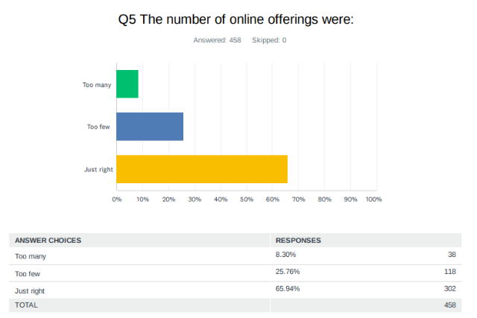
Student DE Survey

Slide 6
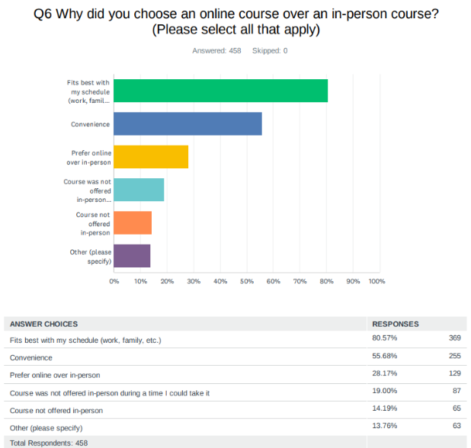
Student DE Survey:

Slide 7
Quality Reviewed Courses
115 (once 2 go through); Saddleback is 1st with 139 (booooo)
3 non-credit courses so far!
Faculty awarded a "Quality" badge in the 23/24 AY: James Harman, Nayeli Strong, Merari Weber, Rick Castillo, Stephanie Clark, Vivian Luu, Elizabeth Smith, Tim Skaggs, Rosa Bernal, Elena Lourenco, Dori Dumon, Trudy Naman, Ilda Cardenas, Emily Andrus, Patty Sanchez, and Martha Guerrero

Slide 8
Quality Reviewed Courses
23/24 AY Peer Online Course Reviewers: Michelle Kimmel, Justin Tolentino, Lance Lockwood, Elizabeth Smith, Fernando Ortiz, Pete Nguyen, Rick Manzano, TJ Naman, Sergio Perez, Emily Andrus, and Willy Villalpando

Slide 9
Updates Fall 2024 Template
We have streamlined and updated the Fall Canvas templates.
2 big changes are as follows:
Added "Version 2024" to the title of updated and most recent modules. For example, Student Resources (version 2024) or Course Information (version 2024). This should make it much easier when you are copying in past material.
Removed the extra modules and pages. Now there is only one module example.

Slide 10
Example of what that looks like:

Slide 11
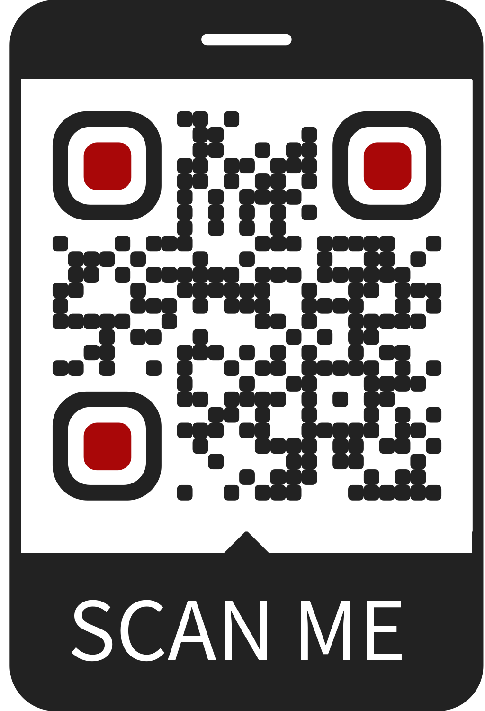
DE Handbook as a Canvas Course

Slide 12
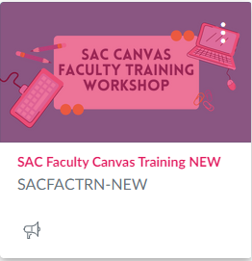
Updated Faculty Canvas Training Course

Slide 13
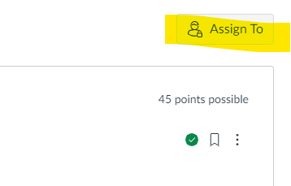
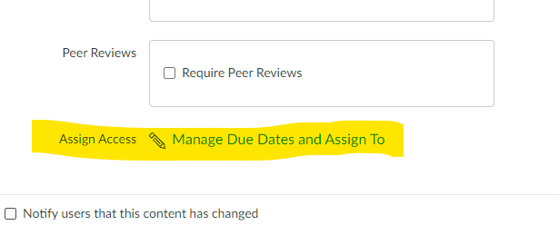
Canvas Updates
Due Dates is now Assign To or Manage Due Dates.

Slide 14
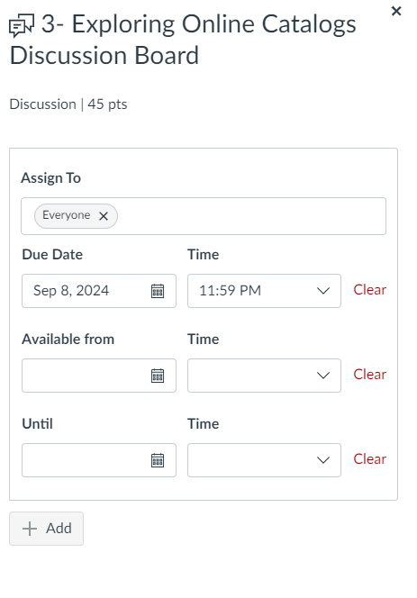
Best practice is not to use the "Available Until" feature on most assignments as it removes content from students, making it invisible.

Slide 15
DE Housekeeping:
DE staff is updating their website to condense, update, and organize all faculty resources.
Be on the lookout for DE's monthly Sway updates as well as some emails from your DE faculty coordinator, Jaki.

