Slide 1


Your leadership over the last two years as the first to serve in the roles of VP of Culture and Engagement and Historian has set a strong foundation for future leaders and made a lasting impact on our organization’s growth and community.
Amberly and Andrew!!!!

Slide 2

Maria Aguilar-Beltran
Vice President, Culture and Engagement
Merari Weber
Vice President, Community Operations
Ann Cass
Historian

Slide 3
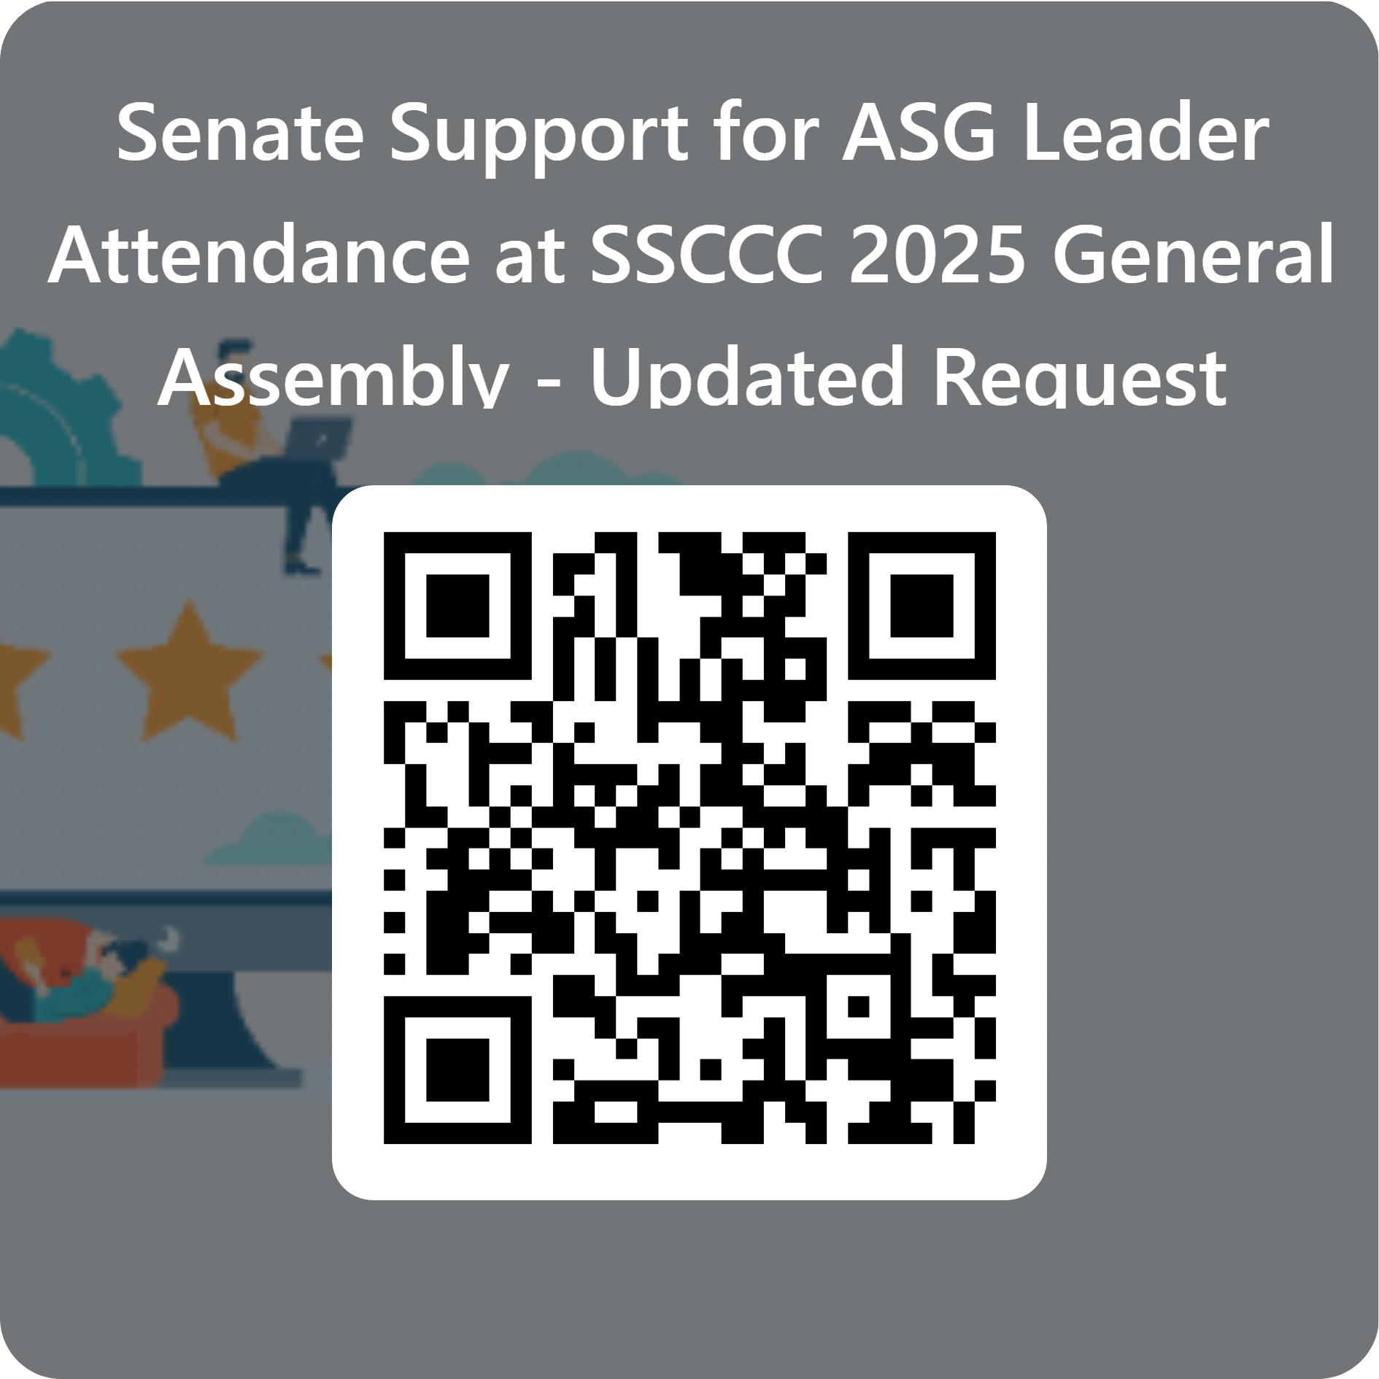
ASG Signage Proposal Identifying Safe Spaces
Faculty support of ASG Proposal
Recommendation Senate Funds ASG
https://forms.office.com/r/58uSx8mJzm

Slide 4
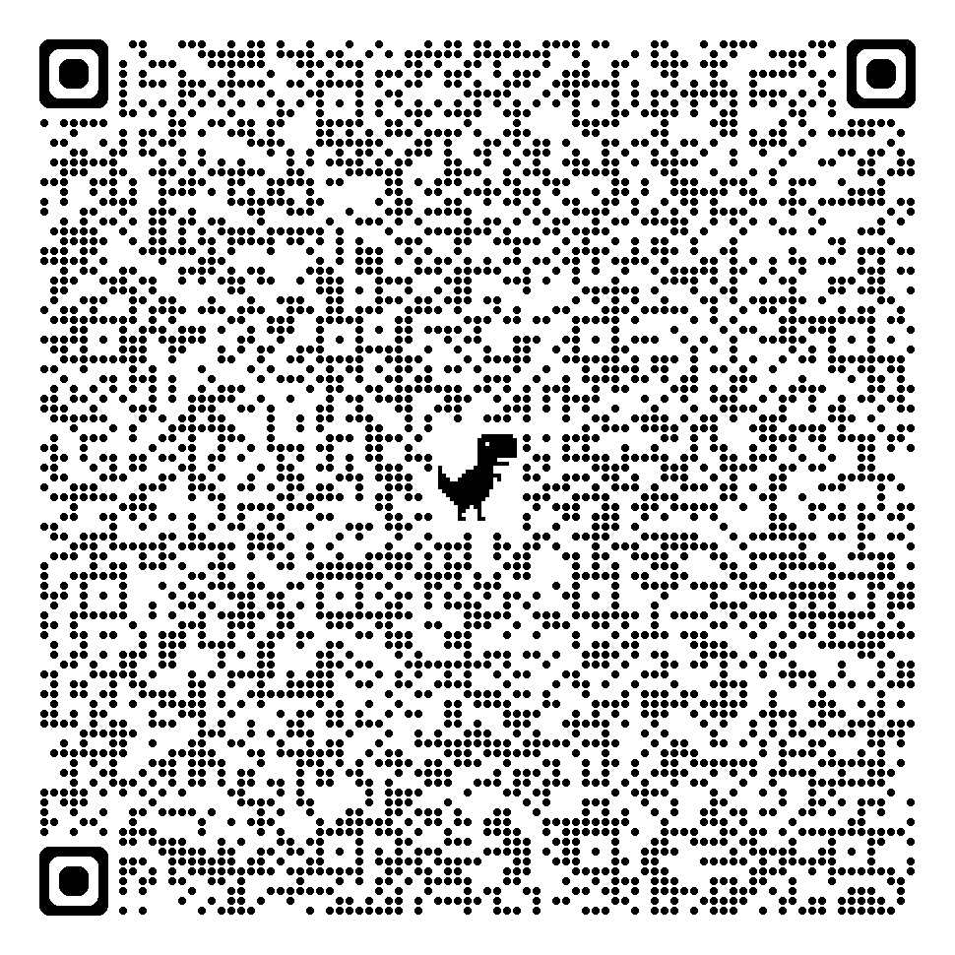
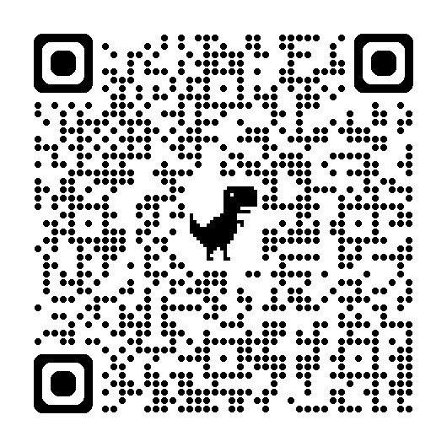
REMINDER: Roster Verification through Self Service – Pilot – Summer 2025
Census verifications of rosters are required by the California Education Code and are crucial for determining state funding for the college.
Email alert prior to Census Date with Due Date for Roster Verification
Self Service: Review Roster, drop no-shows or those not attending, and confirm roster is accurate by Due Date.
Census Verification in Self-Service (video)
Faculty Guide - Certifying Census Roster on Self-Service (written directions with images)
Will be shared out to all faculty and deans

Slide 5
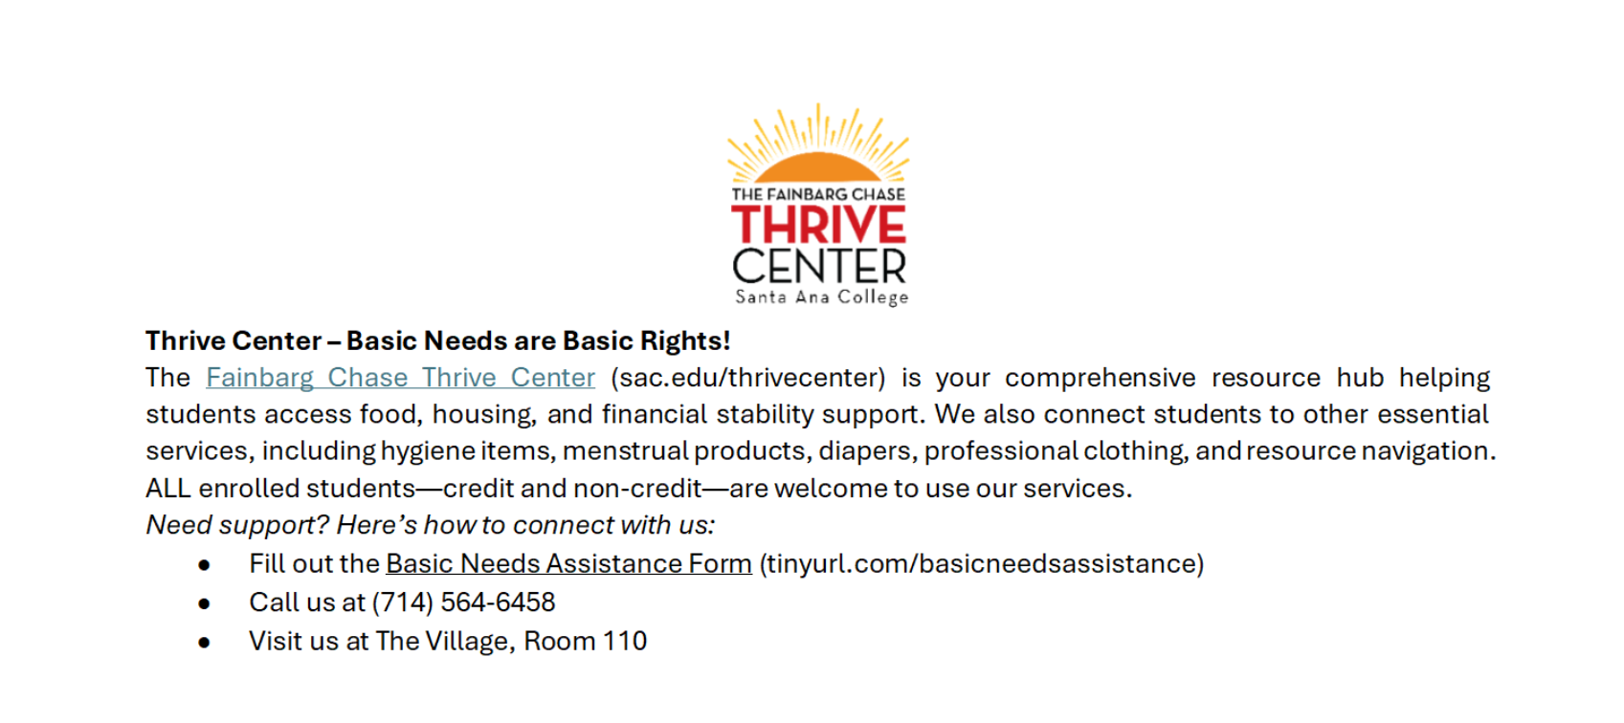
Request from Thrive Center for Syllabus Statement

Slide 6
District Office Resource Requests – Action Item: May 28th POE 1. Facilities Planning: Admin Clerk: $113,338
2. Facilities Planning: Facilities Specialist: $152,819
3. Senior District Safety Officer (armed) – 2 positions: $254,302
Human Resources
1. Director of Human Resources: $279, 337
2. Principal HR Analyst: $208, 131
Educational Services
1. District PIO: Communications Specialist: $113, 553
ITS
Technical Specialist I: $127, 682
Applications Specialist IV: $208, 940
Help Desk Analyst: $127, 682
ITS Technical Supervisor: $98, 182
Total Cost of all Positions (on-going):
$1,682,966

