Slide 1

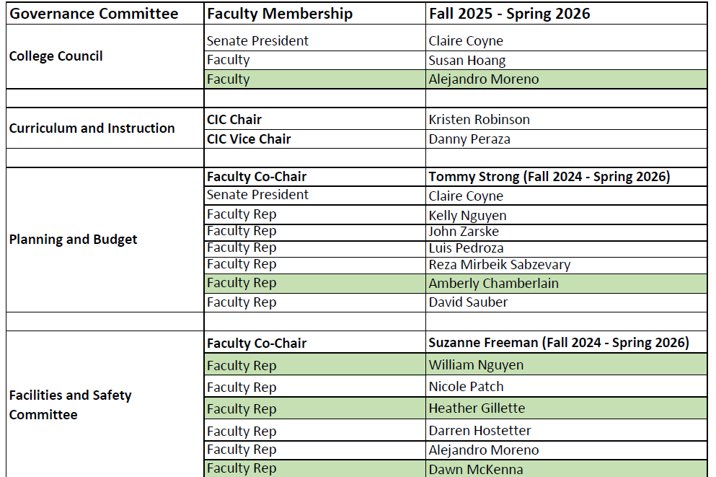
President’s Report – May 13, 2025
Committee Appointments 2025 – 2026

Slide 2
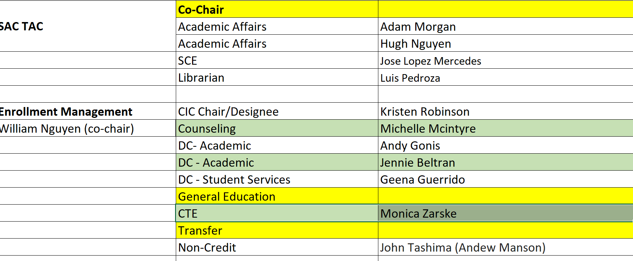
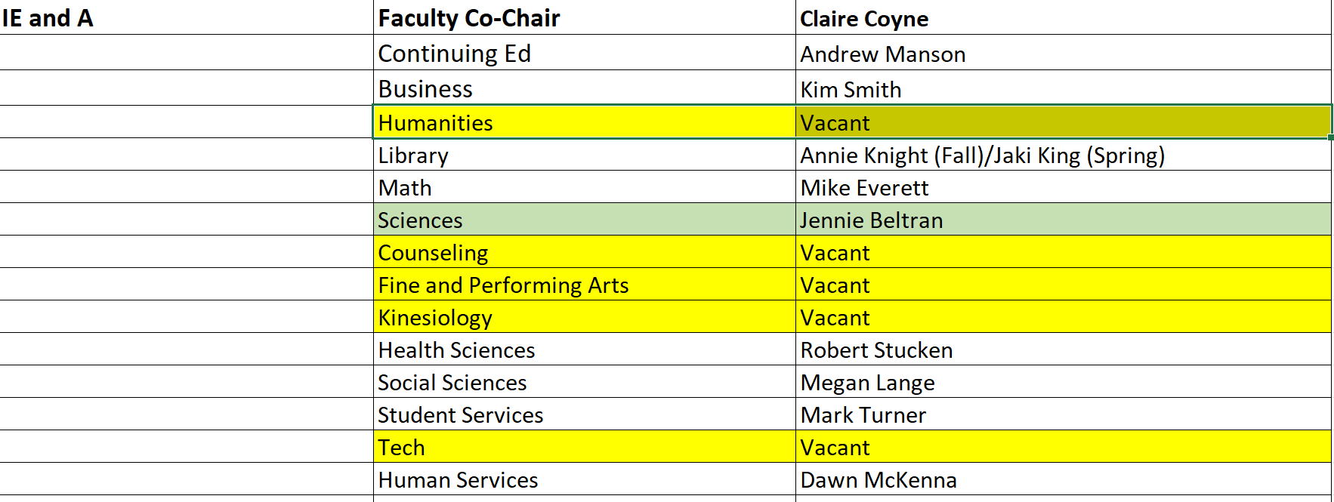
Committee Appointments 2025 – 2026

Slide 3
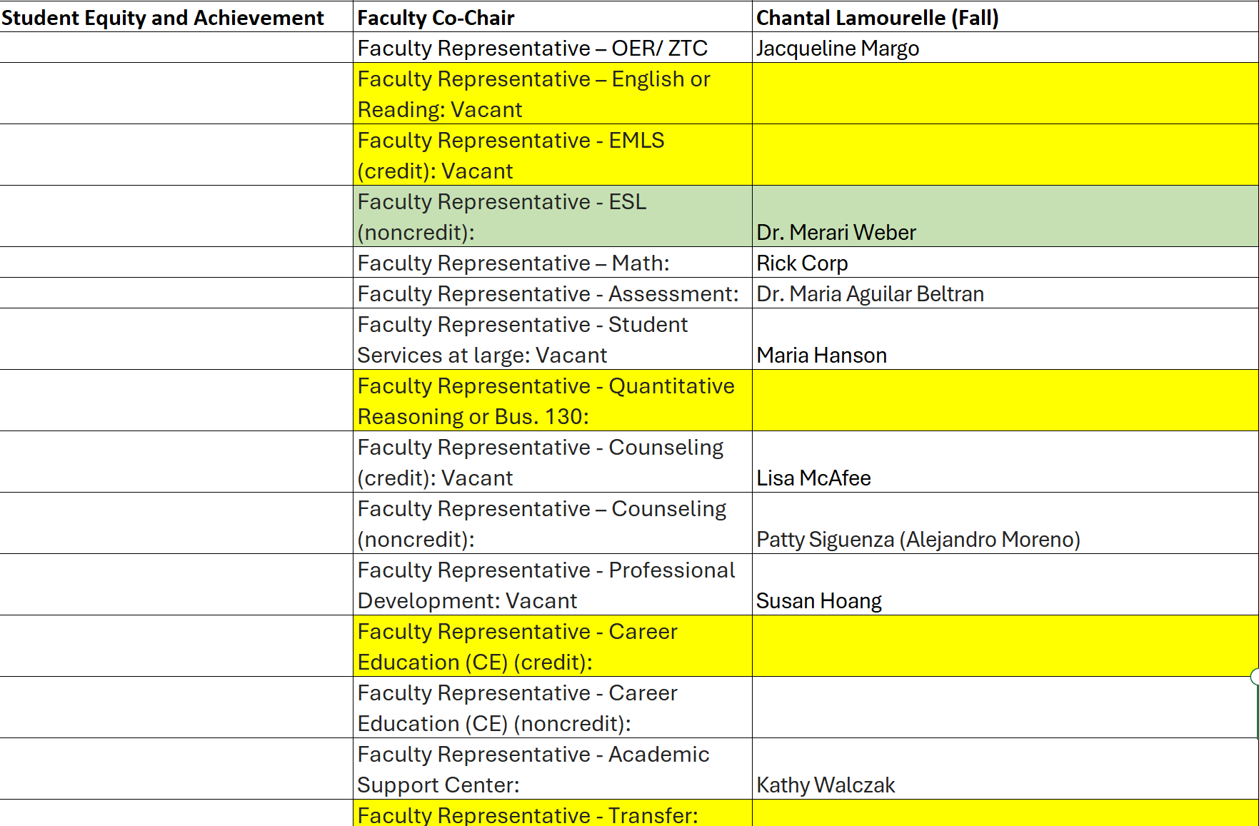

Slide 4
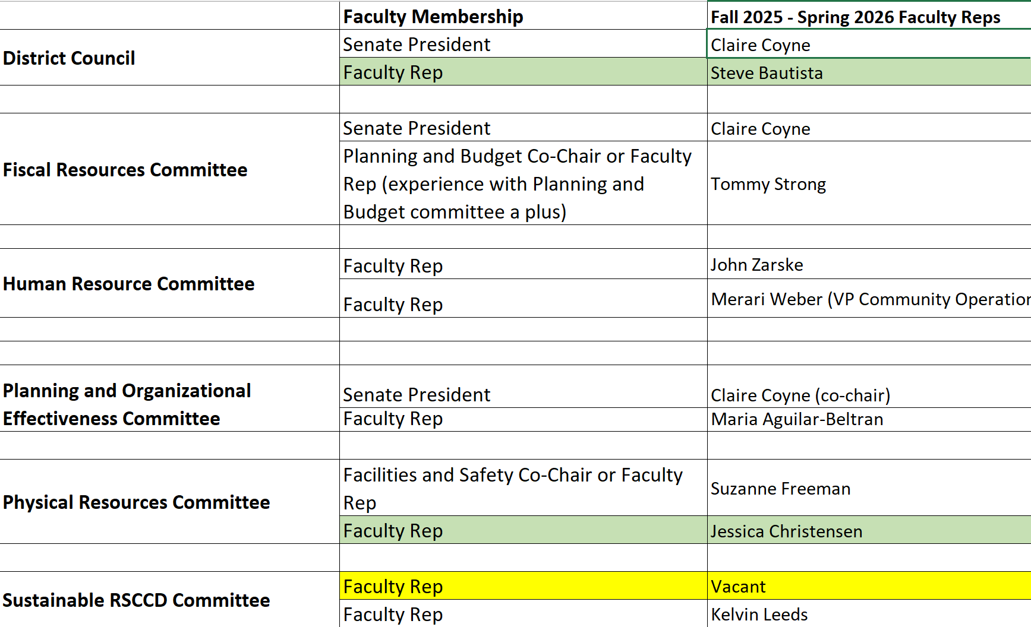
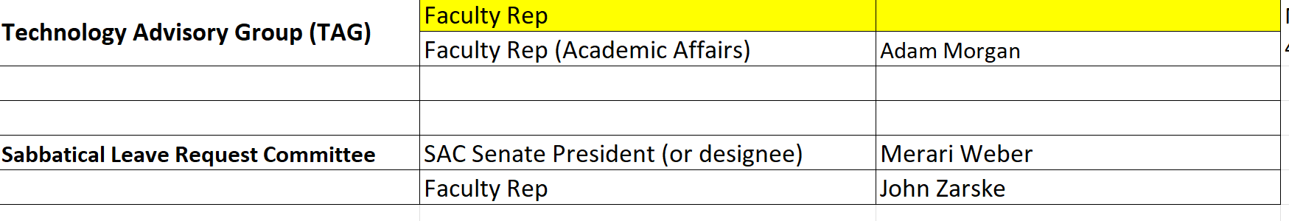
District Committees 2025-2026

Slide 5
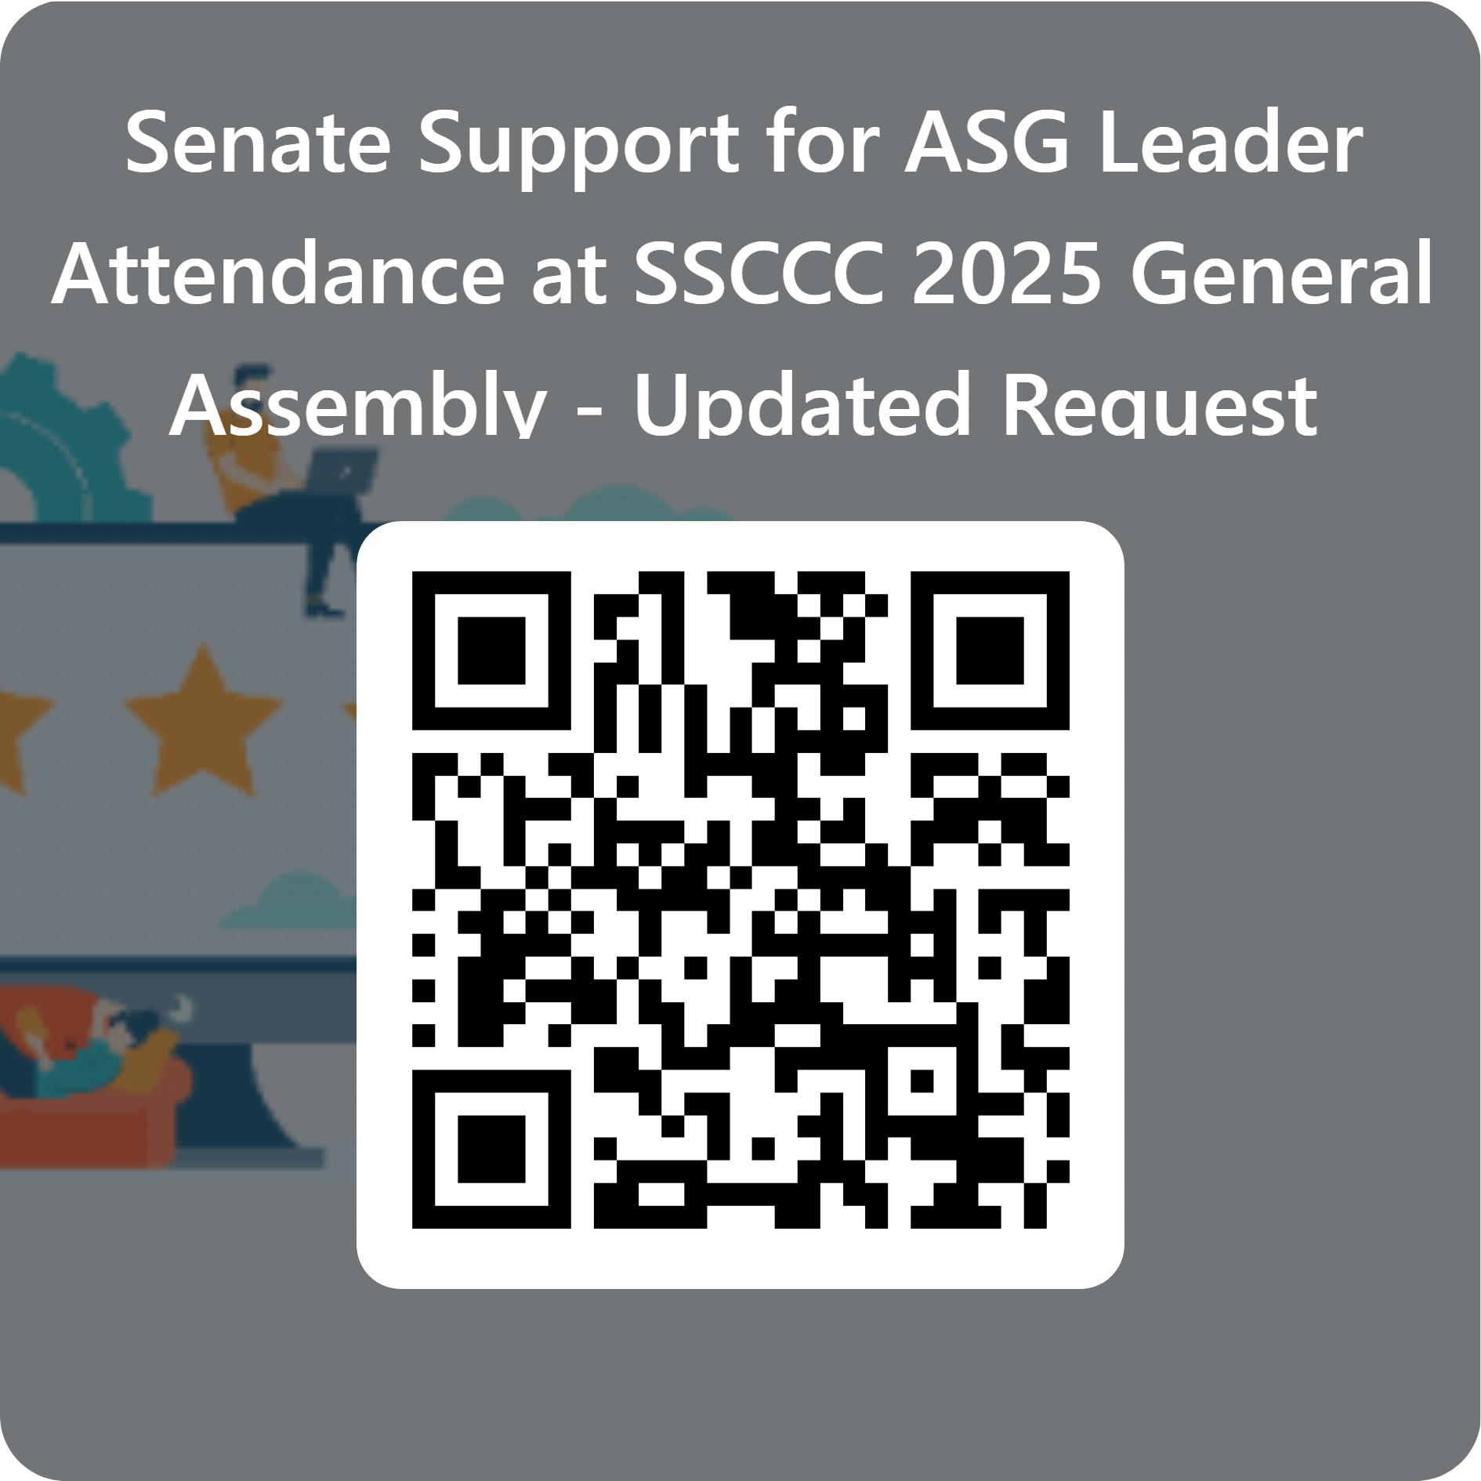
College Council – 5/13
Recommend District Services positions to be approved
College Council Membership
Recommendation Senate Funds ASG
https://forms.office.com/r/58uSx8mJzm

Slide 6
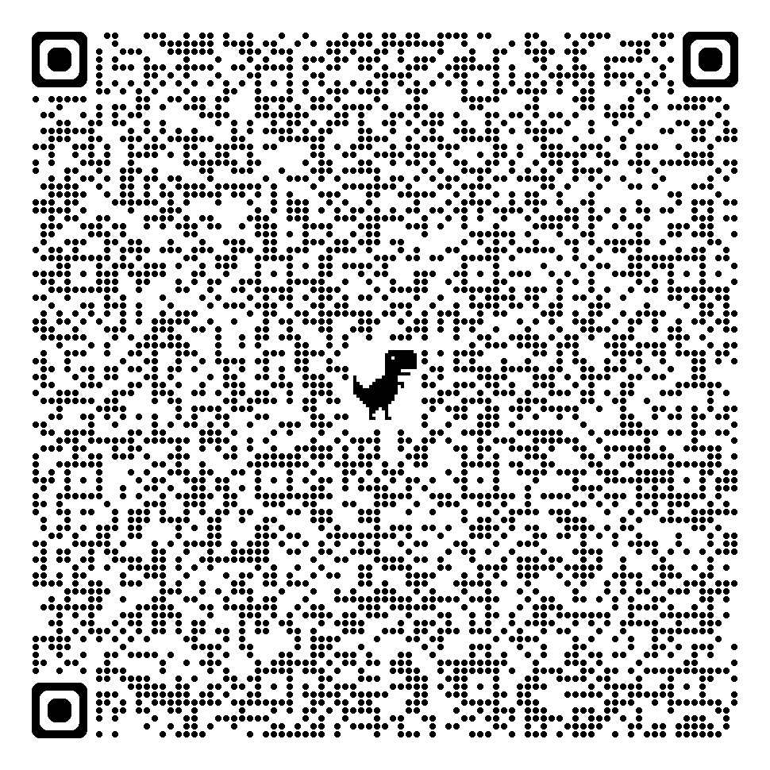
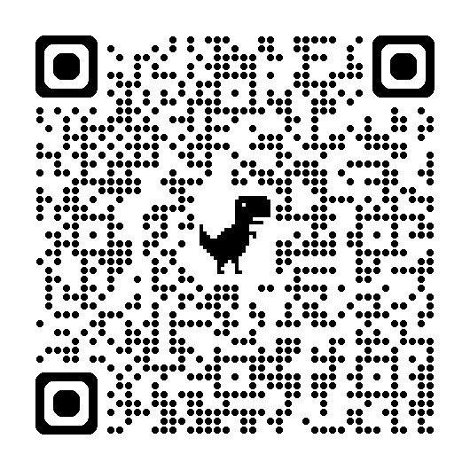
REMINDER: Roster Verification through Self Service – Pilot – Summer 2025
Census verifications of rosters are required by the California Education Code and are crucial for determining state funding for the college.
Email alert prior to Census Date with Due Date for Roster Verification
Self Service: Review Roster, drop no-shows or those not attending, and confirm roster is accurate by Due Date.
Census Verification in Self-Service (video)
Faculty Guide - Certifying Census Roster on Self-Service (written directions with images)
Will be shared out to all faculty and deans

Slide 7
District Office Resource Requests – Action Item: May 28th POE (will post Form w/ rationale)
Business Services
1. Facilities Planning: Admin Clerk: $113,338
2. Facilities Planning: Facilities Specialist: $152,819
3. Senior District Safety Officer (armed) – 2 positions: $254,302
Human Resources
1. Director of Human Resources: $279, 337
2. Principal HR Analyst: $208, 131
Educational Services
1. District PIO: Communications Specialist: $113, 553
ITS
Technical Specialist I: $127, 682
Applications Specialist IV: $208, 940
Help Desk Analyst: $127, 682
ITS Technical Supervisor: $98, 182
Total Cost of all Positions (on-going):
$1,682,966

