Slide 1

Congratulations Justin!

Slide 2

President’s Report – April 22, 2025
DMC Move
Meetings w/ VP AA, Dean F&PA, and faculty
Production courses will remain at DMC through Fall 2025
VP AA advocating for them to remain at DMC until new
location is complete
Meeting w/ District Project Managers in coming weeks
T-Bldg
Some courses being offered at OCC
Building can be repaired
Contractor has been hired (hoping completion prior to Fall 2025)
Working to determine date for faculty/staff access to building
Faculty Liaison to ASG
  Presented to Legislative Committee – March 4th
  Presented to Executive Committee – April 21st – received their endorsement to formalize this role
  Next steps: Joint Resolution with ASG establishing the role/position to begin in Fall 2025

Slide 3
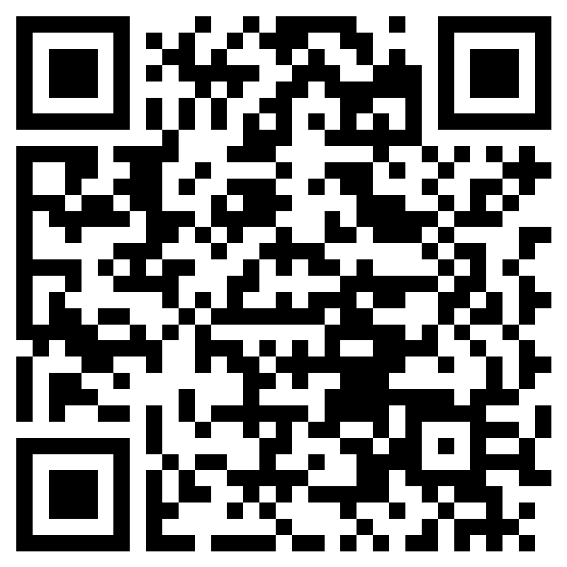
College Council – 4/23
  Future meeting
    Recommend District Services positions to be approved
    College Council Membership – Discussion Tomorrow
ASCCC Upcoming Events
  Spring Plenary: April 24 – 26 in Irvine
  Resolutions – Response Needed
  by Friday, April 25 6pm
  https://forms.office.com/r/hqaZYuYRqa

Slide 4


REMINDER: Roster Verification through Self Service – Pilot – Summer 2025
Census verifications of rosters are required by the California Education Code and are crucial for determining state funding for the college.
Email alert prior to Census Date with Due Date for Roster Verification
Self Service: Review Roster, drop no-shows or those not attending, and confirm roster is accurate by Due Date.
Census Verification in Self-Service (video)
Faculty Guide - Certifying Census Roster on Self-Service (written directions with images)
Will be shared out to all faculty and deans

Slide 5

BOT Meeting – 4/14/25, Next Meeting April 28 at SCC
Congratulations
Maria Davia
and
Jaime Lopez-Garcia!
Board Facilities Committee Meeting – Tonight 5pm
Board Fiscal/Audit Committee Meeting – May 6th 5pm
Board Institutional Effectiveness Committee – April 24 5pm: Discussion of Board Goals
Board Legislative Committee – met April 17th: AB988 – Advisory Board for Dual Enrollment (consist primarily of K-12 representation)

Slide 6
District Office Resource Requests – Action Item: May 28th POE (will post Form w/ rationale)
Business Services
1. Facilities Planning: Admin Clerk: $113,338
2. Facilities Planning: Facilities Specialist: $152,819
3. Senior District Safety Officer (armed) – 2 positions: $254,302
Human Resources
1. Director of Human Resources: $279, 337
2. Principal HR Analyst: $208, 131
Educational Services
1. District PIO: Communications Specialist: $113, 553
ITS
    Technical Specialist I: $127, 682
    Applications Specialist IV: $208, 940
    Help Desk Analyst: $127, 682
    ITS Technical Supervisor: $98, 182
Total Cost of all Positions (on-going):
$1,682,966

