Slide 1

Spring 2025 -
VP of CO
March 2025
ThePhoto by PhotoAuthor is licensed under CCYYSA.

Slide 2

Save the Date

Slide 3

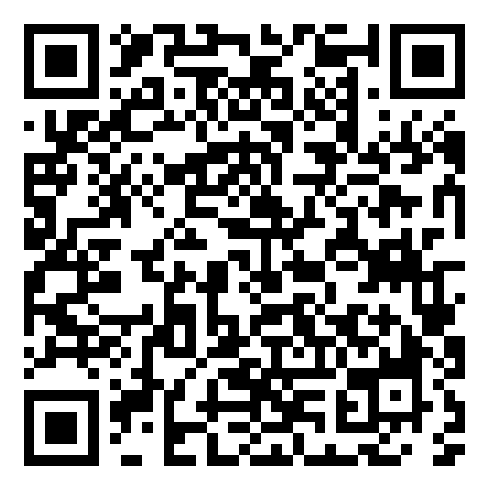
Academic Senate Dues
July 2023
84
March 2025
136
Please visit our Self-Service under the Daily Work Faculty tab labeled "Academic Senate Dues" to sign up.
Please continue sharing to fold in new faculty or faculty that have not signed up yet.

