Slide 1

SAC Online Proctoring DE advisory Recommendation to Senate

Slide 2
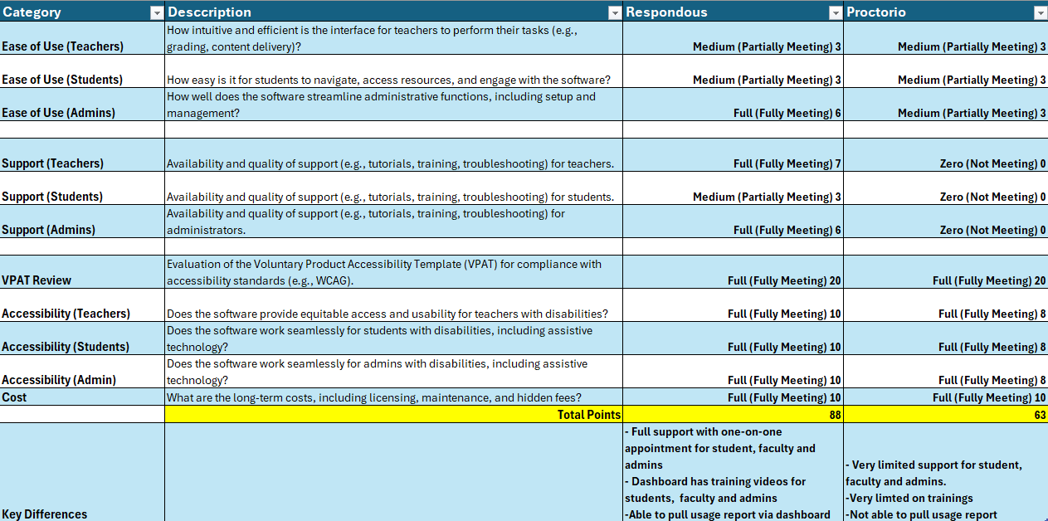

Slide 3

Comparison between Proctorio and Respondus
Respondus:
Full support with one-on-one appointment for student, faculty and admins
Dashboard has training videos for students, faculty and admins
Able to pull usage report via dashboard
Proctorio
Very limited support for student, faculty and admins.
Very limited on trainings
Not able to pull usage report

Slide 4

DE Advisory Workgroup Recommendation
The workgroup recommends not moving forward with Proctorio. Ending our contract after June, 2025 and beginning with Respondus as our online proctoring tool for the next academic year, starting in June 2025.
There will be training and workshop opportunities.
Communication has been made with SCC, regarding this recommendation and they are considering moving forward with us as well.

Slide 5

Thank you
On behalf of the DE Advisory Workgroup

