Slide 1

BOT Report – 3/25/25
Forensic Audit Findings ASCIP Rebates to be
agendized for future meeting
Audit Reports for the Fiscal Year ended June 30, 2024 -Approved
Board Goals
Goal 4: Advance Academic Excellence
Support increase in dual enrollment
Support strategies to decrease equity gaps in participation, persistence, and success
Advocate for increase in bachelor’s degrees
Support programs that increase traditional and non-traditional apprenticeships
Support guided pathways strategies
https://forms.office.com/r/bsvRdhnWNP

Slide 2

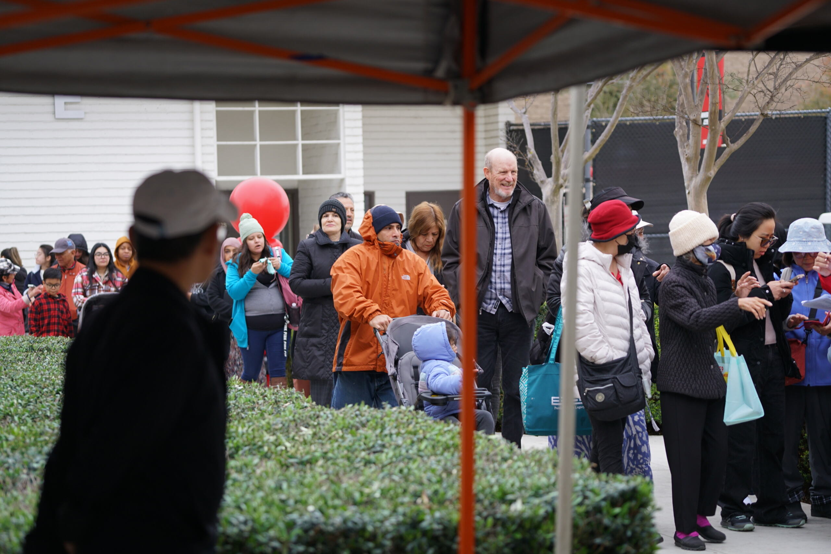
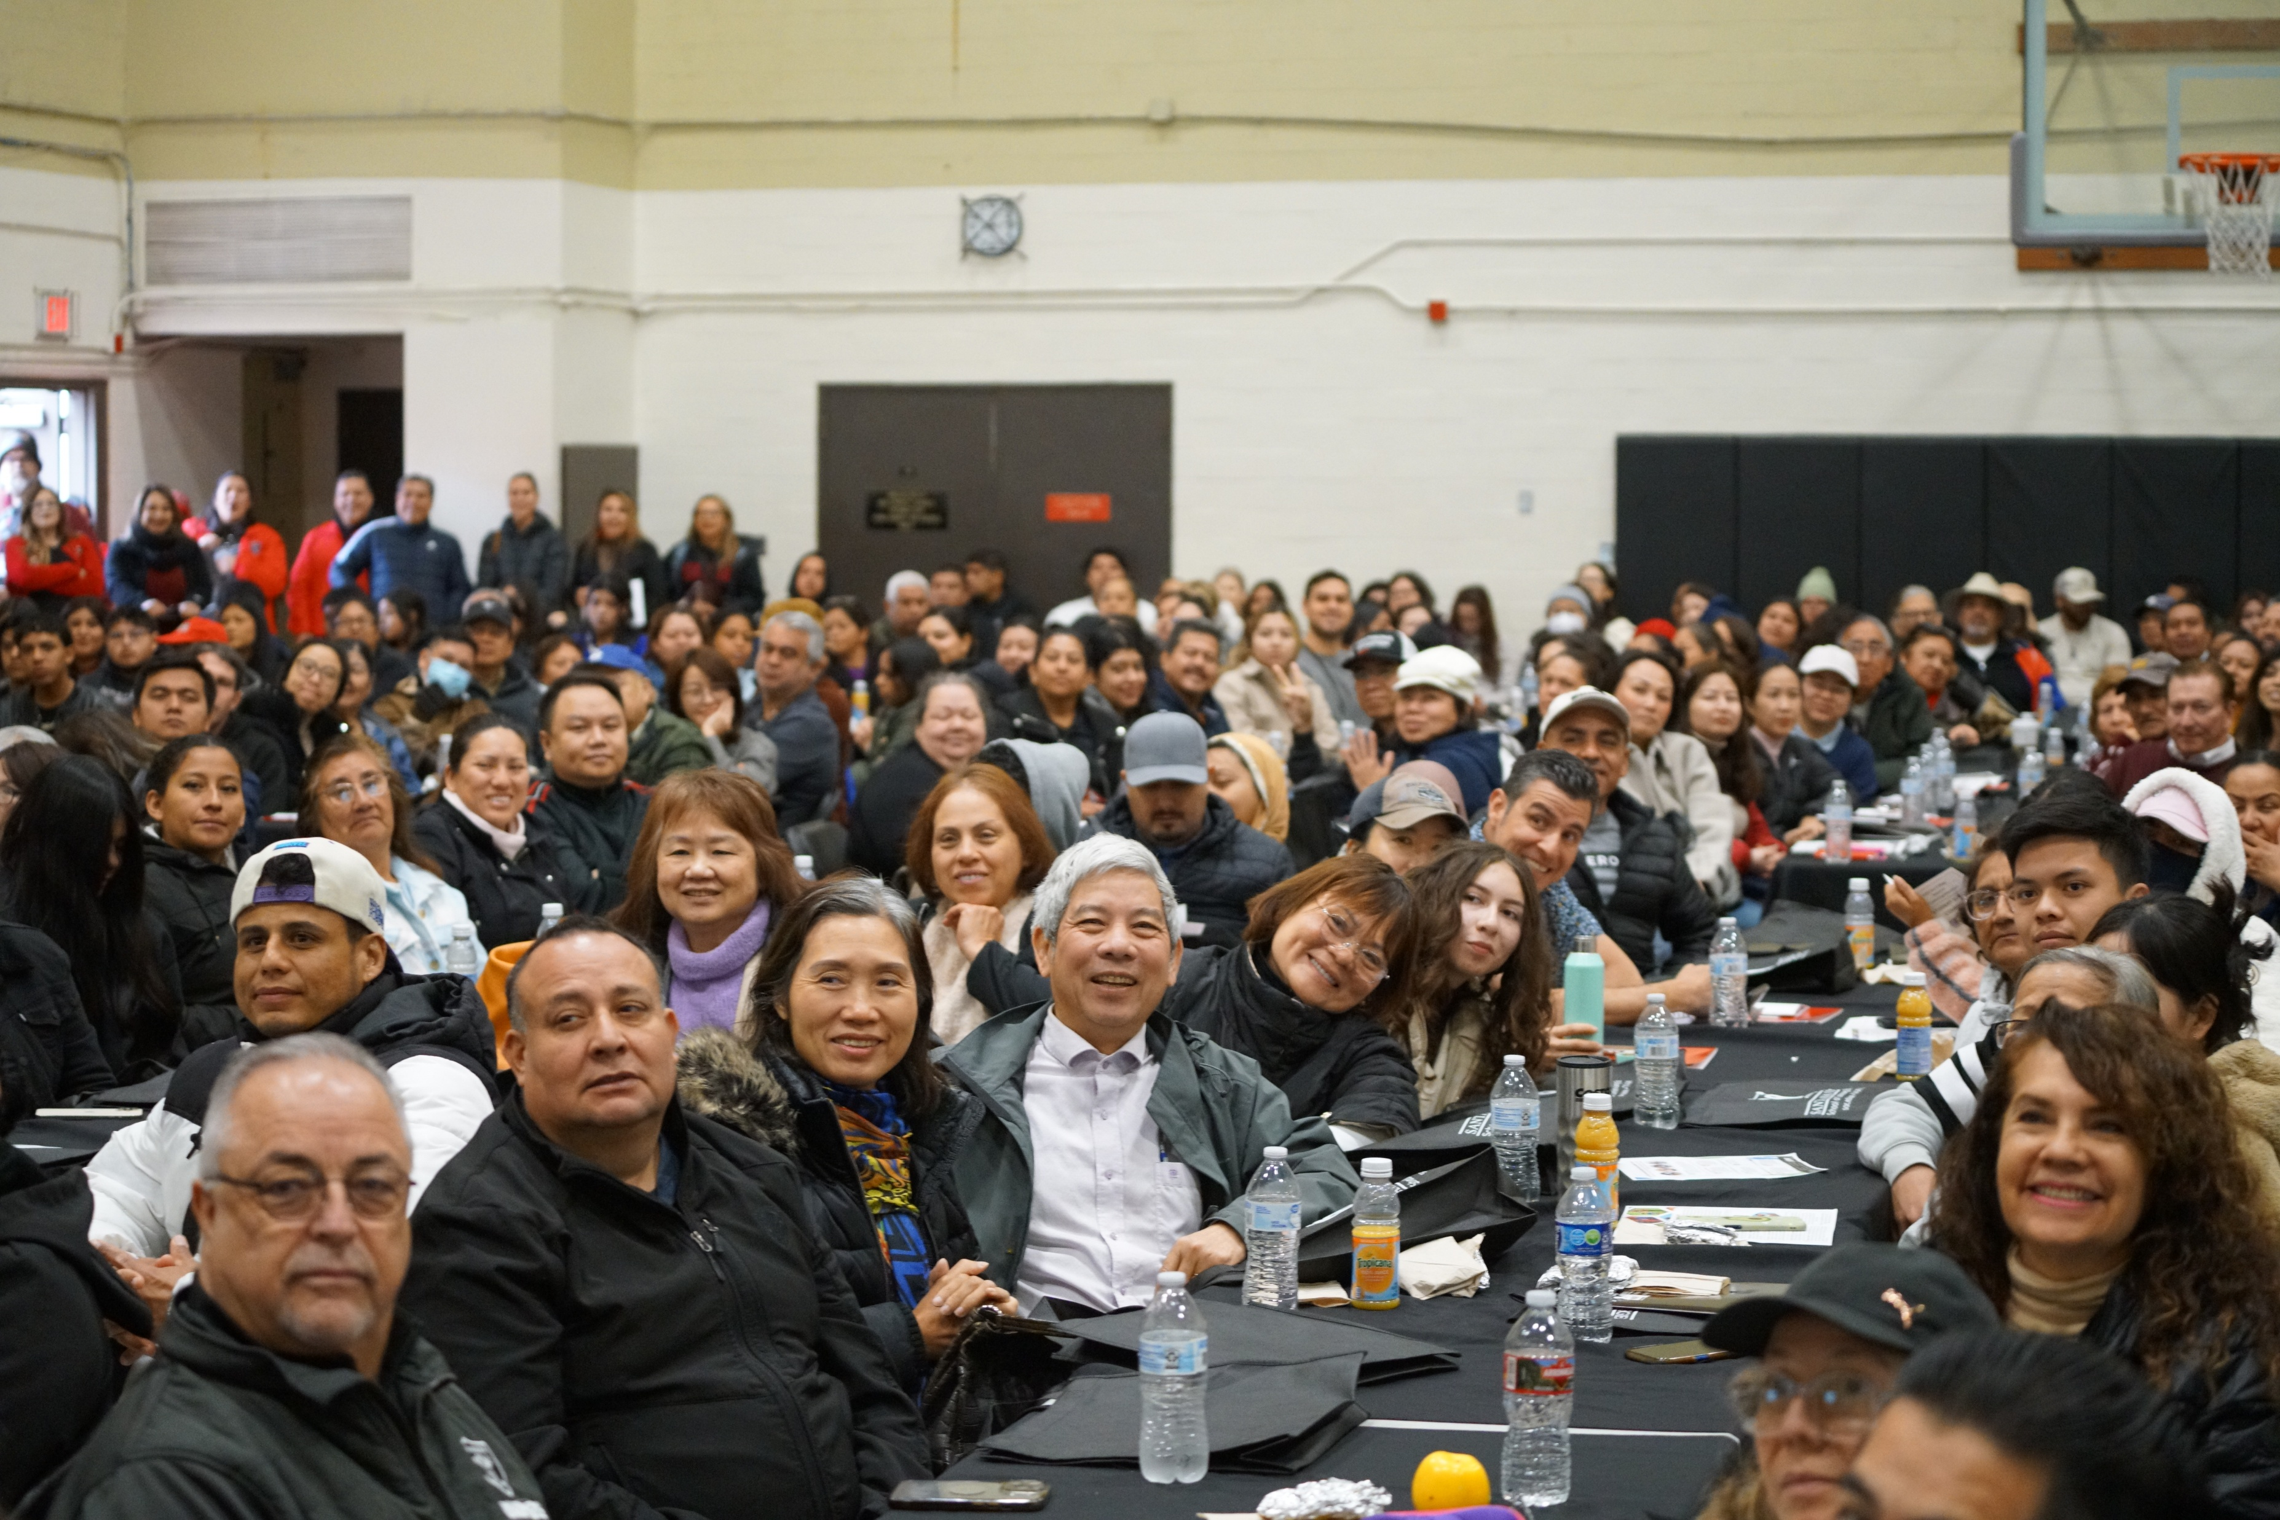
400 attendees -- previous highest attendance was 305 during our first conference in 2019
18 credit programs -the highest number to date, who agreed to participate by showcasing their facility/classroom, equipment, technology, and educate students on what they could expect to learn if they became students. This exceeded last year's number of 15
CONGRATULATIONS DR. MADRIGAL AND ALL THE CONTINUING EDUCATION FACULTY, CLASSIFIED PROFESSIONAL AND MANAGERS THAT MADE THIS EVENT AN AMAZING SUCCESS!!

Slide 3
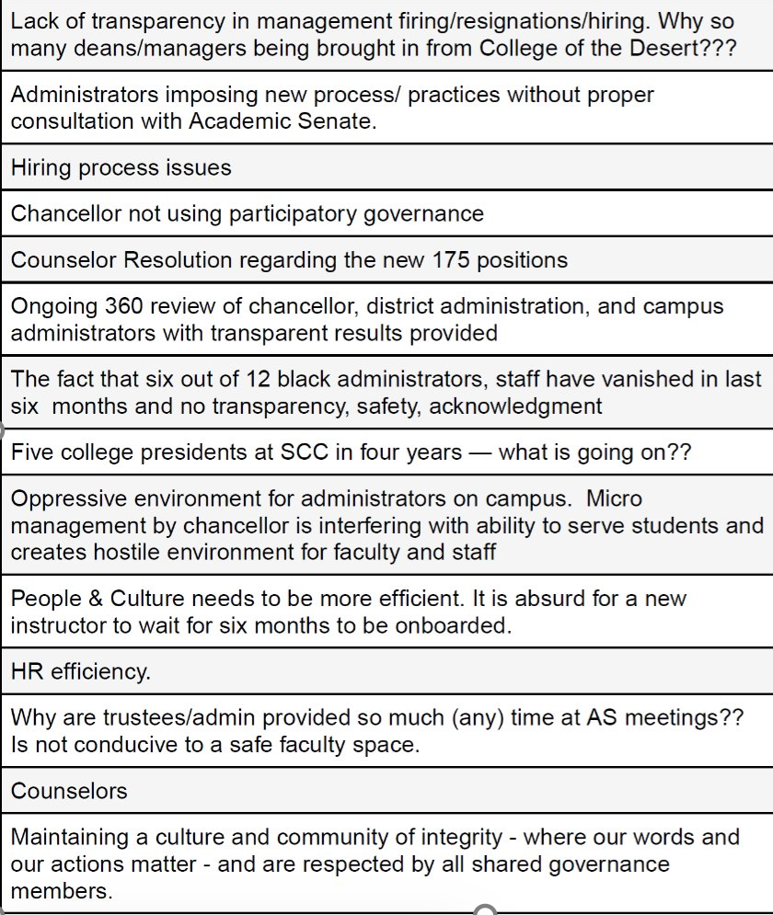
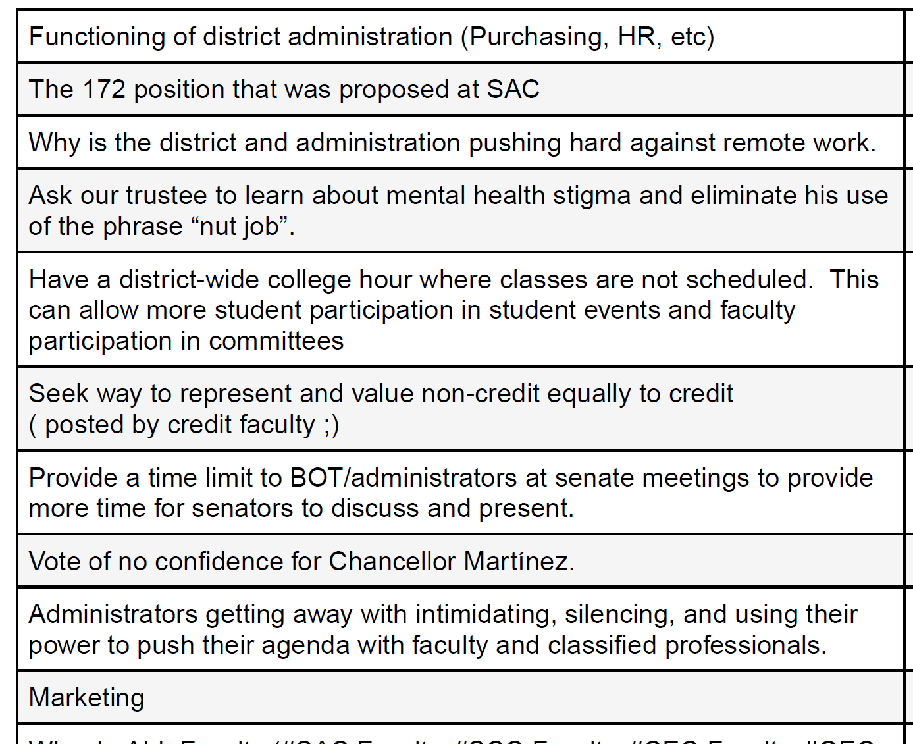
Revisiting
Retreat Survey Fall 2023

Slide 4

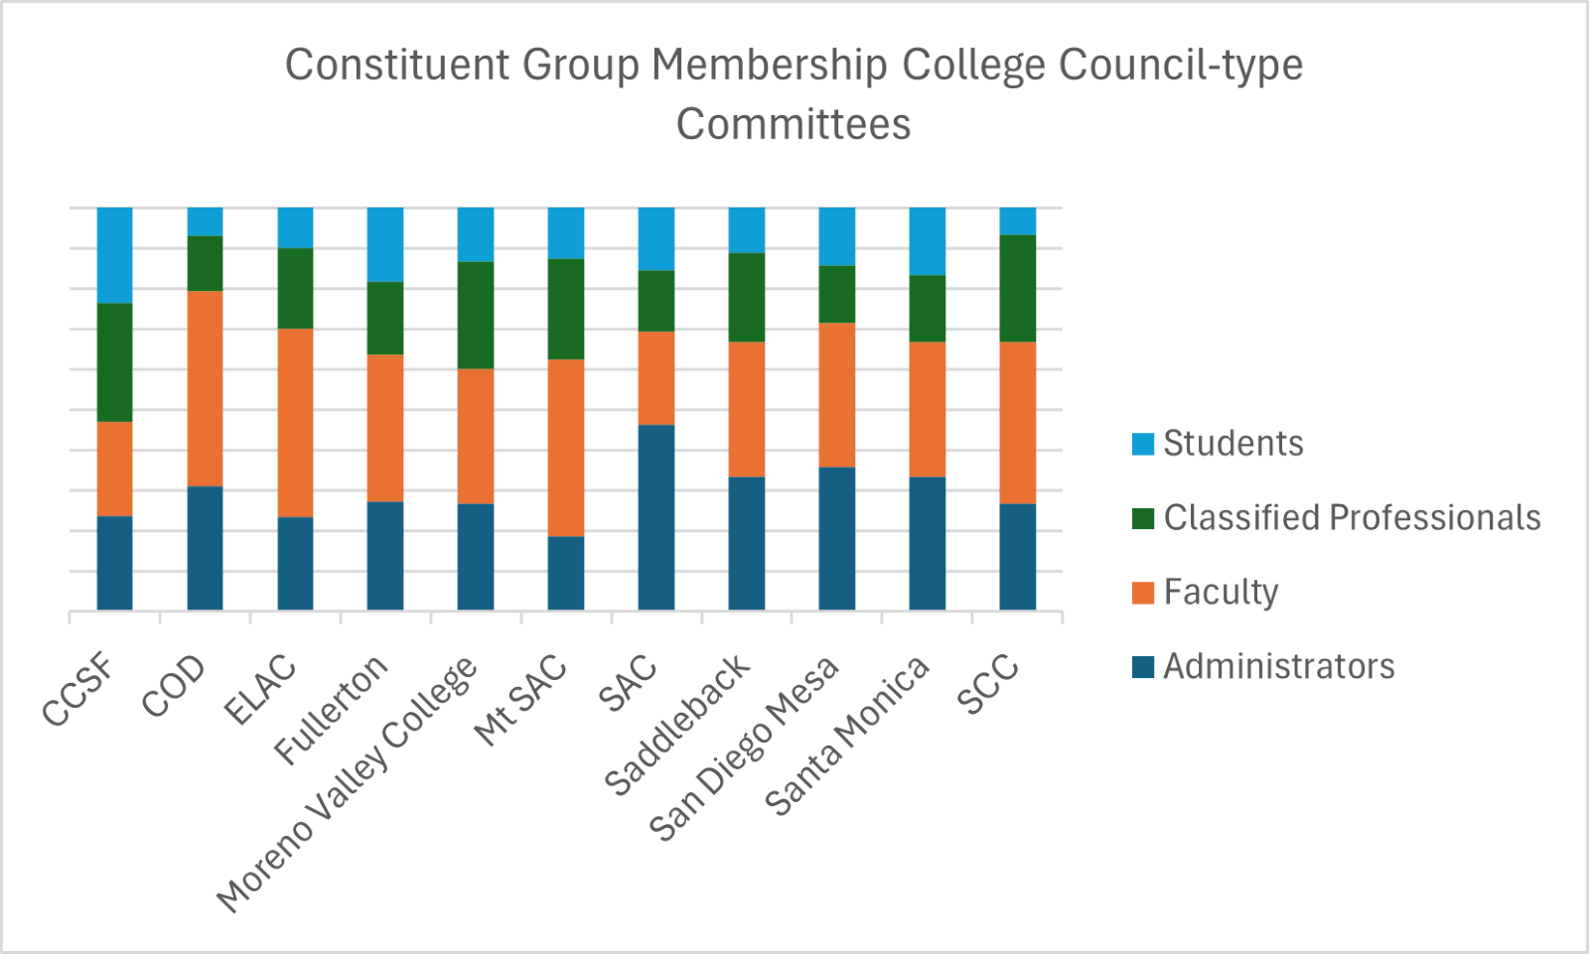
Senate Recommendation:
College Council Membership
College | Admin | Faculty | Class | Student | Total
CCSF | 4 | 4 | 5 | 4 | 17.00
COD | 9 | 14 | 4 | 2 | 29.00
ELAC | 7 | 14 | 6 | 3 | 30.00
Fullerton | 3 | 4 | 2 | 2 | 11.00
Moreno Valley College | 4 | 5 | 4 | 2 | 15.00
Mt SAC | 3 | 7 | 4 | 2 | 16.00
SAC | 6 | 3 | 2 | 2 | 13.00
Saddleback | 6 | 6 | 4 | 2 | 18.00
San Diego Mesa | 5 | 5 | 2 | 2 | 14.00
Santa Monica | 4 | 4 | 2 | 2 | 12.00
SCC | 4 | 6 | 4 | 1 | 15.00

Slide 5
Current Membership of SAC College Council | Recommendation for Updated Membership of SAC College Council
President (only votes in a tie) | President (only votes in a tie)
Administrators: VP, AA VP, AS VP, CE VP, SS Academic Affairs Manager Student Services Manager 6 | Administrators: VP, AA (or designee) VP, AS (or designee) VP, CE (or designee) VP, SS (or designee) 4
Faculty: AS President Faculty Rep Faculty Rep 3 | Faculty: AS President Faculty Rep Faculty Rep Faculty Rep 4
Classified Professionals: CP Rep 1 CP Rep 2 2 | Classified Professionals: CP Rep 1 CP Rep 2 CP Rep 3 CP Rep 4 4
Students: ASG President ASG Rep 2 | Students: ASG President ASG Rep ASG Rep (if available) 2-3
13 | 14-15

Slide 6

Register Today!
Upcoming Events

Slide 7
Future Senate meeting
Recommend District Services positions to be approved
Faculty Lead/Coordinator positions and process
ASCCC Upcoming Events
  Spring Plenary: April 24 – 26 in Irvine
  Funding Available! If you are considering to run for an officer position – please attend!

Slide 8
Equivalencies and Hiring Committees
Equivalencies
If applicant asking for an equivalency, Form 1 must be on file with HR.
Department creates Equivalency Committee – NOT HR
Dept Chair, Dept Faculty (Division or FSA faculty), SCC faculty (asked to participate but can decline) and Senate Representative (appointed by Senate President)
Hiring Committees for Faculty Positions
Administrative co-chair: Dean/Assoc Dean
Faculty co-chair: Dept Chair
All discipline faculty are invited to participate
Classified Rep may be included, Administrative co-chair connects with CSEA
Senate Representative (appointed by Senate President)

Slide 9
Roster Verification through Self Service – Pilot – Summer 2025
Census verifications of rosters are required by the California Education Code and are crucial for determining state funding for the college.
The purpose of census is to ensure accurate reporting of student enrollment for apportionment purposes
If a student receives financial aid but doesn't attend classes, the college may be required to return a portion or all of that aid to the government.
Email alert prior to Census Date with Due Date for Roster Verification
Self Service: Review Roster, drop no-shows or those not attending, and confirm roster is accurate by Due Date.

Slide 10
Faculty Liaison to ASG
Why?
Provides student government with a clear path to engage with faculty on academic concerns, ensuring student voices are heard.
Ensures that student perspectives are actively included in decision-making processes, preventing student concerns from being overlooked or disregarded.
Serves as a mentor for students, helping them navigate governance committees and providing guidance on how to effectively contribute to decision-making processes.
Assists in presenting student government recommendations to faculty, promoting smoother policy changes that benefit students.
Recommendation: Joint Resolution to formally establish a Faculty Liaison to ASG
Volunteers to collaborate with ASG leadership on creating the resolution

Slide 11
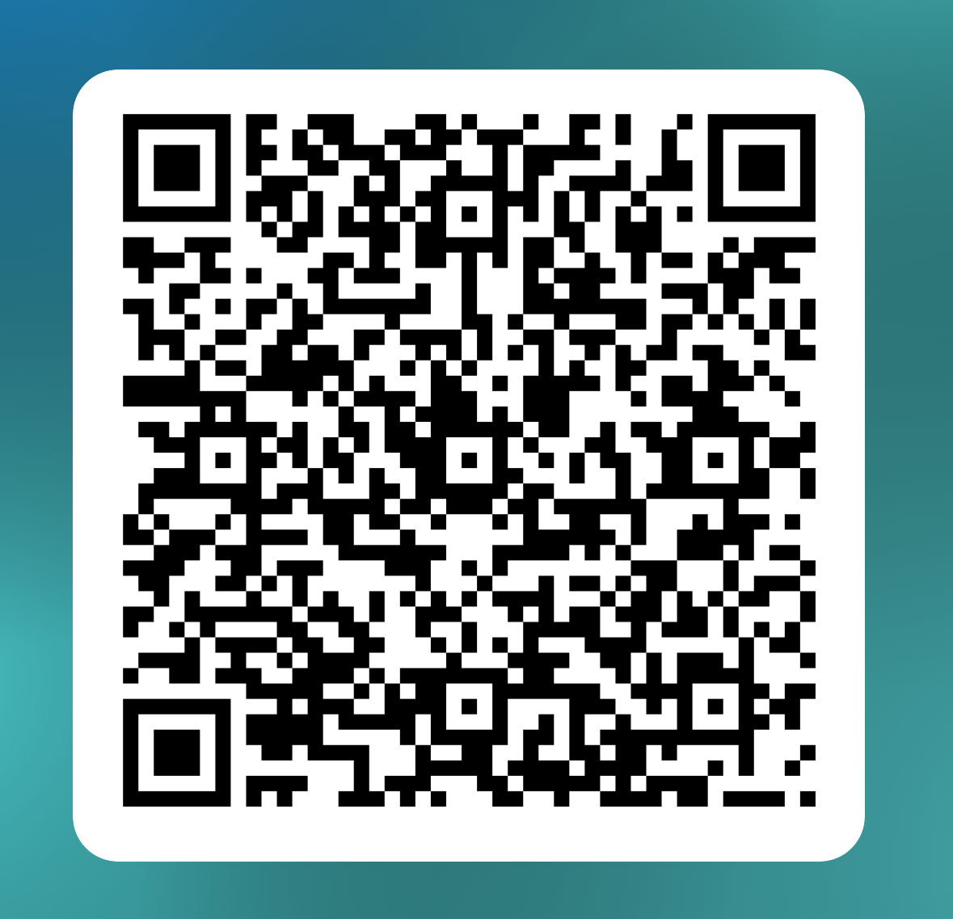
Faculty Prioritization Process Taskforce
Review and recommend updates (process, metrics, ranking rubric, etc.) for Senate approval and implementation for Fall 2025
Complete Form by Noon 3/14
https://forms.office.com/r/bgJbKNZE3U
Tentative Timeline
Data Request to Research - June 2025
Hiring Request Form available in August (Flex Week)
Training: Flex Week
Full-Time Faculty Hiring Request Form Due: mid – late September
FPC Review and Rank Requests: early October
P&B Recommendation to College Council: 1st meeting in October
Final Ranking Meeting: October 17th or 24th
Affirmation of Final Rankings by the SAC Academic Senate: October 28th
President’s approved positions to HR 1st week of November

