Slide 1
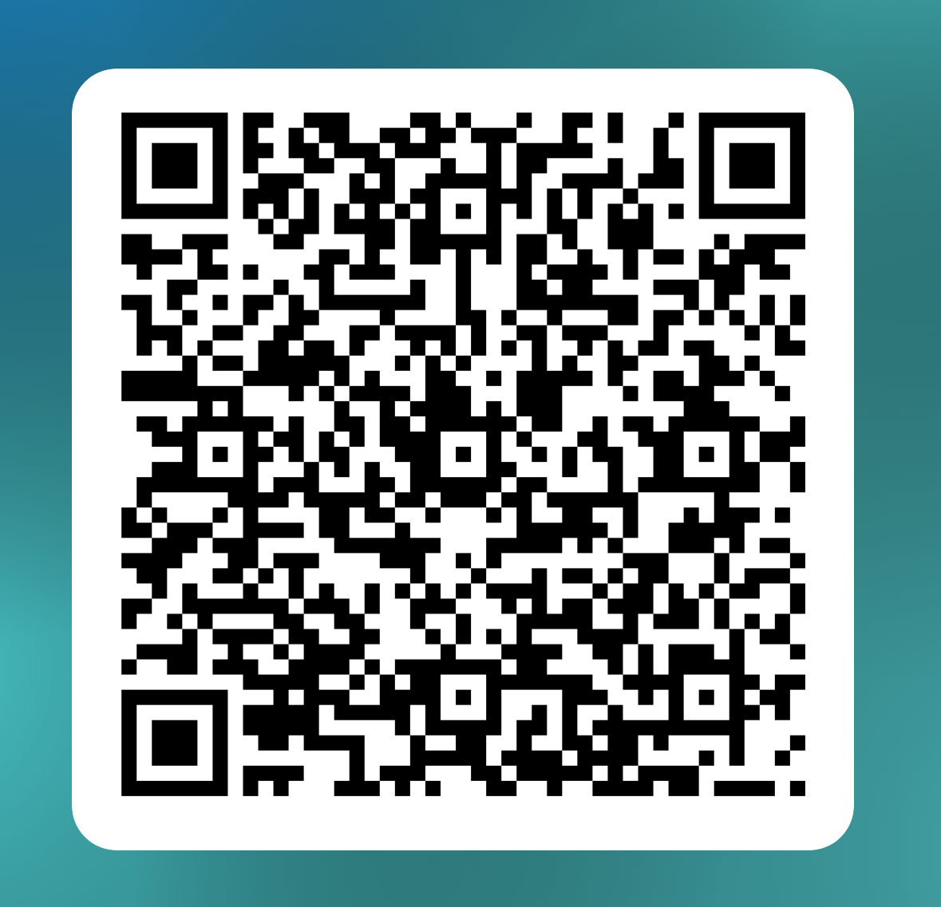
Faculty Prioritization Process Taskforce
Review and recommend updates (process, metrics, ranking rubric, etc.) for Senate approval and implementation for Fall 2025
Complete Form by Noon 3/14
https://forms.office.com/r/bgJbKNZE3U
Tentative Timeline
Data Request to Research - June 2025
Hiring Request Form available in August (Flex Week)
Training: Flex Week
Full-Time Faculty Hiring Request Form Due: mid – late September
FPC Review and Rank Requests: early October
P&B Recommendation to College Council: 1st meeting in October
Final Ranking Meeting: October 17th or 24th
Affirmation of Final Rankings by the SAC Academic Senate: October 28th
President’s approved positions to HR 1st week of November

Slide 2

Faculty Liaison to ASG
Why?
Provides student government with a clear path to engage with faculty on academic concerns, ensuring student voices are heard.
Ensures that student perspectives are actively included in decision-making processes, preventing student concerns from being overlooked or disregarded.
Serves as a mentor for students, helping them navigate governance committees and providing guidance on how to effectively contribute to decision-making processes.
Assists in presenting student government recommendations to faculty, promoting smoother policy changes that benefit students.
Recommendation: Joint Resolution to formally establish a Faculty Liaison to ASG
Volunteers to collaborate with ASG leadership on creating the resolution

Slide 3

BOT Retreat Report – 3/10/24
Presentation on Board Roles and Responsibilities
Focus – Accreditation Standards
Forensic Audit Findings ASCIP Rebates
Board recording will be shared out
Board Goals
Goal 4: Advance Academic Excellence
Support increase in dual enrollment
Support strategies to decrease equity gaps in participation, persistence, and success
Advocate for increase in bachelor’s degrees
Support programs that increase traditional and non-traditional apprenticeships
Support guided pathways strategies
https://forms.office.com/r/bsvRdhnWNP

Slide 4
College Council – 3/12
Reorgs Requests:
  Auxiliary Services-(Director)-Revised
  Guardian Scholars (Fulltime Administrative Clerk)
  EOPS/CARE/CalWORKS/Guardian (Fulltime Student Services Specialist)
  CARE/CalWORKS (Fulltime Student Services Specialist)
  Academic Affairs/Fine & Performing Arts (Associate Dean)
  Academic Affairs/Kinesiology & Athletics (Associate Dean)
Future meeting
Recommend District Services positions to be approved
Update to College Council Membership
ASCCC Upcoming Events
  Area Meetings: March 21
  Spring Plenary: April 24 – 26 in Irvine

Slide 5
Equivalencies and Hiring Committees
Equivalencies
If applicant asking for an equivalency, Form 1 must be on file with HR.
Department creates Equivalency Committee – NOT HR
Dept Chair, Dept Faculty (Division or FSA faculty), SCC faculty (asked to participate but can decline) and Senate Representative (appointed by Senate President)
Hiring Committees for Faculty Positions
Administrative co-chair: Dean/Assoc Dean
Faculty co-chair: Dept Chair
All discipline faculty are invited to participate
Classified Rep may be included, Administrative co-chair connects with CSEA
Senate Representative (appointed by Senate President)

Slide 6
Roster Verification through Self Service – Pilot – Summer 2025
Census verifications of rosters are required by the California Education Code and are crucial for determining state funding for the college.
The purpose of census is to ensure accurate reporting of student enrollment for apportionment purposes
If a student receives financial aid but doesn't attend classes, the college may be required to return a portion or all of that aid to the government.
Email alert prior to Census Date with Due Date for Roster Verification
Self Service: Review Roster, drop no-shows or those not attending, and confirm roster is accurate by Due Date.

Slide 7

Save the Date!
Upcoming Events

Slide 8

Register Today!
Upcoming Events

