Slide 1
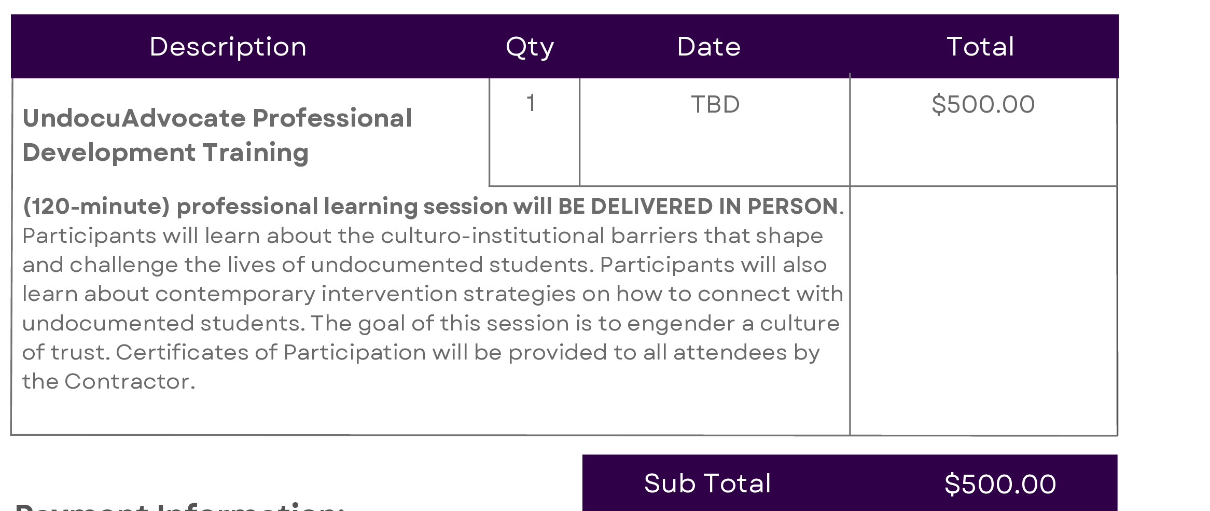
UnDocuAdvocate PD Training
If Senate Supports this PD opportunity: Affirmation of up to $500 Faculty PD funds for this training

Slide 2
President’s Report
Vista Meridian – Updates
Concerns raised regarding Math Center and defacing of property
DM Move to SAC Campus Workgroup – no update
College Council – Tomorrow (via Zoom)
2 Reorganizations
Auxiliary Services-Director → Executive Director, Auxiliary Services & Enterprise Operations
Administrative Clerk – Guided Pathways
18 BPs/ARs reviewed by HRC (Human Resource Committee)
Resource Request Presentation from Chief Communications Office
VRC – Renaming in honor of John Acuna – Clarification – No date has been discussed/determined.

Slide 3
AI Fellows –Applications Due March 7, 2025
Compensation: Response from CCCCOs office – It is a compensated position based in current salary/hourly rates. Fellows would need to receive release time approval.
Enrollment as of Noon 2/25/25
Per 540 Report- Census Reporting Enrollment and FTE Computation
  Total FTES: 4906.85 (5055.73 reported at Enrollment Management 2/18)
  Does not include all Positive Attendance from Academies ~1500 FTES
  Additional sections are being added…
  Continuing Education: Reported at last night's BOT meeting - 2082FTES

Slide 4
Apprenticeships
March 10th Dept of Justice will tour CJA/OC Sheriff’s Academy
March 11th US Forest Service will be meeting with Fire Academy
Credit For Prior Learning – Interested in learning more? Let me know!
Computer Science, EMT – State Recommendations available
Automotive Tech and CJ at SAC – work has been and is being done

Slide 5
Apprenticeships
March 10th Dept of Justice will tour CJA/OC Sheriff’s Academy
March 11th US Forest Service will be meeting with Fire Academy
Credit For Prior Learning
Computer Science, EMT – State Recommendations available
Automotive Tech and CJ at SAC – work has been and is being done

Slide 6

President’s Report
BOT Meeting - February 25 Next meeting Monday, March 10
Presentation on Measure G Findings
Campaign Committee: Chancellor, Cabinet Members, College Presidents and Consultant Group (1 committee member from District)
Vote turnout low, Political Demographics (heavy Republican/Conservative district), More money for campaigning, starting earlier with campaigning, better endorsers of the Bond on voter ballot information booklet
Approve the memorandum of understanding (MOU) with Southern California News Group (SCNG), as presented
Advertising campaign with OC Register for 18 months (funded by General funds of District, SAC and SCC) totaling $237,550. Failed

Slide 7

Save the Date!
Upcoming Events

Slide 8
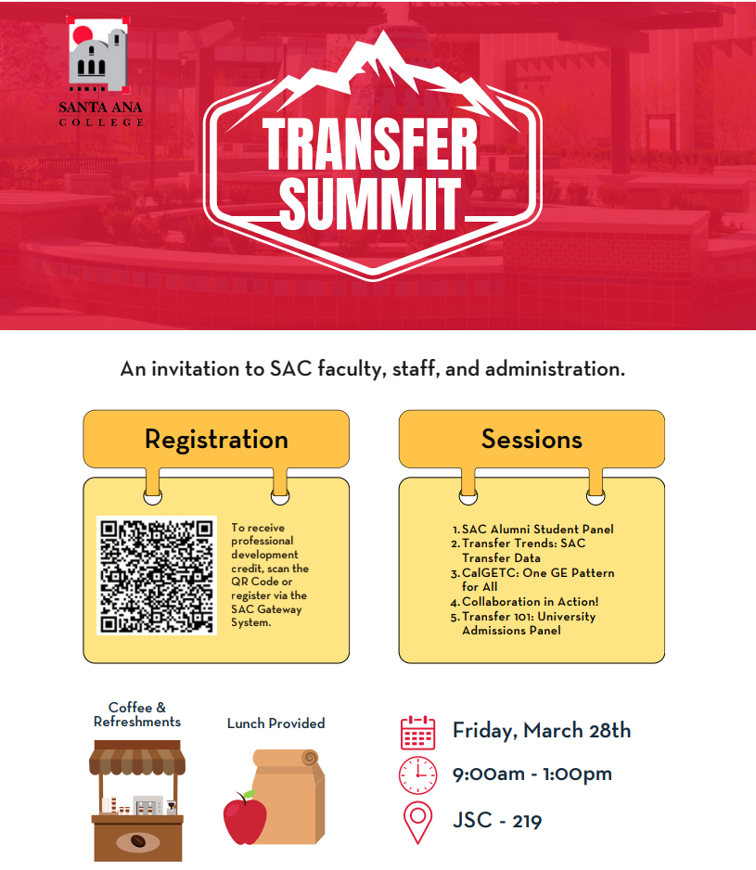
Save the Date
Upcoming Events

