Slide 1
Supporting Student Mental Health during challenging times
Academic Senate Retreat_2/5/25

Slide 2

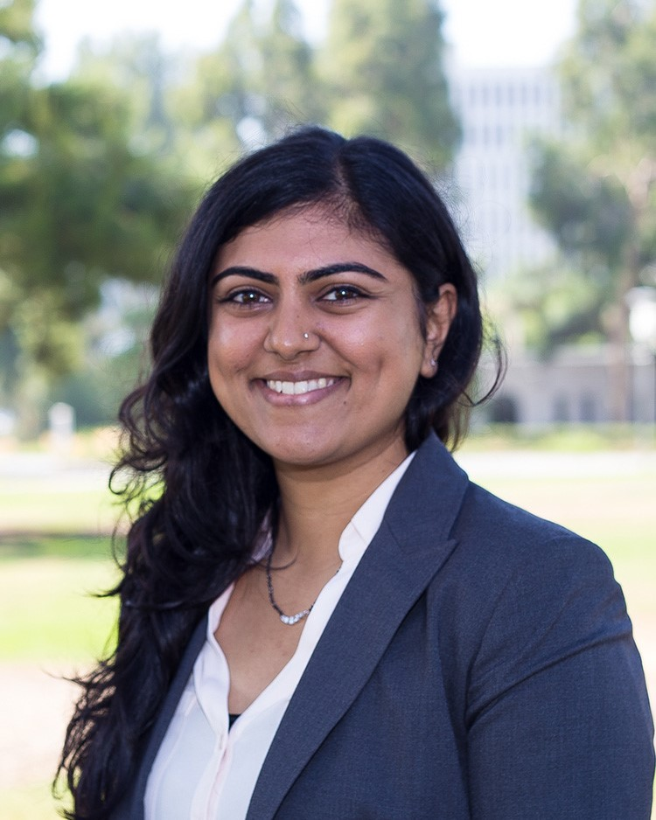

Meet the Psych Services
Team
Geena Guerrido, Ph.D.
Clinical Psychologist
Jill Kapil, Psy.D.
Clinical Psychologist
Rashida Mosley, Psy.D.
Clinical Psychologist

Slide 3
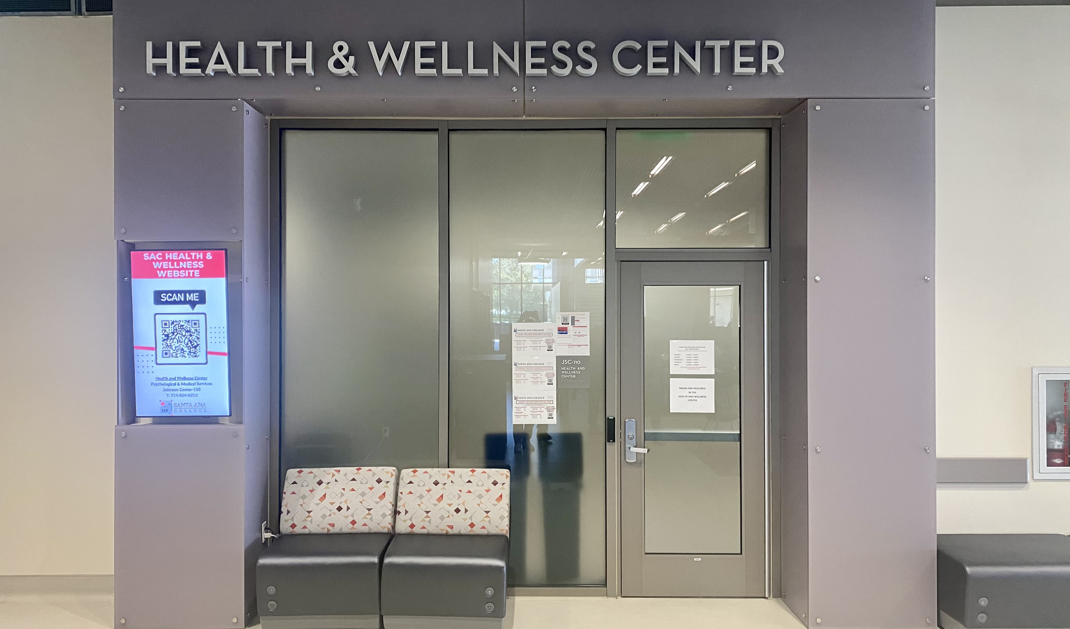

Health and Wellness Center
Johnson Student Center – 110
Spring 2025 Office Hours
  Monday-Thursday: 8am-4:30pm
  Friday: 8am-11:30am
Phone: (714) 564 6216
Email:
sachealth_center@sac.edu

Slide 4
Types of Appointments
Intake
Ongoing counseling
Urgent Crisis

Slide 5
How to Support A student

Slide 6
Supporting students IN distress
Active Listening & Empathy:
Be available to listen without judgment.
Avoid jumping to conclusions or offering solutions immediately unless the student asks.
Normalizing Mental Health Struggles:
Normalize the conversation around mental health.
Let students know that it's okay to struggle emotionally, and it doesn’t reflect their overall abilities or potential.

Slide 7
Create a supportive environment
Encourage
Help-Seeking Behaviors:
Remind students about Health and Wellness Center, and off-campus helplines.
Provide specific information, such as how to make an appointment or how to access services online.
Promote
Open Dialogue on Social Issues:
Foster a safe space where students can share their concerns about national and international issues affecting them, including political change or societal challenges.
Establish ground rules for respectful, open, and nonjudgmental conversations.

Slide 8
Create a supportive environment
Immigrant and Undocumented Students:
Be aware of the challenges faced by immigrant or undocumented students.
Provide them with resources related to legal aid, financial assistance, and mental health services tailored to their needs.
Affirm
LGBTQ+ Identities:
Be an ally to LGBTQ+ students by incorporating inclusive language, policies, and teaching materials that reflect diverse identities.
Let students know that your classroom is a safe space for them to be themselves.
Support

Slide 9
Coping with uncertainty
Mindfulness & Deep Breathing
Practice grounding techniques (e.g., 4-4-4 breathing) to reduce stress and stay focused.
Cognitive Reframing
Help students challenge negative thoughts and reframe them into more balanced perspectives.
Limit News Consumption
Advise setting boundaries on news and social media to prevent overwhelm.
Journaling or Writing
Suggest expressive writing or gratitude journaling to process emotions.

Slide 10
Coping with uncertainty
Social Support
Remind students to connect with supportive friends or peers for comfort.
Self-Compassion
Remind students to treat themselves with kindness during stressful times.
Sleep Hygiene
Advise maintaining a regular sleep schedule for emotional balance and focus.

Slide 11
Outreach Requests
Faculty are welcome to request a Psychologist to present in their classroom. Common topics include:
    overview of HWC services, stress management, coping with anxiety, optimizing sleep, and more
Faculty are encouraged to submit these requests early in the semester to ensure Psychologist availability.
Use the "outreach request form" available on the HWC website to submit your request

Slide 12

Off-Campus Resources
IN AN EMERGENCY: After hours or on weekends, you can:
Call the Suicide & Crisis Lifeline at 988
  1-800-273-TALK (8255)
2) Text the Crisis Text Line: Text COURAGE to 741-741.
If you are in need of emotional support, call or text the NAMI WarmLine:
  The OC WarmLine servicing Orange County, CA resident only.
  Call or text: (714) 991-6412 Toll Free 877-910-9276

Slide 13
Health and Wellness Center
Website review

Slide 14
Thank You
Questions?

