Slide 1
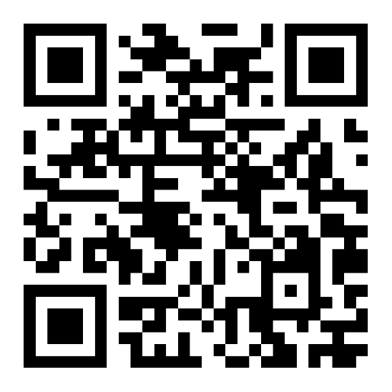
Good morning!
Welcome to the
Spring 2025
Senate Retreat
February 5, 2025

Slide 2

Community Agreements for Brave Conversations
Be true to yourself.
Commit to learning from each other.
Trust that others are doing the best they can.
Recognize and affirm the diverse identities within the room.
When an oppressed person speaks regarding oppression, recognize that they speak with experiential knowledge and thus should be trusted to know this truth.
Challenge the idea and not the person.
Speak your discomfort.
Listen with intention, focusing on understanding others' perspectives.
Seek first to understand, then to be understood

Slide 3
Today's Agenda
Informational Items and Discussion
  Centering Our Commitment to Student Success: Advocacy & Empowerment of our Immigration Impacted & LGBTQ+ community
  A Safe and Secure Campus for All: Answers to educator questions about immigration enforcement
  Supporting Student Mental Health during Challenging Times
  Fraudulent Students
  FARSCCD Upate
Senate Officer Updates
Senate Committee/Advisory Group Updates
Breakouts 1 &2 (separate registration)
  Curriculum Updates for Courses & Programs
  Credit for Prior Learning

Slide 5
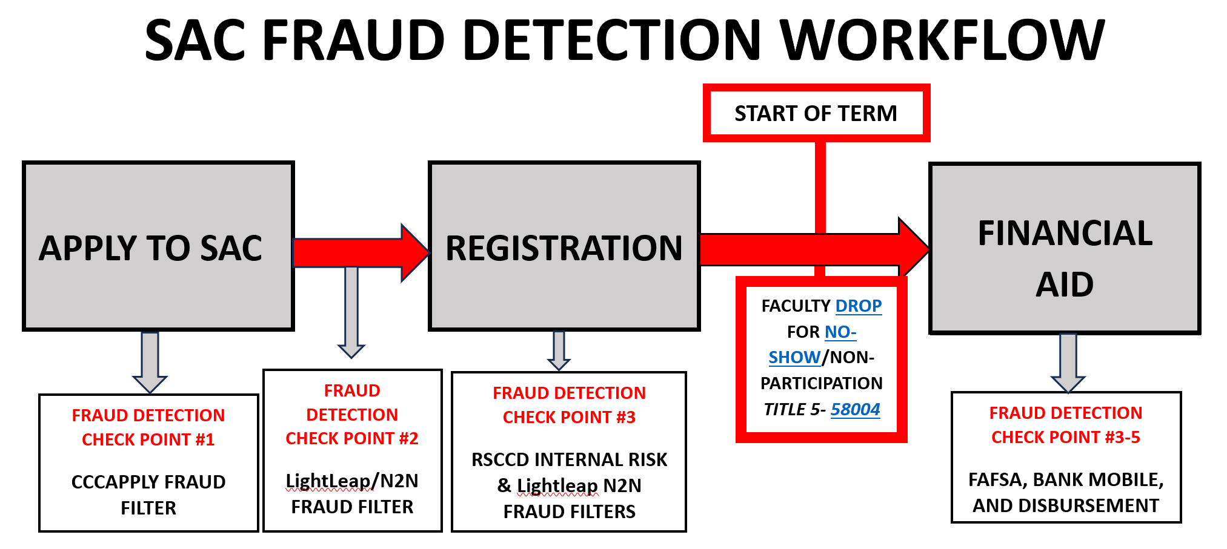
Fraudulent Students – Where are we at?

Slide 6
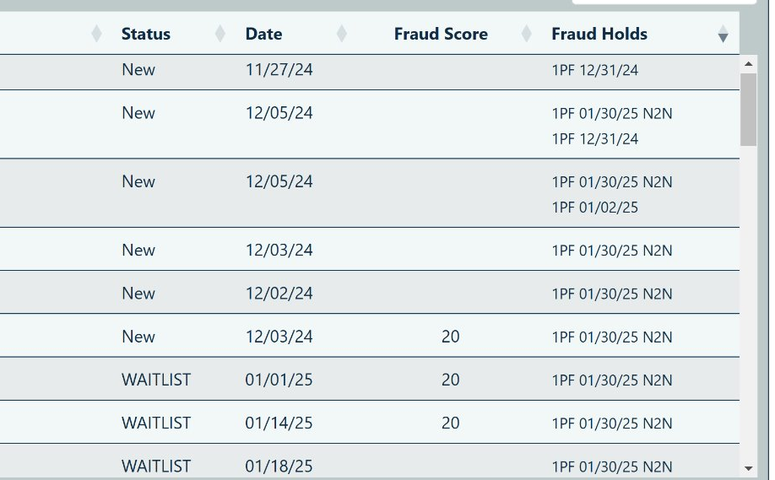
Fraudulent Students – Where are we at?
Fraud Rosters
1PF = SAC Potential Fraud hold
1N2N = Lightleap AI Fraud hold
These should not be as common moving forward
This Friday – Identity not validated and PF removed will be blocked from all SAC programs
Faculty, drop any 1PF/N2N holds on your roster on Monday, first day of class.

Slide 7
Fraudulent Students – Where are we at?

