Slide 1


A Safe and Secure Campus for All
Answers to questions about immigration
Version: 2/04/25 #1
Notes:
The election was about many things and people can have diverse opinions. We must also allow for a range of opinions on our campus. Your students, nevertheless, may be worried about something in particular: immigration, and that is what we will address in this presentation. As professors, teachers, classified, and administrators, we may be called upon to answer student questions. We want you to be prepared. Some colleague will also be impacted by immigration. Our professionalism and response to questions may determine whether a student comes to class, stays in school, or participates in continuing education.
California’s attorney general office states that “postsecondary educators have the incredible opportunity, and responsibility, to provide effective learning environments for all students, regardless of nationality or immigration status “As reported by the Migration Policy Institute, there are currently 150,090 Deferred Action for Childhood Arrivals (DACA) recipients in California. Overall, in 2021, there were approximately 83,000 undocumented postsecondary students in California, approximately 38,000 of whom were DACA recipients.”
“Under the U.S. Constitution, all students have a right to receive an education without discrimination based on immigration status. In Plyler v. Doe, the U.S. Supreme Court recognized that undocumented immigrant students cannot be denied equal access to a public education on the basis of their immigration status.”
Moreover, "[u]nder the California Constitution, all students and staff—regardless of immigration status— have a right to privacy and “the inalienable right to attend campuses which are safe, secure and peaceful. The California Supreme Court has affirmed that an immigrant student’s right to an equal educational opportunity is “a vitally important right in our society.” Protections are expressly codified in California law to assure educational access for all, regardless of a student’s immigration status, “in any [educational] program or activity conducted by an educational institution that receives, or benefits from, state financial assistance, or enrolls pupils who receive state financial aid.”
See: Introduction to "Promoting a Safe and Secure Campus for All. Guidance and Model Policies to Assist California’s Colleges and Universities in Responding to Immigration Issues.”

Slide 2

Topics
This is No Substitute for Legal Advice to Specific Inquiries.
What has RSCCD said?
What happened in prior presidential administrations?
What does this mean for 2025 and beyond?
What are your and your students’ immigration rights?
What community legal resources in immigration are available for students and staff who may need them?
What other resources are available?

Slide 3


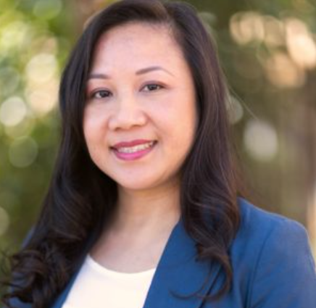
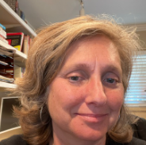
Amina Fields, Esq.
Immigrant Rights Senior Managing Attorney
Council on American-Islamic Relations
Adjunct Instructor, Legal Studies
Santa Ana College
Kim Smith, Esq
Assistant Professor
Legal Studies Department
Santa Ana College
Notes:
This presentation is the work of Professors Amina Fields, Esq., and Kim Smith, Esq. Professor Fields is the senior managing immigration attorney for the Greater Los Angeles Office of the Counsel on American-Islamic Relations (CAIR) and an adjunct professor at Santa Ana College, where she teaches immigration law. Professor Smith co-chairs the Legal Studies Department at Santa Ana College and coordinates SAC students' work experience and clinic opportunities.
This presentation was created in early January 2025. Version dates are noted on the first slide. We invite fellow Educators to amend, review and revise this presentation as they see fit. Professors Smith and Fields provided an attorney review of the original version; however, with the fluid state of law and politics, change may occur quickly. This presentation does not substitute for legal advice which may be needed by individuals without legal status in the United States. Included below in the original presentation are local legal resources. Amina Fields can be reached at irc@losangeles.cair.com and Professor Smith can be reached at smith_kim@sac.edu
Students needing support should contact UndocuScholars@sac.edu for advice, access to attorneys (www.findyourally.com) and allyship. We also want to acknowledge to support, work, and resilience of SAC's Undocu-center, especially Rodrigo Ramirez, and all of SAC's Undocu-scholars. They make these efforts worthwhile.

Slide 4


RSCCD:
A message of Commitment and Support from the Chancellor
Our campuses are, and always will be, places where every member of our community can feel valued, supported, and safe. Please rest assured that RSCCD is committed to maintaining our campuses as safe spaces for all staff and students. No matter our challenges, we will continue to foster an environment where every individual is welcomed and respected.​
Our commitment to these principles is unwavering. We stand firmly behind our students, staff, and faculty, offering steadfast support for those who may feel particularly vulnerable during this time.
Notes:
What has RSCCD said so far? Here is our Chancellor’s Message of Commitment and Support, email to all RSCCD employees dated November 7, 2024. The education community is starting to comment and our response is taking shape. Likely this topic will be addressed more as schools start up.

Slide 5


We remain steadfast in our mission to provide every student with the resources and opportunities they need to succeed. I will continue to stand with all students seeking to better themselves through education at SAC and SCE.​
Santa Ana College is committed to promoting a safe, supportive, and welcoming environment for students, staff, faculty, and community members. We share a collective responsibility to foster an environment where everyone feels valued. Let’s continue to support one another and respect the diverse perspectives that make this community strong. ​
Let us stand together in support of one another.

Slide 6
What happened during President Trump’s first administration?
Attempt to end TPS
Attempt to end DACA
Increase in arrests by ICE
Muslim Ban 3.0
Change in Enforcement Priority
Use of the "Bully Pulpit" to Achieve Policy Goals
Notes:
President Trump is active on the topic of immigration. Here are some of the benefits and programs the Trump Administration tried to end in his first term.
1.Attempt to end TPS – For example, they tried to end TPS for Syria, but it was stopped through litigation because they failed to follow proper procedures. About 60,000 people in California have TPS status. TPS-Fact-Sheet_October-2023.pdf https://immigrationforum.org/wp-content/uploads/2023/10/TPS-Fact-Sheet_October-2023.pdf
2.Attempt to end DACA – It’s still in litigation.
On Sept. 13, 2023, the U.S. District Court for the Southern District of Texas issued a decision finding the Deferred Action for Childhood Arrivals (DACA) Final Rule unlawful and expanding the original July 16, 2021 injunction and order of vacatur to cover the Final Rule. However, the court maintained a partial stay of the order for “all DACA recipients who received their initial DACA status prior to July 16, 2021.” State of Texas, et al v. U.S, et al
3.Increased arrests by ICE – Increased raids at places of work, but not sensitive places like places of worship, schools, and hospitals
Schools are bracing for upheaval over fear of mass deportations; https://www.startribune.com/trump-promised-mass-deportations-educators-worry-fear-will-keep-immigrants-kids-from-school/601187538
It is difficult to predict whether these places will be off-limit.
Since 2011, U.S. Immigration and Customs Enforcement has operated under a policy that immigration agents should not arrest or conduct other enforcement actions near ''sensitive locations,'' including schools, hospitals and places of worship. Doing so might curb access to essential services, U.S. Secretary of Homeland Security Alejandro Mayorkas wrote in a 2021 policy update. The Heritage Foundation's policy roadmap for Trump's second term, Project 2025, calls for rescinding the guidance on ''sensitive places.'' Trump tried to distance himself from the proposals during the campaign, but he has nominated many who worked on the plan for his new administration
4.Muslim Ban 3.0
Iran, Libya, North Korea, Somalia, Syria, Venezuela, and Yemen
This executive order kept families apart for many years. It prevented students from coming to the US to study.
5.Change of Enforcement Priorities
Enforcement focused on people who posed a threat to national security, as well as those immigrants with serious criminal convictions and who recently crossed the border. Unauthorized immigrants who did not fall within these categories were not a priority for enforcement action.
President Trump overturned these enforcement priorities through executive order. The Trump administration’s stated policy was to target virtually any unauthorized immigrant – regardless of their length of residence in the U.S. or their social, economic or family ties. There was a consistent increase of ICE encounters, arrests, and removals from 2016, 2017, and 20
6.Public Charge –Trump tried to pass a policy to apply a stricter interpretation of the public charge rule. We saw a lot of immigrants denied visas under this rule.
7.Refugees number significantly decreased, and funding for resettlement agencies was cut.
The point of highlighting some of these changes is not to fear but to help schools understand how Trump’s first term impacted immigration and extrapolate how that may impact your students and community. And it’s also to provide some context to the fears your students may have. Some of the fear is well founded.

Slide 7


What Does this Mean for 2025?
Can expect Administration to expand on what was done in prior term. The plan seems to be more organized.
Project 2025 and early selection of some advisors may provide insight
DACA protected by Biden. What can Trump do? What can you tell students?
Rhetoric that may create fear, anger, or agreement in the community. Will that mean less students at school?
Notes:
The president can’t change codified immigration laws unilaterally. If the statutes are not changed by Congress, the president’s authority and scope is limited to the current statutes and the Constitution. He can, however, enforce the laws, change policies, and pass rules through the federal agencies. He can use his position as President as a "bully pulpit," resulting in individuals living in fear or perhaps "self-deporting." Therefore, there are many advocacy groups working to make sure President Trump's administration follows current laws when making policies and executive orders. California’s Attorneys General has offered education related guidelines for colleges. See: ” Promoting a Safe and Secure Campus for All. Guidance and Model Policies to Assist California’s Colleges and Universities in Responding to Immigration Issues.”

Slide 8
What could this mean for students?
Students (or their parents) may be scared and stay away from school.
Students or student family and community members may be facing immigration enforcement
Campus colleagues may be facing their own immigration issues, have DACA, or have family and community members at risk of deportation.
Immigration enforcement may take place adjacent to a campus
Immigration enforcement may take place ON a campus
Faculty, colleagues and students will disagree about immigration enforcement policies of the incoming administration.
Notes:
With regard to DACA, we can expect President Trump will attempt to terminate the program, further restrict the program, or make changes to the work authorization for DACA recipients. Whatever happens, likely there will be a period of litigation and push-back.

Slide 9
What Rights do we have?
Home
School
Work
Notes:
What civil rights do? The Constitution and federal and state statutes provide due process rights and rights against unlawful search and seizures, among other protections. Let’s discuss how these rights are applied in encounters with immigration agents at your school, place of employment and home, with an emphasis on students, student families and school communities that include faculty and staff.
From ILRS: Your Rights, Your Future: An Overview for Immigrants in California
Most vulnerable to ICE enforcement are individuals with certain criminal convictions.
For immigrants with no relief from deportation, NOT GETTING FOUND by ICE is their best defense. Strategies for doing this include fighting ICE surveillance and collusion with local law enforcement, know-your-rights training for immigrants to not admit their status/place of birth.
For LPRs, there may be some avenues for relief: avoiding criminal convictions, post conviction relief, and strategies in deportation defense can also help.

Slide 10
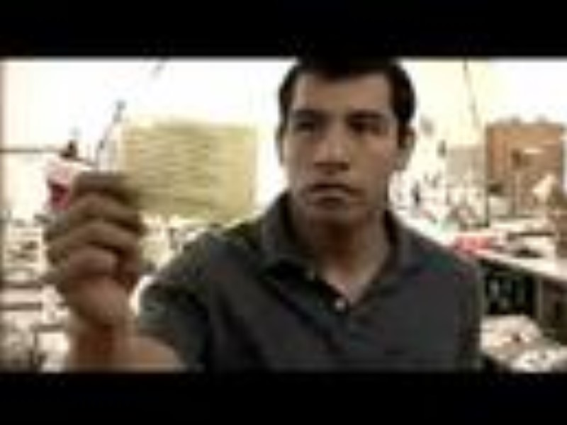
Home
If you are at risk, attend a Know Your Rights training. Practice what you learn.
Stay calm
Keep your door closed
Ask for a search warrant and check it for accuracy and proper signatures.
Exercise your right to remain silent
Don’t lie
Don’t resist if they enter your home
Record the incident if you can or have other record
Don’t sign anything before talking to an attorney, especially if you are detained
Notes:
What do you do if ICE comes to your house? Know Your Rights training is available on YouTube and in the community. Find a class and go. All trainings will emphasis the following:
1.Stay calm
2.Keep your door closed. Don’t even open it a crack.
3.Ask for a search warrant to be slid under the door. (Be careful, agents have been known to trick people.) We all have a 4th Amendment right to refuse an unlawful search and seizure. In this situation when you are at home, you have a right to refuse to let the ICE agent inside your home if they do not have a valid search warrant. Without a valid search warrant, it would be considered an unlawful search and seizure. Everyone, whether you are a US citizen, LPR, or undocumented, has this right regardless of their immigration status. An administrative search warrant doesn’t allow agents to enter your home. A valid search warrant must be:
*signed by a judge
*Identify the name of the person they are looking for
*Identify the address they are searching
*If anything is missing or misspelled, the search warrant is not valid and should not be enforced.
Tip: Usually, ICE agents have an administrative warrant which is not signed by a judge and these administrative warrants permit ICE agents to detain a person named on the warrant but these kind of warrants doesn’t allow ICE agents to enter your home without your consent. Therefore, you need to ask to see the warrant. You can ask them to slip the warrant underneath the door or show it through the window.
3. Exercise your right to remain silent
4. Don’t lie
5. Don’t resist if they enter your home
6. Record the incident if you can or have another person record
7. Don’t sign anything until you have spoken to an immigration attorney

Slide 11
ICE at School
What ICE Can Do and Where they Go Will Depends on A Few Factors.
Where at School? | Description
Public Access/Common Spaces | Spaces that are open to the general public; entry is not restricted or limited. Examples include: Libraries, Common Areas, unrestricted access buildings, streets etc.
Restricted Access/Offices | Spaces that require a key card, locked doors or monitored entryways, including University housing and restricted lab areas.
Limited Access (Know: Quick Copy is Limited Access. Storage spaces, IT, etc., are all locked and access is limited.) | Spaces that are normally not left unlocked during the workday, including, for example, administrative or faculty offices, classrooms while classes are in session, locker rooms, research laboratories, kitchens and food preparation areas, maintenance areas, storage facilities, and physical plant operations. These spaces require a warrant to enter, if requested by the person in charge of the room. i.e. the teacher.
Notes:
Schools, which include postsecondary schools, colleges, universities, and vocational or trade schools, are considered “protected areas” under the policy in effect at the time of publication of this guide. DHS’s current policies, which govern both ICE and CBP, do not prohibit enforcement actions at protected areas. Rather, the policy provides that enforcement actions in or near protected areas should be avoided to the fullest extent possible.
Unfortunately, "protected places" really just reflect enforcement discretion. The bottom line, really, is that ICE can enter any public place. Since a large portion of the public schools are open to the general public, the school doesn’t have the authority to prohibit federal immigration enforcement officers from coming on campus to enforce federal law. However, public access is limited in certain areas of public schools and property because of privacy concerns, operational needs or safety considerations.
Public areas can be categorized by Public, Restricted and Limited. Determine which area or room is restricted and limited and see if there are signs that clearly indicate the category of access. Add signs if helpful or post in your syllabus that your classroom is limited to enrolled students only. No uninvited visitors are allowed. Share the safe areas with your students of places they can seek to go if they receive information that ICE may be on campus.

Slide 12
Direction from SAC: Being Prepared - When Responding to On-Campus Immigration Enforcement Officials
Stay Calm: Immediate compliance is not required. Take your time while working through these steps, and do not panic or feel rushed.
Direct to Campus Safety: Inform the officers that you are not obstructing their process, but that you must refer them to the proper channels for guidance and assistance. Direct the officer to contact Campus Safety on their 24/7 line at (714) 564-6330. You can also point them to the location of the Campus Safety office.
Know that Campus Safety Will Document: Campus Safety will document and report all details of any immigration enforcement activities to the President’s Office.
Notes:
Excerpt from 2/3/2025 email from Dr. Annabelle Nery titles Standing Together in Support of Our Students

Slide 13
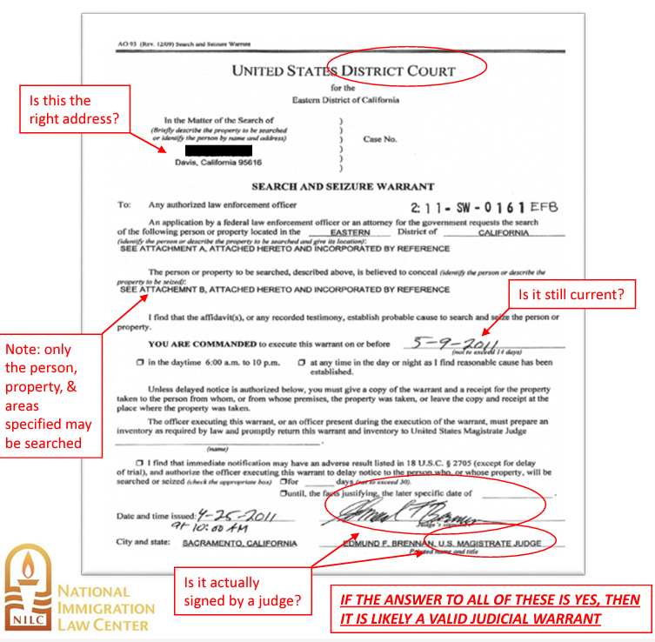
Spaces on Campus where ICE needs a warrant to enter:
SAC: Quick Copy (inside), Health Center, Faculty and Administrative Offices, Locked Rooms where there is No Public Access. Library spaces.
SCE: Same
Faculty/Classified/Admin, this is what a valid warrant looks like--->
Don't open the door. Delay and Contact Campus Security/President/Chancellor's office immediately! Video everything and get names of officers, photo of warrant, and students full name. Advise student not to sign anything before meeting with an attorney.
If ICE enters regardless, step aside. Collect names and information. Video if possible and state that you do not consent to entry.

Slide 14
Excerpt from California Attorneys General Guidance, “Promoting a Safe and Secure Campus for All,” November 2024
When we have ICE interaction in a limited access or restricted place, ask for a signed judicial warrant and review that warrant. Immediately contact Safety and Security and ask them to contact the Presidents or Chancellor Office for assistance. If ICE gains access, do not resist, but make a record.
When making record of the contact with an immigration enforcement officer, the following information is useful:
✓ Name of the officer, and, if available, the officer’s credentials and contact information;
✓ Identity of all school personnel who communicated with the officer;
✓ Details of the officer’s request;
✓ Whether the officer presented a warrant, subpoena, or court order to accompany his/ her request, what was requested in the warrant/subpoena/court order, and whether the warrant/subpoena/court order was signed by a judge;
✓ Any response to the officer’s request;
✓ Any further action taken by the immigration officer; and
✓ Photo or copy of any documents presented by the agent.
Notes:
Here is an excerpt from California Attorney General Guidance, titled “Promoting a Safe and Secure Campus for All,” November 2024
College and university personnel shall advise all students, faculty, and staff responding to or having contact with an officer engaged in immigration enforcement executing an immigration order, to refer the entity or individual to the office of the chancellor or president, or his or her designee, for purposes of verifying the legality of any warrant, court order, or subpoena.
If the officer declares that exigent circumstances exist and demands immediate access to the campus, college or university personnel should not refuse the officer’s orders and immediately contact the designated administrator or campus police liaison. If an officer enters the premises without consent, attempt to make a record of the contact and forward the information to the office of the president or chancellor.
In making record of the contact with an immigration enforcement officer, the following information is useful:
✓ Name of the officer, and, if available, the officer’s credentials and contact information;
✓ Identity of all school personnel who communicated with the officer;
✓ Details of the officer’s request;
✓ Whether the officer presented a warrant, subpoena, or court order to accompany his/ her request, what was requested in the warrant/subpoena/court order, and whether the warrant/subpoena/court order was signed by a judge;
✓ Any response to the officer’s request;
✓ Any further action taken by the immigration officer; and
✓ Photo or copy of any documents presented by the agent.

Slide 15
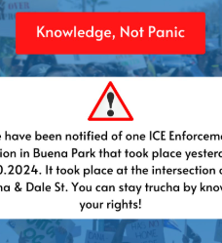
ICE waiting Outside of the school
We Should All Immediately Call the OC Rapid Response Network at (714) 881-1558. They will put out a notification.
If you are at risk, follow https://www.instagram.com/ocrrn for updates about ICE in Orange County, CA.
If you are at risk for deportation, avoid interaction with ICE and local law enforcement by not attracting attention. Drive the speed limit and in vehicles that have operational brake and headlights, and are free of overly-tinted windows or other easy "pretext violations" for making a stop.
Notes:
ICE have been known to wait nearby school sites or courthouses to stop individuals. Protect yourself by staying alert and follow OCRRN on Instagram for updates.
Other potential school related issues ILRC Presentation, "Your Rights, Your Future: An Overview for Immigrants in California":
Student Visas: potential for Trump administration to use visa issuance as carrot/stick for countries to accept removal flights.
Incentivizing cooperation with ICE: Data sharing potential for out of status notifications, criminal issues. Unclear on other government applications like FAFSA.
TPS - No new designations are likely (possible wind-down of existing designations)
DACA – Ongoing litigation at the Fifth Circuit, Likely to rule against DACA. SCOTUS case depends on when the decision comes from the court. Slow down or halting of processing at USCIS.
Parole – new programs not likely. Probably slowdown in advance parole for DACA, TPS, etc.
Public Benefits: Public charge is a priority for new administration and we are likely to see a new rule in 2025-2026. Owing to the necessity for a rulemaking process this means that change will be slower in this space. See: https://www.ilrc.org/resources/public-charge-safe-use-list

Slide 16
Students may be concerned about how schools protect their information
Written consent by the student is generally required before disclosure is allowed.
There are limited exceptions for judicial warrants, a court order, or judicial subpoena.
Notes:
Every individual has a privacy interest in retaining the confidentiality of his or her Social Security number (SSN). The Family Educational Rights and Privacy Act (FERPA) protects the privacy of students by prohibiting all colleges and universities that receive federal funds from disclosing personally identifiable information contained in education records to any third party without the student’s permission. Under FERPA regulations, personally identifiable information cannot be disclosed without written consent. There are, however, some limited exceptions.
One of the most significant exceptions in this instance a court order or judicial subpoena may compel the school to respond, however this is not a quick process. Moreover, notice to the student of the warrant is generally required prior to the institution complying with the order. (Exception to this exception: When subpoena prohibits disclosure.)

Slide 17
At Work –
RSCCD is your Place of Employment
If you are at risk, attend a Know Your Rights training
You don’t have the same privacy expectation as you do at your home
Stay calm
Don’t lie
Exercise your right to remain silent
Don’t sign anything
Notes:
ICE agents must follow rules when they enter a places of business. Those rules are slightly different from the ones they have to follow at your home and are similar to those rules for schools. Basically, like any regular member of the public, ICE can enter areas that are open to normal people. However, they must have either the approval of the business’s owner or a signed judicial warrant to search any places that are closed to the public.
ICE can ask for identification, even if you are minding your own business in the workplace. If this happens, remain calm. Don’t run. You can provide your name and then politely ask them if you are free to go back to work. Try to go to a restricted place for only employees. If your employer doesn’t provide consent to ICE to enter that restricted place, you should be safe. (This is similar to protecting your students at school. If ICE comes on campus, you can allow your student to stay in your office or in the classroom and lock the door.)
Is there any way you can leave without answering their questions? Maybe. If they continue to ask questions, you can assert you right to remain silent. Then politely ask if you are free to go back to work. But you shouldn’t run from them. Be calm. If they haven’t talked to you, walk away from the area without running or looking suspicious or nervous.
There are some California Code Sections that may bear upon a situation if you work for a college or university:
College and university staff must be available to assist, in a sensitive manner, undocumented students, as well as other students, faculty, and staff who may be subject to an immigration order or inquiry, or who may face similar issues, and whose education or employment is at risk because of immigration actions. Ed. Code, § 66093.3, subd. (j)(2).
The Immigrant Worker Protection Act (Assembly Bill No. 450, 2017-2018 Regular Session) imposes obligations on public employer conduct, and persons acting on their behalf, at colleges and universities in the event an immigration enforcement agent seeks to enter the employer’s place of business, subject to certain specified exceptions. Public employers, or persons acting on behalf of the employer, are prohibited from providing “voluntary consent” for an immigration enforcement agent to enter “any nonpublic areas of a place of labor.” This provision does not apply if the immigration agent provides a judicial warrant. Gov. Code, § 7285.1, subd. (a).

Slide 18
The Basics, no matter where you are:
Stay calm. Agree with coworkers in advance that running only attracts attention and gives ICE permission to pursue. Think ahead about where you might find a safe space to wait until you are able to calmly walk away.
Continue what you are doing and if it is possible, be discrete and go to a room where the public is not allowed. Consider ask the person in charge of the room if they will protect you and if they understand they are not required to allow ICE into the space without a federal warrant signed by a judge. The warrant should specify the place to be searched, who is being looked for, and the warrant must be current so check the date.
Do not provide false documents and do not carry documents that would identify you as an unlawful immigrant to the US. You have a right to remain silent.
Do not sign anything before consulting with an attorney. Tell ICE repeatedly that you would like to speak with your attorney if you are detained. You should have an opportunity to a phone call. Memorize your attorney phone number in advance.

Slide 19


Community resources
Notes:
Let's look at some community resources available in Orange County, California, and nearby.

Slide 20

Know your rights training
YouTube:
Notes:
Also see: https://youtube.com/playlist?list=PLqGEMQus_mIhq4Y8Z3tLQXpHEz6mSnyKj&si=jtEAxvhQHUzShbYI
SAC Legal Studies students will be facilitating KYR training and family preparation plans on Saturdays in the ACC from 10-2 in Jan.

Slide 21




Family Preparation Plans
Notes:
SAC's CLIRRCs will be helping with family preparation plans. Go to www.sac.edu/clirrc for information.

Slide 22


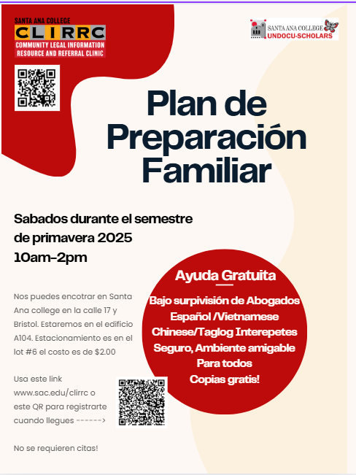

Slide 23
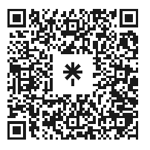
ethical and affordable Legal resources in Orange County

Slide 24


The CA Community College Immigration Legal Services Project provide free immigration legal services, including application assistance, education and outreach to undocumented and mix students, staff (Credit & Non-Credit), and faculty on California community college campus.
SERVICES PROVIDED:
Areas of immigration legal assistance:
Adjustment of Status
﻿﻿Immigration Relief Screenings
﻿﻿Deferred Action for Childhood Arrivals (DACA)
﻿﻿Family-based petitions
﻿﻿Naturalization/Citizenship
﻿﻿Special Immigrant Juvenile Status
﻿﻿T visas
﻿﻿U visas
﻿﻿Violence Against Women Act (VAWA) petitions
Types of immigration legal services provided:
Help completing forms
﻿﻿Filings with USCIS
﻿﻿Representation before the Immigration Court
﻿﻿Representation before the Board of Immigration Appeals (BIA)
Federal court appeals

Slide 25
CAIR’s Immigration Services
Free consultation to help you understand your immigration options
Depending on your income, we may also represent you in your preparing your application and throughout your immigration process
Naturalization
Adjustment of status
Removal of Condition
Petition for relatives
Asylum, U-Visa, VAWA
TPS, DACA
Some Removal Proceedings
Address: 2180 W. Crescent Ave, Anaheim, CA 92801
Email: IRC@LosAngeles.CAIR.com
Phone: 714.776.1177 ext 1
Walk-In Hours at the Office:
Tuesday between 1:00 to 3:00

Slide 26
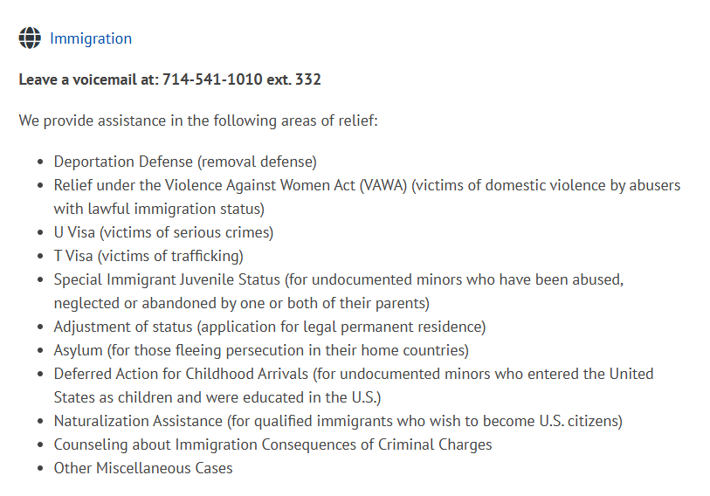


Slide 27

These attorneys will cost money:
*You should consult with several attorneys to determine who suits your needs and who you can afford. You should demand a written fee agreement (sometimes called a "retainer") and be able to contact your attorney and receive calls back from them when necessary. If you are detained, DO NOT sign anything without attorney advice.

Slide 28

Community Advocacy Groups

Slide 29


Slide 30


Don't Fall Victim to a Scam
Notes:
See also: https://immigrantjustice.org/know-your-rights/avoid-immigration-fraud

Slide 31

Take a moment for yourself, breathe.
Remember that it’s okay to feel overwhelmed, angry, sad, lost, and uncertain during these difficult times. It’s important to acknowledge these feelings; sometimes, we need to cry, vent, and reach out to allies, educators, friends, and loved ones for love, connection, and support. In addition, remember the power you hold and the power we hold as a community.
Notes:
Take care of yourself. This is a stressful time for some, so remember to reach out to allies, churches and community groups to sustain yourself. Reading and art can also be a powerful antidote to stress.

Slide 32
Question & Answer: @Home
Q: Can you just keep the door closed? A:YES, you can keep the door closed. If the agents show you a warrant that is not valid, assert your rights. Tell them this is not a valid warrant that gives them a right to enter your home. Say, I am not giving you permission or consenting for you to enter my home.
Q: What if agents refuse to show you the warrant? A: You need to verbalize and express that you do not consent to the entry into your home and that they should leave. You should not open or slightly crack the door to talk to them. They could be aggressive at times and walk in if the door is open.
Q: Do immigration agents ever mislead you to get inside the home? A: Yes
Q: What if someone else in your family opens the door unknowingly? A: If someone opens the door or gives them consent to enter your home, officers can search for the person on that warrant and detained that person. If this happens, you should not answer questions or speak to the officers while they are in your house conducting their search. Stand silently and observe what they do, where they go, and what they take. Write down everything you observed as soon as you can.

Slide 33
Question & Answer:
Q: Should we run? A: Everyone in the home should remain calm and not resist arrest. You should record and take pictures of what is happening. You or your family member can still assert your right and ask to see the warrant. You can still try to verbalize that you don’t consent to their entry into your home but it will not likely do anything at this point.
Q: Is this a good time to confess? A: You have the right to, and you should, remain silent. You should not discuss your immigration or citizenship status with police, immigration agents, or other officials. Anything you tell an officer can later be used against you in immigration court.
Q: What if I am asked for my papers? A: If you are not a U.S. citizen and an immigration agent requests your immigration papers, you must show them if you have them with you. If asked this by your school, let the president or chancellor's office know, as "papers" are not required to attend school.
Q: Can you be searched? A: If an immigration agent asks if they can search you, you have the right to say no. Agents do not have the right to search you or your belongings without your consent or probable cause. Don't fight or resist the officer if they proceed against your will, simply state your position clearly.
Q: I have a green card. Am I at risk? A: If you’re over 18, carry your papers with you at all times. If you don’t have them, tell the officer that you want to remain silent, or that you want to consult a lawyer before answering any questions.

