Slide 1







Rodrigo Ramirez, Lisa Macafee, & Maria Aguilar Beltran
Centering our commitment to Student Success: Advocacy & Empowerment of our immigration impacted and lgbtq+ community

Slide 2


RODRIGO MARCOS RAMIREZ M.ED.
STUDENT SERVICES COORDINATOR & DREAM LIAISON

Slide 3
  Undocu-Scholars Center
    The Village: VL-109
  Undocu-Scholars Program

Slide 4

What comes to mind when you hear the term “Undocumented”?

Slide 5
Who comes to mind when you hear the term undocumented?

Slide 6
Undocumented or DREAMer?
  Undocumented students is not synonimous with DREAMer
  DREAMer is a self-identifing marker that developed during the Undocumented Student Movement
  Used by primearly by undocumented youth

Slide 7

Undocumented or DREAMer?

Slide 8
Understanding Undocumented Students
1) Entered without Inspection
AB 540 Students
CROSSING THE BORDER WITHOUT
INSPECTION AT AN OFFICIAL CHECKPOINT
4) Entered with legal status but overstayed
5) Vulnerable Immigrants
3) Deferred Action for Childhood Arrivals (DACA)
WITHOUT AUTHORIZATION
(E.G. POLICY SHIFT, LIMBO, LACK OF FUNDS)
EXECTUITIVE ORDER
2) Currently in the process of Legalizing

Slide 9

Immigration Status Survivors of Trauma
Asylum: protects people fleeing persecution in their country of origin.
  To qualify, you must have a fear of persecution based on political opinion, religion, race, nationality, or affiliation with a particular social group
Special Immigrant Juvenile Status (SIJS)​: protects minors who are abandoned, abused, or neglected by at least one parent.
  To qualify, you must be unmarried and under the age of 18 (21 in some states)
T-Visa protects survivors of human trafficking.
  To qualify, you must be inside the U.S. as a direct result of trafficking
  Trafficking includes force, fraud, or intimidation to make someone do work
VAWA (Violence Against Women Act) protects survivors of domestic violence.
  To qualify, you must be a survivor of domestic violence by a U.S. Citizen or Lawful Permanent Resident spouse, child or parent (domestic violence may be emotional, economic, or verbal abuse/control)
U-Visa protects survivors of crime.
To qualify, you must have:
  Been the survivor of an eligible crime listed by the U.S. Citizenship & Immigration Services (USCIS)

Slide 10
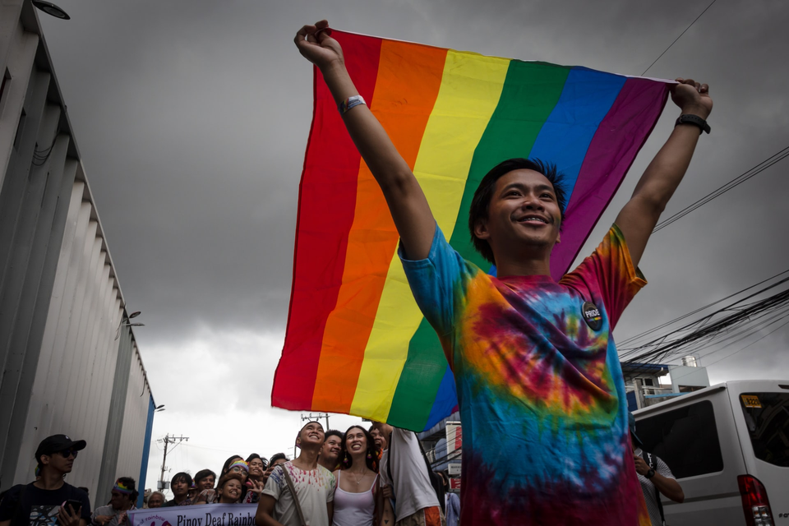
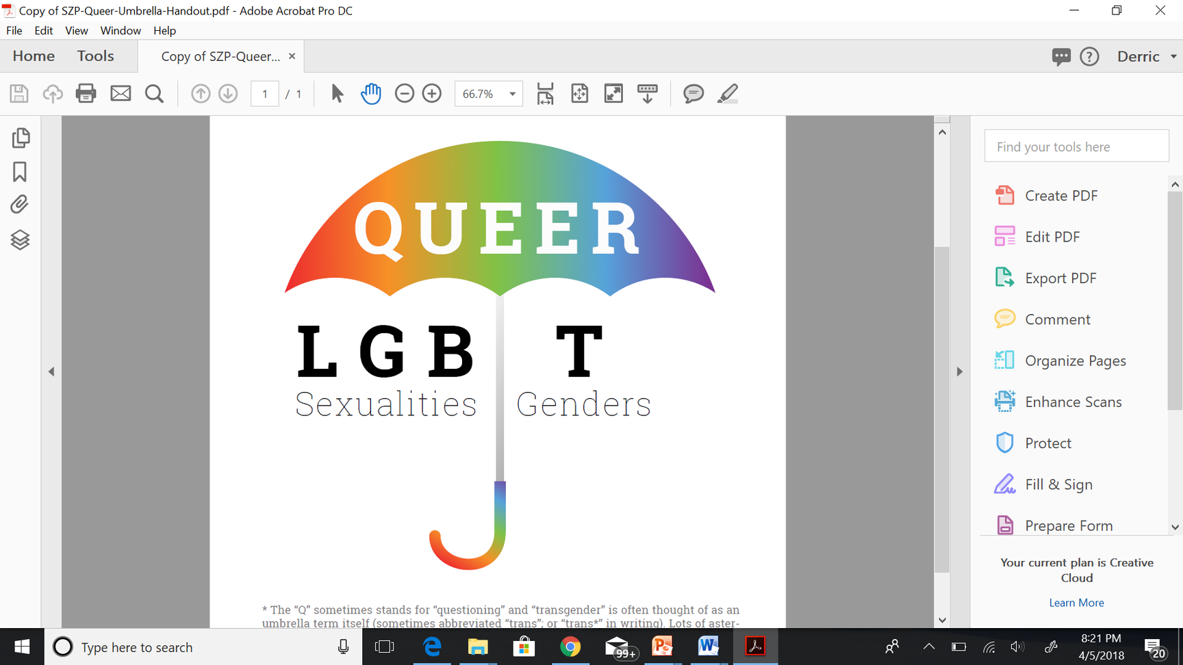

LGBTQ+ Community Impact
Lesbian, Gay, Bisexual, Trans, Queer/Questioning, Intersex, Asexual/Aromantic/Ally, 2Spirit, …
This represents many communities Including sexual orientations, genders, and intersex identities

Slide 11
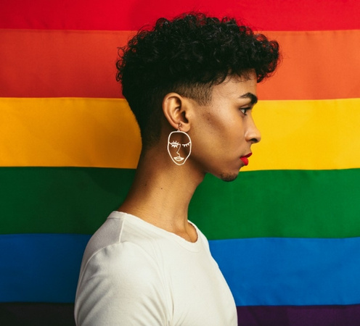

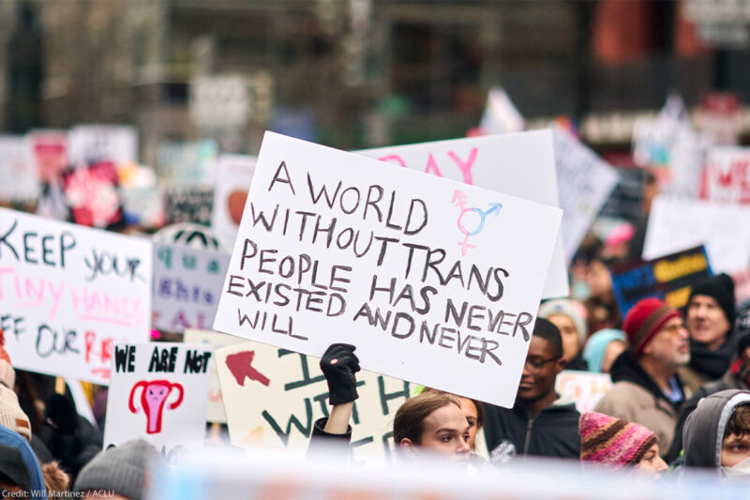
Executive Action
“It is the policy of the United States to recognize two sexes, male and female. These sexes are not changeable”
What it means:
  Threatens end of Federal funding to schools that respect pronouns, chosen names, allow trans-affirming restroom use, trans athletes to compete, or provide therapy for gender-related concerns
    Called “Patently unconstitutional nonsense” by Lambda Legal
  Transgender women will be forced into men’s prisons and detention centers
  Withdraws trans health care from federal prisons and government-funded insurance for those under 19
  Applications for gender change on passports "suspended.“
  Emboldens people to discriminate against and express hate to trans and queer people.
This presentation is the intellectual property of Lisa Macafee for AffirmingNeurodiversity.com

Slide 12

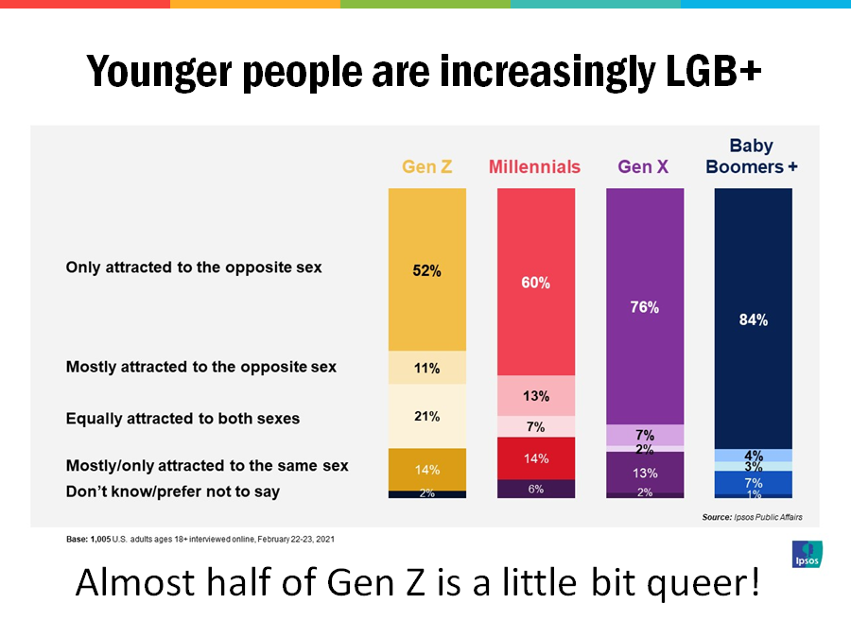

Who is impacted?
7.6% of the US identify as LGBTQ+ (28% of Gen Z)
1.6% of the US is trans (4% Gen Z)
27% of CA teens are gender non-confirming
The Williams Institute, UCLA School of Law (December 2017)
This presentation is the intellectual property of Lisa Macafee for AffirmingNeurodiversity.com

Slide 13
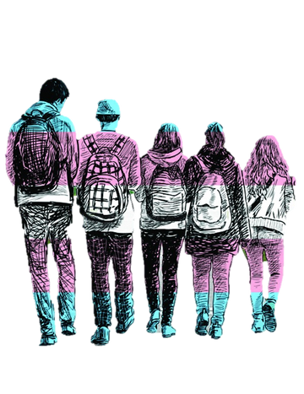

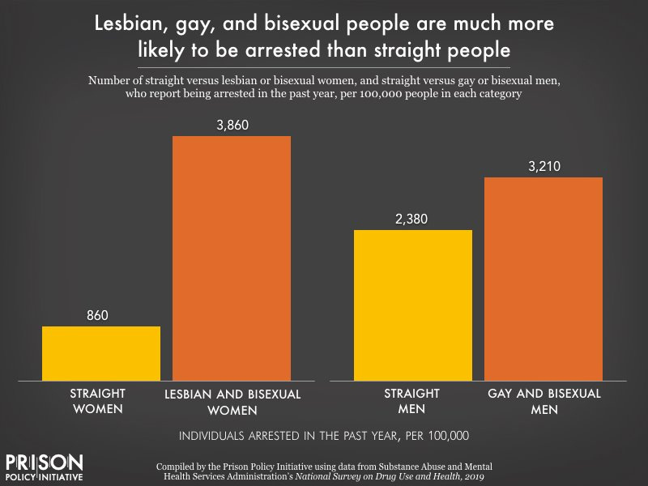
Trans Lived Experiences
34% are experiencing poverty
18% unemployment rate
28% intersex or unsure if intersex
Youth Detention
  40% of homeless teens are LGBT
  30% Foster Care Youth are LGBT
  20% detained youth identify as LGBTQ+
  50% CA girls locked up identify as LGBTQ+
  92% of CA LGBT youth detained are people of color
2022 US Trans study ( USTS) National Center for Transgender Equality Anonymous online survey, about 92.329 respondents
Angela Irvine, 2010. ‘We’ve Had Three of Them:’ Addressing the needs of Invisibility of Lesbian, Gay, Bisexual, and Gender Non-Conforming Youth in the Juvenile Justice System
5
This presentation is the intellectual property of Lisa Macafee for AffirmingNeurodiversity.com

Slide 14
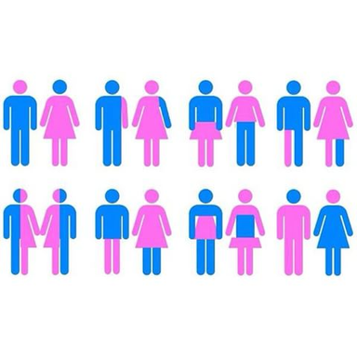


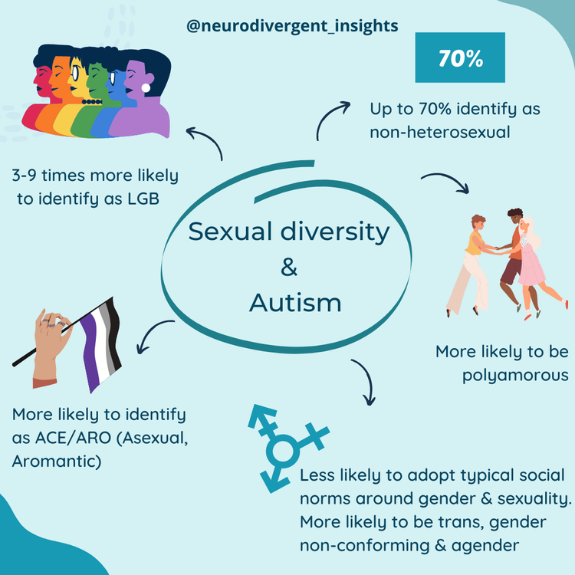
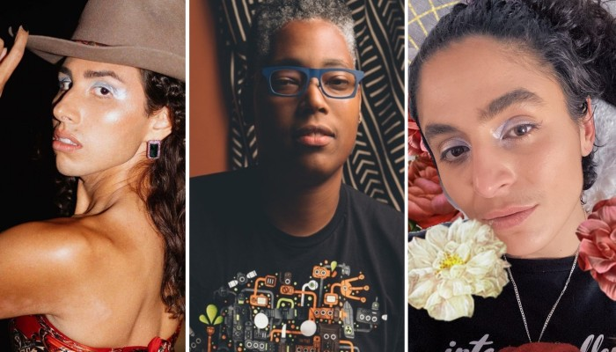
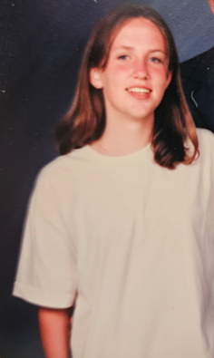

Trans / LGBTQ+ Autism Correlations
  About 25% of trans folks are autistic
  15%+ of autistic adults identify as transgender, 70% non-heterosexual
  Higher intersex traits among autistics
This presentation is the intellectual property of Lisa Macafee for AffirmingNeurodiversity.com

Slide 15

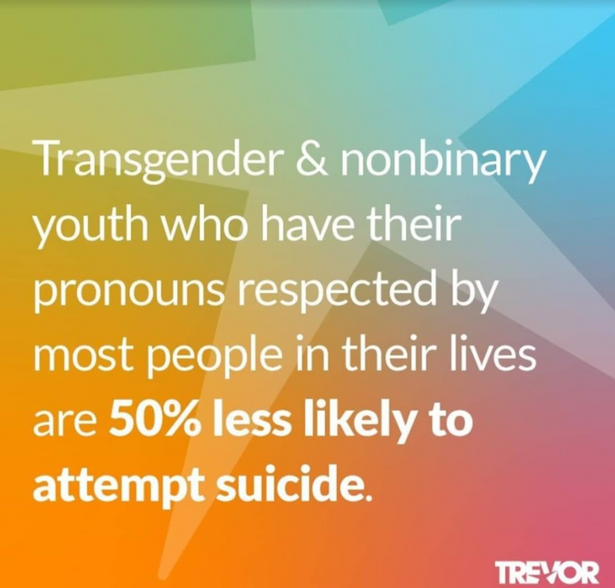


Physical and Mental Health Outcomes
  60% of trans /non-binary adults have a long-term health condition
    2x rate of mental health concerns
    63% experienced a serious discrimination
    23% experienced three or more acts of serious discrimination
    1/3 use multiple substances
    smoke 10x as often
    40% trans suicide attempt rate
The Trevor Project Reported a 33% Increase in
Crisis Line Volume on Inauguration Day
6
This presentation is the intellectual property of Lisa Macafee for AffirmingNeurodiversity.com

Slide 16

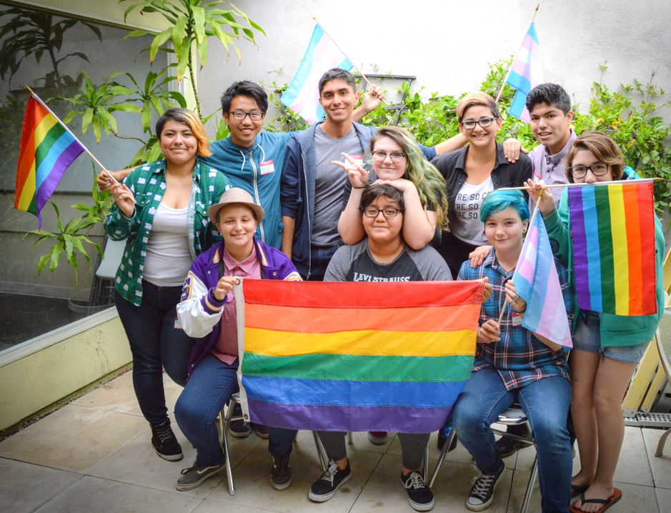
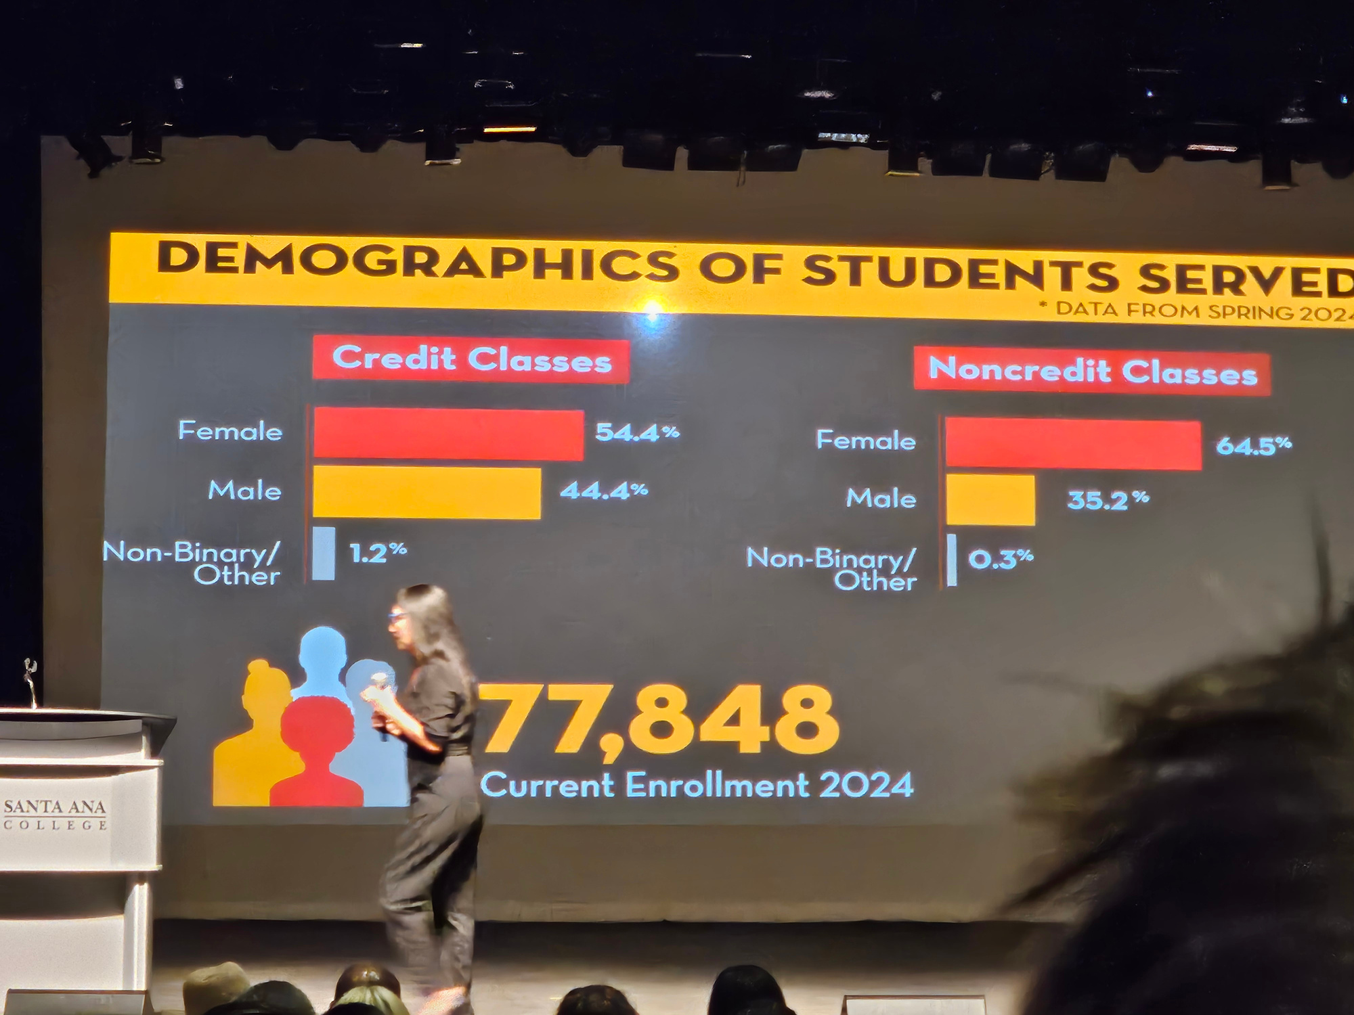
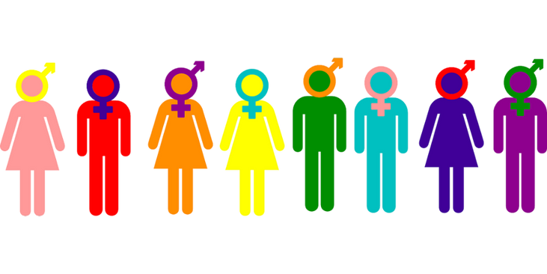
Santa Ana College ACHA-NCHA II 2016
(no more recent climate surveys?)
Students self-describe as:
    Asexual 12.2%
    Bisexual 3.2%
    Gay 2.7%
    Lesbian 1.5%
    Pansexual 0.3%
    Questioning 1.0%
    Queer 0.9%
    Straight 77.7%
    Another ID 1.0%
266 non-binary/other
535 LGBT students
4.6% non-binary/other from yesterday’s convocation stats!
This presentation is the intellectual property of Lisa Macafee for AffirmingNeurodiversity.com

Slide 17
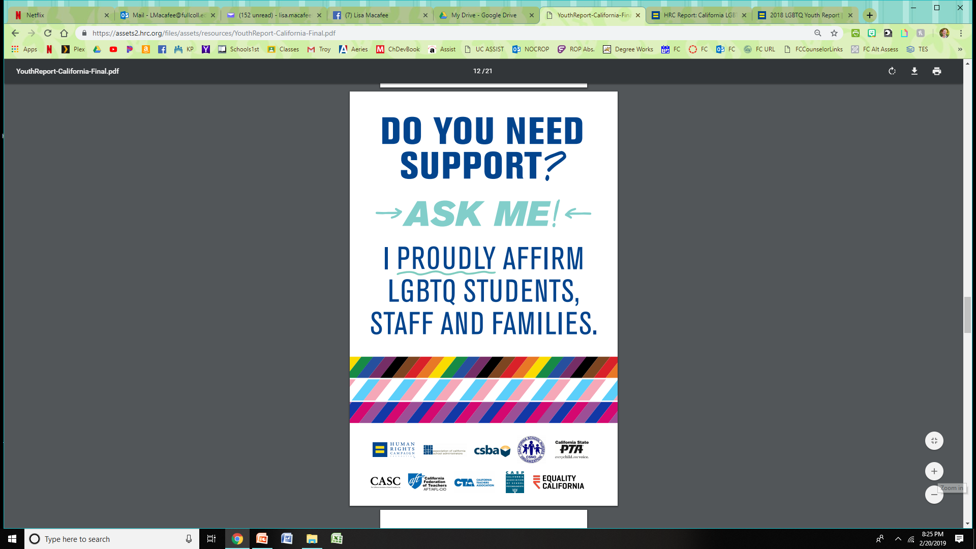
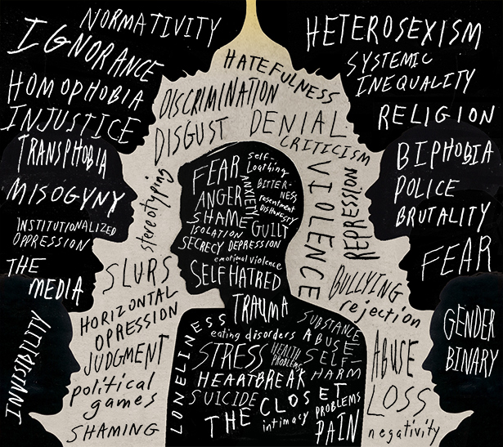
LGBTQ+ Completion Gaps
SAC LGBT students:
  56% less likely to complete Math & English in the first year
SAC Trans/non-binary students:
  50% less likely to complete math and English in the first year
  50% less likely to complete unit thresholds in Fall
New LGBTQ+ Curriculum!
  HIST 129 LGBTQ+ History in the U.S.
  SOC 286 Introduction to LGBTQ+ Studies
This presentation is the intellectual property of Lisa Macafee for AffirmingNeurodiversity.com

Slide 18

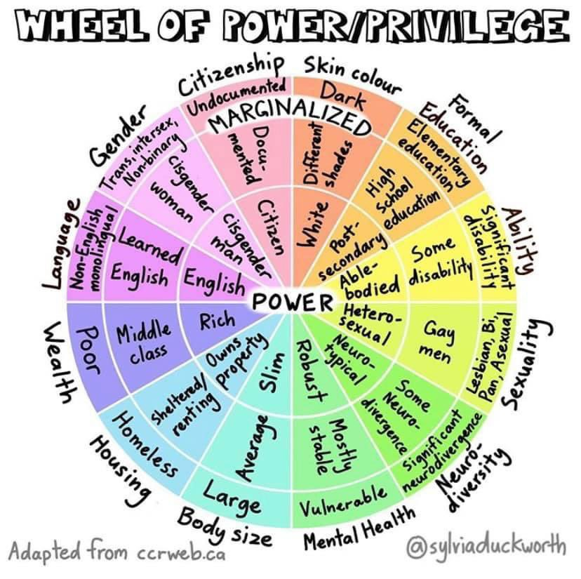
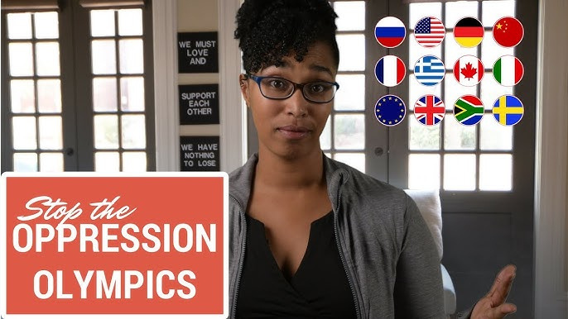
According to the CCC Chancellor’s Office…
  17% of all CCC students identify as queer/LGBTQ+
  1.7% transgender / non-binary
    4% of Gen Z
  70% are people of color
  19% have a disability
This presentation is the intellectual property of Lisa Macafee for AffirmingNeurodiversity.com

Slide 19



Keeping Yourself Sane
Everyone has different capacities - Learn and respect yours
“If you have come here to help me, you are wasting your time. But if you have come because your liberation is bound up with mine, then let us work together.” -Lilla Watson
This presentation is the intellectual property of Lisa Macafee for AffirmingNeurodiversity.com

Slide 20

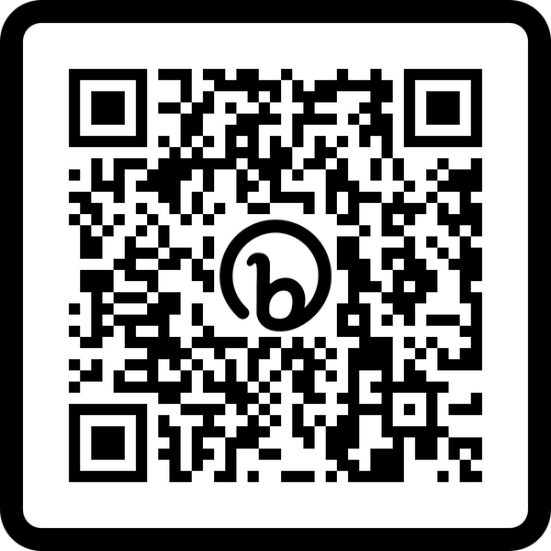
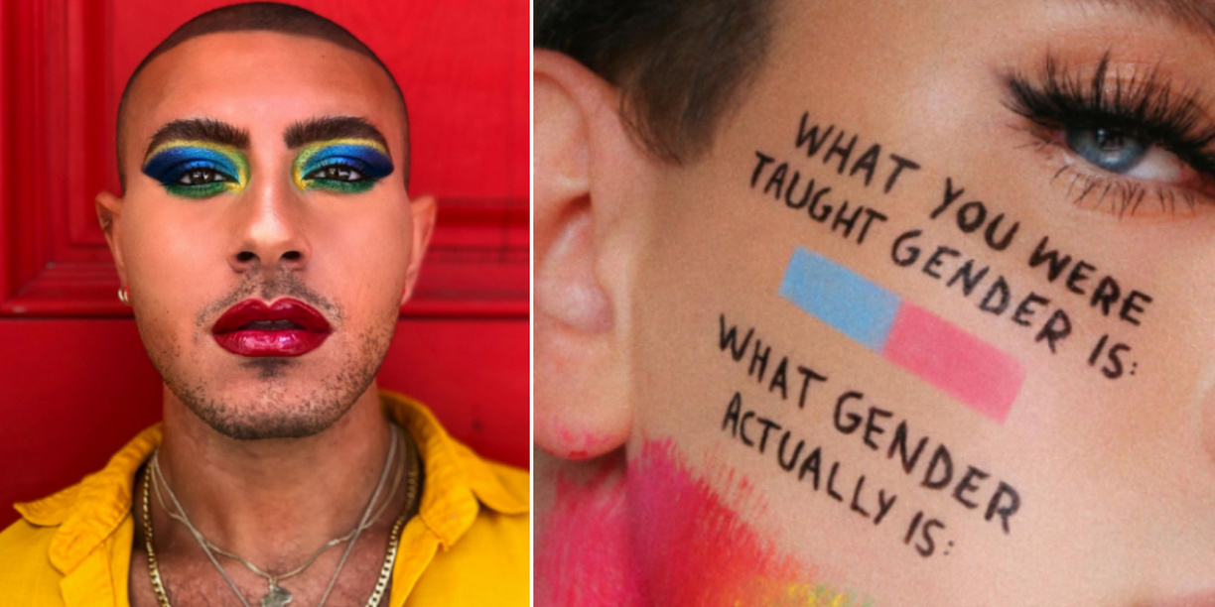
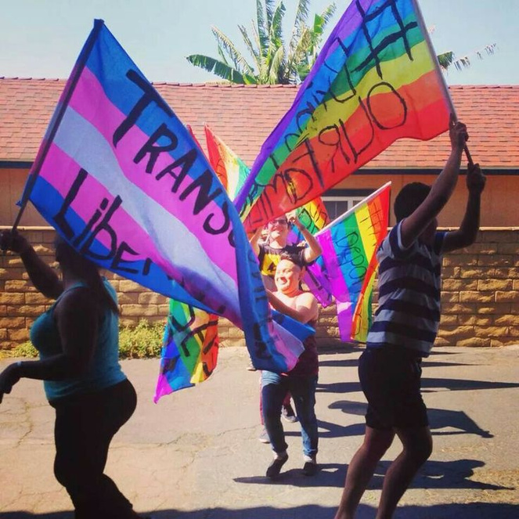
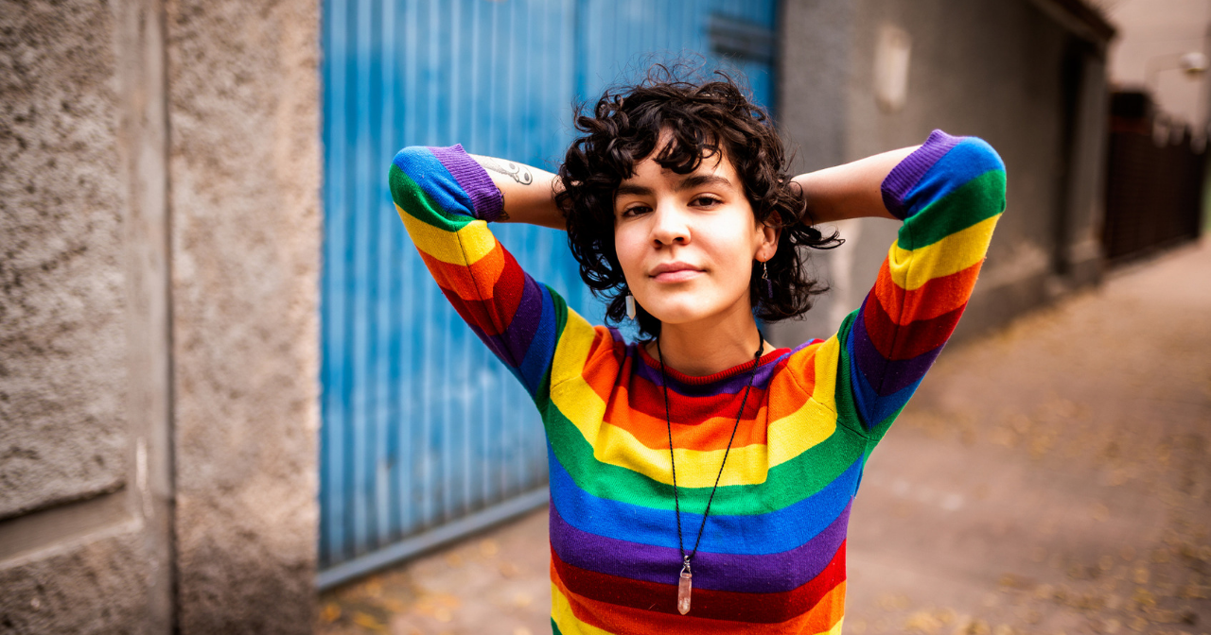
www.sac.edu/pride
Resources on and off campus
Sign-up for
Lisa’s LGBTQ+
Listserv→
Trans 101 The Basics -5:15
5 Tips for Being an Ally
Beck Miller is here to support LGBTQ+ students for SAC Pride!
Beck is currently working in VL-205 (out of the Outreach office) on:​Tuesdays 8am-5pm, Wednesdays 12pm-5pm, Fridays 7am-12:30pm

Slide 21

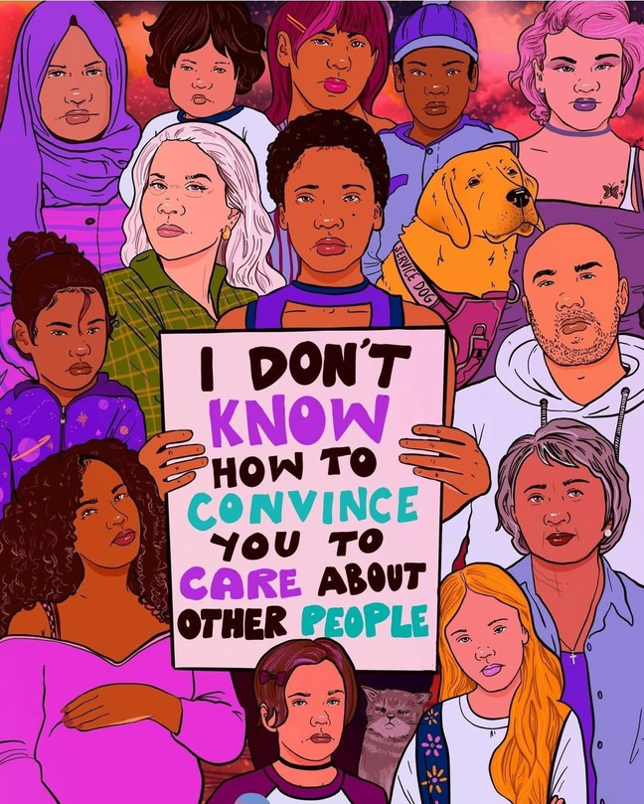
Community Discussion

Slide 22
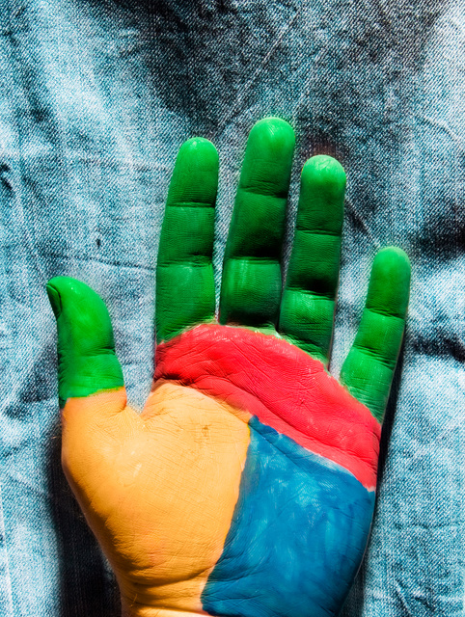


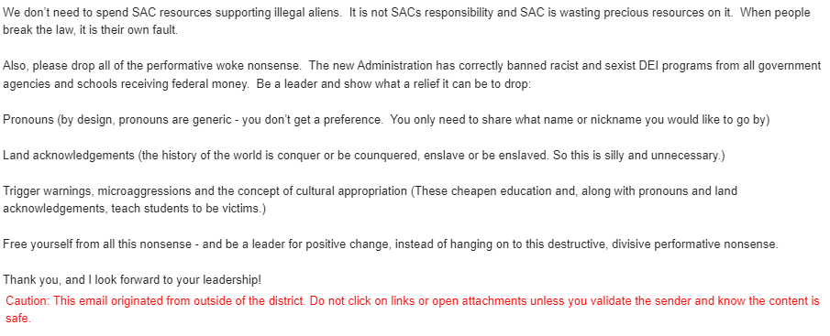

Slide 23
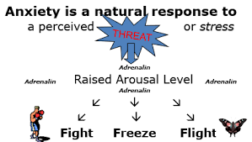
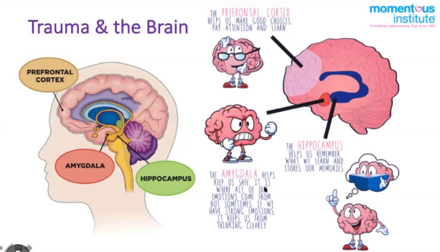
Sympathetic Nervous system

Slide 24

Let’s watch & experience
SAC AB 540 Form

Slide 25
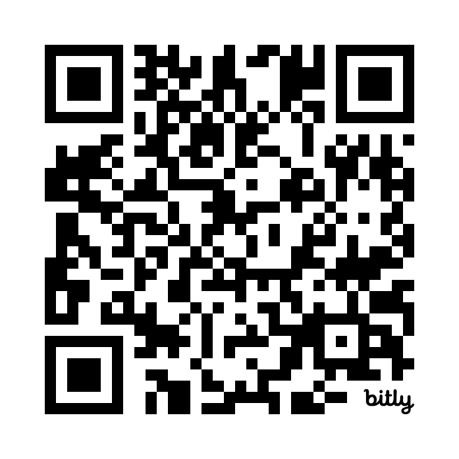
Community Resources
Visit the Bitly Link below OR scan the QR code.
https://bit.ly/3WQTnTV

