Slide 1


FARSCCD Update
Madeline Grant,
President FARSCCD
SAC Academic Senate Retreat
February 3, 2025

Slide 2
Spring Updates
Dept. Chair – compensation while off contract
Upcoming Training (in partnership with HR)
  PT Faculty Evaluations
  Tenured Faculty Evaluations
Faculty Hiring Season
  EEO Training
  Comments to/about PT Faculty
Sick/Personal Necessity Leave
  Completing documentation
Notes:
Wendy

Slide 3
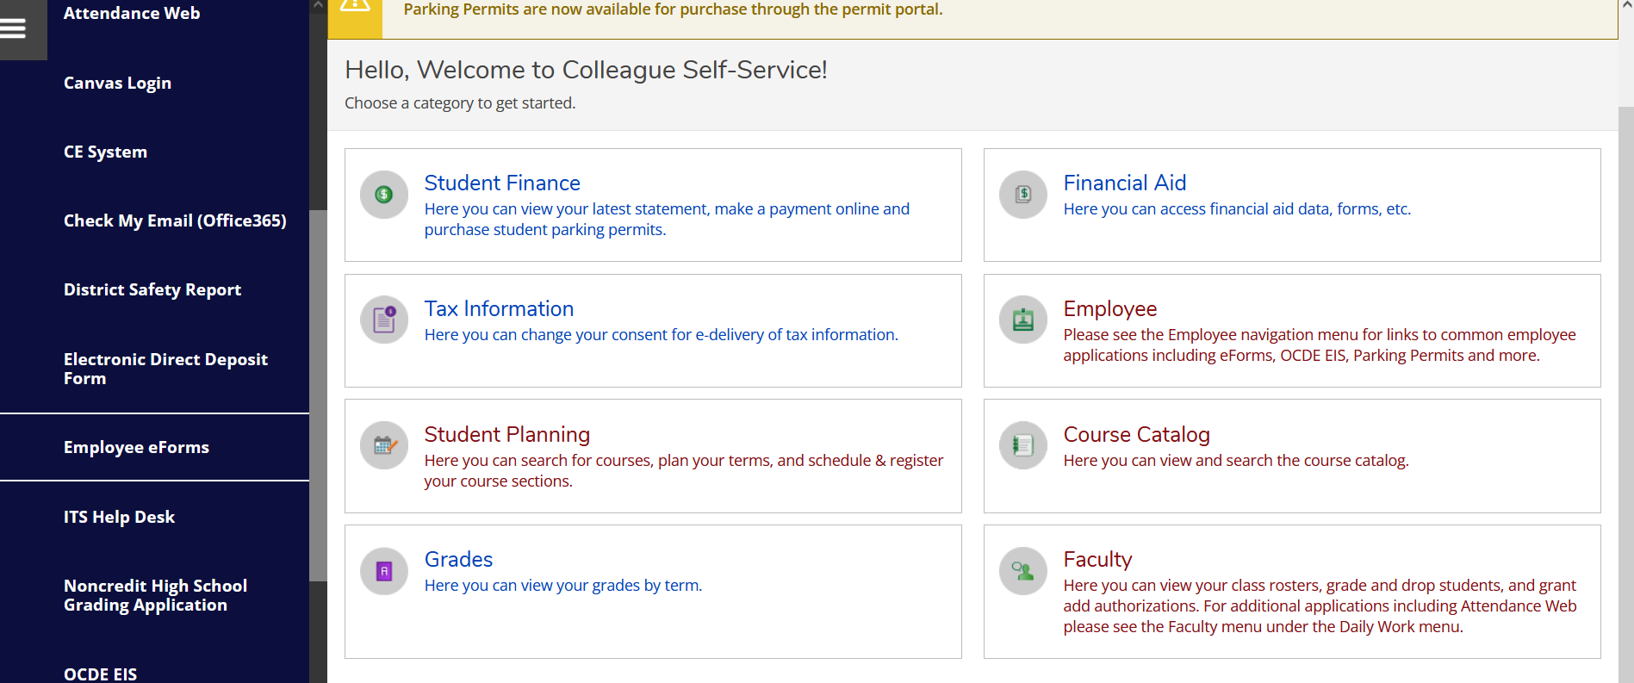
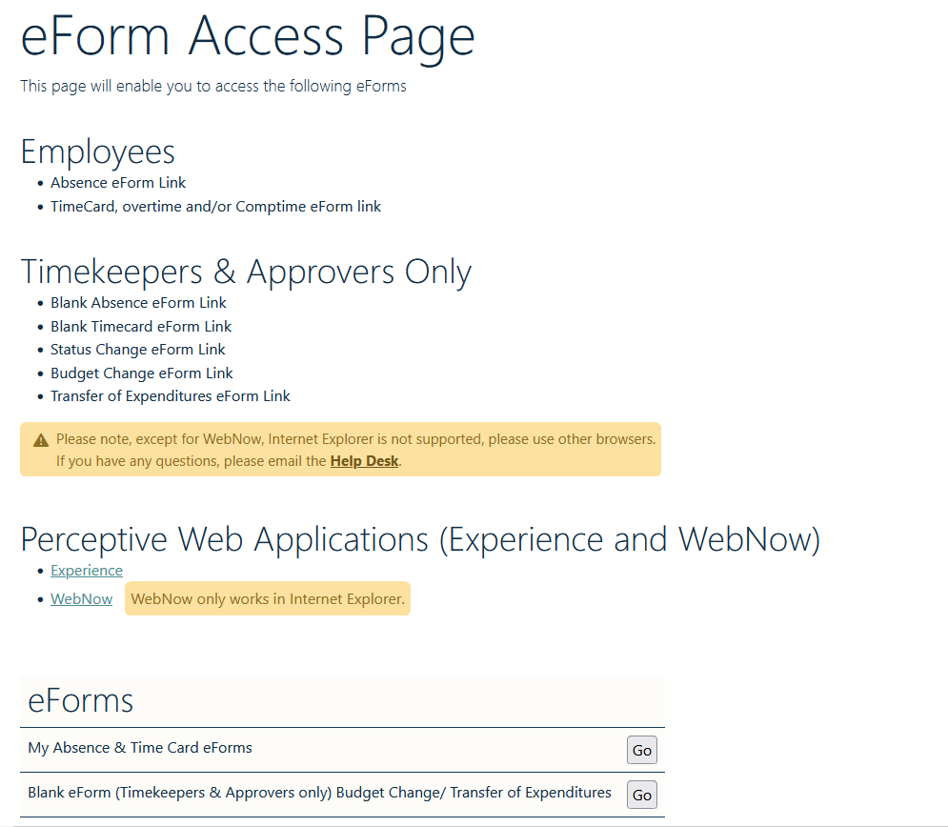
Notes:
Wendy

Slide 4
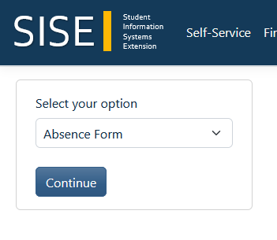
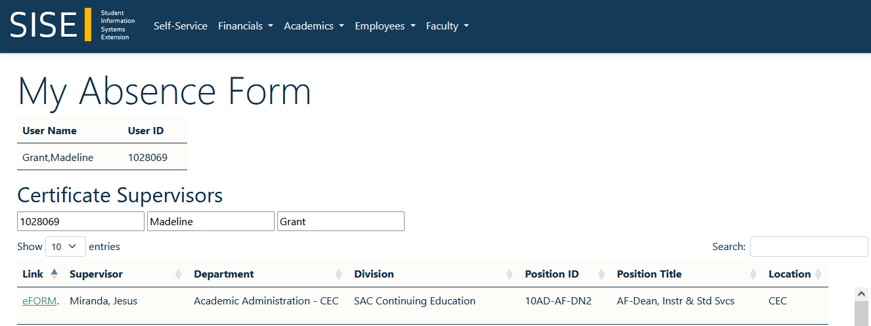
1.
2. Supervisors Name
3.
Notes:
Wendy

Slide 5
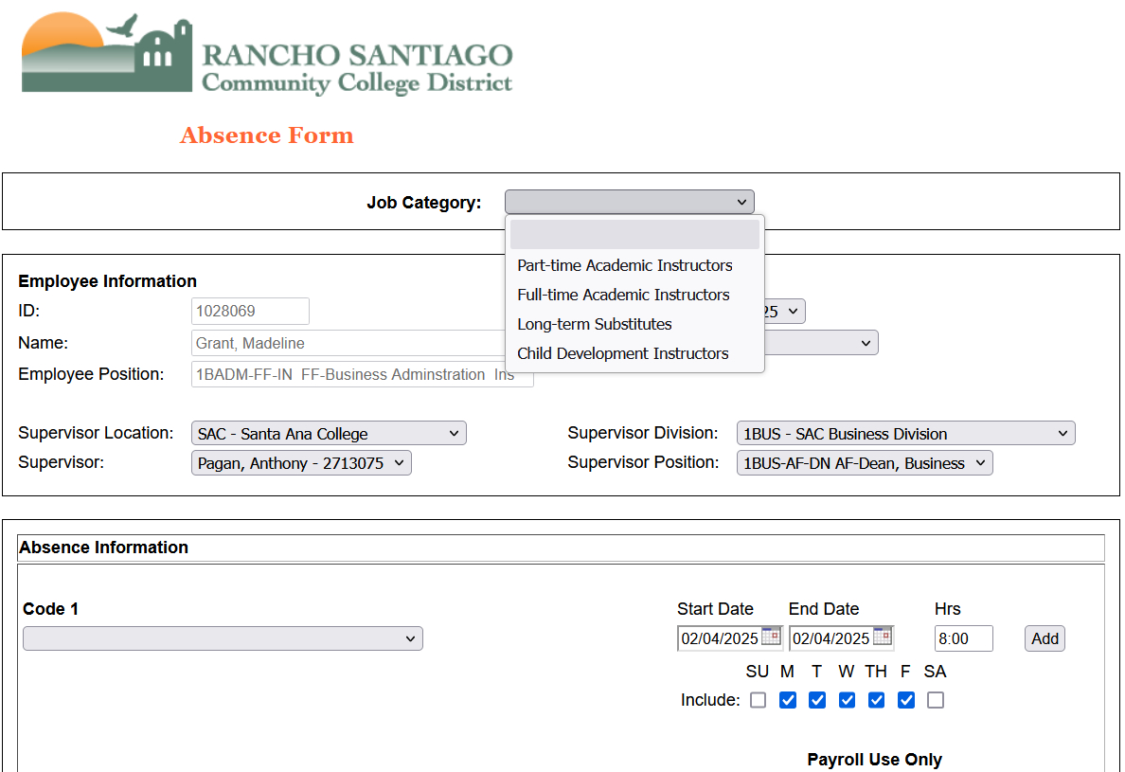
Notes:
Wendy

Slide 6
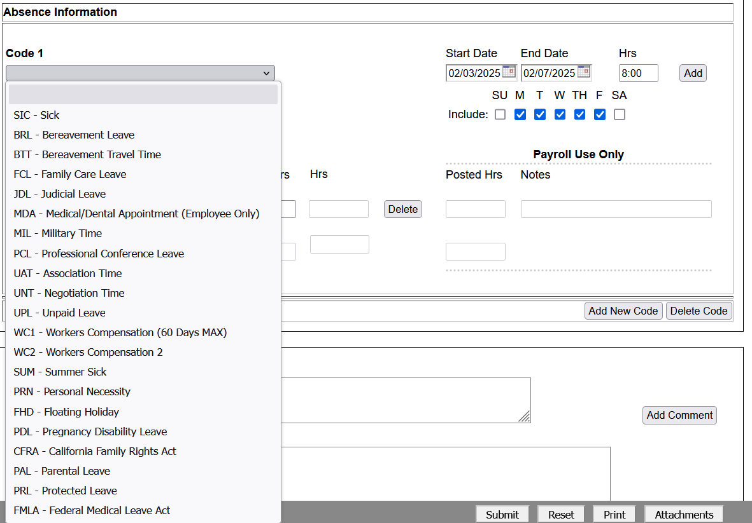
Notes:
Wendy

Slide 7
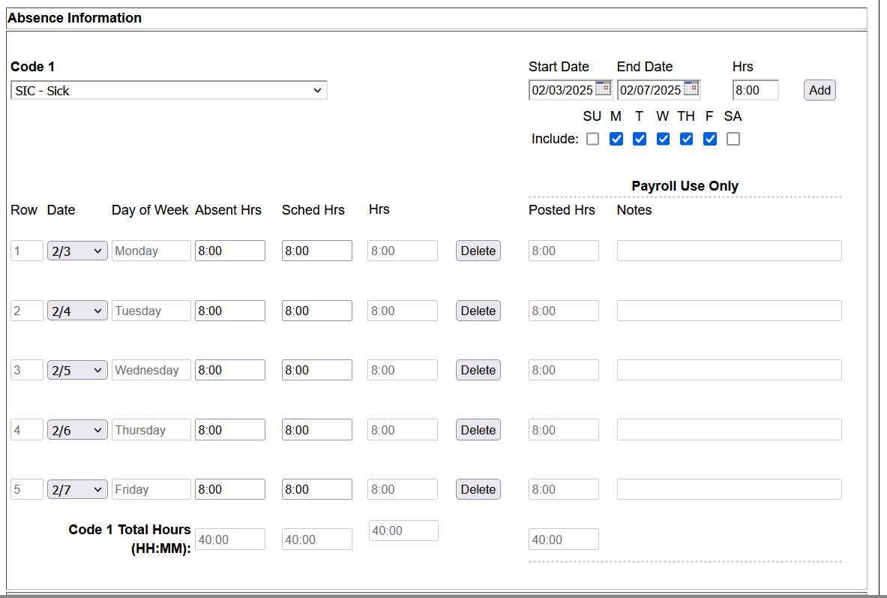

Slide 8
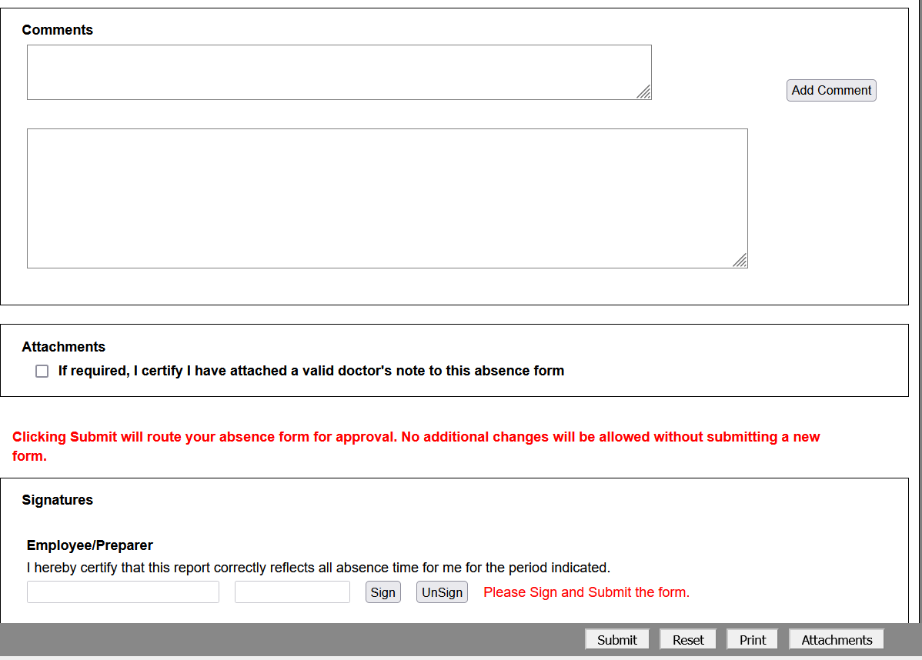
1.
2.
3.

Slide 9
Spring Updates
Negotiations
  Working on contract language related to the Initial Proposal
  Developing Strategies for Negotiations
Membership – Your Insurance Policy
What do you need from FARSCCD?
Notes:
Wendy

