Slide 1
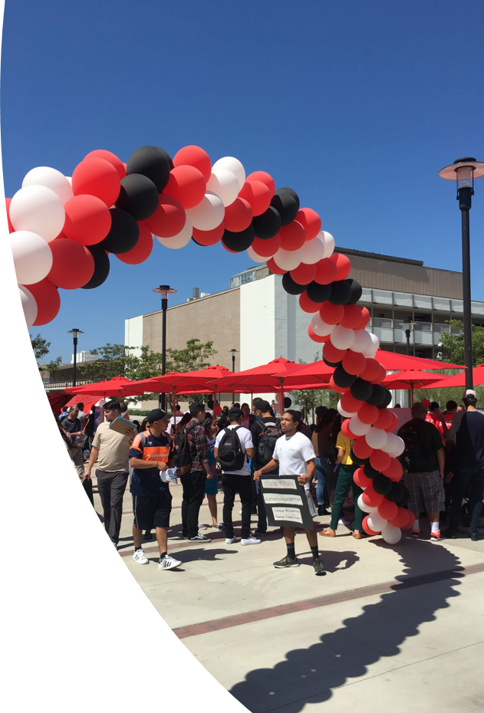
CAGP Institute #6 Advance Work: Quick Overview of Guided Pathways Progress at Santa Ana College

Slide 2
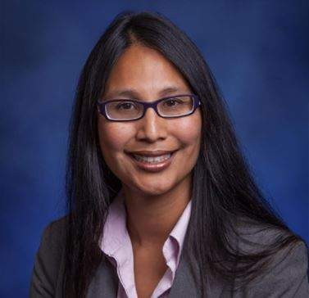
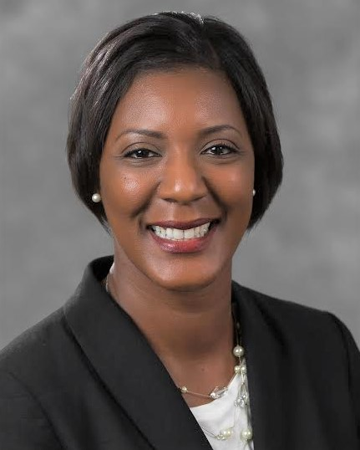
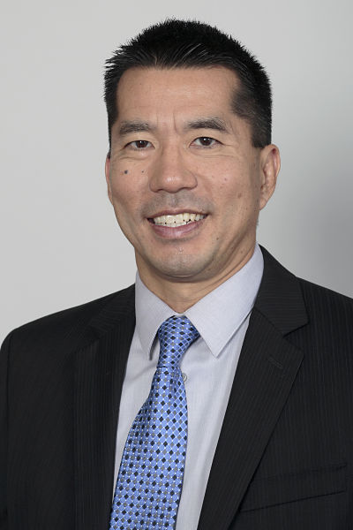
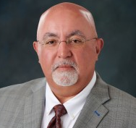
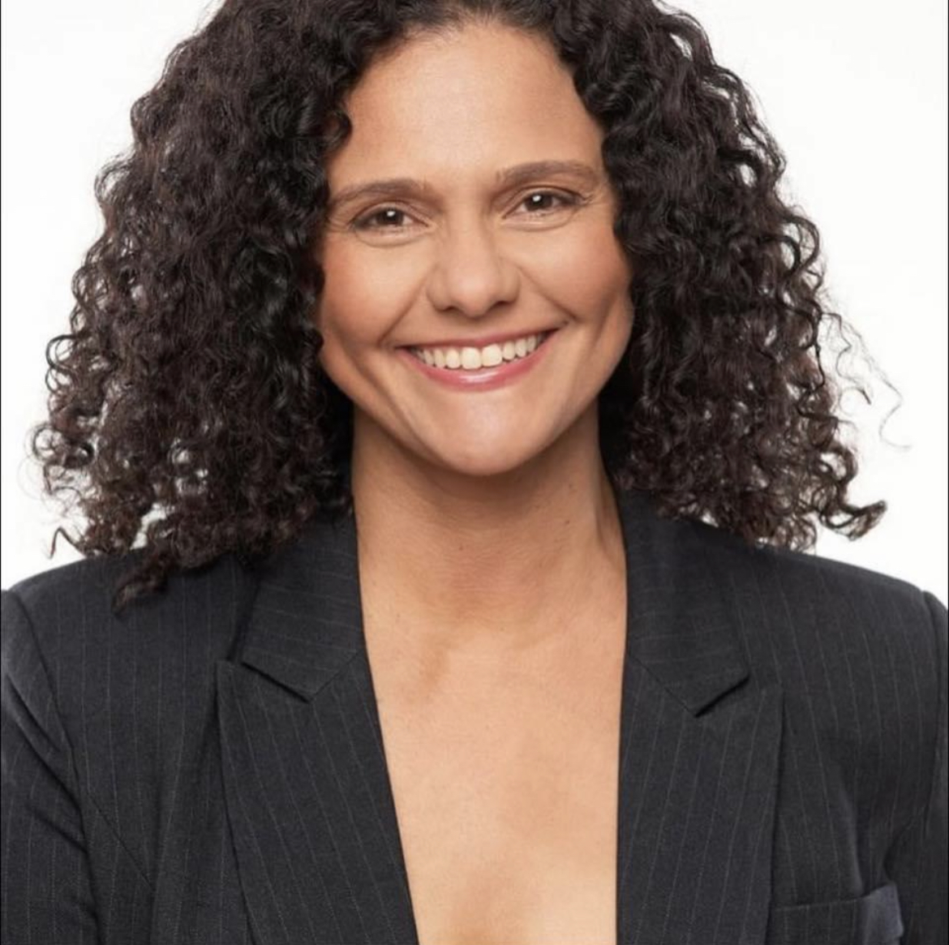
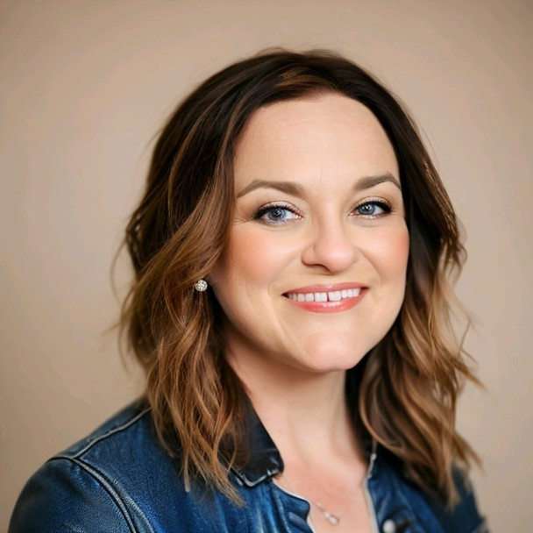
Dr. Annebelle Nery President
Guided Pathways Institute #6 Team
Dr. Vaniethia Hubbard Vice President, Student Services
Dr. Gregory Toya Dean, Student Affairs
Dr. Daniel Martinez Associate Dean, Research, Institutional Effectiveness & Planning
Claire Coyne
Academic Senate President
Chantal Lamourelle Student Equity Coordinator
Tanisha L. Burrus
Interim Director of Student Success

Slide 3
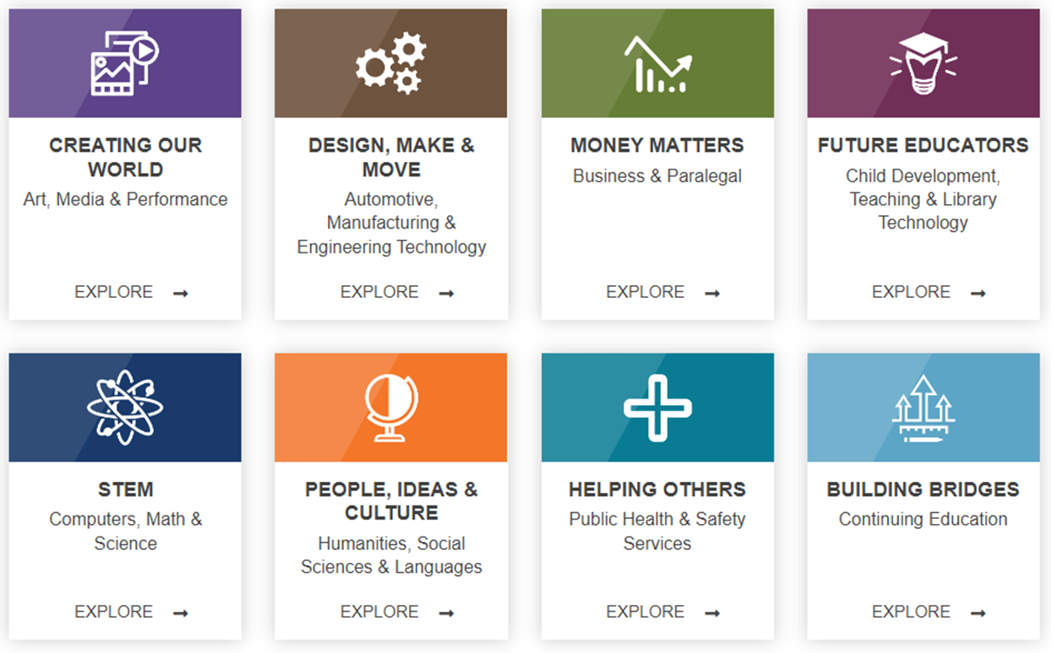
#1 - Guided Pathways Accomplishments (1)
What are your top GP accomplishments in the past four years (2019-2023)?
Accomplishment #1: Created framework around "Four Pillars"
Pillar One: Enter the Path—Superstrong (Career Assessment Tool)
Pillar Two: Clarify the Path—Program Maps/Meta-Majors
Pillar Three: Stay on the Path—Success Teams
Teaching & Learning—New Faculty Institute
Accomplishment #2: Launched Career & Academic Pathways (8 CAPS) with Success Teams in fall 2020 which Starfish (student success technology platform).
Starfish connects students, faculty and staff to maximize student success and connection. Supported by pathways Success Teams and Coaches, Starfish is a critical tool supporting Guided Pathways. In the first year of usage, Santa Ana College achieved 5% higher persistence among students whose instructors used Starfish as well as better course outcomes.
Notes:
Accomplishment One:
•The Beginning (2017-2022):
•A redesign of SAC programs that is student-centered
•SAC selected as 1 of 20 GP demonstration colleges
•Began a five-year implementation Fall 2017
•GP Steering Committee (cross-functional)
Creation of 4 Pillar focuses
Accomplish Two:
Starfish is used for our Early Alert/Progress Survey. Starfish empowers faculty to relay student concerns to the Success Coaches, academic/attendance concerns, collaborate with counselors and support services, and connect students with essential campus resources. recognize achievements with kudos, address academic/attendance concerns, collaborate with counselors and support services, and connect students with essential campus resources.

Slide 4
#1 - Guided Pathways Accomplishments (2)
What are your top GP accomplishments in the past four years?
Accomplishment #3: Guided Pathways Steering Committee started in fall 2023. This committee serves as the participatory governance body responsible for developing and implementing college planning efforts, along with making recommendations to the College Council regarding the Guided Pathways workplan (incorporates Equity plan goals) and commitments.
Accomplishment #4: Fostering and Enhancing Collaborative Partnerships Established Throughout the Campus:
SEAP (Guided Pathways Workplan incorporates equity goals)
CAP Discovery Day (Career Center in collaboration w/ Success Teams)
Affinity Programs & Centers: Undocu-Scholars, U2 Scholars (Umoja), Asian Pacific Student Program (APSP), SAC PRIDE!
Notes:
#3: Previous model was Executive Team and Core Team
Following campus-wide discussions and input for the GP workplan 2022-2026, Santa Ana College temporarily delayed the submission of the next plan to ensure the establishment of transformative practices in this work. Through a deeper evaluation of our Guided Pathways implementation plan, the recommendation emerged to form a Guided Pathways Steering Committee in fall 2023. This committee serves as the participatory governance body responsible for developing and implementing college planning efforts, along with making recommendations to the College Council regarding the Guided Pathways workplan and commitments.

Slide 5
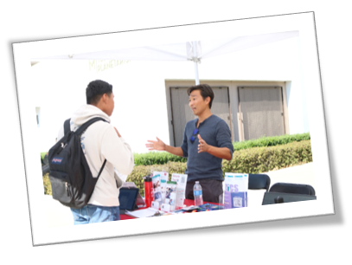
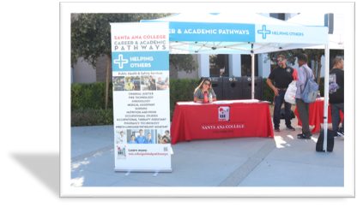
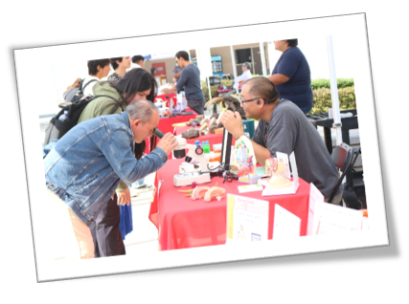
#2 – Evolutions to the Student Experience (1)
How has the student experience changed as a result of these accomplishments?
Student Experience Evolution #1: Increased student understanding of Career & Academic Pathways (CAPS) is facilitated through enhanced direct engagement with program-specific information. This engagement is fostered through regular communication in the following ways:
Success Team members via Canvas Shell messaging
CAP Exploration Fair
CAP Exploration Months
CAP Discovery Day event
Student Experience Evolution #2: The formation of the Success Teams directly contributed to the increase in the number of students having comprehensive education plans across all CAPS by 30%.

Slide 6
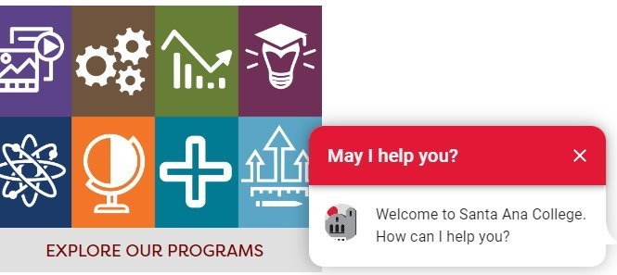
#2 – Evolutions to the Student Experience (2)
How has the student experience changed as a result of these accomplishments?
Student Experience Evolution #3: Improved communication with current students and prospective students by adding Ocelot technology to our college website homepage and various student services departments. www.sac.edu
Student Experience Evolution #4: CAP Discovery Day
63 total programs, CAPs-credit and non-credit academic programs
Among survey completers, there was a 46-percentage point increase in survey respondents knowing what a CAP is after the event.
Notes:
#3:
#4: CAP Discovery Day (Coordination led by Career Center)

Slide 7
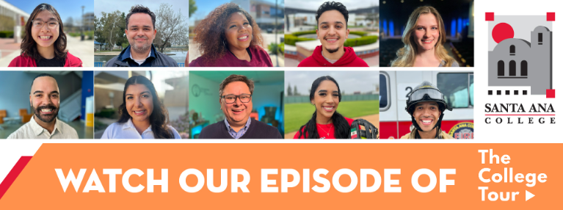
#3 - Key Epiphanies
What were some epiphanies you had as you engaged in this work?
Epiphany #1: Collaborating closely with Student Equity Achievement Program (SEAP) committee is essential to avoid duplicating efforts, promote effective collaboration, and to meet our Guided Pathways Work Plan goals.
Epiphany #2: When campus practitioners grasp the significance of the transformative nature of this work, they are willingly to offer their time and expertise.
Epiphany #3: We must increase ways students are able to develop relationships with their peers, classified professionals and faculty members in efforts to best support their learning experience at Santa Ana College.
“I have felt welcomed and included, and I’m treated just like any other full time college student.
While attending SAC, faculty is always helping me prepare for my future, even as a sophomore in high school. Because of the dual-enrollment program at SAC I feel ready and excited to continue my college experience.” -KS, DE student
“​​What a privilege it is to educate yourself. I never thought I’d be back in school studying something I’m passionate about. I encourage others to push through their fears and go after your heart’s desires, especially being supported by a great school like Santa Ana College.”--K.D. People, Ideas & Culture CAP/Fine Arts Student

Slide 8
#4 – Future Areas of Inquiry
What areas of inquiry and future work are next for the college as you continue this work to improve the student experience and make outcomes more equitable?
Future Area of Inquiry #1 Create a marketing campaign in key student spaces across campus. Specifically, we should focus on strategic locations such as the Welcome Desk in S-Building, Science Center, JSC, Bookstore, Math Center, and Learning Center. These spaces serve as focal points for student engagement and activity, awareness of Career & Academic Program (CAP) and the Success Team support.
Future Area of Inquiry #2: Combine CAP Discovery Day with SAC Days campus events to increase awareness of all programs and degrees across all pathways.
Future Area of Inquiry #3: Enhance the position of Success Coaches by adding Guided Pathway related duties to Classified professionals' job descriptions and transitioning to a case management model.
Notes:
Inquiry #2 Describe both events: CAP Discovery Day and SAC Days

Slide 9
#5 – Challenge for Peer Feedback
As you view the path ahead, what are one or two challenges / issues for which you’d like to access the expertise and experience of your peers in the room?
Challenge #1: Dissemination of updates on the advancement of Guided Pathways throughout the campus.
Challenge #2: Encouraging campus-wide understanding that Guided Pathways initiatives are not merely additional tasks or extra workload, but rather the fundamental groundwork for enhancing the student experience and ultimately promoting student success.
Challenge #3: GP work is embedded in the work of the faculty, for classified professionals and students to be involved in this work we have had to rely on those who are willing to volunteer their time to reach our goals.
Challenge #4 – Securing on-going funds. As the one-time funds deplete, what and how are peer institutions securing on-going funds?

