Slide 1
Success Team Summit
Learn from our Pilot Success Team Members
Friday, May 8th
9:00 - 10:30 am

Slide 2
Welcome
Purpose: learn from future educators pilot success team
Working together as a team
Identifying goals for success team
Working towards student success

Slide 3
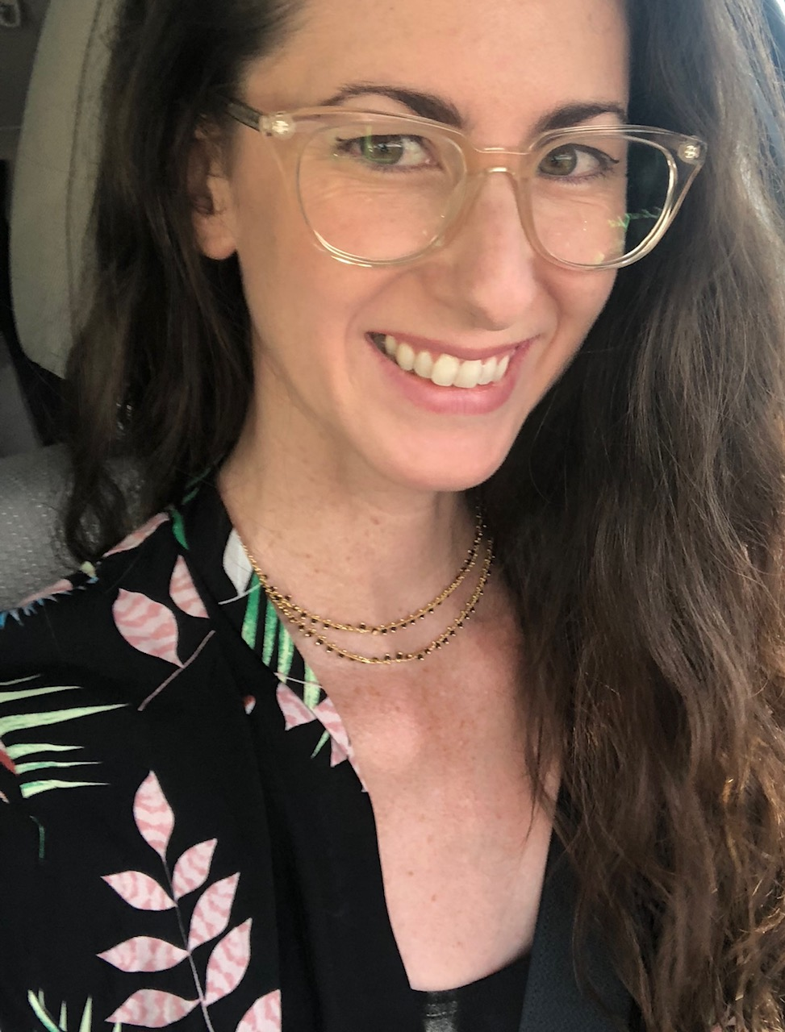
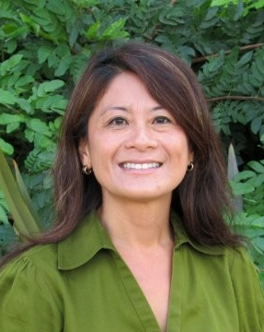
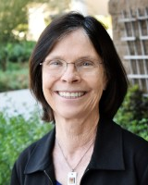
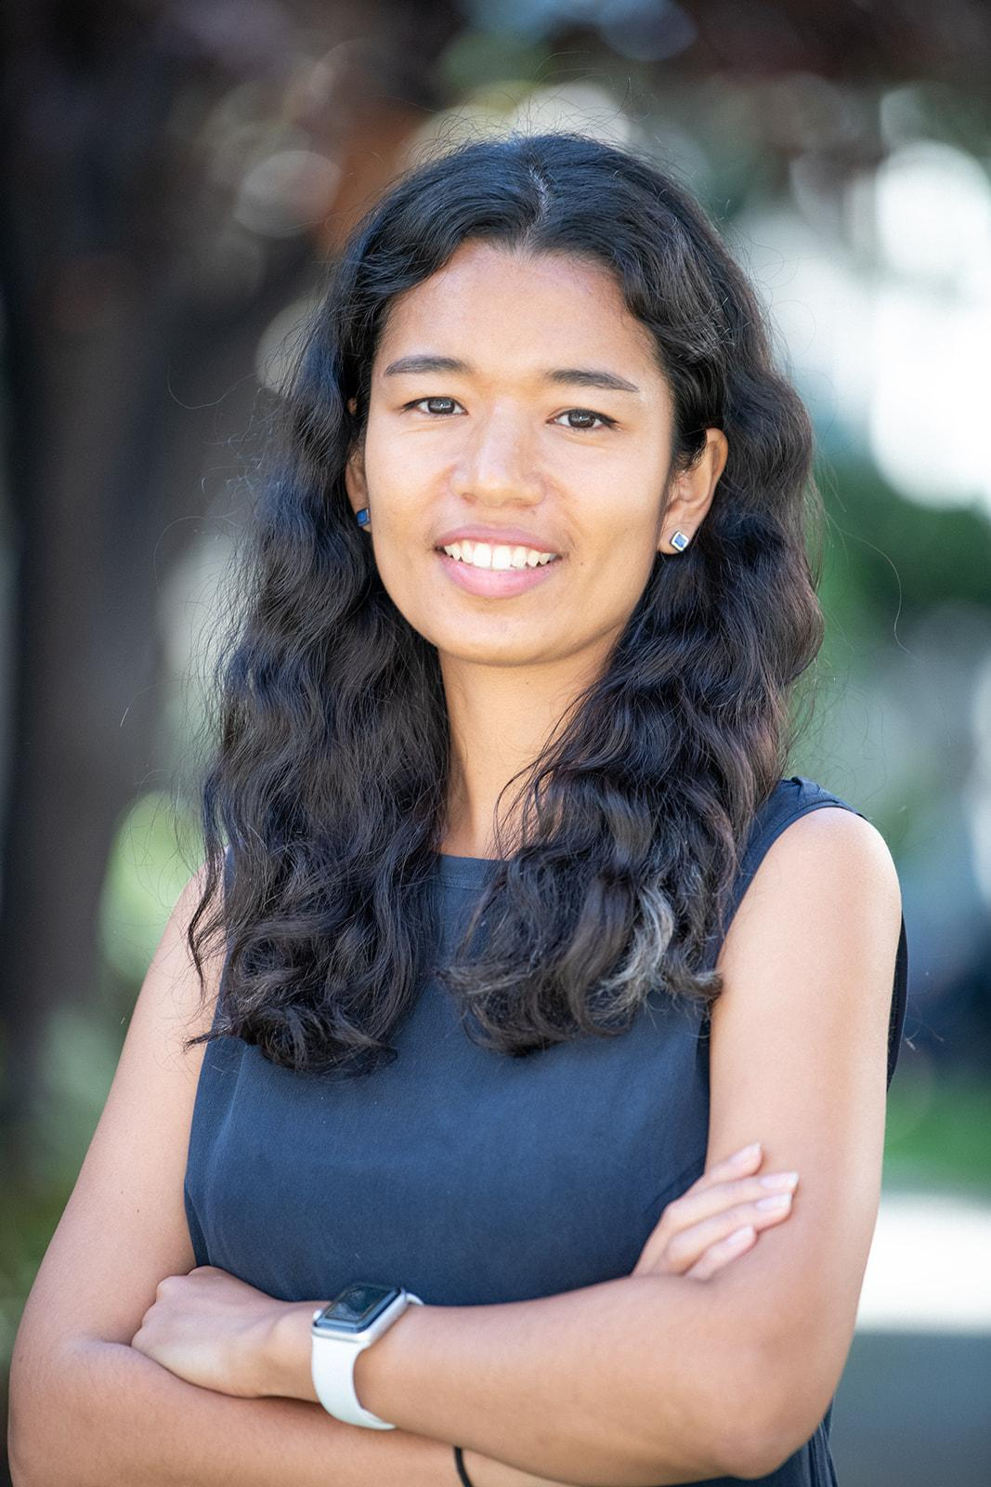
Team introduction
Stephanie Clark
Guided Pathways
Coordinator
Maria Dela Cruz
Dean of Counseling
Mary Huebsch
Faculty PD Coordinator
Sia Smith-Miyazaki
Director
Career Ladders Project

Slide 4
Webinar norms
Comments &
A Tech support
Questions for
panelists

Slide 5
What is your WHY?
Write your response in the chat to share
Notes:
College mission: Inspire, transform, and empower

Slide 6
Success Teams
Success Teams are cross-functional teams focused on supporting and guiding students through their academic journey.

Slide 7
Success Teams
Designed to improve college communication with students, and also improve communication between offices and services.

Slide 8
Pilot Success Team
Future Educator’s Pilot Success Team members/roles:
CAP Coordinator - Maria Dela Cruz
Counselor Lead - Steve Bautista
Discipline Faculty Leads - Michelle Hardy, Mary Funaoka, Stacy Russo
Career Coach - Aurea Gandarilla
Student Success Coaches - Sara Vu, Tanisha Burrus
Administrative Support - Financial Aid Specialist - Sonia Lopez, Research Analyst - Tyler Johnson, Technology Support - Hang Le

Slide 9
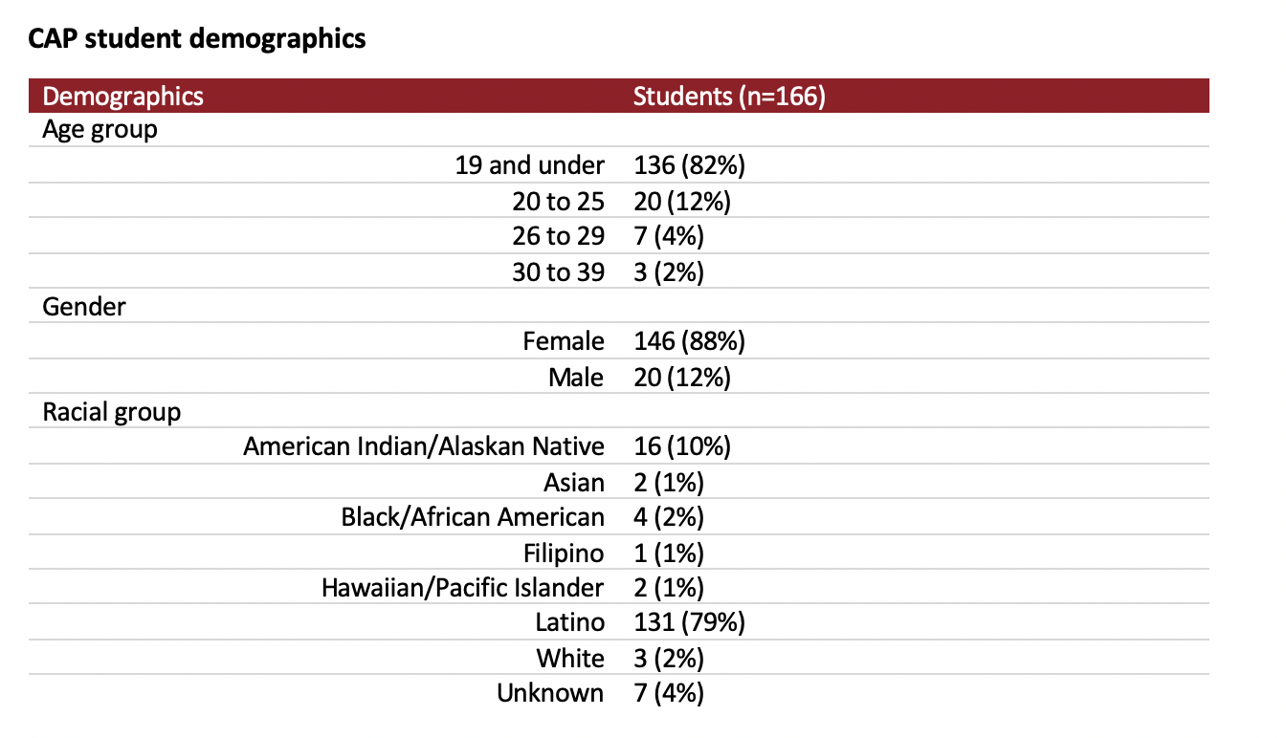
Pilot Success Team

Slide 10
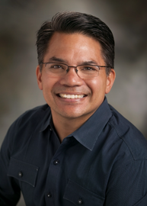
Lead Counselor
Role:
Provide Counseling expertise to the team, serve as a liaison to my department, work directly with students in the CAP, collaborate to help students and the team reach our goals.
What I enjoy most:
Working with dedicated professionals and with SAC students who want to make a difference in the lives of others as future educators.
Steve Bautista
Counselor | Coordinator Center for Teacher Education

Slide 11
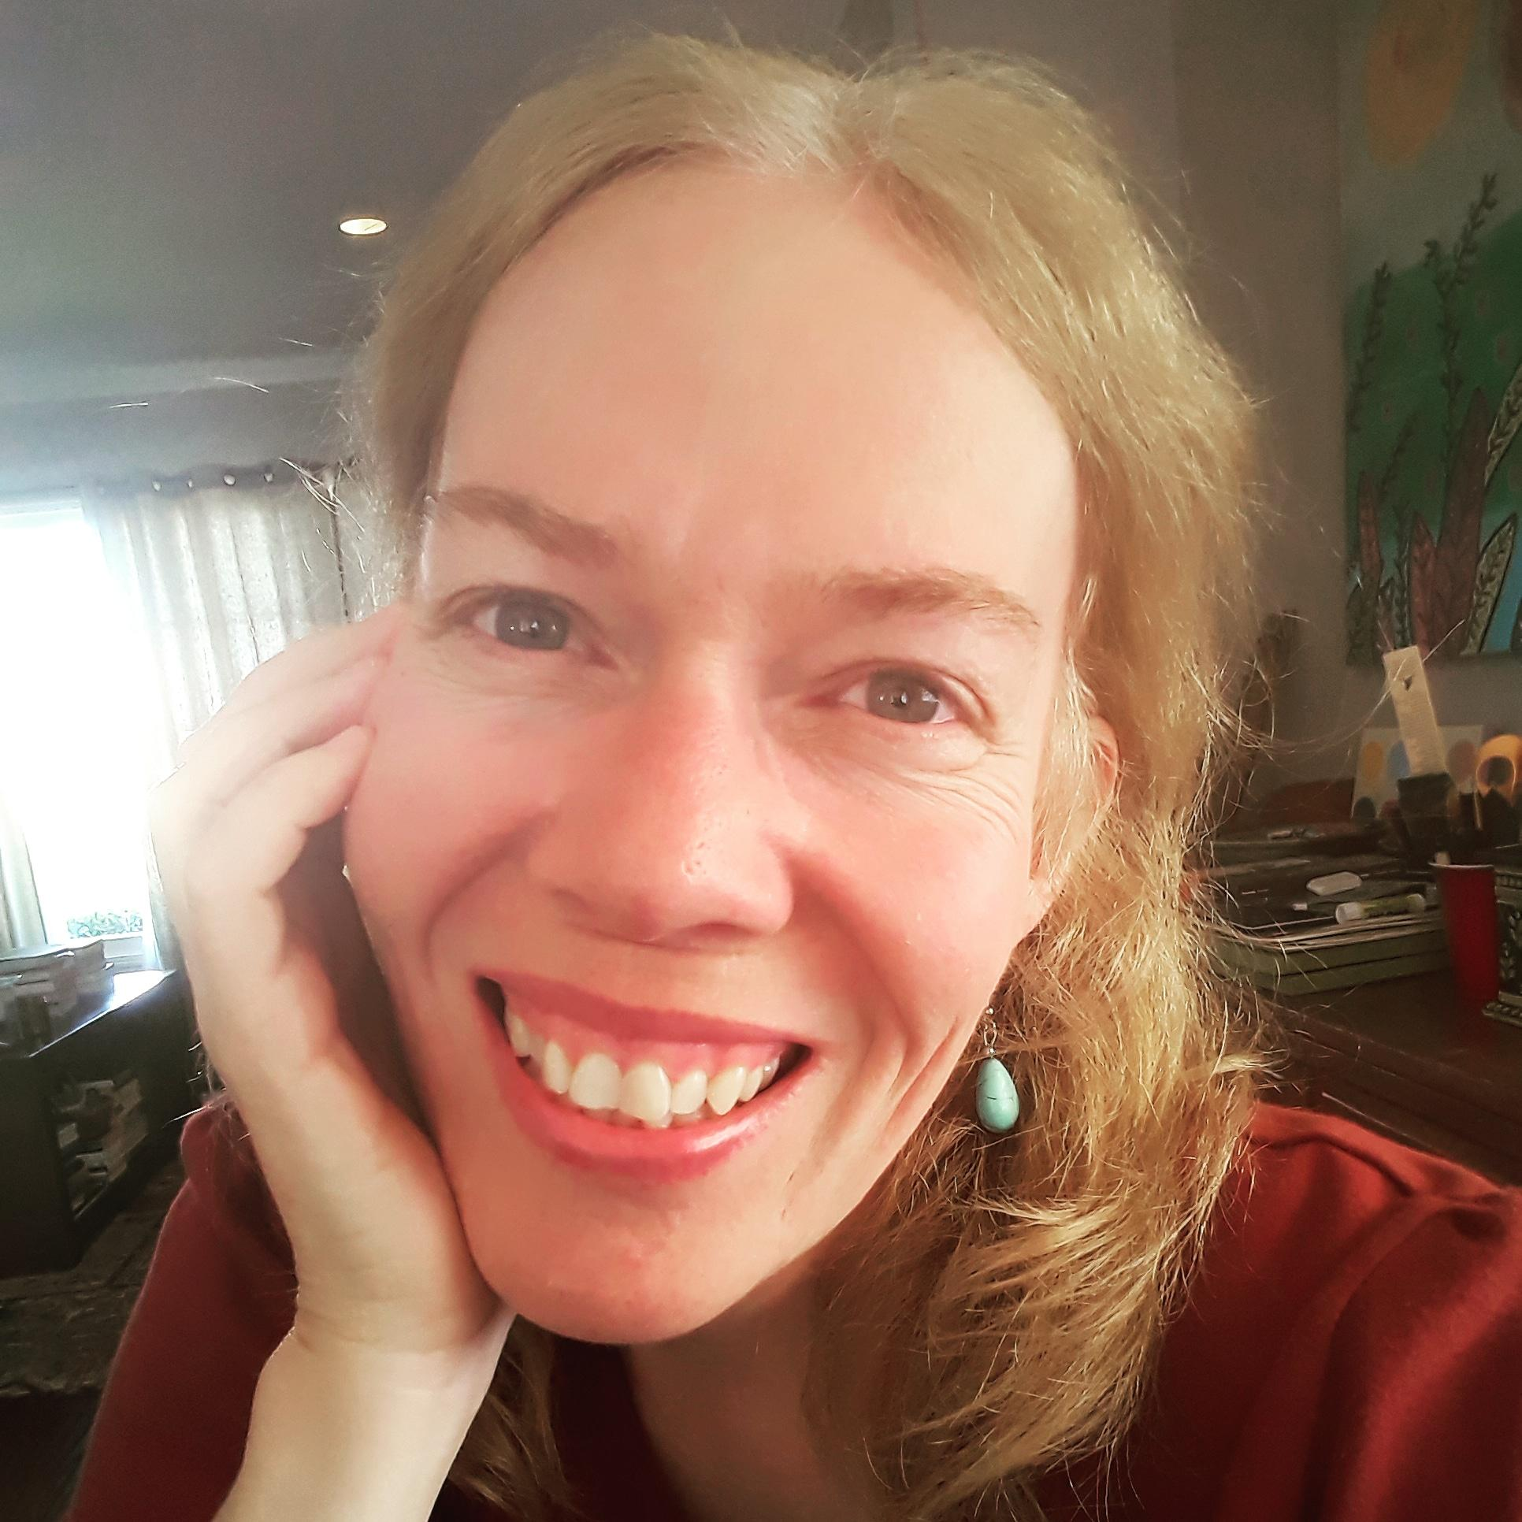
Discipline Faculty Lead
Role:
Offering curriculum and overall program information to the team
Providing information about Library Tech students and the library profession
Sharing Success Team updates with faculty colleagues
Collaborating with Success Team members, including understanding their roles at SAC and how we can work together to help students be successful
What I enjoy most:
Being on the Success Team has given me the opportunity to work with staff members on campus I would normally not interact with. I’ve discovered processes I was not aware of. All of this work is creating a foundation for improving student success.
Stacy Russo
Librarian | Associate Professor
Library Technology Program Department Chair

Slide 12
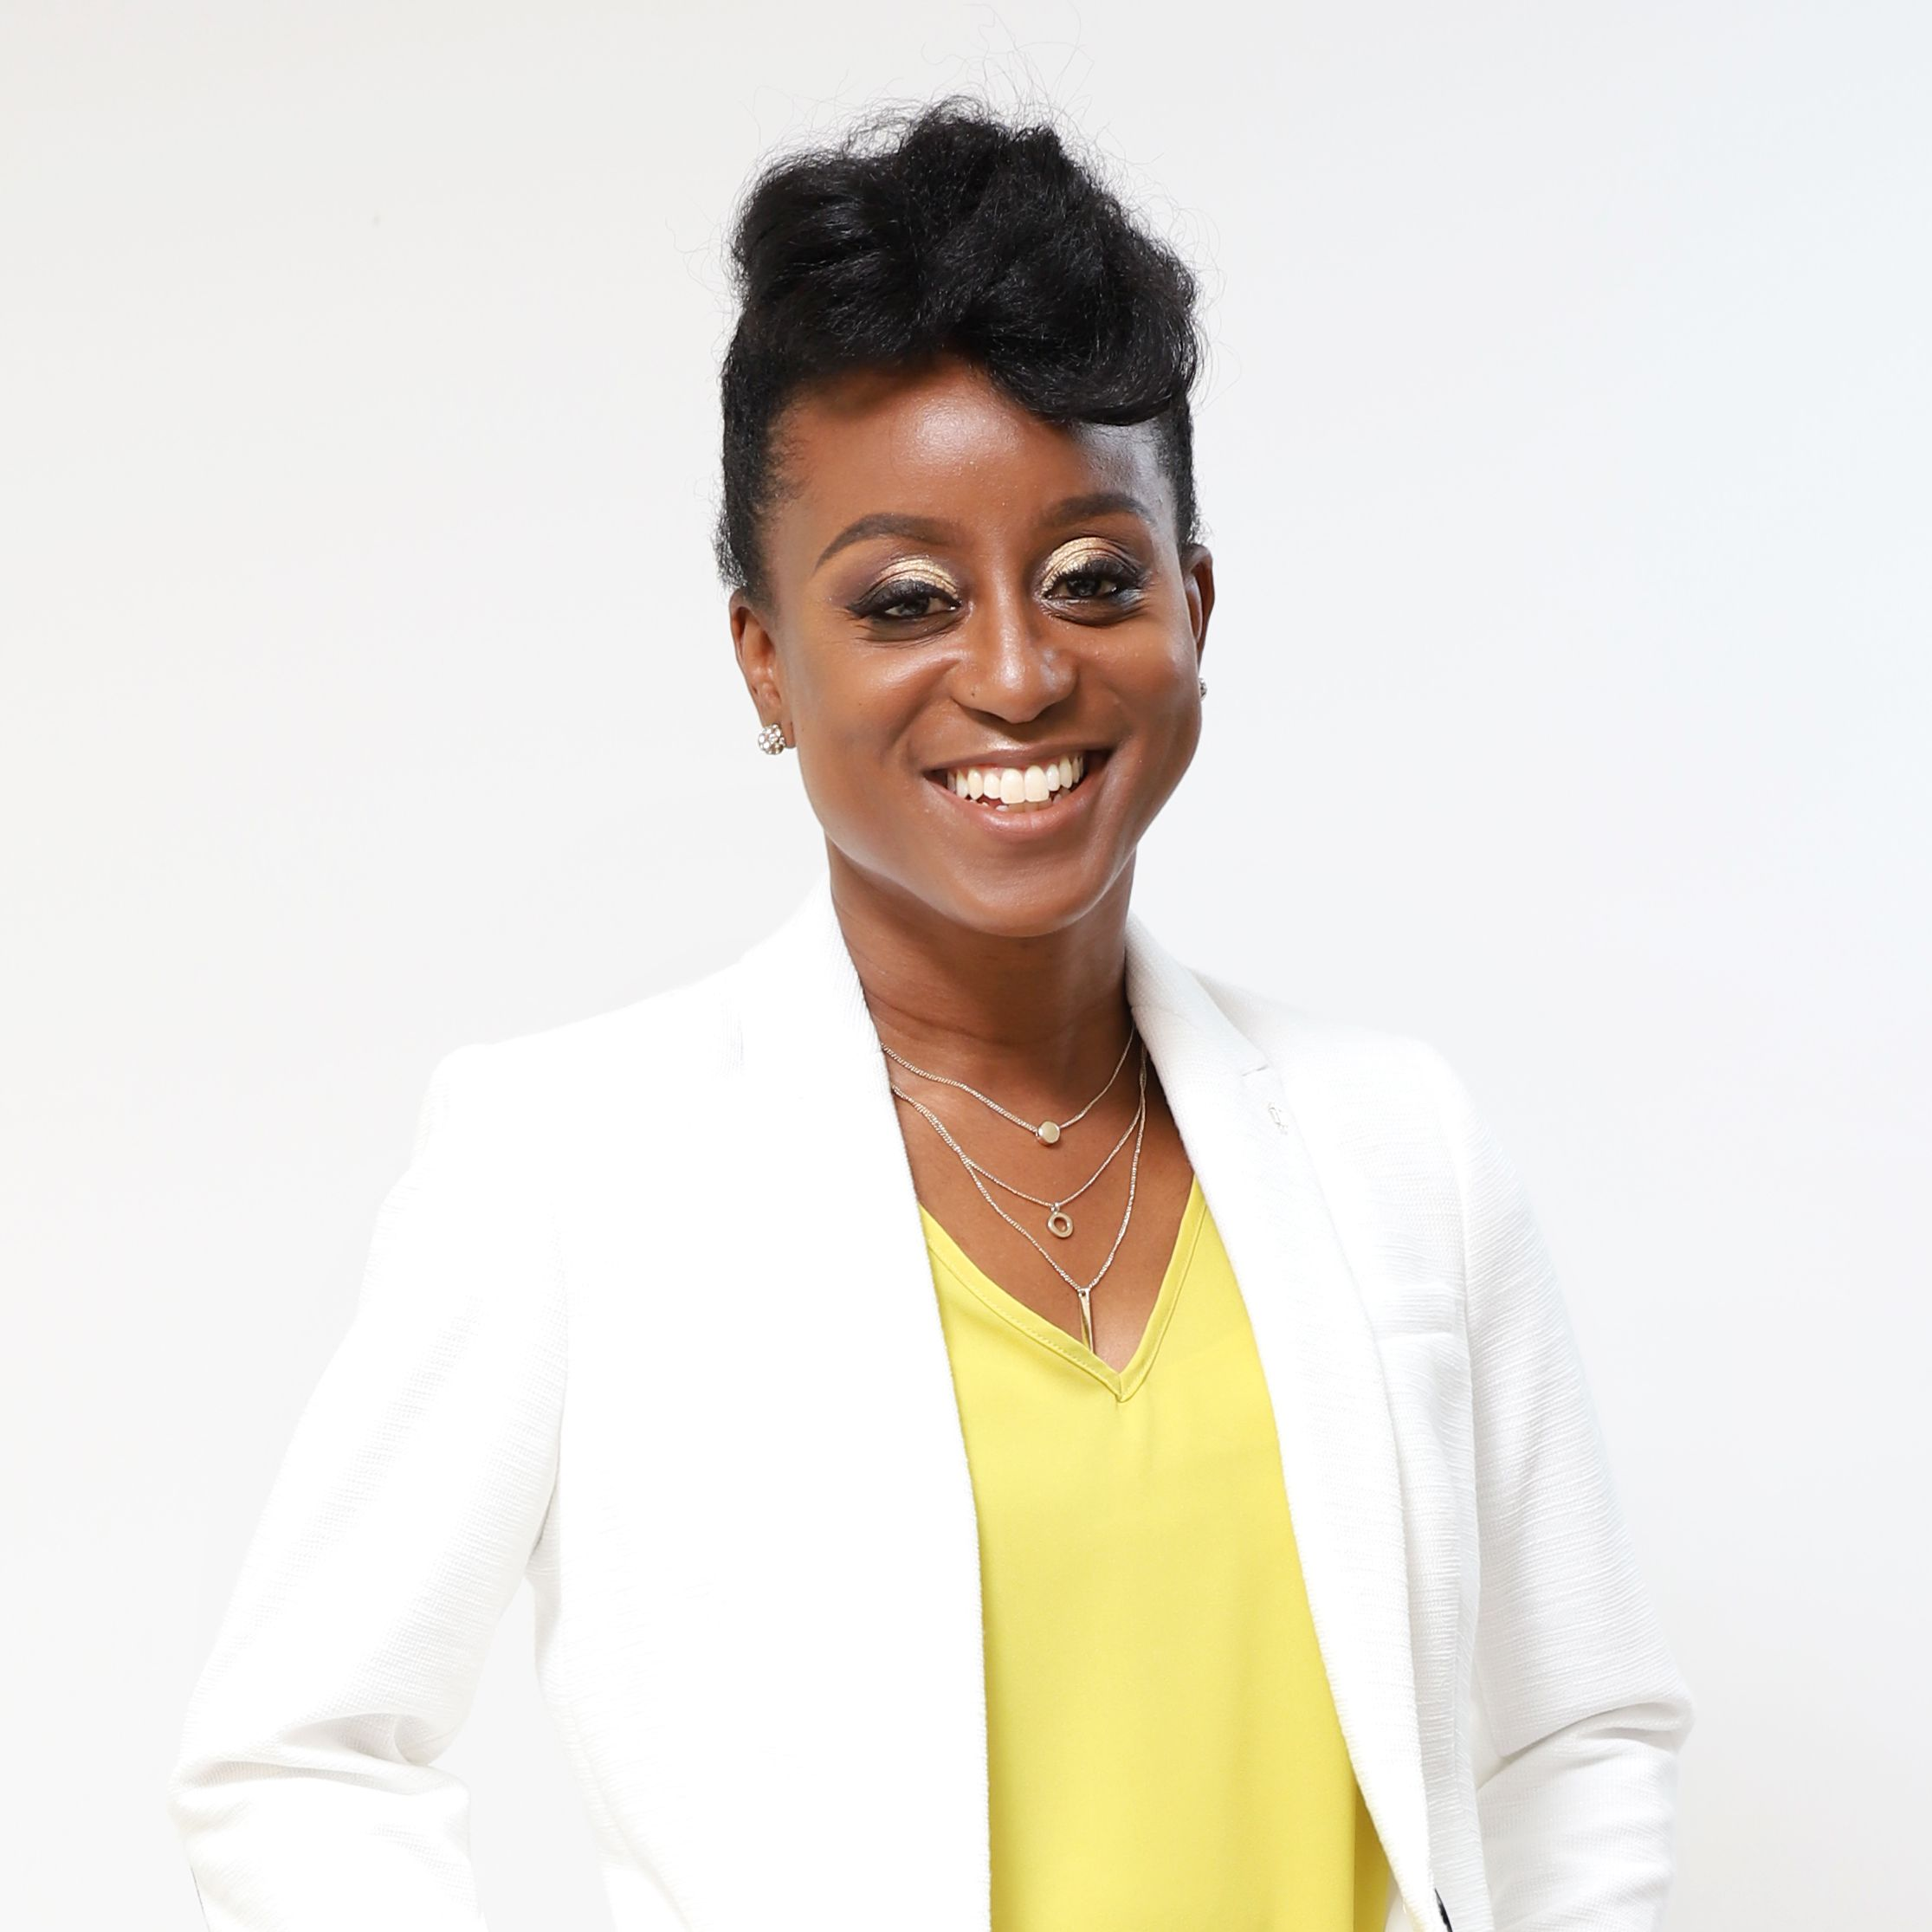
Student Success Coach
Role:
Provide direct support to students in person, email, or by phone
Responsible for tracking student services students received including online education plan
Created and implemented outreach strategies to increase the number of completed online education plans for our students
Direct support for lead counselor
What I enjoy most:
Collaboration with other colleagues from various departments across campus to assist students using effective student-centered practices.
Tanisha Burrus
Student Services Coordinator
Center for Teacher Education

Slide 13
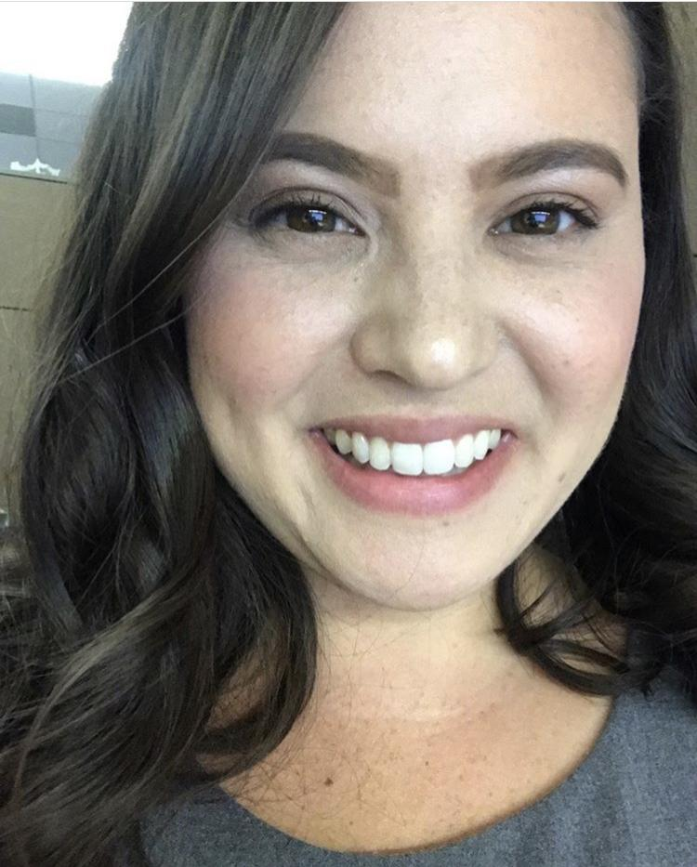
Student Success Coach
Role:
Provide direct support to students in person, by email, or by phone
Serve as an informed referral source for students’ needs
Assist in communication efforts and and monitor student progress
Direct support for lead counselor
What I enjoy most:
I love being part of a team of student-centered educators and providing holistic support to students. I think the integration of academic and student services makes students feel like we’re truly invested in their success!
Sara Vu
Student Services Coordinator
Center for Teacher Education

Slide 14
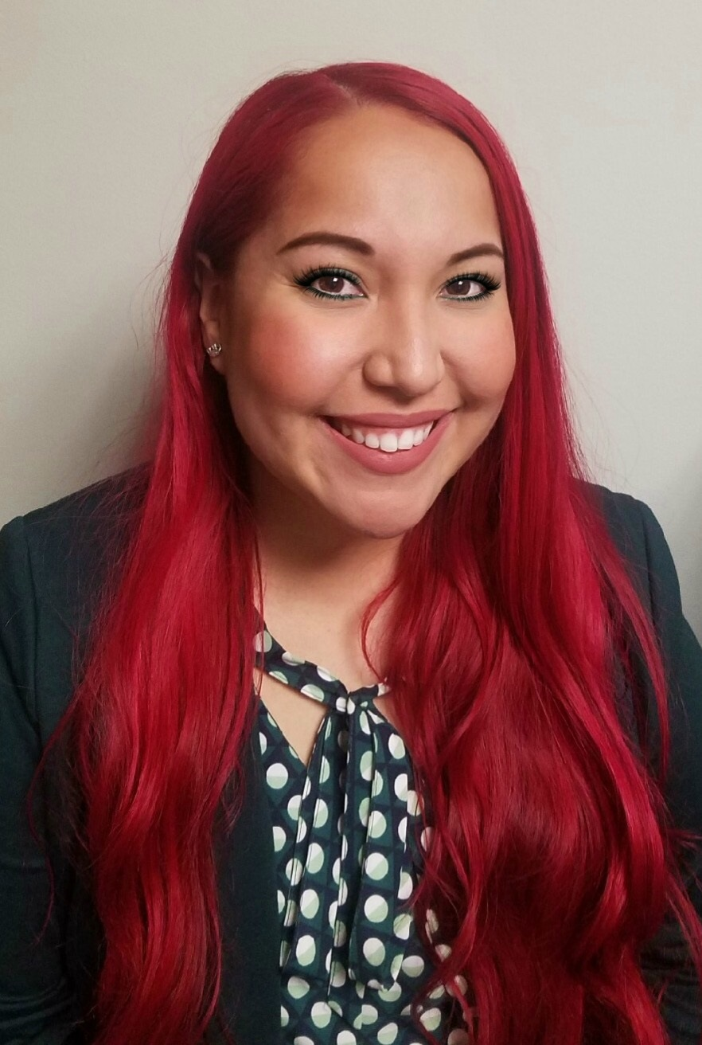
Career Coach
Role:
Provide direct support to students with career and internships opportunities
Promote work-based learning opportunities such as Service Learning to relate to their pathway
Assist in career exploration and career options related to the field
Conduct employment preparation skills workshops such as résume writing, résume critique and LinkedIn
What I enjoy most:
Discovering new ways of consulting/collaborating as a team to streamline services to students and assist in fulfilling their educational/career goals.
Aurea Gandarilla
Career Technician
Career Center

Slide 15
Working together as a success team
Overview:
Setting goals for the team
How are we doing in reaching those goals?
Using equity-minded approaches and practices
Information gathering
Communication
Notes:
Steve

Slide 16
Setting goals for the team
Goals specific to pilot success team
English and Math (first year attempt & completion)
Retention (fall-spring)
Assist near-completers
Program orientation
One contact with discipline faculty lead*
Self-assessment for CAP students
Early field work experience
Notes:
Steve
English and Math (first year attempt & competition)
Retention (fall-spring)
Assist near-completers
Ensure all students in CAP came to program orientation (program overview)
One contact with discipline faculty lead (didn’t quite operationalize yet)*
Self-assessment for students
To identify interests & needs - drafted with research
Challenge: survey response not as robust (sent 2-3 times)
Early field work experience (courses, jobs, service learning)
Created a student session in fall/spring - importance of field work for students (before service learning orientation); “finding field work”; connect students with field work immediately after

Slide 17
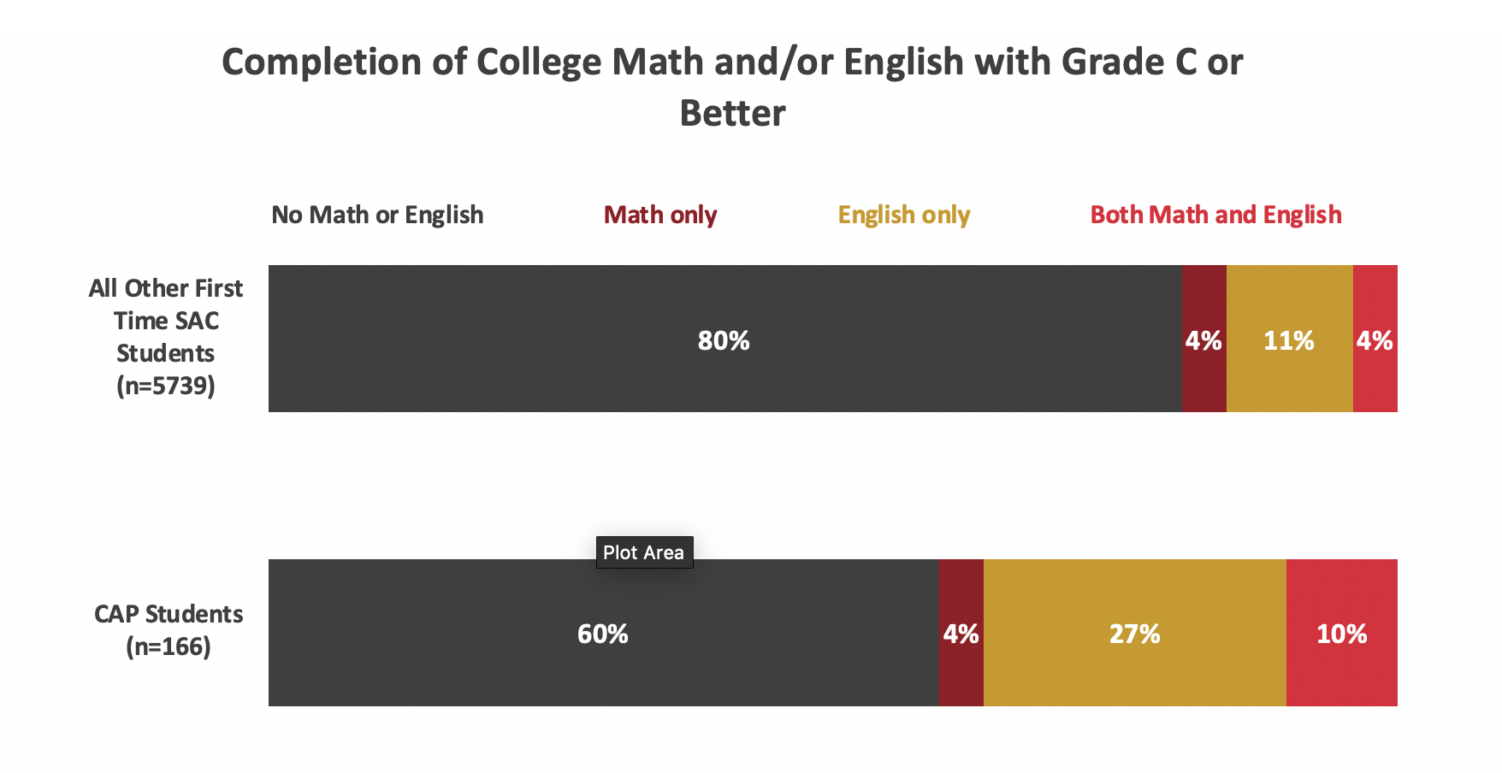
Pilot Success Team

Slide 18
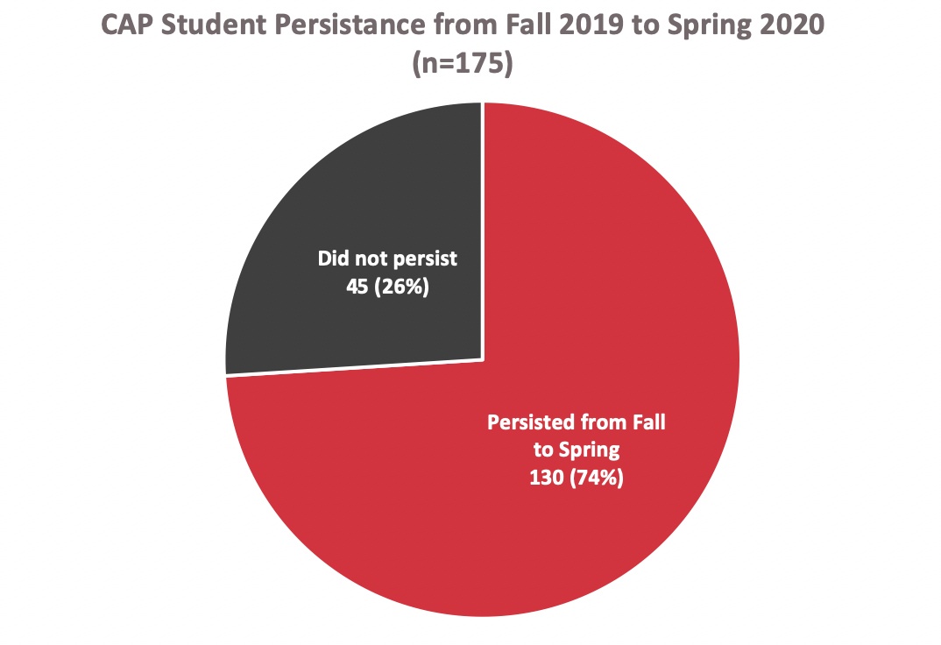
Pilot Success Team

Slide 19
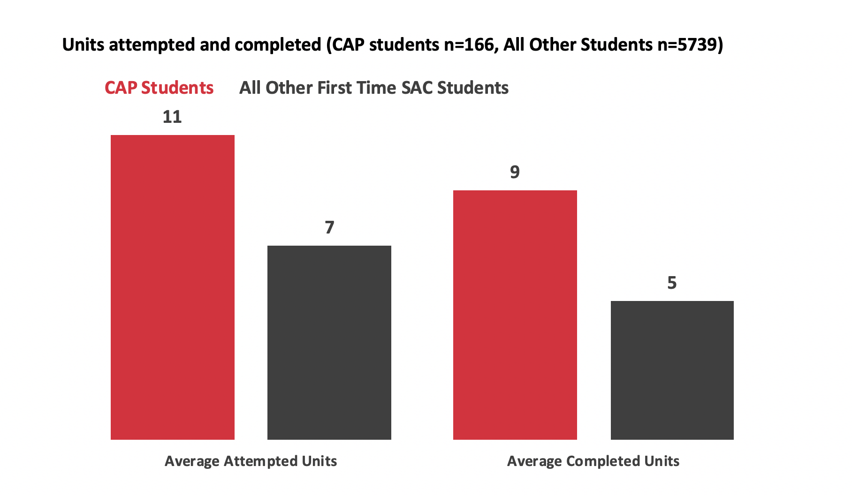
Pilot Success Team

Slide 20
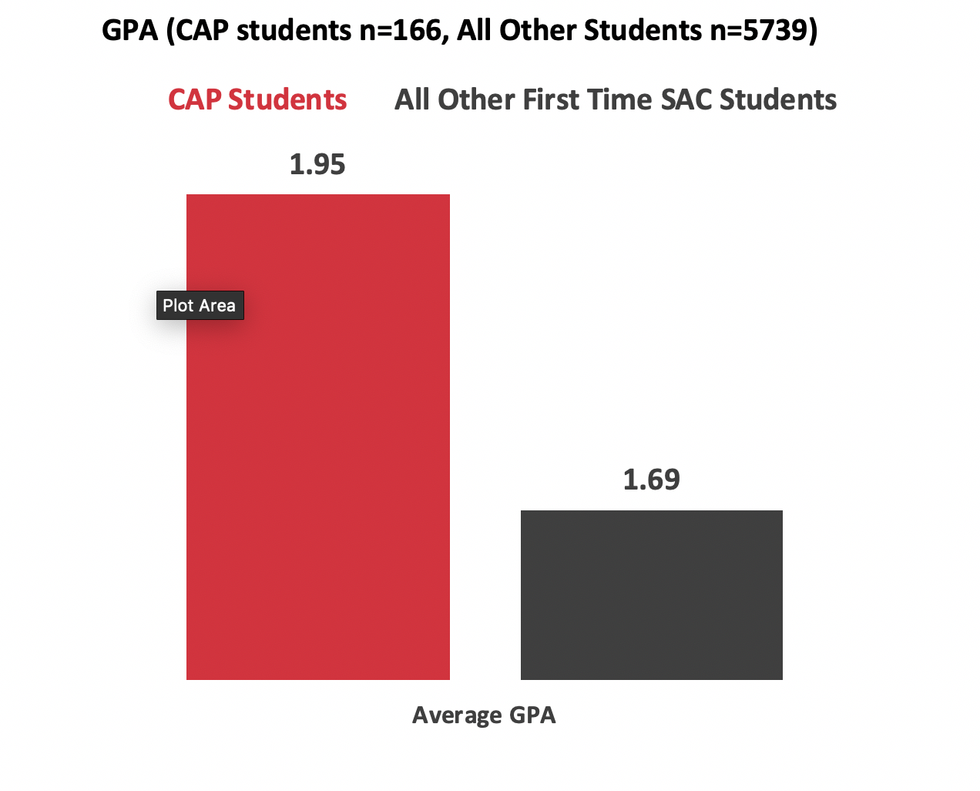
Pilot Success Team

Slide 21
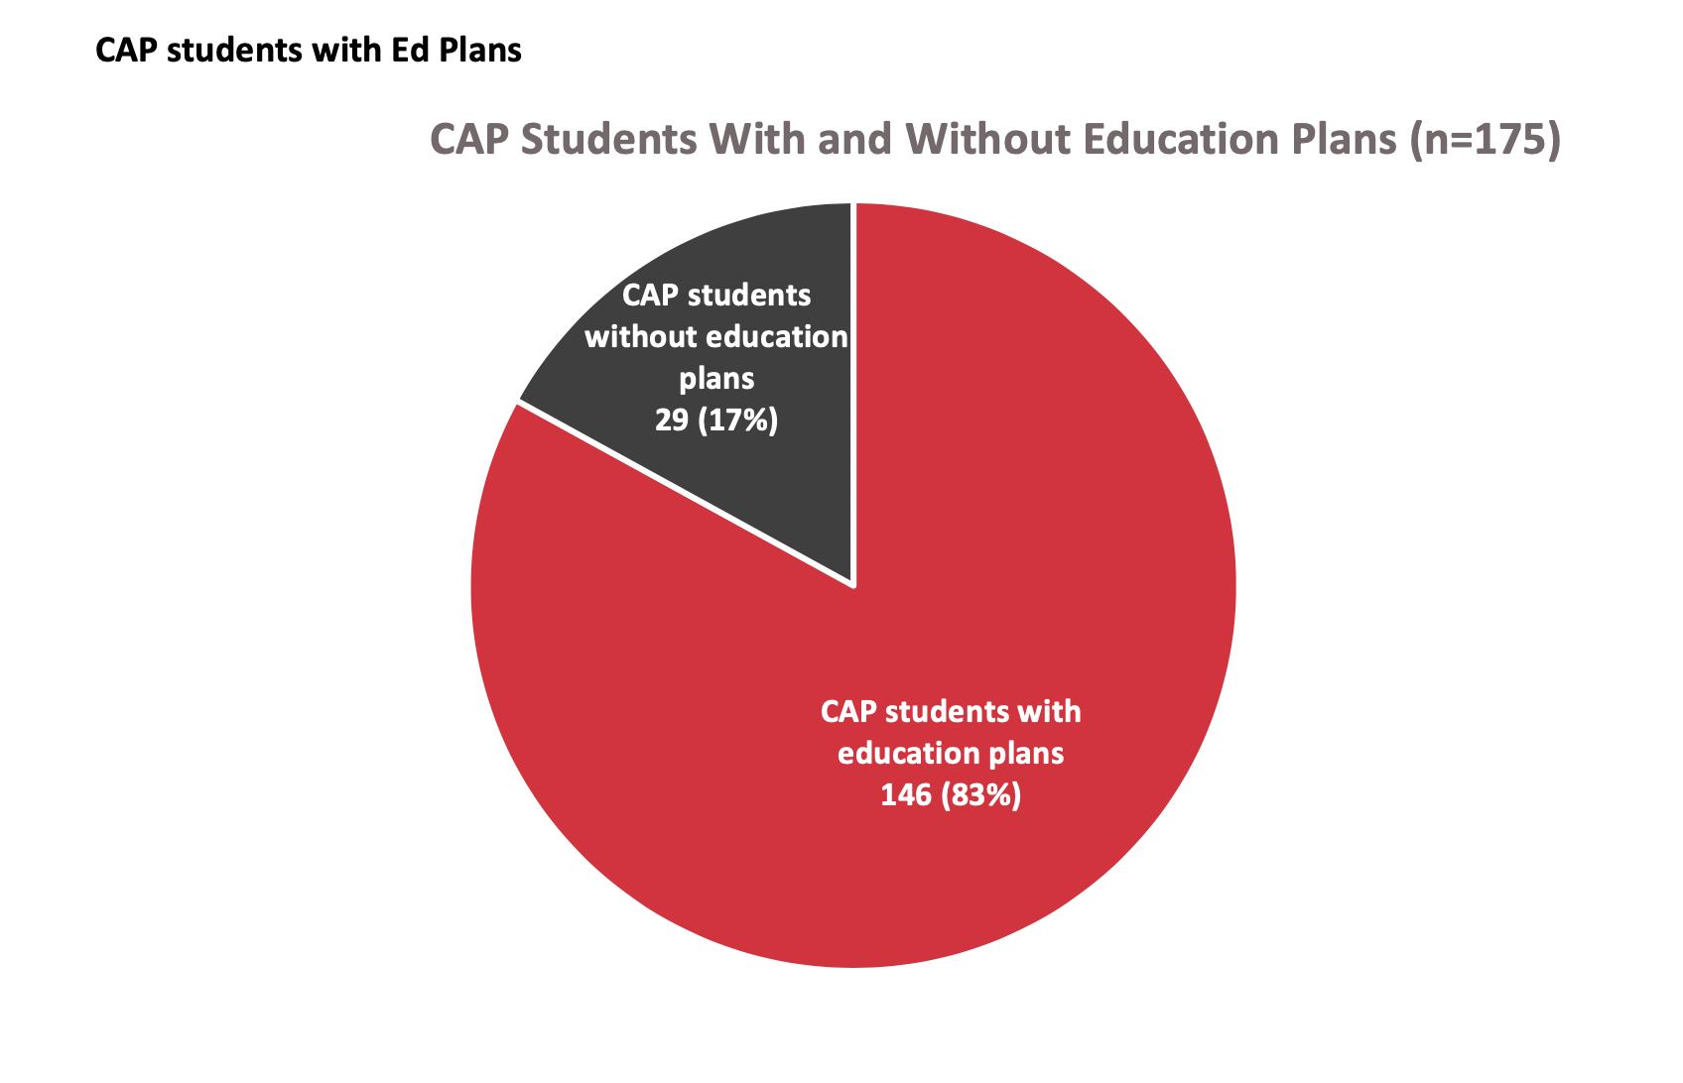
Pilot Success Team

Slide 22
Information gathering
Take inventory
Catalog existing campus/ division offerings related to the CAP
Learn existing policies, process, and procedures
What prevents students (structurally) from completion? From accessing existing resources? What policies and regulations create unnecessary barriers for students?
Invite guests to join success team meetings to learn more
Near completers
Early alert
Notes:
Take inventory - Sara
Stacy
Invited guests: Near completers - counselor who handles students who are near completion; discover more about process - see how team can work together
work with near completers: counselor reaches out but may not be aware of course offering; but chair is aware; faculty lead can see where the issues are (e.g a course offered every 3 semesters - everyone knows when those courses are offered)
Early alert - all faculty in dept to make sure they were aware of early alert. Some faculty didn’t know about the process at all; reached out to students struggling in classes

Slide 23
Communication
E.g. Communicating career opportunities to students
Career coach: notify CAP team of job opportunities
Faculty leads: share with faculty members in CAP, who share with their students via canvas
Success coaches: targeted student outreach
Email student database; campaign with student assistants
Collaborate with student services for info dissemination and connect with specialized programs
Notes:
Tanisha
Communication including: Agenda for meetings, choosing format for internal collaboration/ communication, communication to students
Student communication example: career opportunities
Campaign with student assistants - targeted roster, specialized email, phone call, some text
Connect with specialized programs - where students are, and also database to pull from for targeted campaigning

Slide 24
Supporting students with their career
Employer agreement with SAUSD
Build solid connection & access to paraeducator jobs
Targeted partnerships - students get first access (“perks” for CAP)
Community partnerships
Library, professional associations, etc
Road to teaching conference (leveraging existing event)
Used grants to fund students to attend
Opportunity to learn about teaching profession, PD
Connect the dots for students & remove barriers
Notes:
Aurea: Connect the dots for students & remove barriers
Employer agreement (recruitment) with SAUSD
Build solid connection/ access to paraeducator jobs
Targeted partnerships; Students - first access (“perks” to CAPs)
Community partnerships
Library, professional associations
Tanisha
Road to teaching conference (leveraging existing event)
Used grants to fund students to attend for free
Opportunity to learn about teaching profession, PD

Slide 25
Setting goals for the team
Common goals for all SAC success teams
Ensure students are in the correct major / program
Ensure that Pell-eligible students are receiving their financial aid
Ensure that all new FTF in CAP have a two-semester or comprehensive student educational plan
Notes:
Steve
Accurate CAP info - make sure they are in right major
Pell eligible were receiving

Slide 26
Goal: Student educational plan
Targeted campaign for those without ed plans
Individual outreach via call and text; book counseling appointment
General outreach
Presentation to classes
Counselor: outside CAP building/classes with a sign
Considerations
Impact on counseling capacity; students need to be helped quickly to ensure timely ed plan completion
Notes:
Tanisha - success coach role
Considerations:
Need to establish procedure with lead counselor
book appt for students (assign someone to do it)
a lot of back and forth = students may not complete

Slide 27
Next steps/ things to consider
Streamline student communication by CAP
Visual branding, streamlined, concise with call to action
Familiarity and connection; reduce volume of email for students
CAP kick-off event for students
Envision a grand kick-off
What is a success team? Who is on it? Where to find community? Understanding who students can turn to when they need support
Notes:
Tanisha & Sara
New student communication - they are inundated with emails
Outreach within each CAP - visual branding, streamlined, concise with call to action
Recognition - instead of getting different emails from different people - it looks familiar & students know it’s coming from their own CAP
More we do to connect as a CAP and with students
Kick-off event for students
SAC days last fall
What we envision as a grand kick-off
Who/ what is a success team? Community? Understanding who students can turn to when they need support

Slide 28
Questions?
Write your questions in Q&A

Slide 29
Reflection from our panelists
What is your WHY?

Slide 30
Closing & Next Steps
May 13th: GP Forum - Consider joining the Success Team conversation.
May 22nd: Success Teams Part 2 - Convene our current Success Team membership to identify and work towards goals.
Interested in joining a Success Team? Contact me at clark_stephanie@sac.edu

Slide 31
Template
text

