Slide 1


MLA 8th Edition Formatting
and
Style Guide:
The Basics
Adapted from the Purdue Online Writing Lab
for
Santa Ana College

Slide 2
After This Workshop I will…
Understand the basic elements required of an MLA formatted assignment
Be able to search for information regarding an MLA formatted assignment by using the OWL at Purdue
Be able to use Microsoft Word to create my own properly formatted MLA assignment

Slide 3
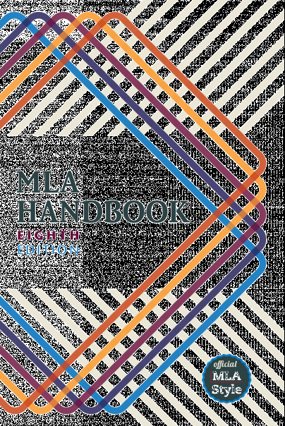
What is MLA?
MLA (Modern Language Association) Style formatting is often used in various humanities disciplines.
In addition to the handbook, MLA also offers The MLA Style Center, a website that provides additional instruction and resources for writing and formatting academic papers.
https://www.mla.org/

Slide 4
What does MLA regulate?
MLA regulates:
Document format
In-text citations
Works-cited list

Slide 5
Basic Elements of an MLA Formatted Assignment (8th ed.)
An MLA Style paper should:
  Be typed on white 8.5“ x 11“ paper
  Double-space everything
  Use 12 pt. Times New Roman font
  Leave only one space after punctuation
Notes:
The entire document should be double-spaced, including the heading, block quotations, footnotes/endnotes, and list of works cited. There should be no extra space between paragraphs.
Leave only one space after periods or other punctuation marks (unless otherwise instructed by your instructor).
Set the margins of your document to 1 inch on all sides

Slide 6
Basic Elements of an MLA Formatted Assignment (8th ed.)
An MLA Style paper should also:
  Set all margins to 1 inch on all sides
  Have a header with page numbers located in the upper right-hand corner
  Include your name, the instructor’s name, your class, and the day (day month year) in upper left
    Indent the first line of paragraphs one half-inch
Basic rule for any formatting style:
Always follow your instructor’s guidelines
Notes:
Indent the first line of paragraphs one half-inch from the left margin. MLA recommends that you use the Tab key as opposed to pushing the Space Bar five times.
Create a header that numbers all pages consecutively in the upper right-hand corner, one-half inch from the top and flush with the right margin. (Note: Your instructor may ask that you omit the number on your first page. Always follow your instructor's guidelines.)
･Use italics throughout your essay for the titles of longer works
･If you have any endnotes, include them on a separate page before your works-cited list. Title the section Notes (centered, unformatted).
Many instructors who require their students to use MLA formatting and citation style have small exceptions to different MLA rules. Every bit of instruction and direction given in this presentation comes with this recommendation: ALWAYS follow the specific instructions given by your instructor.

Slide 7
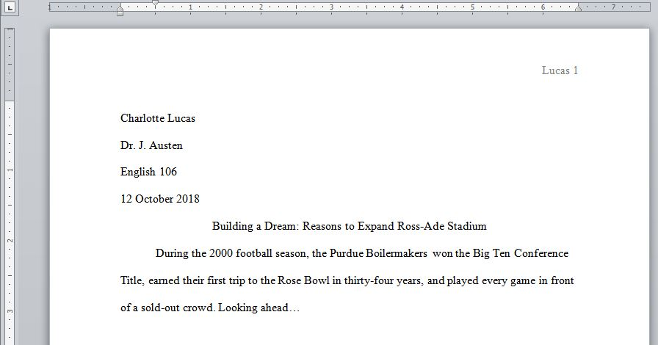
Sample First Page
½”
1”
1”
Double-space
Double-space
½”
1”

Slide 8
The First Page of an MLA Style Paper Will:
Have no title page
Double space everything
List your name, your instructor's name, the course, and date in the upper left-hand corner
Center the paper title (use standard caps but no underlining, italics, quote marks, or bold typeface)
Create a header in the upper right corner at half inch from the top and one inch from the right of the page (list your last name and page number here)
Notes:
･Do not make a title page for your paper unless specifically requested
･In the upper left-hand corner of the first page, list your name, your instructor's name, the course, and the date. Again, be sure to use double-spaced text.
･Double space again and center the title.
Do not underline, italicize, or place your title in quotation marks; write the title in Title Case (standard capitalization), not in all capital letters.
･Use quotation marks and/or italics when referring to other works in your title, just as you would in your text: Fear and Loathing in Las Vegas as Morality Play; Human Weariness in “After Apple Picking“
･Double space between the title and the first line of the text.
･Create a header in the upper right-hand corner that includes your last name, followed by a space with a page number; number all pages consecutively with Arabic numerals (1, 2, 3, 4, etc.), one-half inch from the top and flush with the right margin. (Note: Your instructor or other readers may ask that you omit last name/page number header on your first page. Always follow instructor guidelines.)

Slide 9
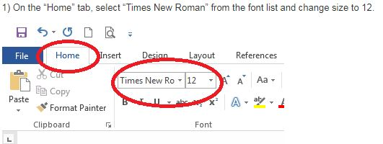
How to Create an MLA Formatted Document in Microsoft Word
***Please note that not all word processors have access to the tools required to set up MLA format, so it is recommended that you compose or edit documents in Microsoft Word as this tutorial does.
Adapted from Northeast Wisconsin Technical College’s Library website, http://nwtc.libanswers.com/faq/212878

Slide 10
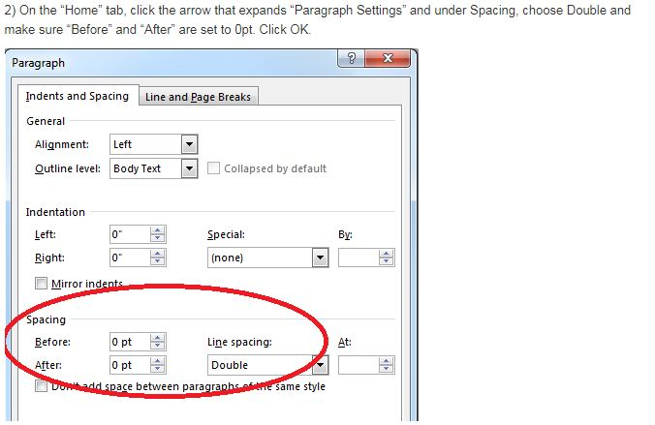
How to Create an MLA Formatted Document in Microsoft Word
Adapted from Northeast Wisconsin Technical College’s Library website, http://nwtc.libanswers.com/faq/212878

Slide 11
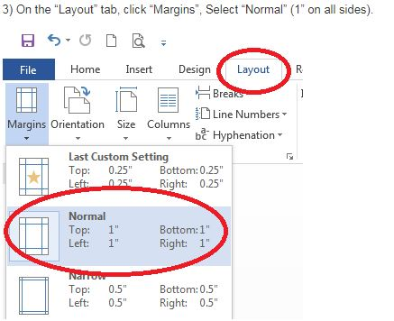
How to Create an MLA Formatted Document in Microsoft Word
Adapted from Northeast Wisconsin Technical College’s Library website, http://nwtc.libanswers.com/faq/212878

Slide 12
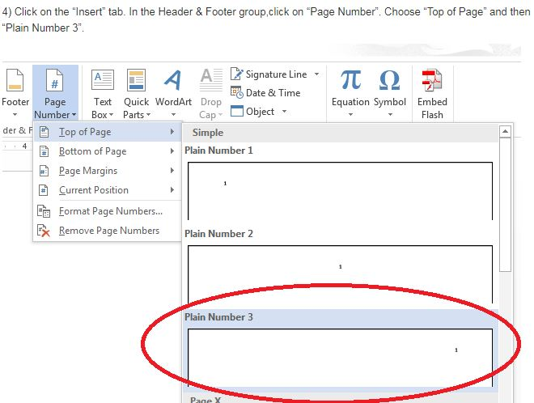
How to Create an MLA Formatted Document in Microsoft Word
Adapted from Northeast Wisconsin Technical College’s Library website, http://nwtc.libanswers.com/faq/212878

Slide 13
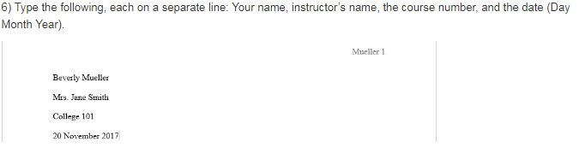
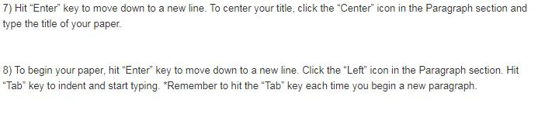
How to Create an MLA Formatted Document in Microsoft Word
Adapted from Northeast Wisconsin Technical College’s Library website, http://nwtc.libanswers.com/faq/212878

Slide 14
Where do I go to Review or Learn More?
The best open (free) source for questions about MLA format is the Online Writing Lab from Purdue University, more commonly known as OWL.
Their website can be accessed through the url: https://owl.purdue.edu/owl/purdue_owl.html

Slide 15
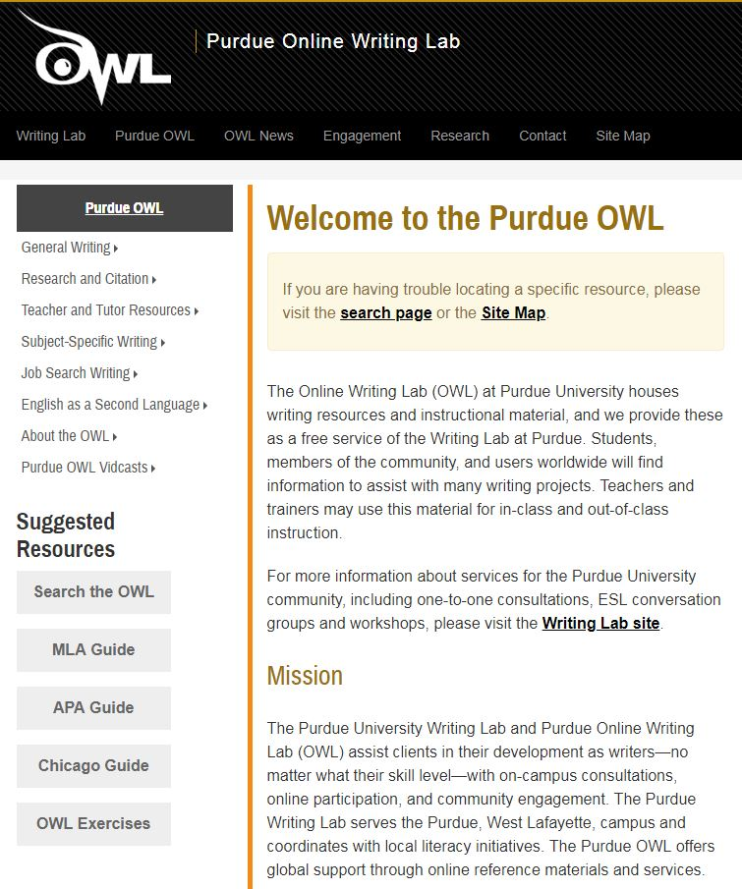
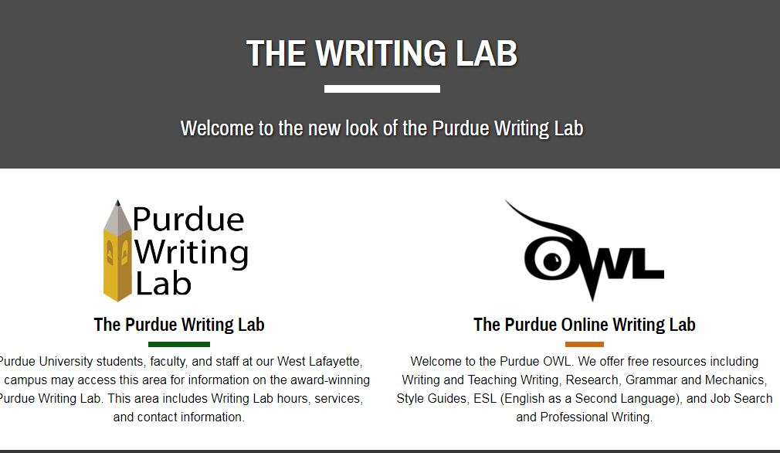
Where do I go to Review or Learn More?
Choose “The Purdue Online Writing Lab”
Next, select “MLA Guide” and then “General Format” under the “MLA Formatting and Style Guide” menu.

Slide 16
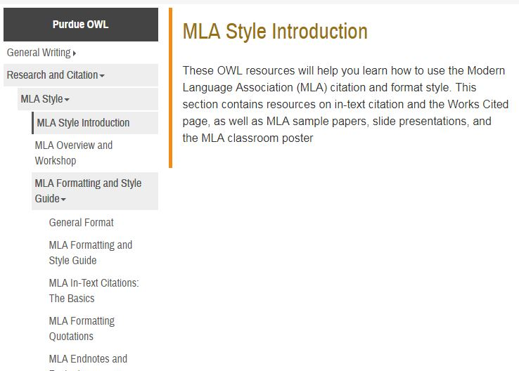
Where do I go to Review or Learn More?
Click on the MLA Formatting and Style Guide.
Select the “General Format” from the dropdown menu for more details about setting up basic MLA format.

Slide 17
Now you…
Understand the basic elements required of an MLA formatted assignment;
Can search for information regarding an MLA formatted assignment by using the OWL at Purdue; and
Will use Microsoft Word to create your own properly formatted MLA assignment.

Slide 18
Create your own MLA Formatted Paper
Use the information for the student below to create your own MLA formatted paper.
Name: Buffy Summers
Class: English 061X
Instructor: Professor Giles
Date: March 26, 2018
Title: The Slayer Strikes Again

Slide 19
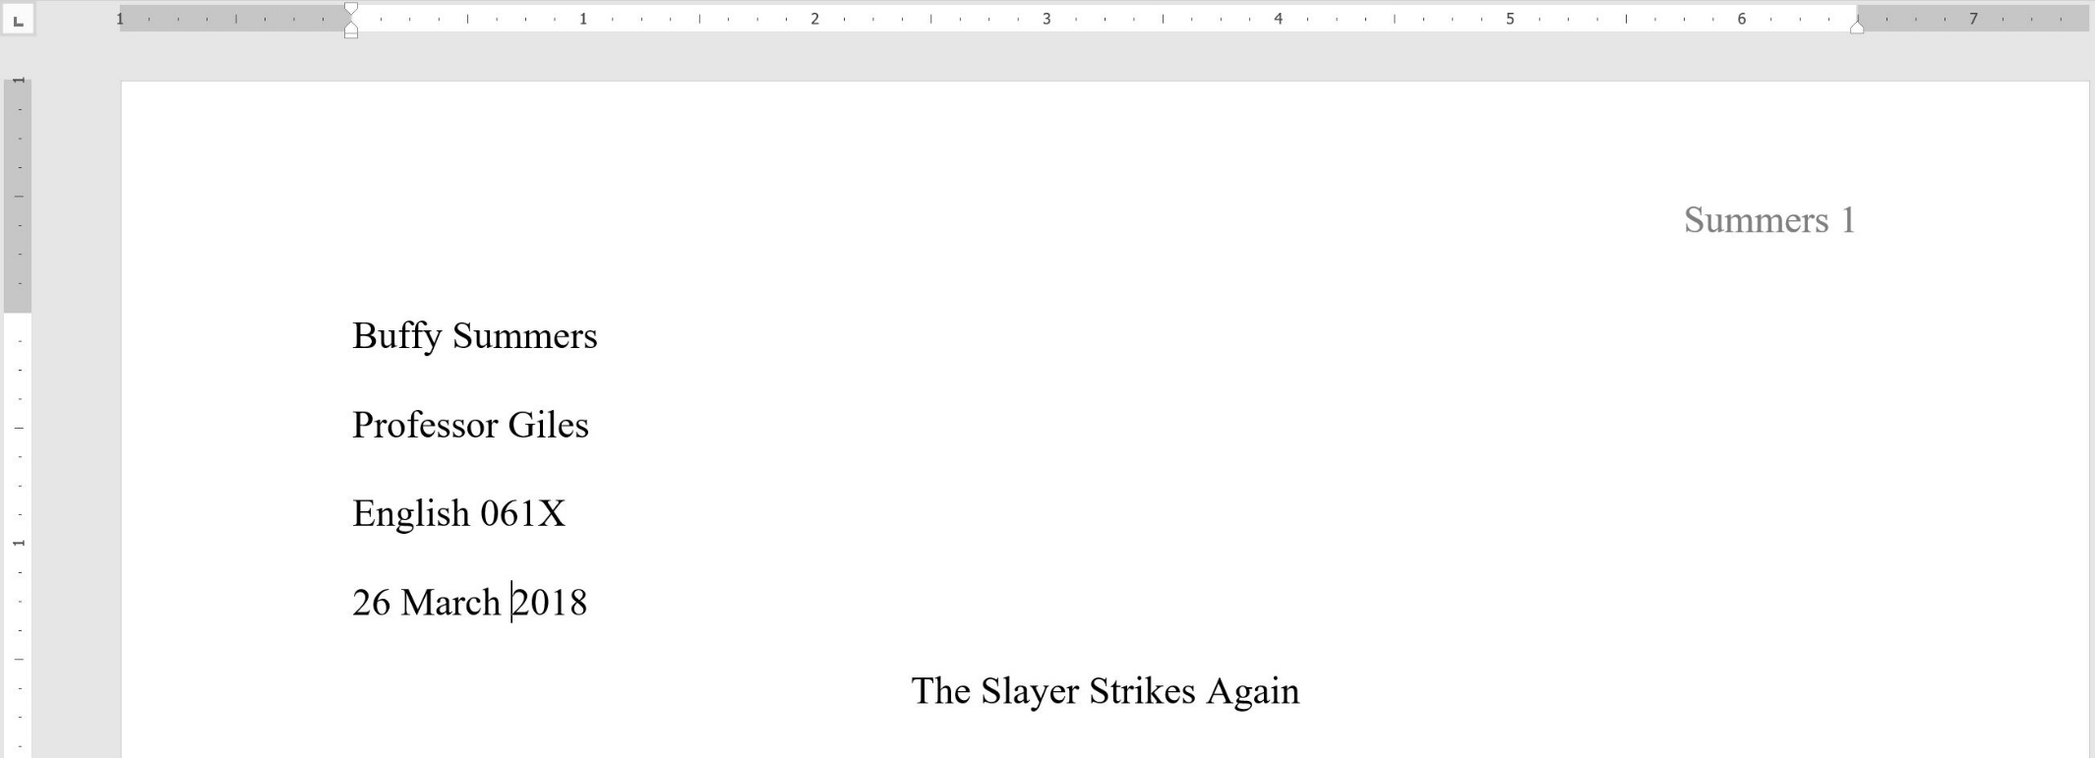
Create your own MLA Formatted Paper: Answer
½”
1”
1”
1”
Double-space
Double-space

Slide 20
Works Cited
The Purdue OWL Family of Sites. The Writing Lab and OWL at Purdue and Purdue U, 2008, owl.english.purdue.edu/owl. Accessed 17 Aug. 2018.
“How to Setup MLA Formatting in Word 2016.” Northeast Wisconsin Technical College, 2018, nwtc.libanswers.com/faq/212878. Accessed 17 Aug. 2018.

