Slide 1
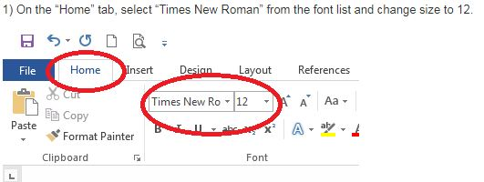
How to Create an MLA Formatted Document in Microsoft Word
***Please note that not all word processors have access to the tools required to set up MLA format, so it is recommended that you compose or edit documents in Microsoft Word as this tutorial does.
Adapted from Northeast Wisconsin Technical College’s Library website, http://nwtc.libanswers.com/faq/212878

Slide 2
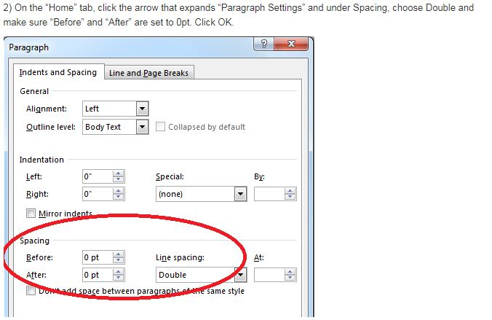
Also check the box which says “Don’t add space between paragraphs of the same style.”
Adapted from Northeast Wisconsin Technical College’s Library website, http://nwtc.libanswers.com/faq/212878

Slide 3
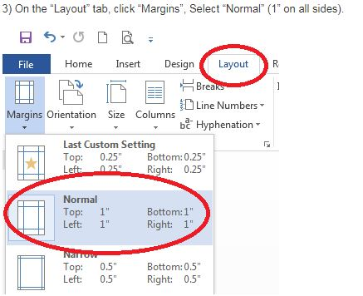
Adapted from Northeast Wisconsin Technical College’s Library website, http://nwtc.libanswers.com/faq/212878

Slide 4
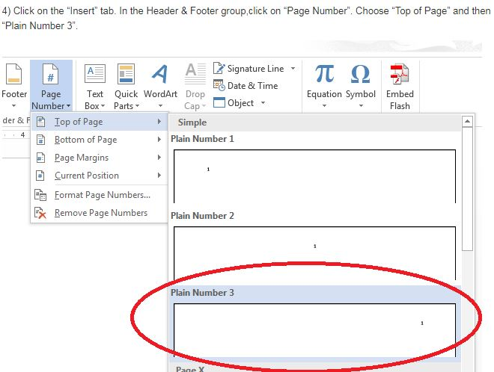
Adapted from Northeast Wisconsin Technical College’s Library website, http://nwtc.libanswers.com/faq/212878

Slide 5
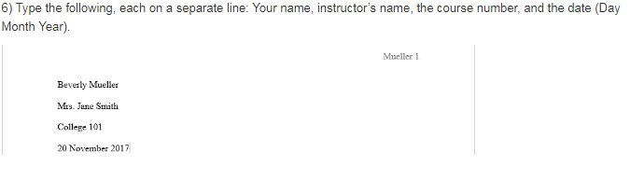
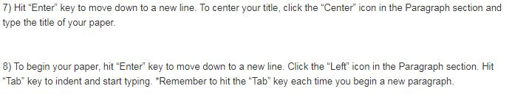
Adapted from Northeast Wisconsin Technical College’s Library website, http://nwtc.libanswers.com/faq/212878

