Slide 1
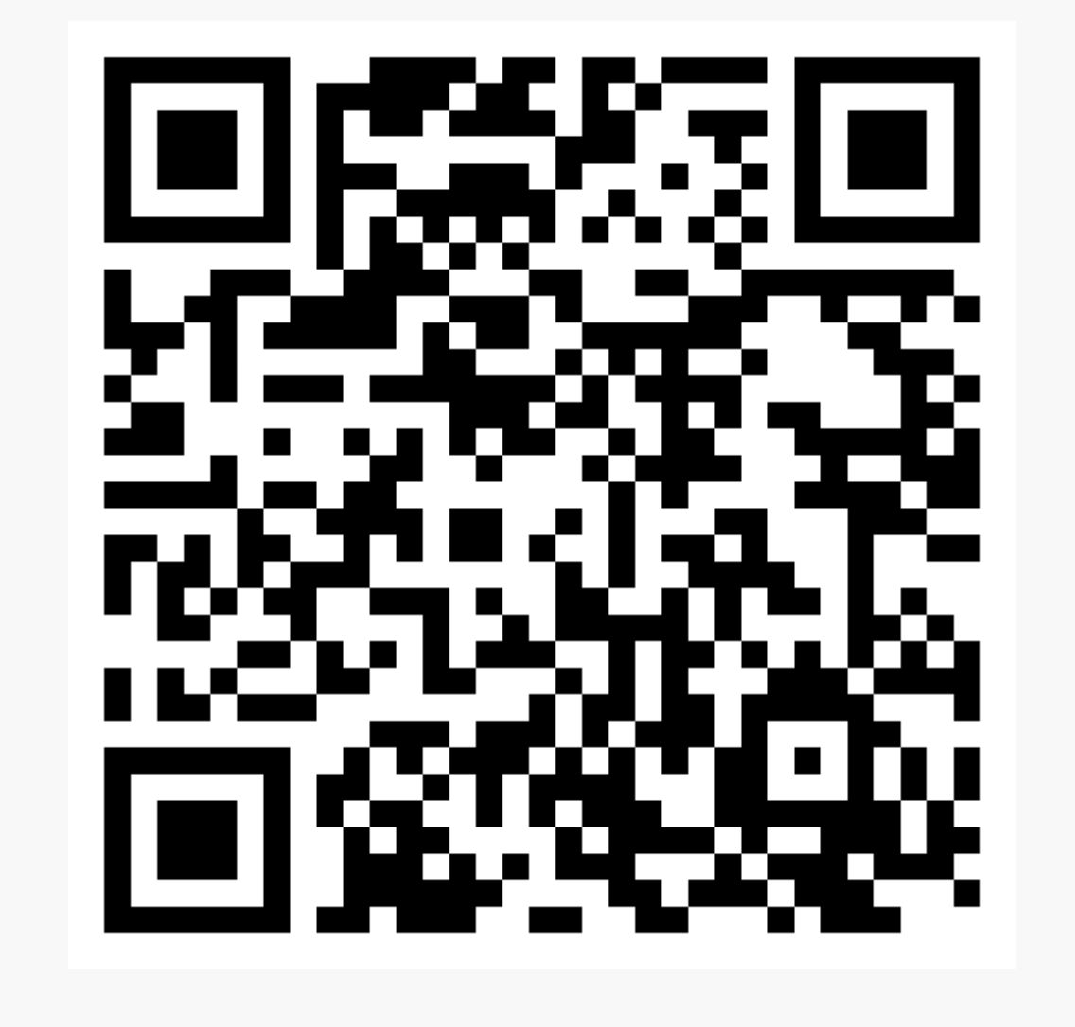
Academic Senate Dues
July 2023
84
February 13, 2024
132

Slide 2
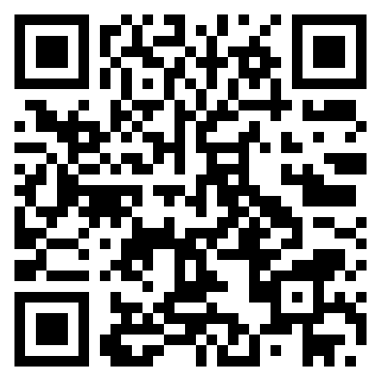

Slide 3
Awards of Excellence
Timeline:
Nominations close on February 20th
First taskforce convening week of February 20th
Decline or Accept to Nominees (by end of Feb)
Task Force meetings and selection of recipients by April 7th
Recipients notified and confirmed
Awards on May 1st

Slide 4
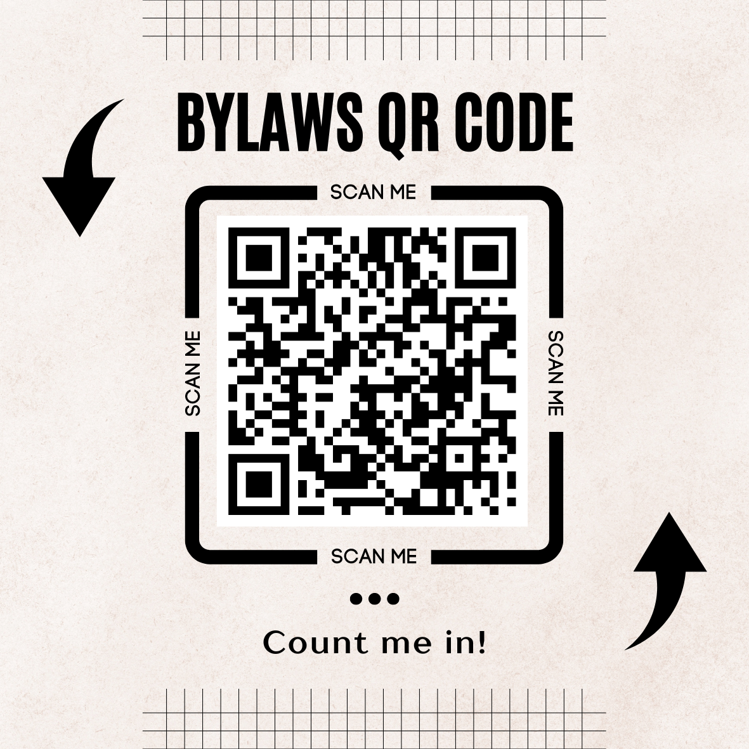
By-Laws Taskforce
We need to look at the by-laws and submit recommendations for edits/amendments by end of this term.
Interested in being part of the taskforce. Please complete the following our form by scanning the code here.

