Slide 1

PRESENTATION TITLE
Subhead presenter date

Slide 2
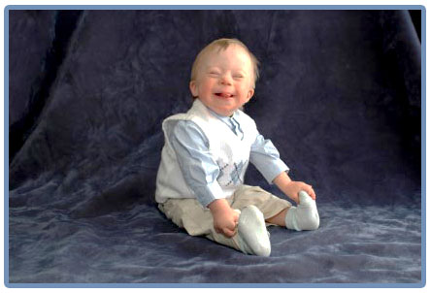
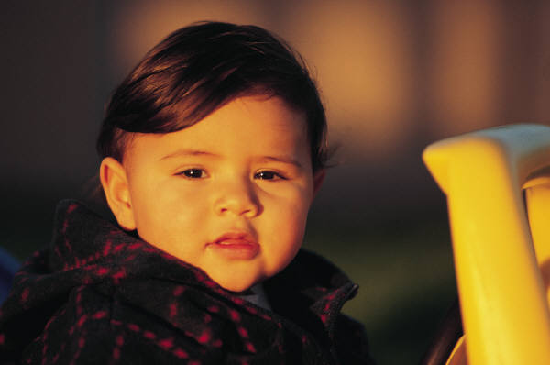
Early Intervention and Early Childhood Special Education (EI/ECSE)
EI/ECSE programs provide specialized educational services to children from birth to 5 years of age and their families.

Slide 3
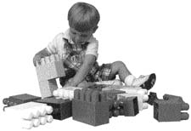
How we serve children
EI/ECSE Programs
Speech-language classes
Specialized preschools
Reverse mainstreamed preschools
Community preschools
Service Coordination
Specialized equipment
Home visits
Parent training
Parent-Toddler classes
Skill groups
Community consultation

Slide 4
Working in EI/ECSE
https://distance-ed.fullerton.edu/bbpresentations/janice_myek_wayne/early_intervention/player.html

Slide 5
ECSE Credential In California
Early childhood special education (ECSE) includes the provision of educational services to children from birth through pre-kindergarten who are eligible for early intervention, special education, and/or related services under federal and state laws. This specialization is committed to preparing reflective professionals who will provide high quality services to infants, toddlers, young children, and their families.

Slide 6
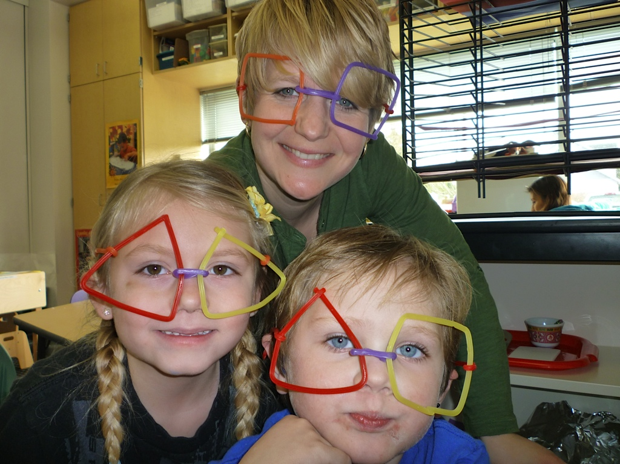
Children who received EI / ECSE are ready for school

Slide 7
Nature of Work
Work as a team member in providing for the needs of infants, toddlers, and young children, who have sensory and physical impairments, are cognitively and/or emotionally challenged, and/or have experienced environmental or
Interface with families and other service providers, such as occupational/physical therapists, social service-providers, and medical personnel, in planning, delivering, and evaluating interventions that positively impact the developmental needs of the child.
Provide direct services in a variety of settings - classroom, home, or center-based programs- that may include technical/medical interventions, as well as developmentally appropriate learning activities.

Slide 8
Personal Qualities:
Good organization and collaboration skills.
High energy level and ability to handle multiple tasks simultaneously.
Interest in medical terminology and unusual medical conditions.
Ability to perform strenuous physical tasks, such as lifting and carrying young children.

Slide 9
Admission Requirements at CSUF
Bachelors Degree
9 units of Child Development
CBEST
GPA 2.75
Pre-requisites: Observation Hours Required
SPED 322: 10 Hours Required
SPED 371: 5 Hours Required
SPED 425: 30 Hours Required
http://ed.fullerton.edu/sped/documents/2016/08/special-education-program-overview-2.pdf

Slide 10
Job Outlook and Advancement
Current level of need for personnel in this career field is very high. Recent legislation has provided for more jobs, with many grants being awarded to non-profit agencies targeted at "seeking out" this population of children and serving them more effectively.
Advancement may come through promotion to supervisor status in agencies, which contract with school districts, or the district, itself.
Positions in Higher education- colleges and universities, as well as teachers in community colleges- are available for experienced early childhood special educators, and will become more in demand as the trend toward increased interventions/education for younger children continues.

Slide 11
How to Prepare for a Career:
Work in an early childhood or day care center that welcomes children with disabilities.
Visit a local early childhood center for children with disabilities, such as the Easter Seal Clinic or a public school setting that houses an Early Childhood classroom.
Talk to professionals in the field to get a good idea of the level of commitment and activity needed to perform this job well.
Inquire from your local community college and/or college/university about the availability of coursework that leads to this degree and certification.

