Slide 1
Teaching Students with Autism Spectrum Disorder
Tiffany Leger-Rodriguez, Ph.D.
Cal State Fullerton
“Road to Teaching Conference” 2014
Santa Ana College

Slide 2
Welcome!
Introduction
KWL activity
Characteristics of autism
Autism and education
Career paths in the field of autism
Wrap-up

Slide 3
Characteristics of Autism Spectrum Disorder

Slide 4
Common Myths
Everyone with autism is a genius
Everyone with autism has an intellectual disability or low IQ
People with autism don’t want to be social or have relationships
Children with autism are not affectionate

Slide 5
What is autism spectrum disorder?
ASD is a disorder that appears within the first 3 years of life and affects the brain’s normal development of social and communication skills.
(US National Library of Medicine)
Range of severity of symptoms can be severe to high-functioning

Slide 6
Characteristics of ASD
Difficulty with social interactions
Difficulty with verbal and non-verbal communication
Difficulty with pragmatics, or the functional use of language
Difficulty recognizing and comprehending social cues

Slide 7
Characteristics of ASD
May be overly sensitive to light, sound, smell, or certain tastes and textures
May become unusually distressed when routines are changed
May repeat words or phrases, such as commercials
May have difficulty with eye contact
Difficulty with social cues (ex “Everyone take out your math books!”)

Slide 8
Characteristics of ASD
May find normal noises painful and cover ears
May have a heightened or lower response to pain
Gets stuck on a single topic or task (perseveration)
May be overactive or very passive
Exhibits a strong need for sameness and routine

Slide 9
Autism Spectrum Disorder and Education

Slide 10
Discuss:
What is required of children at school?
What do children need to do in order to learn?
What are some typical “official” rules at school?
What are some typical “unofficial” rules at school?

Slide 11
Common School Difficulties for Students with ASD
Attending to lessons and activities
Lack “learning to learn” behaviors
Comprehending verbal instructions
Making friends
Keeping friends
Completing tasks
Coping with change
Coping with sensory issues
Motor skills
Abstract concepts
Often a target for bullying

Slide 12
Where are students with ASD educated?
General education classrooms
Resource specialist settings
Special education classrooms
Private schools
Nonpublic schools
Charter schools
Homeschools
Online education programs

Slide 13
Tips for Teaching Students with ASD
Keep language simple
Maintain a highly structured environment
Have a predictable daily routine
Give fair warning of any routine changes when possible
Avoid using sarcasm and idioms
Use closed captions on videos when possible
Recognize all behavior is a form of communication and avoid taking anything personally
Notes:
*Keep language simple, direct, concrete, and accompany with written words or pictures whenever possible
*Because of their difficulty with language, idioms such as “zip your lips” or “kiss your brain” can cause confusion for kids with ASD
*Structured environment includes using picture labels, schedules, and clear environmental boundaries to designate specific areas. Use mats, tape, signs, maps, etc.
*CC helps with reading development and improves comprehension for students who can already read.

Slide 14

Use special interests to facilitate learning

Slide 15
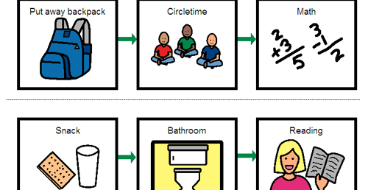
Use picture schedules

Slide 16
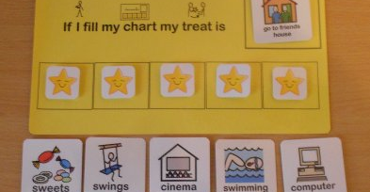
Use a rewards system for positive behavior
Notes:
Should be motivating to the child, based on his interests and likes

Slide 17
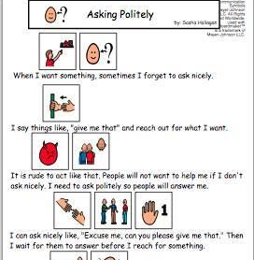
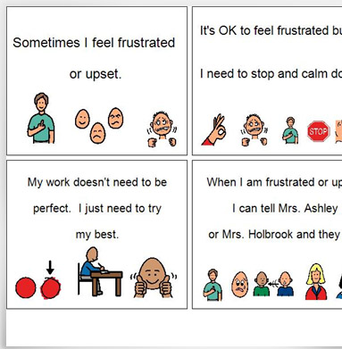
Use social stories to increase social comprehension and positive behavior

Slide 18
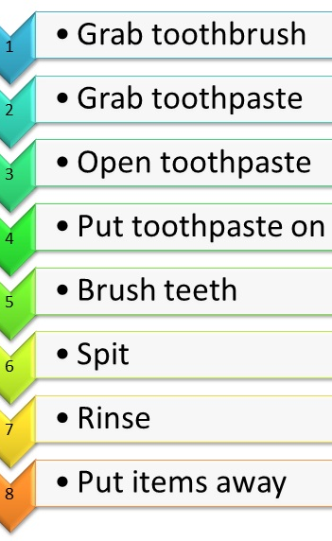
Task Analysis

Slide 19
Career Paths in the Field of Autism and Education

Slide 20
Who works with students with autism?
General education teachers
Special education teachers
Special education paraeducators
Speech and language therapists
Occupational therapists
Adaptive P.E. teachers
Cognitive therapists
Inclusion specialists or autism specialists
Behavior specialists

Slide 21
Wrap-Up

