Slide 1
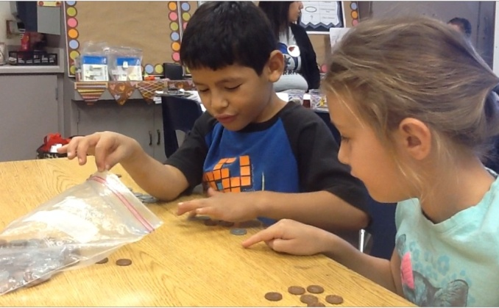
It’s All About That Math: Building Children’s Mathematical Thinking
18th Annual Road to Teaching Conference
Saturday, November 22, 2014
Shauhna Feitlin
La Habra City School District
Mathematics Coach

Slide 2
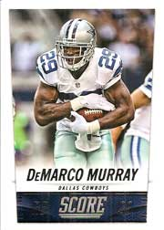
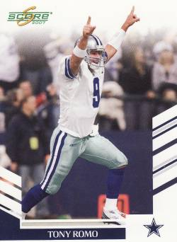
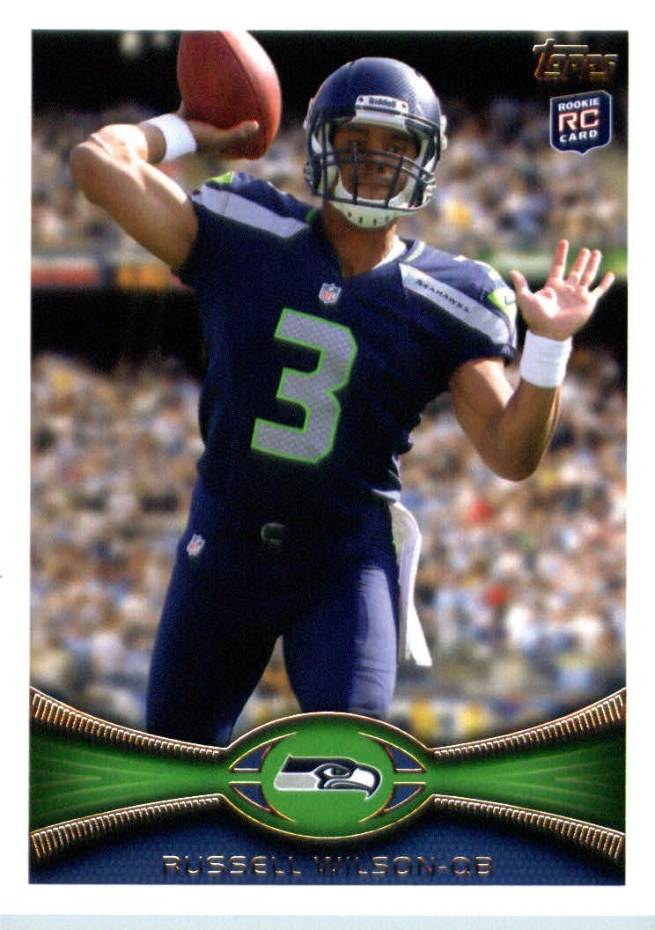
Solve the following using any strategy except the standard algorithm.
Scott can put 6 football cards on a page. If he fills 8 pages, how many football cards does Scott have?

Slide 4
Children’s Solution Strategies
Direct Modeling: Follow the structure of the story and represent all numbers.
Counting: Follow the structure of the story, but conserve one of the numbers.
Relational Thinking: Uses the properties of operations or derived facts to solve the story.
Number Facts: Known to memory

Slide 5
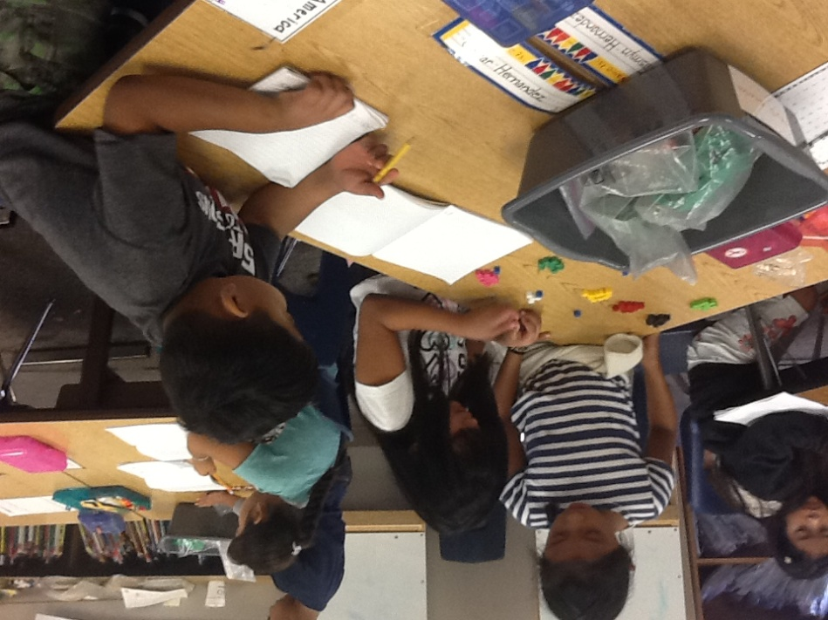
Analyzing Student Thinking
Anticipate student thinking
Identify student strategy
Analyze student level of understanding

Slide 6
Problem Solving…Its knowing what to do when you don’t know what to do!
http://www.youtube.com/watch?v=QETus6zBBvo

Slide 7
Shauhna Feitlin La Habra City School District
sfeitlin@lhcsd.k12.ca.us

