Slide 1
Bond Project Presentation
Marty Rudd & Roy Shahbazian
Senate Business Meeting 9/24/2019

Slide 2
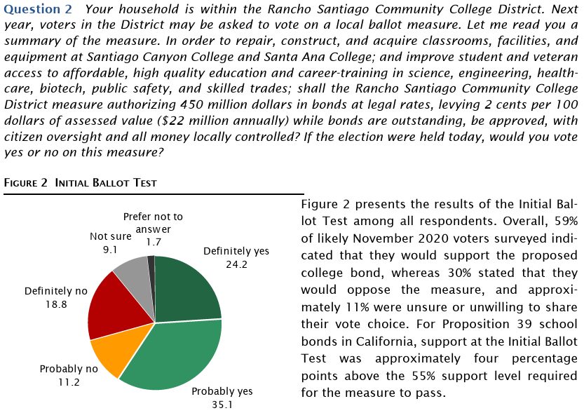

Slide 3
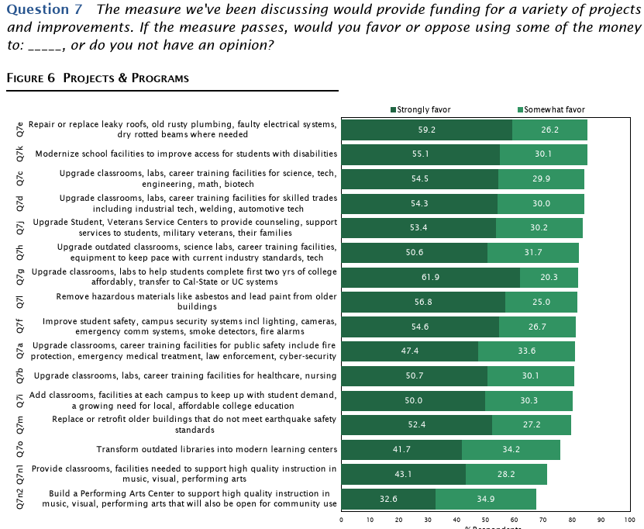

Slide 4
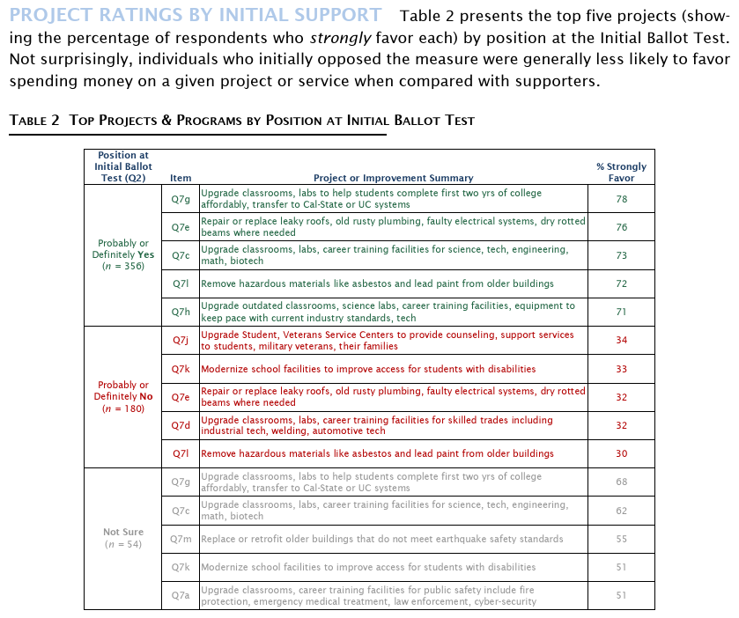

Slide 5
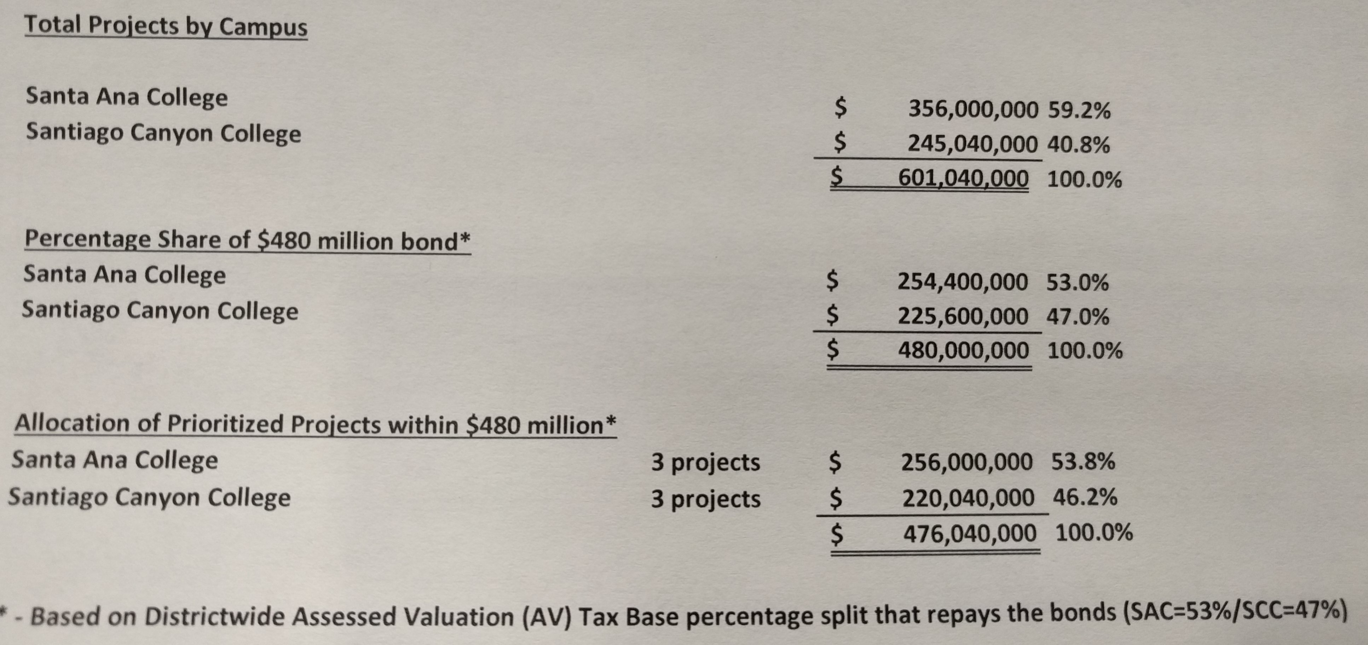

Slide 6
