Slide 1
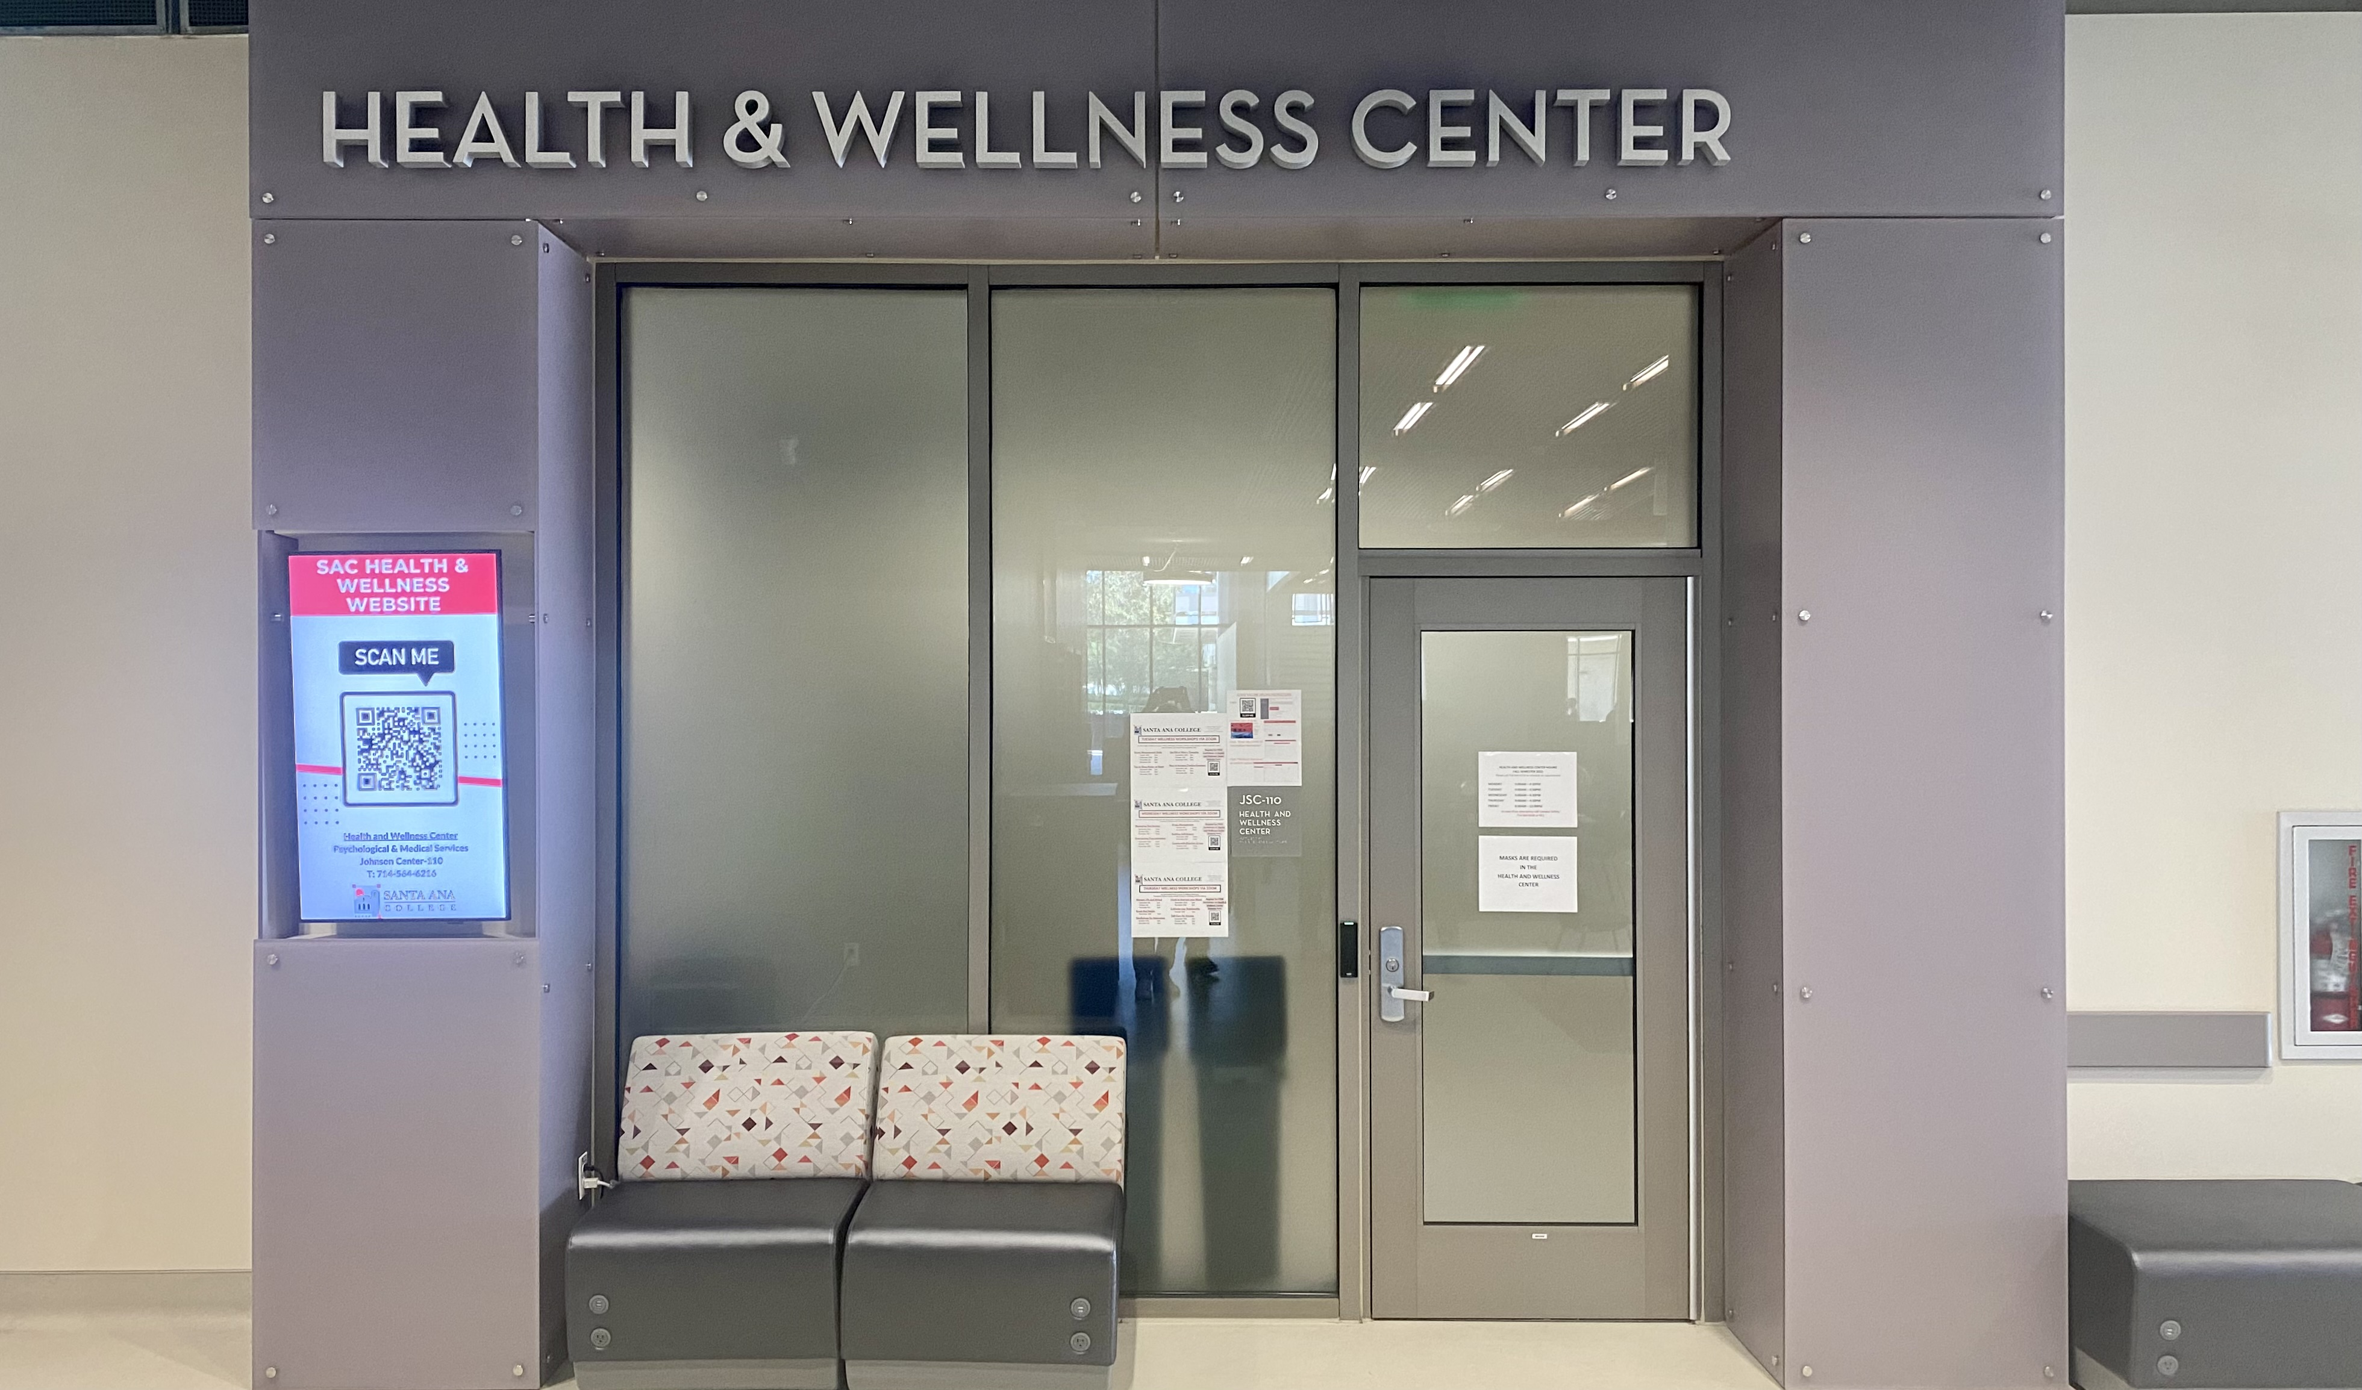
Santa Ana College Health and Wellness Center
Johnson Student Center - 110
Fall 2023 Office Hours
Monday – Thursday: 9am-4:30pm
Friday: 9am-11:30am
Phone: (714) 564 6216
Email: sachealth_center@sac.edu

Slide 2
Physical Health
Licensed staff - RN’s and a Physician
Free MD visits (in person and virtual)
Birth Control Services (male/female)
FamilyPact services for eligible students
Small Fees
Limited medications
Lab blood/urine testing
Immunizations

Slide 3
Psychological Health
Individual therapy
In-person or virtual
Psychoeducation workshops
Register on our webpage
No additional cost

Slide 4
Confidentiality
Everything shared with Psychologists is CONFIDENTIAL
Exceptions
Thoughts of harming self
Thoughts of harming others
Concerns about:
Child abuse, under age 18
Elder abuse, age 65 or older
Dependent adult abuse
If records are subpoenaed by the courts

Slide 5
Off-Campus Resources
IN AN EMERGENCY: After hours or on weekends, you can:
Call the Suicide & Crisis Lifeline at 988
1-800-273-TALK (8255)
2) Text the Crisis Text Line: Text COURAGE to 741-741.
If you are in need of emotional support, call or text the NAMI WarmLine:
The OC WarmLine servicing Orange County, CA resident only.
Call or text: (714) 991-6412 Toll Free 877-910-9276

Slide 6
Thank You Questions?

