Slide 1
President’s Report
Senate Resolution S2024.01 Update
Increase Response and Support from Facilities and Maintenance and Operations team
C-bldg: Walk-through conducted on April 16th with numerous concerns identified.
Current positions:
    Custodians: (4) open positions - job posting closes on 4/18/2024 – interviewing now.
    Central plant operator: (1) open position –interviews today!
    Grounds keeper: (2) open positions - Offering positions to 2 candidates.
Future positions:
        Lead custodian – swing shift
        Custodians – swing shift
        Facilities Coordinator
        HVAC mechanic

Slide 2
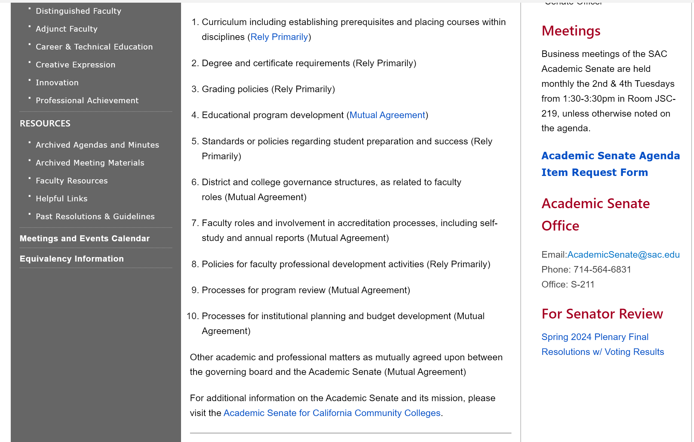
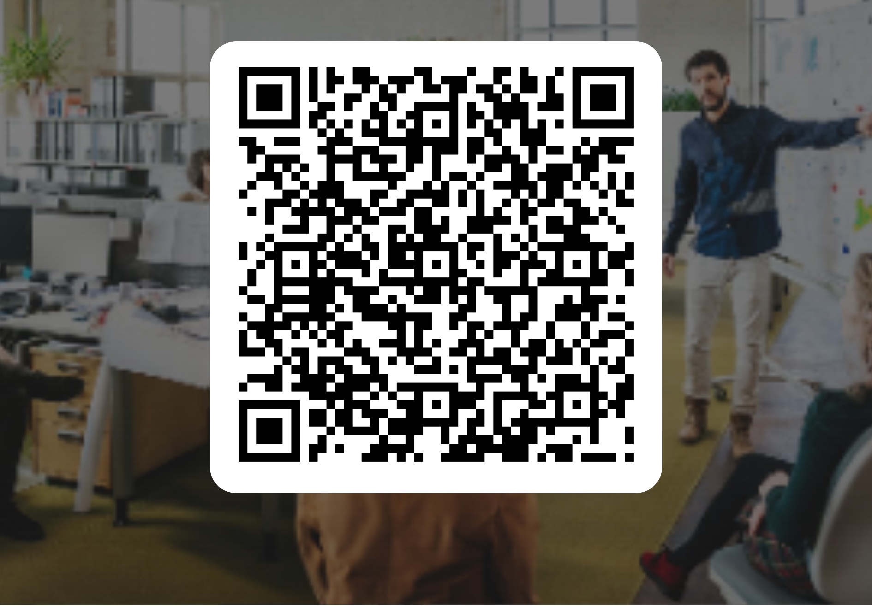
President’s Report
Noncredit Institutue, May 2 - May 3 in Anaheim
Faculty Leadership Institute, June 20 - 22, 2024 in Palm Springs
Curriculum Institute, July 10 - July 13 in Pasadena
Complete Interest Form by Friday, April 26
Plenary – Final Resolutions Packet with Voting Results available on Senate webpage (sac.edu/academicsenate)
https://forms.office.com/r/wpKr20vnuV

Slide 3
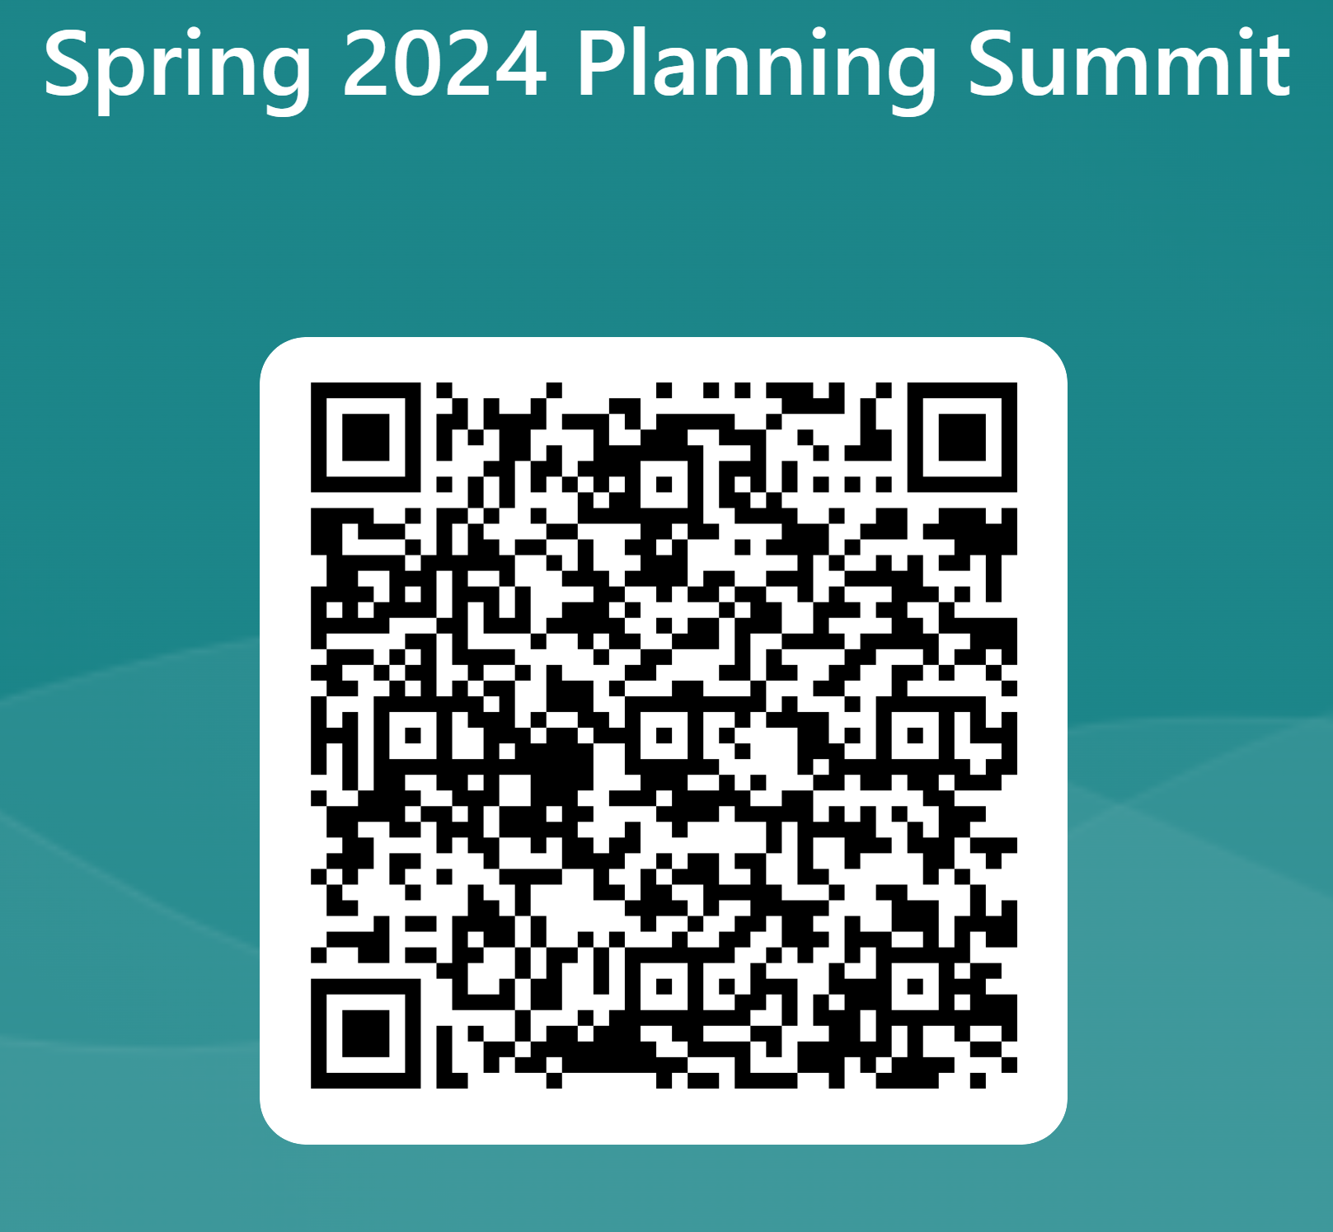
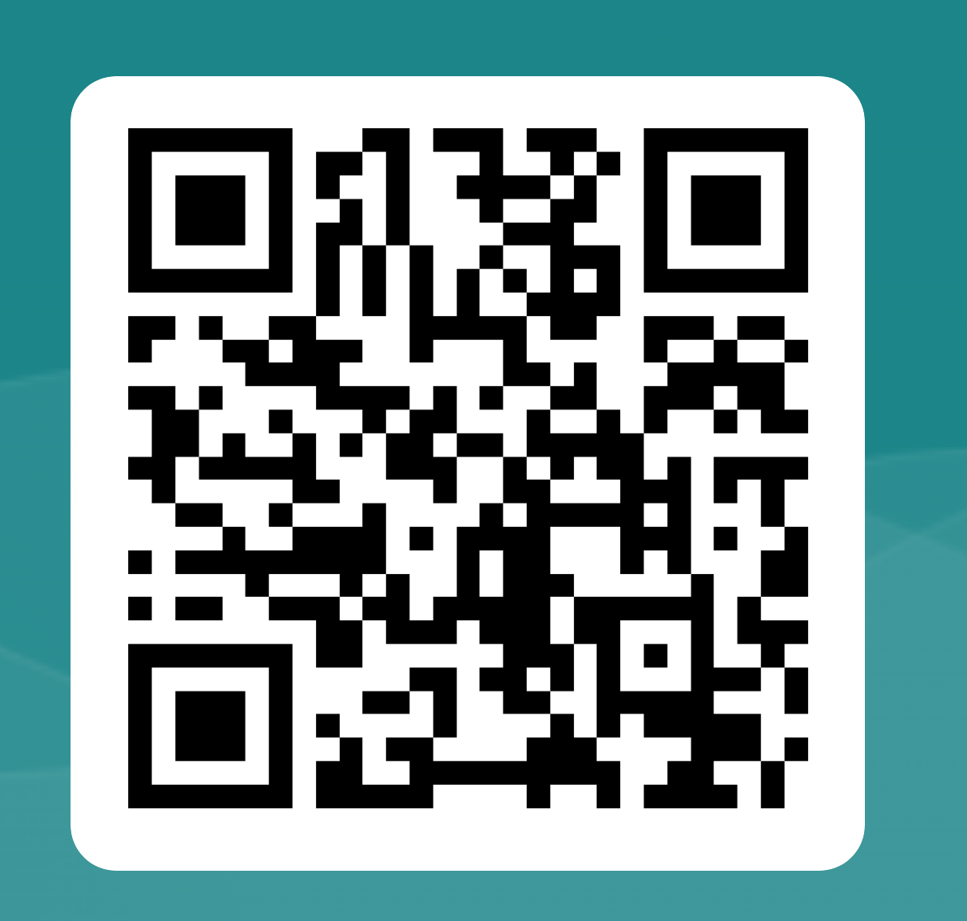
Coming up…
Spring 2024 Planning Summit: Monday, May 13th 9am – Noon
RSVP by April 30th
Faculty Service on Participatory Governance Committees
Interested in Serving, Interested stepping down from service, go to https://forms.office.com/r/CyeeJNQnCi
Responses Requested by May 7th
Resource Allocation Requests (RAR): Submit via Nuventive by May 22
Honors Transfer Program Faculty Coordinator – Letter of Interest due to Dr. Butler by 4/29
Equity Goal Facilitator – Letter of Interest to Christina Miranda by 5/1

