Slide 1
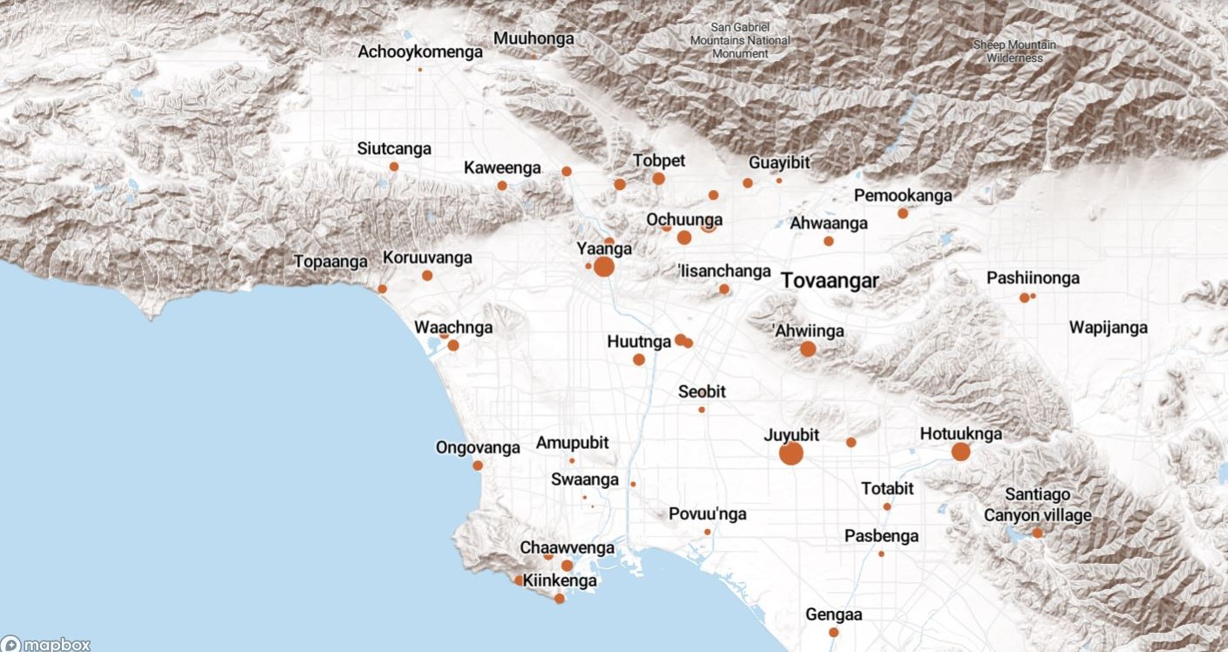
Land Acknowledgement
We acknowledge that the land on which Santa Ana College exists today is the ancestral land of the Tongva people, whose presence and resilience in Santa Ana continues to this day. We take this opportunity to honor the original caretakers of this land and recognize that histories of land theft, forced removal and assimilation, genocide, and erasure, and settler colonialism that have brought our institutions and ourselves here.
To acknowledge is not enough. This land acknowledgement is additionally a call to act, to consider our positionality and complicity in relations to these forces, and to engage in relationships and solidarity with the Tongva and other indigenous peoples.

Slide 2

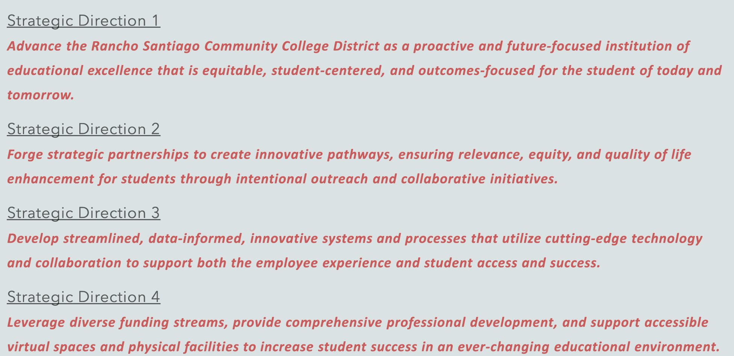
President’s Report
Board of Trustee's Meeting – Feb 12, 2024
Strategic Directions Approved – Now the work of goal setting at the college can begin
Goal Planning Retreat: Feb 21-22, Joint Planning Session: Feb 23
Taskforce Faculty members: Merari Weber, David Roper/Zachary Diamond, Zack Fish, Leo Pastrana

Slide 3
Board approved additional funding for bond related activities:
Additional $198,000 for printing and mailing of district-wide informational mailers to voter households in the Rancho Santiago Community College District (131,586 households), and the distribution of similar messaging via social media and other digital channels.
Additional $45,250 for second poll survey of district community.
College Council – First Meeting of Semester Tomorrow
20 Board Policies and Administrative Regulations up as 1st reads – Please read/review and provide feedback to AcademicSenate@sac.edu
If you serve on Planning and Budget:
AR 6100 Delegation of Authority,
Business & Fiscal Affairs*
AR 6200 Budget Preparation*
AR 6250 Budget Management*
AR 6300 Fiscal Management*
AR 6303 Fiscal Accountability*
AR 6305 Reserves*
AR 6320 Investments*
AR 6400 Financial Audits*
If you serve on Facilities and Safety:
AR 3500 Campus Safety*
AR & BP 3502 Networked Video Cameras (NEW)*
AR 3505 Emergency Response Plan*
AR & BP 3515 Reporting of Crimes*
AR 3516 Registered Sex Offender Information*
AR 6750 Vehicle Operation and Parking*
AR 7600 Campus Security Officers (NEW)*

Slide 4

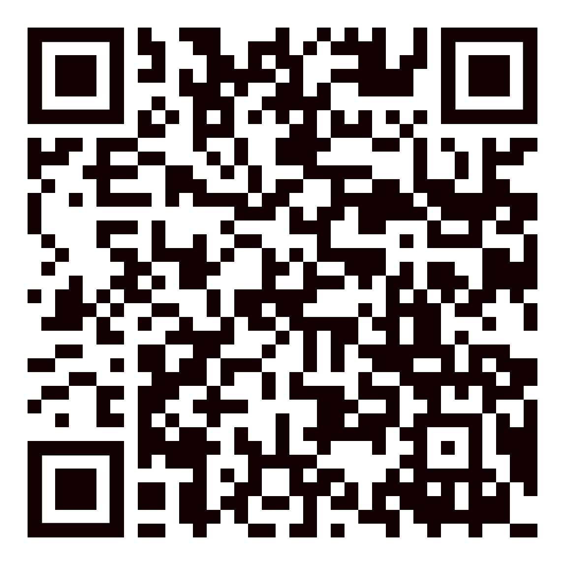

Faculty Opportunities:
Outcomes Assessment Faculty Coordinator – Sent out today, Letter of Interest due to Dr. Butler by March 8
Date of assignment: June 17, 2024 – June 7, 2026
Release of 12 LHE in FA; 12 LHE in SP, 3 LHE in WI; 3 LHE in SU
Scholarship Readers Needed – Look out for request from SAC Foundation
Hiring Committees: Complete Interest Form​

